Slide 1
Defence’s Response to the National STEM Challenge
National Science Learning Network Development Day
6 July 2016
Captain Mike Rose RN
Defence Engineering Champion Team Leader
22 Oct 15

Slide 2
Scope
• National strategic context - the why for Youth STEM engagement in Defence
• The Youth STEM engagement strategy for Defence:
The Vision
Strategic Partners
What Defence already does
What Defence can offer
Next steps

Slide 3
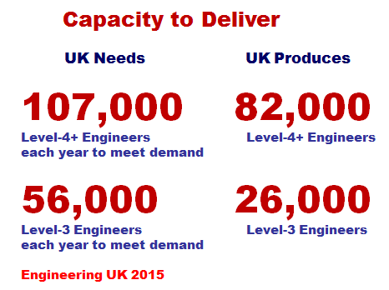
The National Challenge
Insufficient capacity &
rate of growth to meet
the demand for skill
Gap is substantial
Industry & Defence
fishing - relative stock
depletion - is driving
behaviour
Threat or opportunity?

Slide 4
Defence Context & Response
Defence Board-inspired ‘Eng Deep Dive’ in late-2014 - Engineering as a ‘critical skill’
Defence Engineering Champion appointed Feb 15, amid backdrop of lots of single-Service activity, but not coherent over life-cycle:
Attract - Recruit - Train - Develop - Retain - Transition
Aim to improve strategic engagement & coordination:
Prepare the ground - support to national initiatives - STEM
Improve recruitment performance ……….
Improve retention ………………
Improve engagement & performance – Diversity ………..
Develop innovative Enterprise Approach ………
Notes:
4

Slide 5
The Defence Youth STEM Engagement Strategy (DYES)
June 15: Defence STEM/UTC Engagement Workshop:
Aim: develop greater coherence and clarity to Defence’s approach to STEM/UTCs
Deduction:
The single Services already undertaking STEM engagement - varying degrees - lacked coherence and clarity - sub-optimal in delivery.
Requirement for an overarching Defence strategy

Slide 6
The DYES Vision
‘Defence, in conjunction with others, inspiring sufficient young people to study STEM subjects in order to ensure that the appropriate national talent exists from which Defence can recruit its future technical people’

Slide 7
STEM Partners

Slide 8
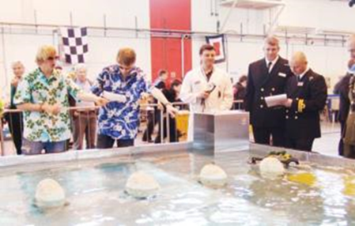
What Defence Already Does - RN
Support to the Big Bang Fair (attracting 70,000 attendees aged 7 to 19); the smaller local Big Bang Solent Fair; Isle of White Physics Festival; and, the UTC Engineering Challenge (a competition across the UTCs that attracts 500 pupils - HMS SULTAN).
Sponsorship of joint BAES/RN/RAF STEM Roadshow: engages over 100,000 10 to 13 year old pupils (and their teachers) at £140k per year
Involvement in seven and the leadership of the Portsmouth UTC.
60 STEMNET Ambassadors

Slide 9
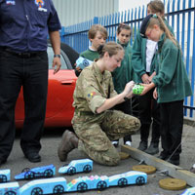
What Defence Already Does - Army
Forming a STEM youth engagement team to synchronise the activity of three specific ‘STEM Presentation Teams’, Corps Engagement Teams and recruiting Outreach Teams.
Support to Big Bang Fair; sponsorship of five female STEM teachers; Bloodhound and the associated ‘microbit’ competition (expected to reach 10,000 11 to 14 years olds)
43 STEM Ambassadors

Slide 10
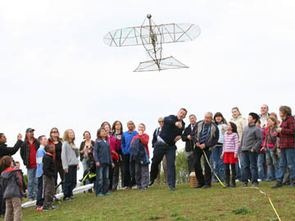
What Defence Already Does - RAF
48% of roles in the RAF require STEM-literacy
STEM outreach forms part of the youth and diversity programme
Sponsorship of joint BAES/RN/RAF STEM Roadshow: engages over 100,000 10 to 13 year old pupils (and their teachers) at £140k per year
Has modernised the Air Cadet syllabus to inspire STEM and Cyber interest
Organises a ‘STEM Residential’ programme in conjunction with a number of charities focused at, primarily female, 14-year old pupils. In 2015 this engaged 282 students but the programme capacity doubled last year and is planned to double again next year.
Organises ‘STEM days’ for 13 to 14 year olds to address BAME/Gender under representation
201 STEM Ambassadors

Slide 11
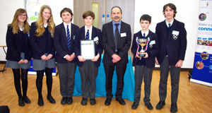
Civil Service
DSTL
Operates an active STEM outreach programme focused locally in the Wiltshire, Hampshire and Dorset area. It is delivered by 105 STEMNet Volunteers
DE&S
Support to local schools in the Bristol area: 10 schools Go4SET over past 4 years, and 12 schools Primary Engineer over the past 6 years, combined support of over 100 DE&S staff as mentors

Slide 12
What Defence Can Offer
DYES will encourage greater numbers of volunteer STEM Ambassadors
MoUs with key STEM Partners to coordinate delivery
National, Regional, and Local engagement: from the ‘Big Bang’ to local school engagement
Support to STEM Learning’s STEM Insight Programme
Support to ‘2018 - Year of the Engineer’

Slide 13
Next Steps
Formal issue of the DSYES
Implementation of the strategy, in consort with the Services and STEM partners – Steering group
Encouragement and support of more Defence personnel to volunteer as STEM ambassadors
Defence support to 2018 Year of the Engineer Initiative – need to maximise for Youth STEM Engagement

Slide 14
Questions?

