Slide 1



Slide 2

Self- assessment
Science Mark Gateway statements
Silver/Gold/Platinum
Students show high levels of engagement with the big ideas of science. They constantly demonstrate curiosity by the way they question scientific concepts, and can offer clear explanations to a wide range of natural phenomena.
The vision has been developed collaboratively with stakeholders both within and beyond the science team and reflects a broad perspective. There is ongoing development and redefining of the vision, based on the latest cutting edge developments in science and science education.
All students’ needs are met by the planning, delivery and continued evaluation of the curriculum and all students are working at or above the appropriate level for their age and ability. The curriculum challenges and engages all students to understand more and it actively prepares and enthuses them for making the transition to further study and training. High numbers of students progress to post-16 STEM-related study or employment.

Slide 3
Interim submission
One criteria from each of the sections
Section 1: Curriculum
Section 2: Leadership and Management
Section 3: Learning and Teaching

Slide 4
COMPLETING THE
SUBMISSION

Slide 5
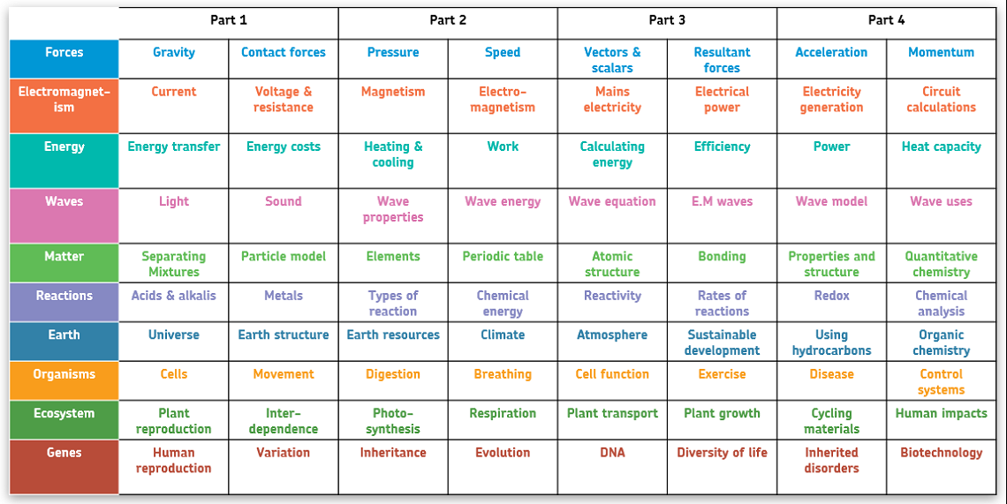
The Big Ideas through KS3 + KS4

Slide 6


