Slide 1
Workshop 1 – Partnerships
Claire Arbery, Chris Catto and Nadine Payne
July 2016

Slide 2
Session will aim to cover:
Reach of SLP partnerships
Direction and leadership of SLPs
Depth of use of partnership knowledge and expertise

Slide 3
Experience of Central Midlands SLP
How we created the partnership:
Sent out invites to TSAs in the area to an initial meeting
Interested TSAs then joined the partnership
However….

Slide 4
Experience of Central Midlands SLP
Active Partners:
The original meeting didn’t produce our most active partners
These mostly came from personal contacts

Slide 5
Experience of Central Midlands SLP
How we work with our partners:
Host courses
Teacher presenters - from at least four partner schools
Ten partner schools hosted at least one CPD day during this academic year; some hosted several
RCUK

Slide 6
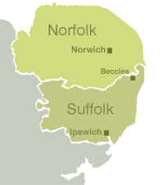
Building Partnerships
Why?
Improved Student Outcomes
Supporting and making Teachers feel valued
What?
Bespoke School to School Support
Traditional CPD
STEM activities
PSQM
TSST
Who?
Schools
Local Industry
LEA
Presenters
Science/STEM organisations
How?
Original Set up meetings
Continued Strategic Meetings
Heads of Science /Science Coordinator Networks
Science Festivals
Where?

Slide 7
What have you identified as a issue ?
Discussion on issues identified by SLPs with Partnerships
Top 3 areas for development to feedback

Slide 8
Common issues identified

Slide 9
Opportunities
Local Teaching School Alliances
http://apps.nationalcollege.org.uk/s2ssd_new/
Emerging Multi Academy Trusts
Science Bodies
Museums and Science Centres

Slide 10
Feedback to main stage

