Slide 1
Detecting Fire for the Internet of Things (IoT)
Investigating heat sensors

Slide 2
Early detection and the IoT
Unfortunately it is all too common to hear stories in the news of people, often young children, dying in house fires.
In most cases there is a short but vital period between the start of a fire and the spread of the fire which traps and kills people.

Slide 3
Early detection and the IoT
Unfortunately, people can be slow to react and under extreme pressure frequently make poor decisions.
Automated systems respond very quickly and in a predictable way. The internet provides an infrastructure that will enable automated systems to link up and to communicate.

Slide 4
Detecting a fire
Key to such an automated system is the ability to detect the fire.
How to detect a fire:
What would be changed by the fire?
How could the changes be detected?
Is there a change that could be measured/quantified?

Slide 5
Detecting a fire
soot
carbon
light
ash
flame
Smoke
Heat
sparks
Fire
burning
Smell
temperature increase
cooking
Gases
CO
irritating
cyanide
CO₂
SO₂
NO₂

Slide 6
Detecting a fire - sensing smoke

Slide 7
Detecting a fire - sensing smoke

Slide 8
Bimetal strip temperature sensor

Slide 9
Bimetal strip temperature sensor
The metal part of the bimetal temperature sensor is made from a strip of brass and a strip of iron.
When the strip is heated, the brass expands more than the iron.
This causes the strip to bend with the brass on the outside of the curve and the steel on the inside.

Slide 10
Bimetal strip temperature sensor

Slide 11
Detecting a fire - sensing heat
Your challenge this lesson is to design, make, test and refine a device that can sense a rise in temperature and trigger an electrical response.

Slide 12
Input process output
There are three aspects to a fire alarm.
Some form of input (produced by the fire) that can be detected by a sensor.
A processor that ‘decides’ if the alarm needs to sound.
Some form of output that alerts the people in the house, usually a loud noise.
Input (rise in temperature)
Process (when temperature reaches a threshold, close a switch)
Output (switch on alarm)

Slide 13
Bimaterial strip temperature sensor
You are going to make a temperature sensor based on a bimaterial strip made from aluminium and paper.
You will then place your bimaterial strip into the gap in your circuit and use it to close a switch when the temperature reaches a threshold level.
The alarm will sound.

Slide 14
Electrical circuit
Using a battery, buzzer (alarm) and wires, you will build a series circuit with a gap somewhere in the circuit.

Slide 15
Electrical circuit
The gap in the circuit is where you will place the temperature sensor.

Slide 16
Bimaterial strip temperature sensor
Apparatus
Two wooden blocks
Buzzer
Batteries
Wires to connect up the circuit
Aluminium foil to make four strips 8 cm by 1 cm
Self-adhesive paper labels to make four strips 6 cm by 1 cm
Scissors
Sticky tape
Tealight candle
Tongs
Heatproof mat

Slide 17
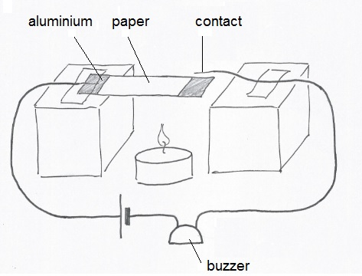
Bimaterial strip alarm circuit

Slide 18
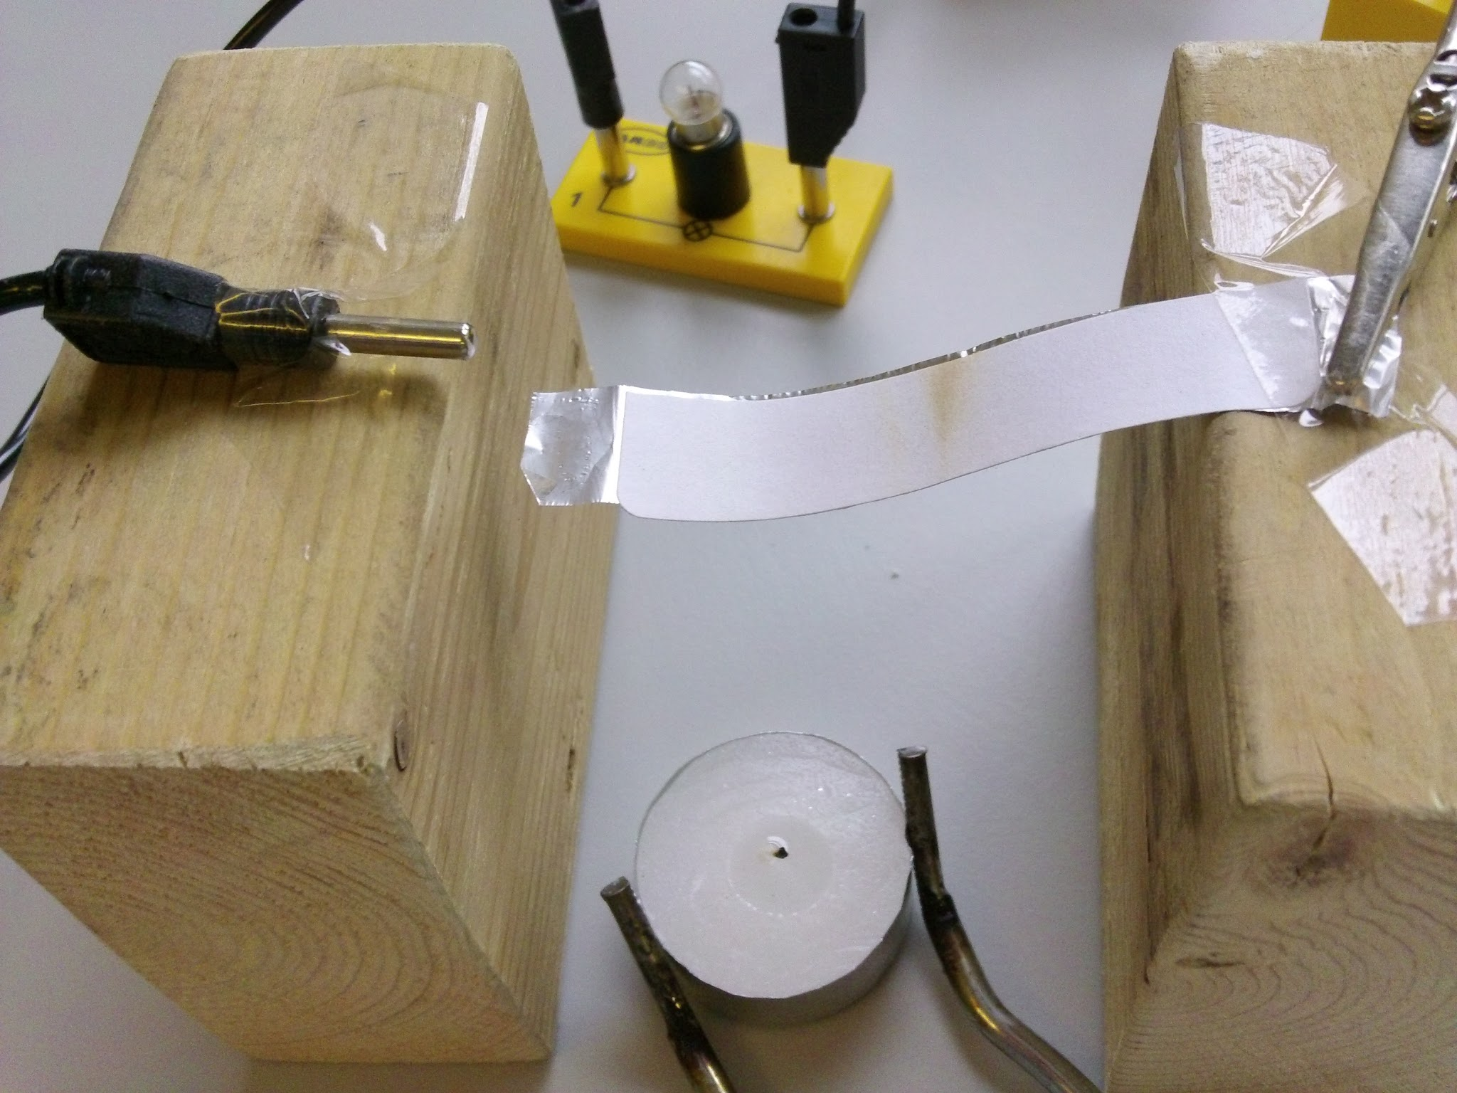
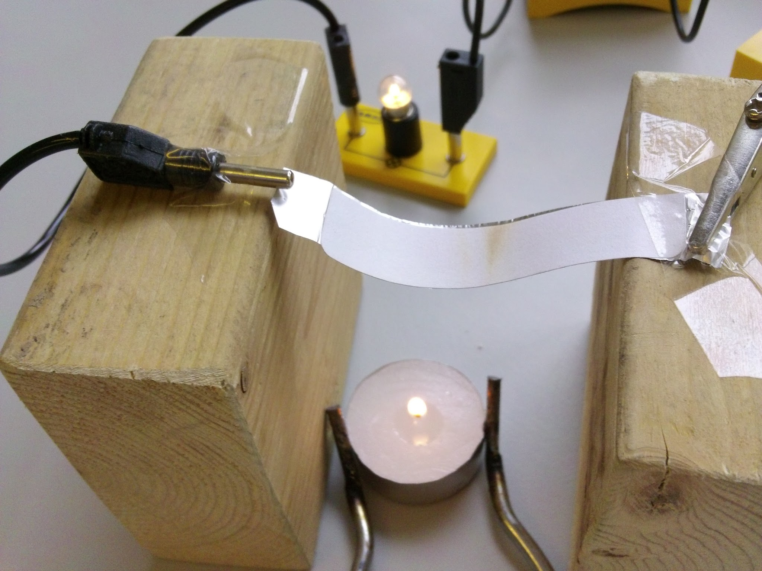
Bimaterial strip alarm sensor
COLD - switch open HOT - switch closed

Slide 19
Bimaterial strip alarm operation

Slide 20
Discussion questions
What did you do to make it less sensitive?
What did you do to make it more sensitive?
Evaluate the bimaterial strip as a fire sensor. What are its advantages and what are its disadvantages?
How might such a device be incorporated into the IoT to produce a more rapid response to a fire?

Slide 21
Cisco Little Big Futures
Image credits:
Thermistor: By Ansgar Hellwig (photo taken with Canon PowerShot G3) [CC BY-SA 2.0 de (http://creativecommons.org/licenses/by-sa/2.0/de/deed.en)], via Wikimedia Commons
IOT drawing: By Wilgengebroed on Flickr [CC BY 2.0 (http://creativecommons.org/licenses/by/2.0)], via Wikimedia Commons
Bluetooth and Wi-Fi logos are registered trademarks in the public domain.

