Slide 1
Fighting fires with the Internet of Things
Computing

Slide 3
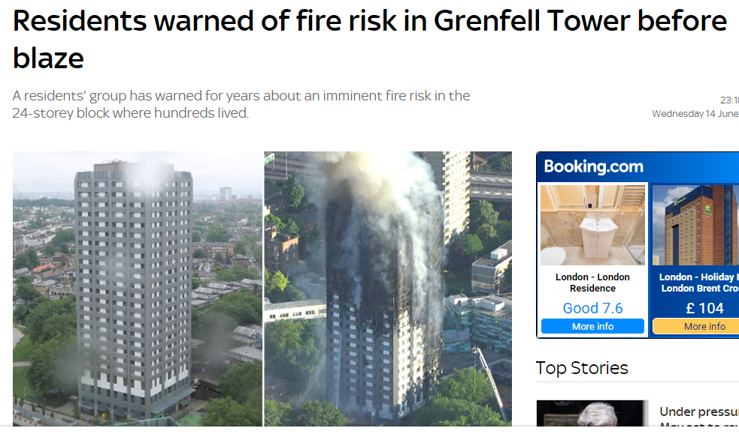

Slide 4
Challenge
Design an IoT-driven fire safety system that could save lives.

Slide 5
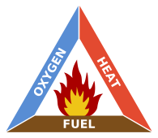
Fire risks
Fire can start wherever the 3 sides of the fire triangle are found.
In industry…
education…
residential property…
shops...
transport…
natural environment…
historical sites…

Slide 6
Designing IoT solutions
Network and Gateways
Processors
Sensors
Applications

Slide 7
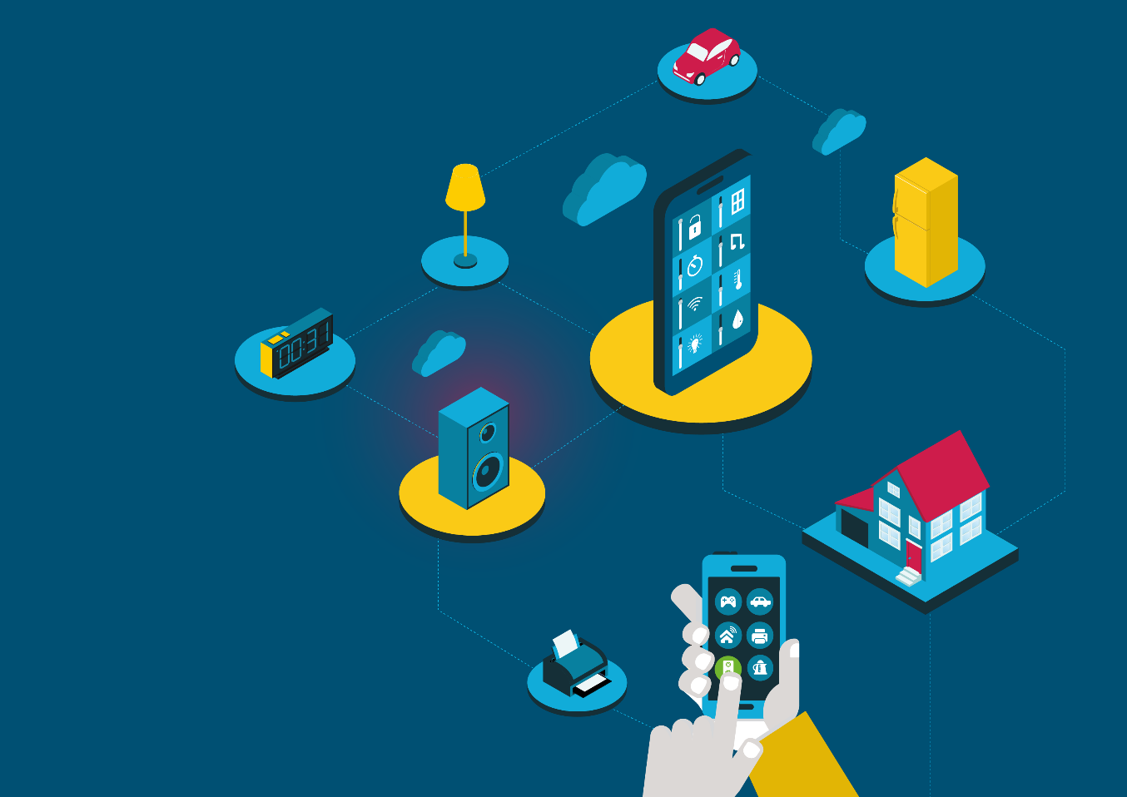
Cisco Little Big Futures
Image credits:
Fire triangle By Gustavb - Own work, Public Domain, https://commons.wikimedia.org/w/index.php?curid=618479

