Slide 1
Cuboid Faces
Based on
https://nrich.maths.org/12466
Who took it from
South East Asian Mathematics Competition

Slide 2
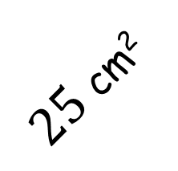
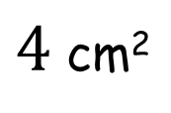
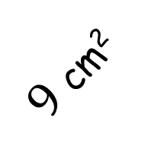
Cuboid Faces
The faces of a cuboid have areas as shown in the diagram.
What is the volume of the cuboid?
$25$ cm²
(not to scale)
$9$ cm²
$4$ cm²

Slide 3
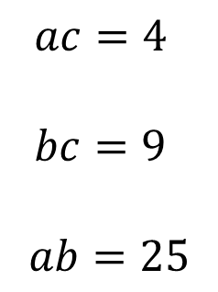
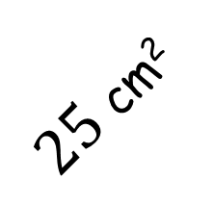
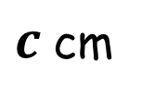
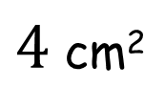
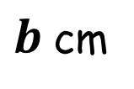
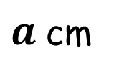
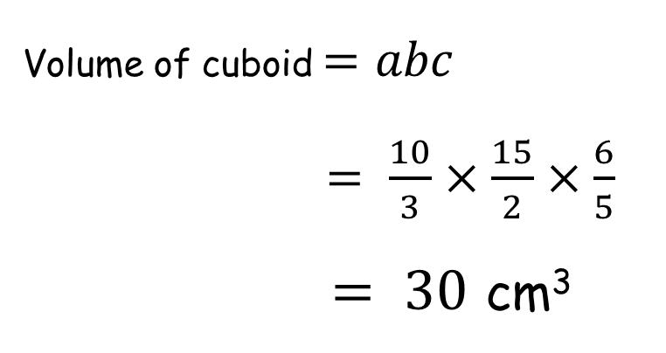
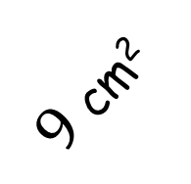
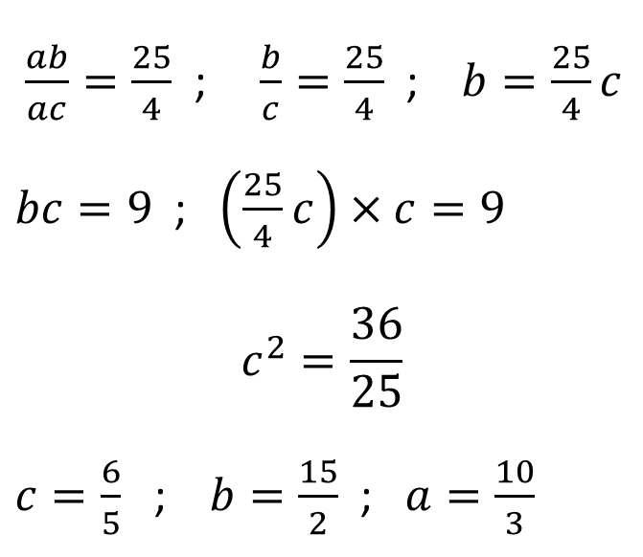
$ac=4$
$bc=9$
$$ab=25$$
Cuboid Faces
$25$ cm²
$c$ cm
$9$ cm²
$\frac{ab}{ac}=\frac{25}{4}$ ; $\frac{b}{c}=\frac{25}{4}$ ; $b=\frac{25}{4}c$
$bc=9$ ; $\left(\frac{25}{4}c\right)×c=9$
$$c^{2}=\frac{36}{25}$$
$c=\frac{6}{5}$ ; $b=\frac{15}{2}$ ; $a=\frac{10}{3}$
$4$ cm²
$b$ cm
$a$ cm
Volume of cuboid $=abc$
$= \frac{10}{3}×\frac{15}{2}×\frac{6}{5}$
$= 30$ cm³

Slide 4
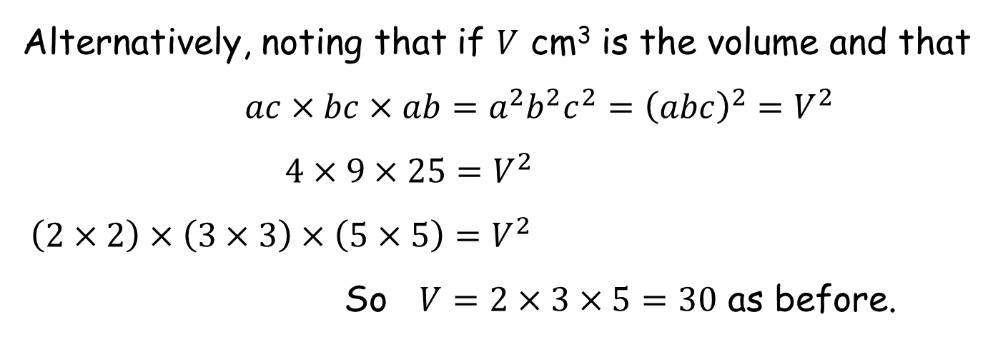
$ac=4$
$bc=9$
$$ab=25$$
Cuboid Faces
$25$ cm²
$c$ cm
$9$ cm²
$4$ cm²
$b$ cm
$a$ cm
Alternatively, noting that if $V$ cm³ is the volume and that
$ac×bc×ab=a^{2}b^{2}c^{2}={\left(abc\right)}^{2}=V^{2}$
$4×9×25=V^{2}$
$\left(2×2\right)×\left(3×3\right)×\left(5×5\right)=V^{2}$
So $V=2×3×5=30$ as before.

Slide 6
RESOURCES

Slide 7
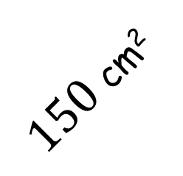
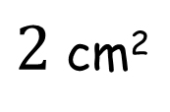
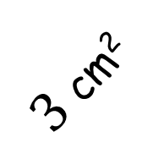
Cuboid Faces
SIC_64
The faces of a cuboid have areas as shown in the diagram.
What is the volume of the cuboid?
$150$ cm²
(not to scale)
$3$ cm²
$2$ cm²
A

Slide 8
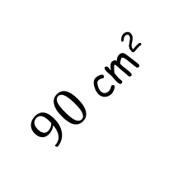
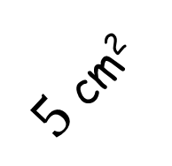
Cuboid Faces
SIC_64
The faces of a cuboid have areas as shown in the diagram.
What is the volume of the cuboid?
$90$ cm²
(not to scale)
$5$ cm²
$2$ cm²
B

Slide 9
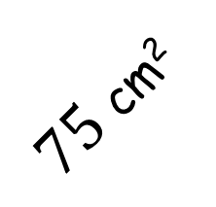
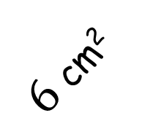
Cuboid Faces
SIC_64
The faces of a cuboid have areas as shown in the diagram.
What is the volume of the cuboid?
$75$ cm²
(not to scale)
$6$ cm²
$2$ cm²
C

Slide 10
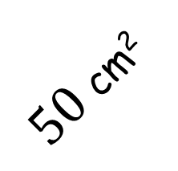
Cuboid Faces
SIC_64
The faces of a cuboid have areas as shown in the diagram.
What is the volume of the cuboid?
$50$ cm²
(not to scale)
$9$ cm²
$2$ cm²
D

Slide 11
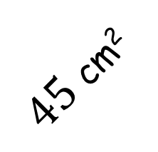
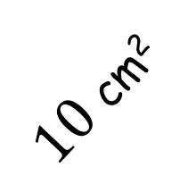
Cuboid Faces
SIC_64
The faces of a cuboid have areas as shown in the diagram.
What is the volume of the cuboid?
$45$ cm²
(not to scale)
$10$ cm²
$2$ cm²
E

Slide 12
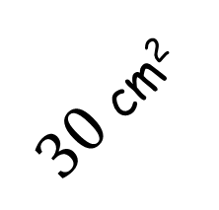
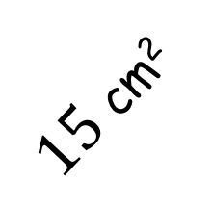
Cuboid Faces
SIC_64
The faces of a cuboid have areas as shown in the diagram.
What is the volume of the cuboid?
$30$ cm²
(not to scale)
$15$ cm²
$2$ cm²
F

Slide 13
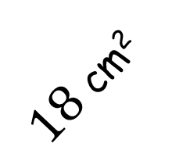
Cuboid Faces
SIC_64
The faces of a cuboid have areas as shown in the diagram.
What is the volume of the cuboid?
$25$ cm²
(not to scale)
$18$ cm²
$2$ cm²
G

Slide 14
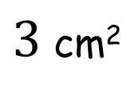
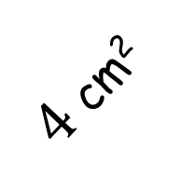
Cuboid Faces
SIC_64
The faces of a cuboid have areas as shown in the diagram.
What is the volume of the cuboid?
$75$ cm²
(not to scale)
$4$ cm²
$3$ cm²
H

Slide 15
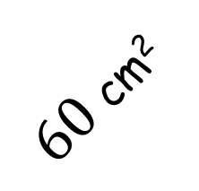
Cuboid Faces
SIC_64
The faces of a cuboid have areas as shown in the diagram.
What is the volume of the cuboid?
$60$ cm²
(not to scale)
$5$ cm²
$3$ cm²
I

Slide 16
Cuboid Faces
SIC_64
The faces of a cuboid have areas as shown in the diagram.
What is the volume of the cuboid?
$50$ cm²
(not to scale)
$6$ cm²
$3$ cm²
J

Slide 17
Cuboid Faces
SIC_64
The faces of a cuboid have areas as shown in the diagram.
What is the volume of the cuboid?
$30$ cm²
(not to scale)
$10$ cm²
$3$ cm²
K

Slide 18
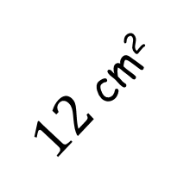
Cuboid Faces
SIC_64
The faces of a cuboid have areas as shown in the diagram.
What is the volume of the cuboid?
$25$ cm²
(not to scale)
$12$ cm²
$3$ cm²
L

Slide 19
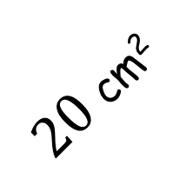
Cuboid Faces
SIC_64
The faces of a cuboid have areas as shown in the diagram.
What is the volume of the cuboid?
$20$ cm²
(not to scale)
$15$ cm²
$3$ cm²
M

Slide 20
Cuboid Faces
SIC_64
The faces of a cuboid have areas as shown in the diagram.
What is the volume of the cuboid?
$45$ cm²
(not to scale)
$5$ cm²
$4$ cm²
N

Slide 21
Cuboid Faces
SIC_64
The faces of a cuboid have areas as shown in the diagram.
What is the volume of the cuboid?
$25$ cm²
(not to scale)
$9$ cm²
$4$ cm²
O

Slide 22
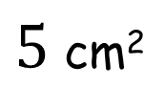
Cuboid Faces
SIC_64
The faces of a cuboid have areas as shown in the diagram.
What is the volume of the cuboid?
$30$ cm²
(not to scale)
$6$ cm²
$5$ cm²
P

Slide 23
Cuboid Faces
SIC_64
The faces of a cuboid have areas as shown in the diagram.
What is the volume of the cuboid?
$20$ cm²
(not to scale)
$9$ cm²
$5$ cm²
Q

Slide 24
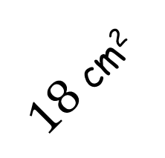
Cuboid Faces
SIC_64
The faces of a cuboid have areas as shown in the diagram.
What is the volume of the cuboid?
$18$ cm²
(not to scale)
$10$ cm²
$5$ cm²
R

Slide 25
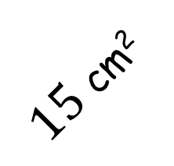
Cuboid Faces
SIC_64
The faces of a cuboid have areas as shown in the diagram.
What is the volume of the cuboid?
$15$ cm²
(not to scale)
$12$ cm²
$5$ cm²
S

Slide 26
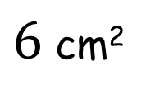
Cuboid Faces
SIC_64
The faces of a cuboid have areas as shown in the diagram.
What is the volume of the cuboid?
$15$ cm²
(not to scale)
$10$ cm²
$6$ cm²
T

