Slide 1
Fire detection with the Internet of Things (IoT)
Discover CREST Award

Slide 2
Making fire detection more connected
The Internet of Things (IoT) connects the unconnected
The IoT is improving fire detection, helping to save lives through more intelligent, faster and efficient systems
‘Smart’ fire detectors can now communicate with other detectors, alert the fire service and warn people at risk of fire

Slide 3
Making fire detection more connected
You work in a company specialising in fire detection.
You have been asked by a business to protect its headquarters from fire.
The business grounds are made up of three indoor areas within one large outdoor area.
You must place fire sensors in order to cover as much of the grounds as possible.

Slide 4
Making fire detection more connected
The company you work for have three different types of fire detectors that you can install to protect the area from fire.
Optical sensors
Heat sensors
Ionisation sensors

Slide 5
Making fire detection more connected
Optical sensors: Optical smoke alarms visually detect fire- they are best for slow smouldering fires such as soft furnishings or electrical wiring.
Details: These cameras can be place indoors only- but anywhere within a building. In this exercise the sensors can detect fire through windows, but not through walls.
Range: 40m
Field of vision: 360º
Cost: £500

Slide 6
Making fire detection more connected
Heat sensor
Heat alarms react to heat instead of smoke so are less likely to give false alarms. They can detect most fire but are best used in smoky environments like a kitchen.
Details: These cameras can be placed on any wall
Range: 8m Field of vision: 135º Cost: £200

Slide 7
Making fire detection more connected
Ionisation sensor
Ionisation smoke alarms detect changes in the air due to smoke. These types of sensors are quick to alert to possible fires.
Details:
These cameras can only be placed on vertices
Range: 4m
Field of vision: 45º
Cost: £150

Slide 8
Connected fire detection
The fire detection system works as a star network.
A star network consists of one central hub or node which acts as a conduit to transmit messages.
When a fire is detected, the sensor passes a message to the central node which then can alert people to the fire.
Central node
Sensor
Sensor
Sensor
Sensor

Slide 9
Connected fire detection
The internet of things allows the central node to alert more and more people, devices and organisations.
Who would you alert?
Fire department
Fire marshals/facilities team
Employees
Neighbouring buildings
See how connected fire detection is saving lives in informal settlements

Slide 10
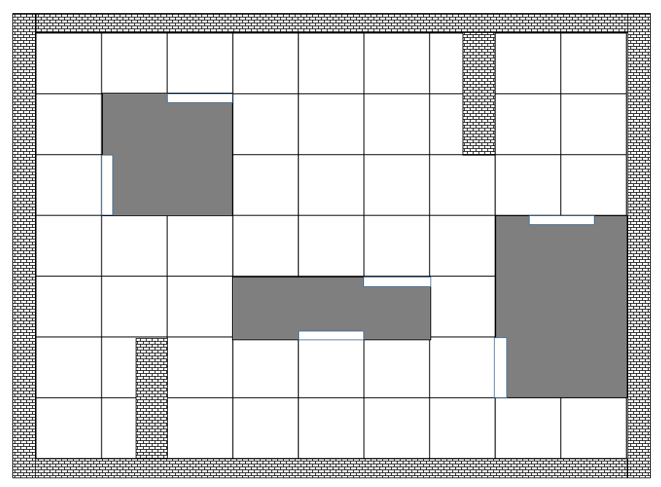
Your task
Place the fire detectors in the company grounds to cover as much area as possible.
Here is a plan view of the grounds:
36m
28m

Slide 11
Your task
The company decide that they can only spend up to £2000 on the system.
They have asked for at least one optical sensor installed, but no more than three, and at least one of the other types of camera.
Place the cameras in a way so that the most area is covered within the budget.
36m
28m

Slide 12
Your task- extension
Once you have placed your sensors, decide where to place the central node.
Is there an optimal position to minimise the average distance from each of the fire detectors?
36m
28m

Slide 13
Your task
Compare the solutions as a whole class.
what problems did you have?
how did you overcome them?
which group did well?
how can you tell?
36m
28m

Slide 14
Group challenge
You have decided to set up your own rival fire detection company, that will use the Internet of Things as well as existing fire detectors to improve fire safety.

Slide 15
Your challenge
You will present your ideas for the company in a presentation. Your presentation will comprise of two main parts:
Design a fire detection coverage and a pricing strategy- using the business grounds from the previous task as a template
Include your ideas on how the IoT could be used as an early warning system for all relevant stakeholders- who are you going to alert and how?

Slide 16
Your challenge
Your presentations should include:
how much area of the ground your proposal covers
a breakdown of costs
how many of each camera did you use - and why
where will the central node be placed. How far on average is it from the detectors?
a company name, logo and slogan
ideas for how the Internet of Things can be used to connect the system
who is going to be told if there is a fire and how are they going to be alerted

Slide 17
Cisco Little Big Futures
Image credits:
IOT drawing: By Wilgengebroed on Flickr [CC BY 2.0], via Wikimedia Commons
Flames
Fire detector

