Slide 1
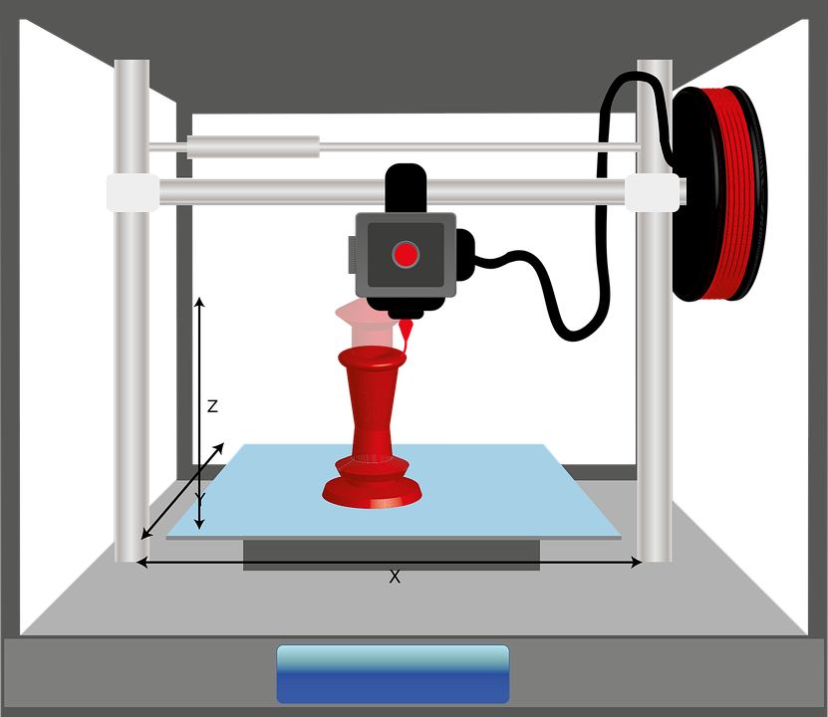
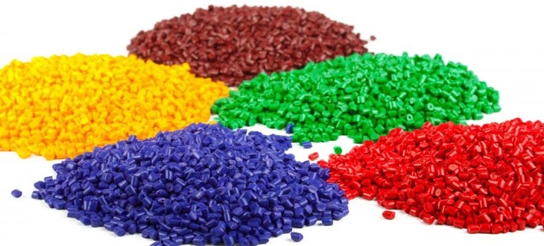
Starter
What’s the most common types of plastic in the world?

Slide 2
Answers
Polyethylene terephthalate (PET or PETE)
High-density polyethylene (HDPE)
Polyvinyl chloride (PVC)
Low-density polyethylene (LDPE)
Polypropylene (PP)
Polystyrene (PS)
Plastic is everywhere, even in 3D printing. We have a responsibility to be as sustainable as possible during the 3D printing process.

Slide 3
Objectives
To review different 3D printing materials and their impact on the environment.

Slide 4
Main 3D printing materials

Slide 5
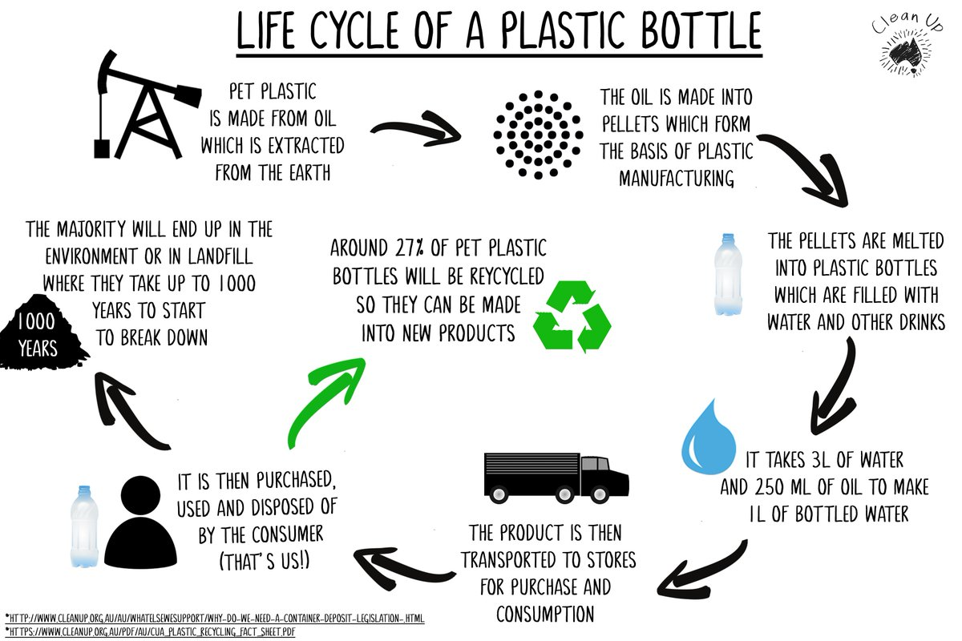
How are oil based plastics made?

Slide 6
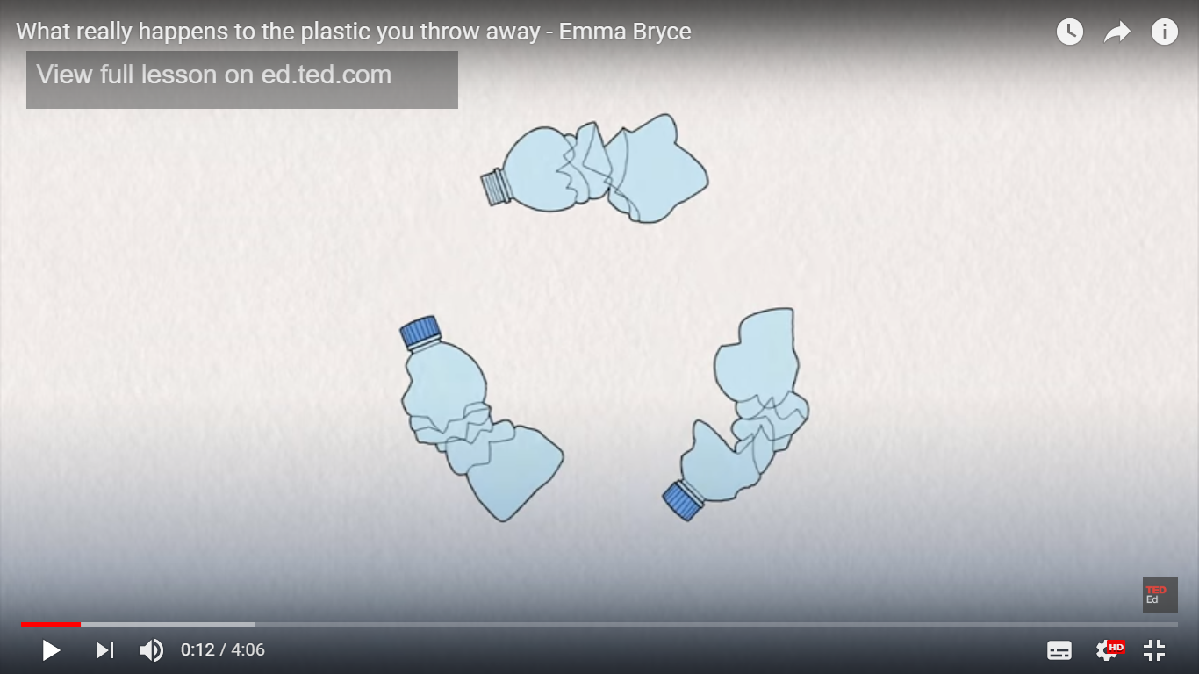
Life cycle of a plastic bottle

Slide 7
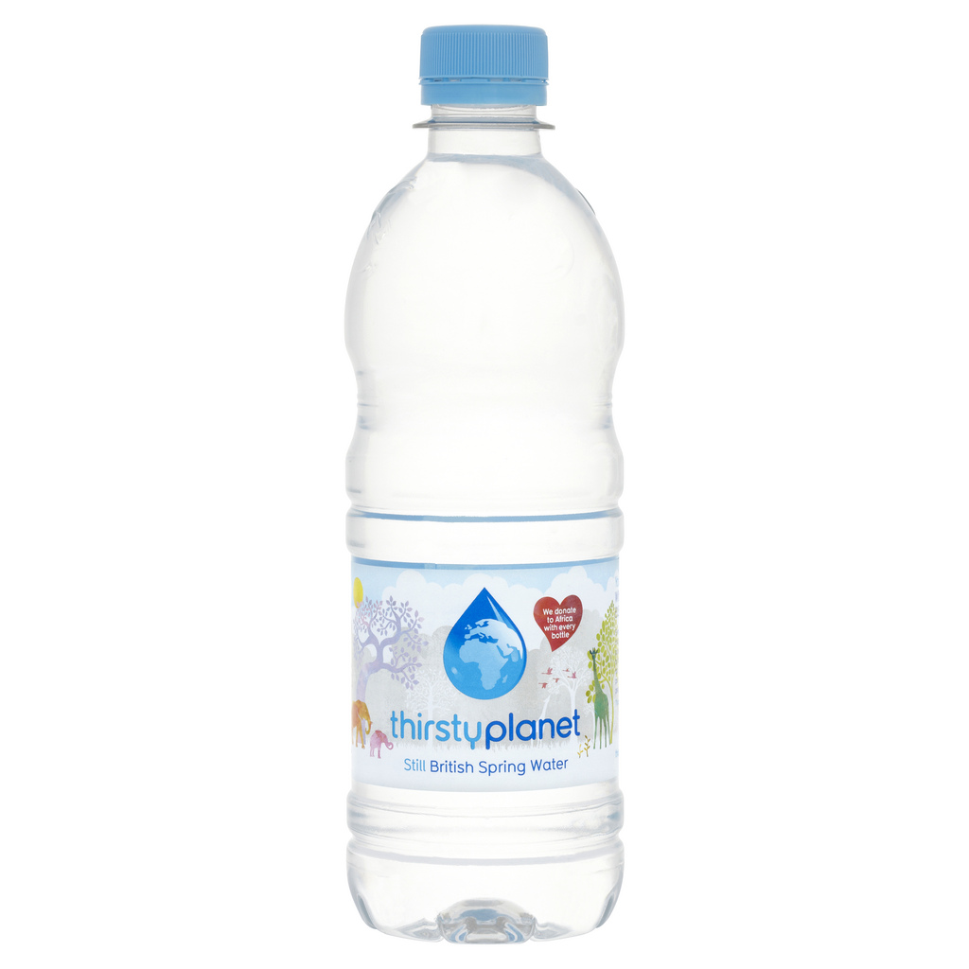
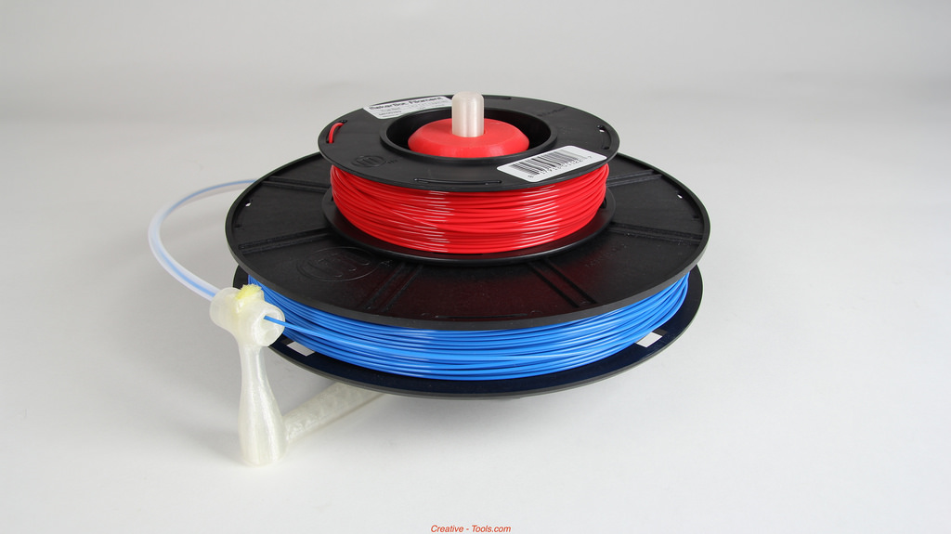
ABS plastic has the same effect as plastic bottles
ABS plastic takes hundreds if not thousands of years to bio-degrade.
When burnt they produce toxic gases.
Oil is finite and can’t be replaced once it has ran out.

Slide 8
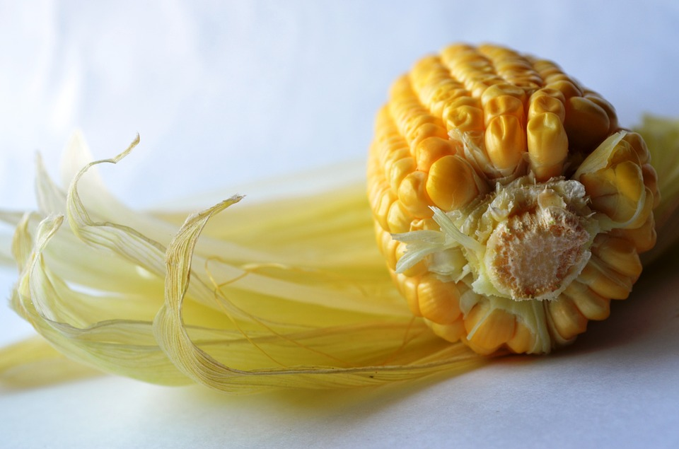
PLA(polylactic Acid) plastic is made from Cornstarch
It looks the same as ABS in most cases, but behaves very different.
It can biodegrade in landfill if thrown away.
The source of the material is corn that is farmed and harvested rather than oil that is extracted.
Corn can be re-grown and is classed as sustainable.
When burnt it doesn’t release toxic fumes.
Do we have enough landmass to provide enough corn to meet our plastic needs?

Slide 9
Discussion question
If you could go back in time would you stop the discovery of oil based plastics?

Slide 10
Plenary
What does PLA stand for?
Is it better to use PLA or ABS that has been recycled?

