Slide 1
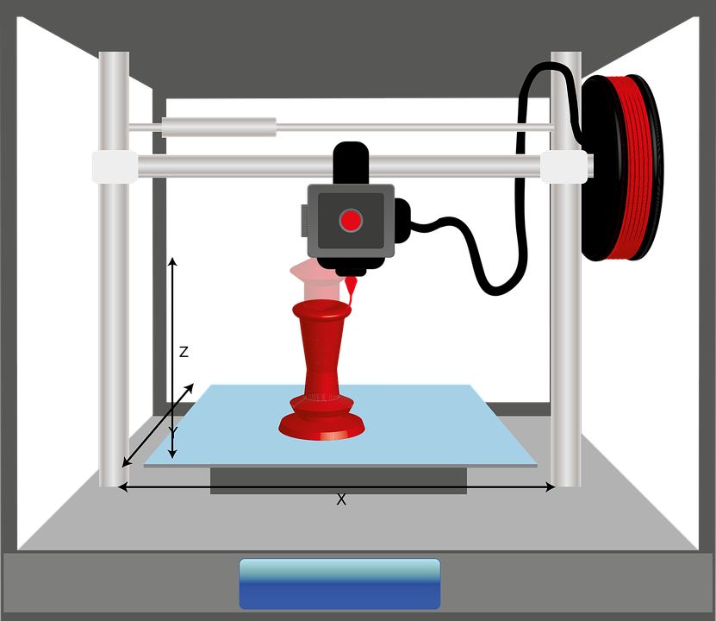
Starter
‘What is the difference between 2D and 3D?
Can you draw an object in 2D and then in 3D?

Slide 2
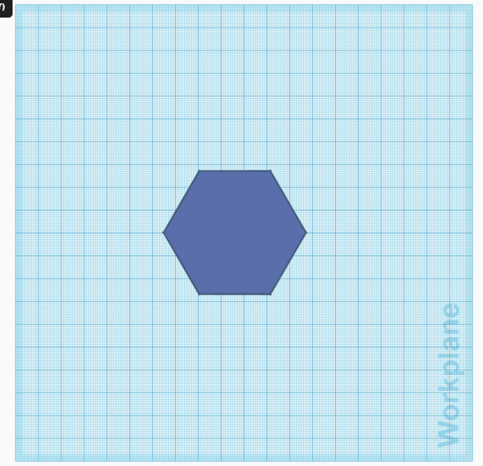
3D image of a shape. You can see more than one side
2D image of a shape. You can only see one side.

Slide 3
This is a 2D image where you can only see one side (the front)
A 3D image you can see more than one side (the front, the side and the top)
https://www.apple.com/uk/shop/buy-iphone/iphone6s

Slide 4
Objectives
To define the term CAD and CAM
To create basic 3D models in Fusion 360.

Slide 5
CAD and CAM
CAD means ‘Computer Aided Design’
This means designing with the help of a computer
CAM means Computer Aided Manufacture
This means making using a machine controlled by a computer

Slide 6
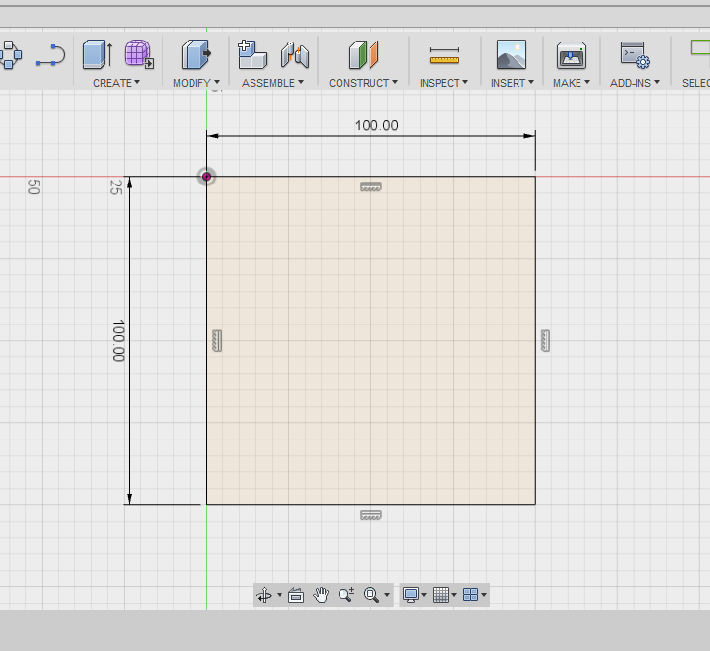
To create basic 3D models in Fusion 360.
Draw a square 100mm by 100mm like below

Slide 7
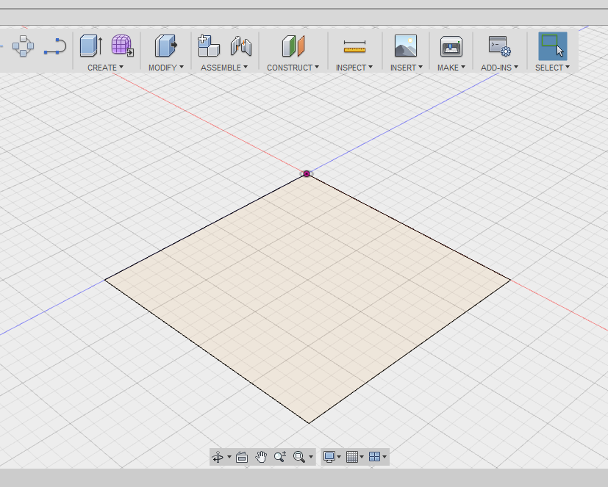
Select ‘stop sketch’ and you will leave sketching mode and be able to modify the shape to make it 3D.

Slide 8
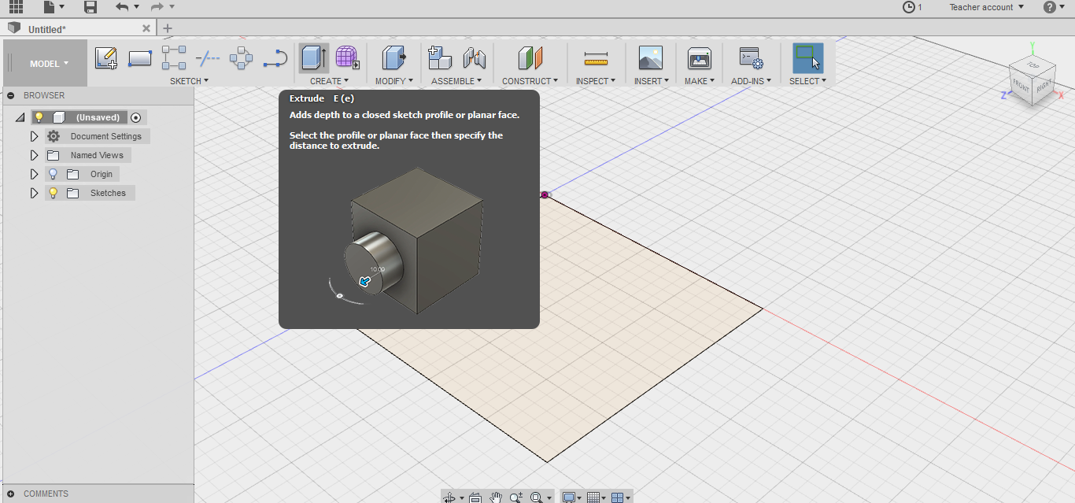
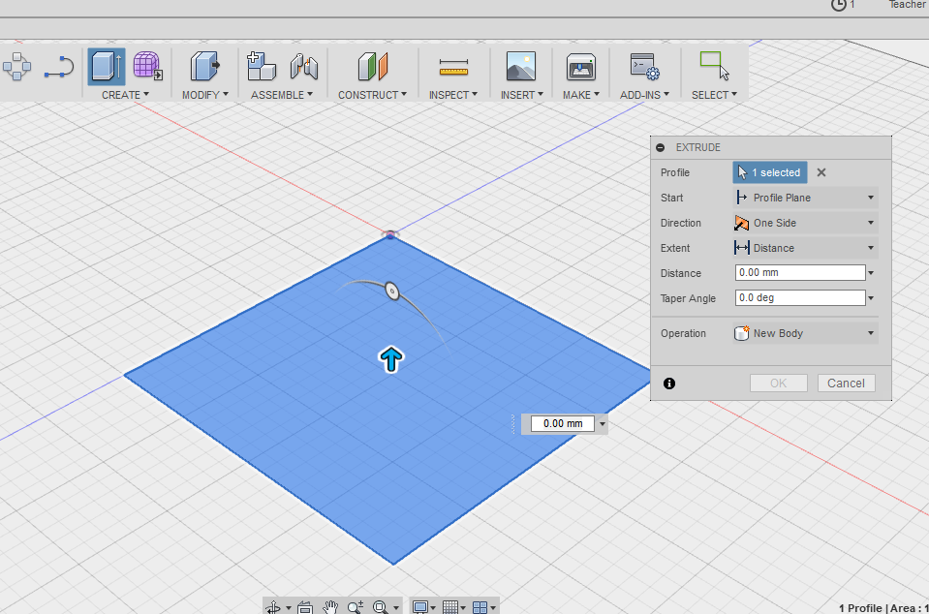
Select create and then click on the shape. This will turn it blue. Type in the distance box ‘100mm’ and press ok.

Slide 9
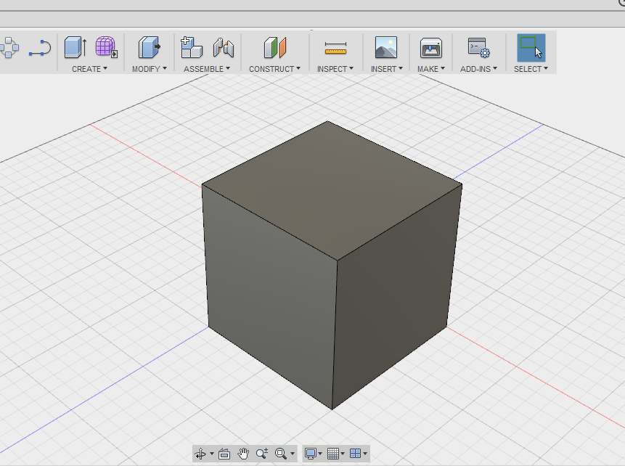
The 3D shape should look like this.

Slide 10
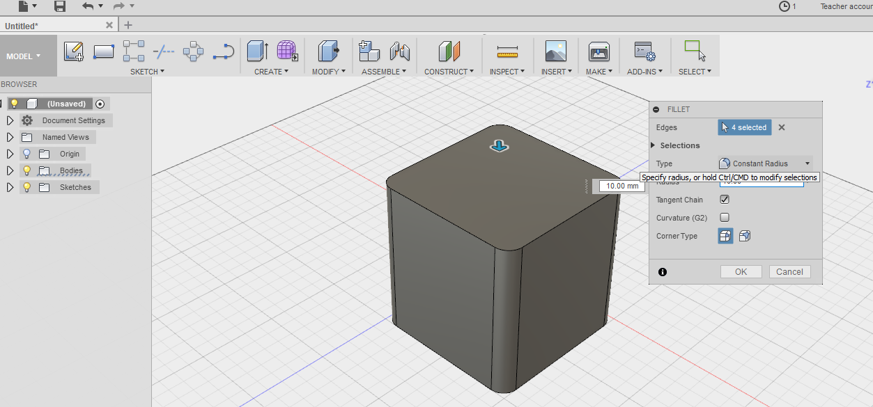
Click on modify and fillet and then click on the edges. This will add a radius to the corners. Make the size 10.00mm.

Slide 11
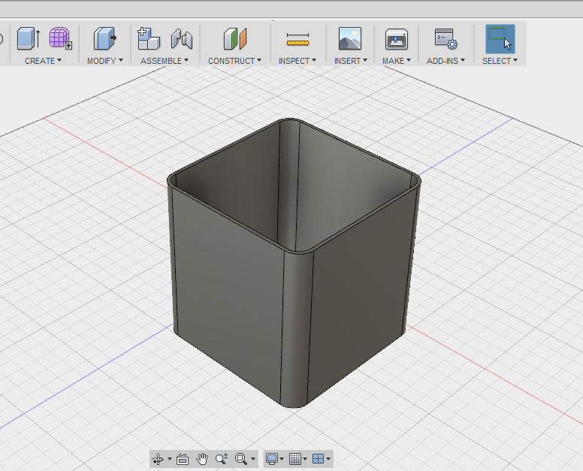
Click on ‘modify’ and then ‘shell’ and click the top surface of the shape. Type in a shell thickness of 2.00mm and then click ok.

Slide 12
Task
Model this basic shape just demonstrated.
Attempt the model the shapes on your student worksheet.

Slide 13
Plenary
Describe the difference between 2D and 3D.
Explain three features that you have learnt today on Fusion 360.

