Slide 1
Which material and why?
Selecting materials based on their properties

Slide 2
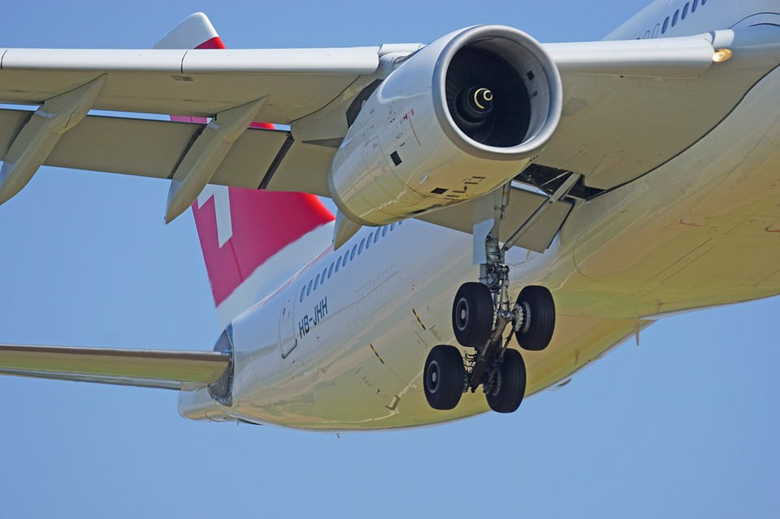
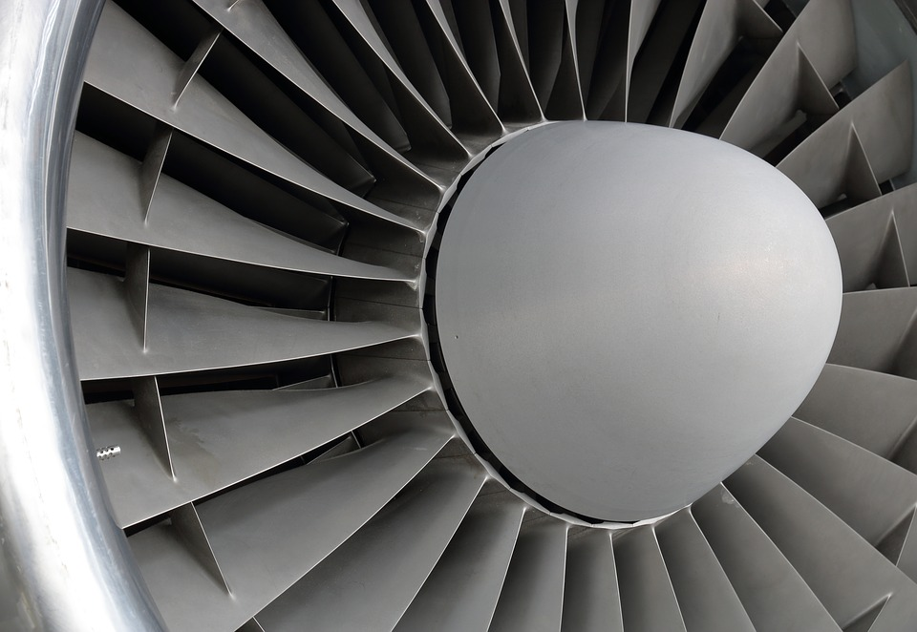
Turbojet engines for aircraft
Turbojet engines work by sucking in air at the front using a fan.
This is then compressed, mixed with fuel and heated.
Finally, the hot mixture is passed out through a nozzle at the back of the engine to create thrust.
The temperature of the hot gases may be as high as 2000ºC
The materials used in the construction of the different parts of the engine directly affect how well it works.

Slide 3
Turbojet fan blade materials
The material used to make a turbojet fan blade must have good:
thermal resistance
toughness
creep resistance
corrosion resistance
strength to weight ratio
What is the meaning of each of these properties? Why are they important for this application?
Turbojet fan blade
Notes:
Learners could write their responses in their books or on post it notes.

Slide 4
Properties
Thermal resistance – resistance to the flow of heat.
Toughness – resistance to brittle fracture.
Creep resistance – resistance to mechanical deformation under load over an extended time.
Corrosion resistance – resistance to chemical reactions with the environment, such as oxidation.
Strength to weight ratio – the strength of material divided by its density.
Notes:
Learners should check these definitions with their own responses and correct as necessary using self or peer assessment.

Slide 5
Selecting a material
You have been asked to select an appropriate material for manufacturing a turbojet fan blade.
Research the properties of each of the materials shown in the table.
Select the most appropriate material for this application.
Justify your choice.
Material type | Material
Ferrous metal | Cast iron
Non-ferrous metal | Aluminium
Alloy | Aluminium alloy
Polymer | Acrylic
Manufactured board (timber) | Plywood
Composite | Structural concrete
Notes:
The teacher may wish to edit the materials presented here depending on what has been studied. Some materials have been provided which would be clearly unsuitable, but it is up to the learners to come to this conclusion and explain why. Arconic are currently producing aluminium-lithium alloys for use in turbojet fan blades.

Slide 6
Now do this:
Produce a presentation of your findings. You should include:
The material selected and why its properties make it suitable.
Other factors, such as cost, environmental impact and machinability of the selected material.
Information about the materials not selected and why they were unsuitable.
Notes:
Findings could be presented back to the class via a PowerPoint or using other visual aids.

