Slide 1
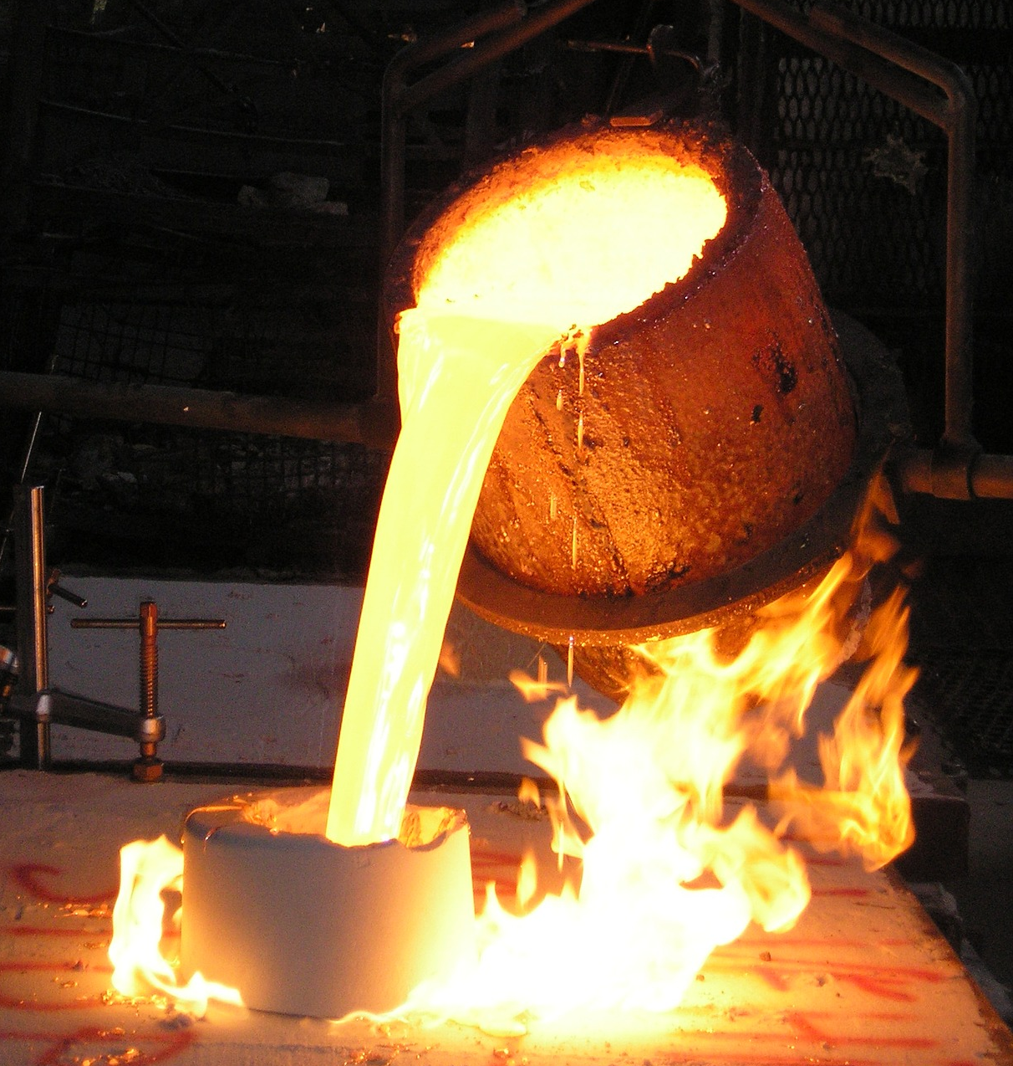
Why Cast it?
Understanding the reasons why casting is used to make parts
Notes:
All images in this presentation are from commons and do not require attribution.

Slide 2
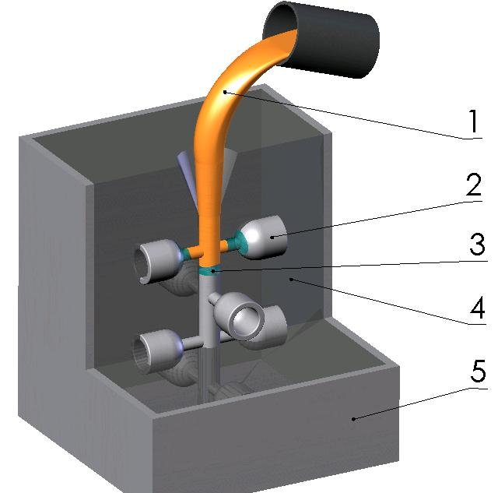
What is Casting?
Casting is a process where a liquid material is ‘delivered’ into a mould
The mould contains a hollow space of the intended shape (or shapes), which fills with the liquid material
The material then hardens into the required shape, typically as it cools
Notes:
The liquid, typically molten, material (1) is poured into the sprue, a channel which allows the material to flow into the mould (3); (2) are the shapes being cast, (4) is the material that the mould is made from, and (5) is the casing for the mould.

Slide 3
Types of Casting
Sand casting uses a mould made from sand:
the mould can only be used once.
It is typically in two parts, and the ‘space’ for the part is made using a reusable pattern.
molten metal is ‘delivered’ by being poured into the mould
Pressure die casting uses a mould made from metal:
the mould can be reused many times.
It may range from two to several parts, with the ‘space’ for the part is made by machining
the molten metal is ‘delivered’ by being injected into the mould under pressure
Notes:
The image shows the sand casting of a small product.
This slide could be extended to cover injection moulding of plastics, which has many process features similar to pressure die casting (reusable metal mould, liquid material injected under pressure).

Slide 4
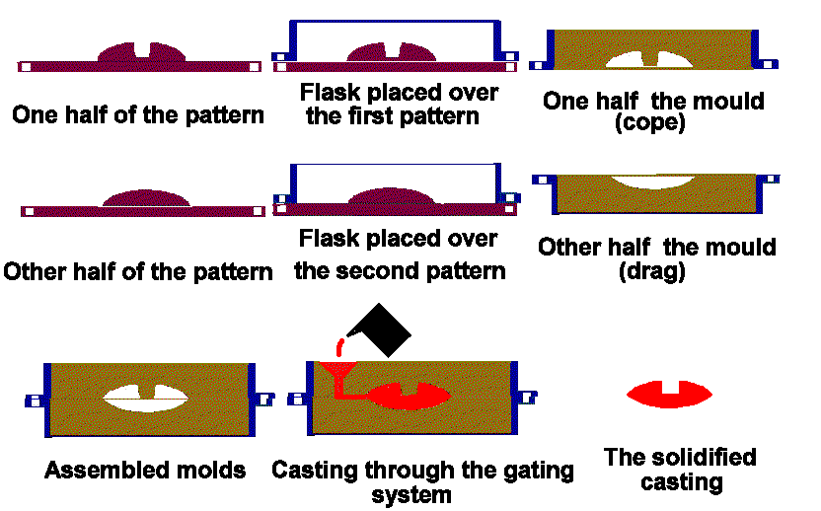
Sand Casting: Making the Mould and Casting
Notes:
The sequence of operations runs left to right, then from top to bottom. The gating system is made at the same time as the mould. There is normally a sprue to allow the liquid material to be poured in, and frequently a ‘runner’ to allow air to escape from the mould as it is filled. These have to be removed/cut off the part after it has solidified.

Slide 5
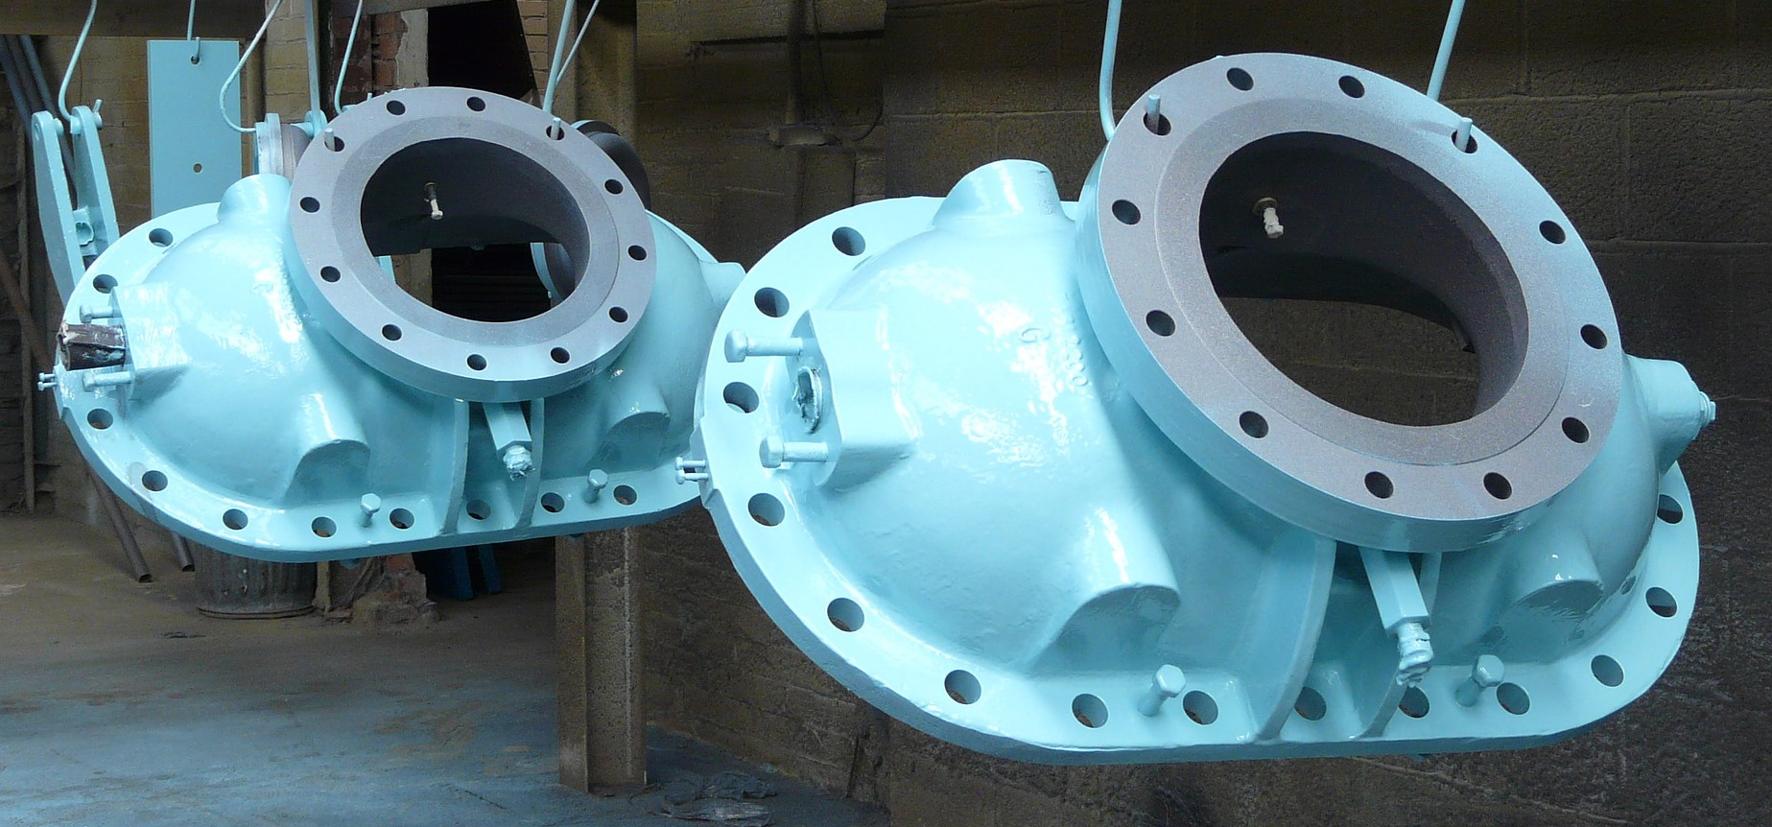
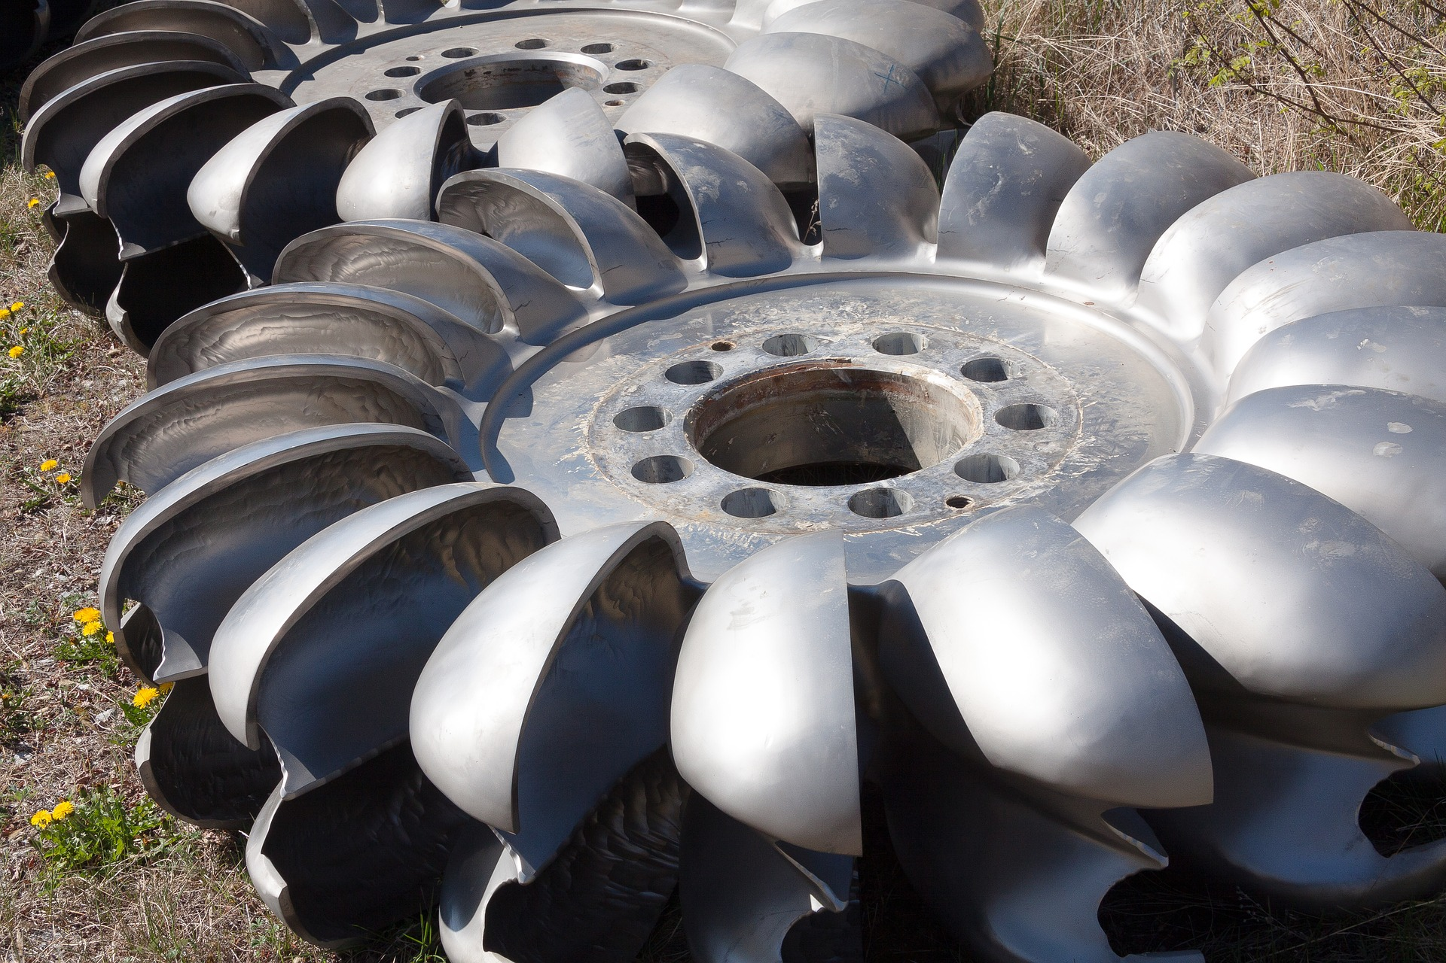
Reasons for Using Casting
Casting can make a complicated 3D part in a single, quick operation
If the part had to be machined instead, it may need many different machining operations (turning, milling and drilling the required features), each taking a lot of manufacturing time – and therefore cost.
There would also be a lot more waste material – costing more for both the material and the environment
Notes:
Pictures include: a bronze statue; a door knocker; a metal casing; a turbine. All would require substantial machining to achieve the desired shape.

Slide 6
Now do this:
Using the material provided, make the shape using the mould provided. Record how long this takes.
Using modelling tools, manufacture the same shape by hand. Record how long this takes.
How do the times compare? Which of the processes had the opportunity to make the most mistakes? Which process gave the highest quality of manufactured part?

