Slide 1
Stranded! A teamwork
challenge
1

Slide 2
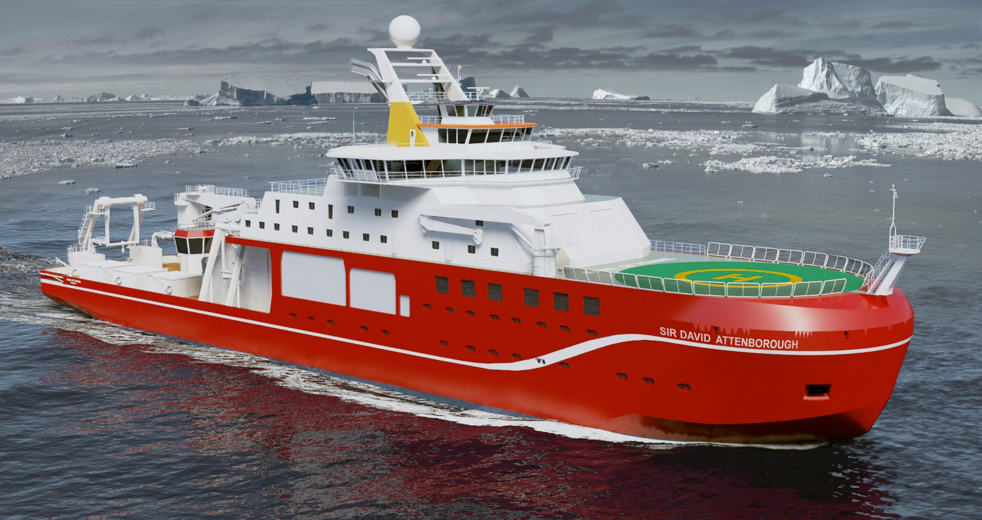
RRS Sir David Attenborough
2

Slide 3
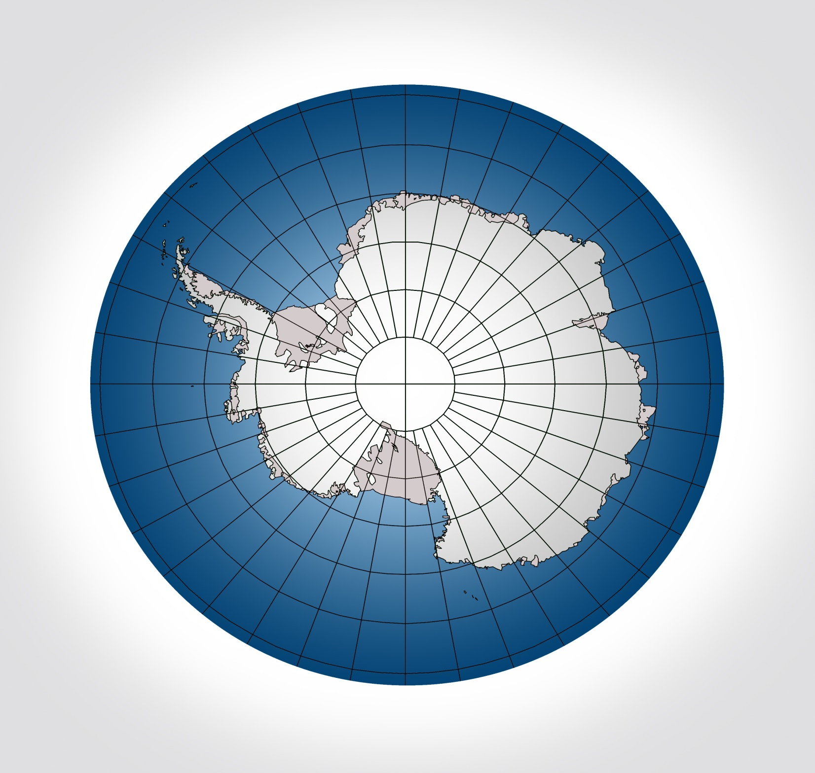
Antarctica
3

Slide 4
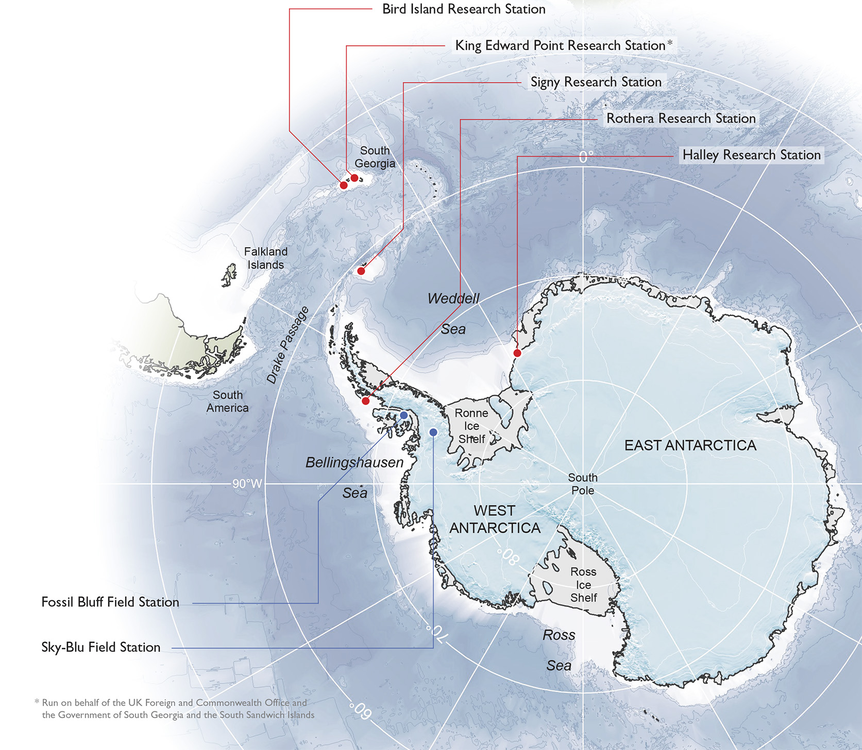
British Antarctic Survey Antarctic Research Stations
4

Slide 5
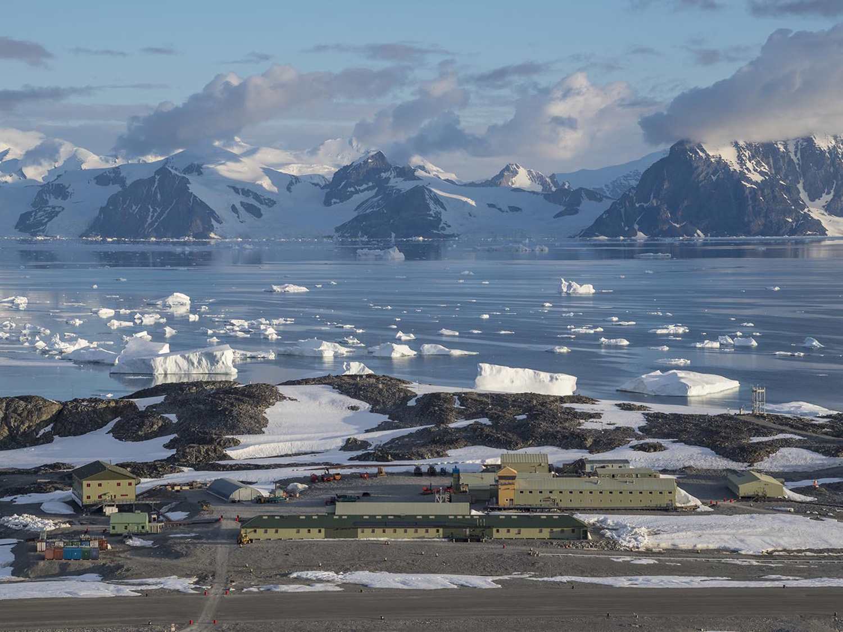
Rothera Research Station
5

Slide 6
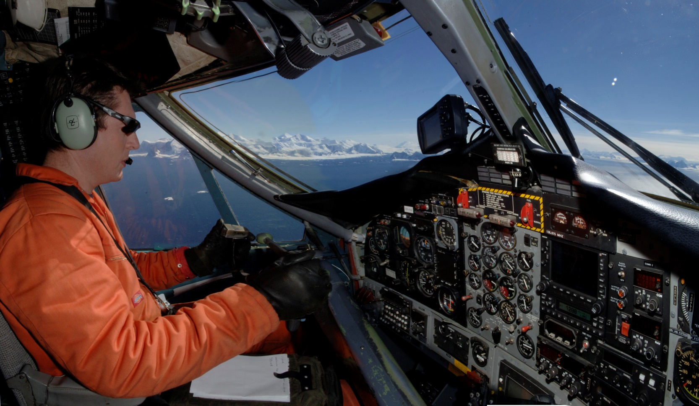
Pilots take part in search and rescue
6

Slide 7
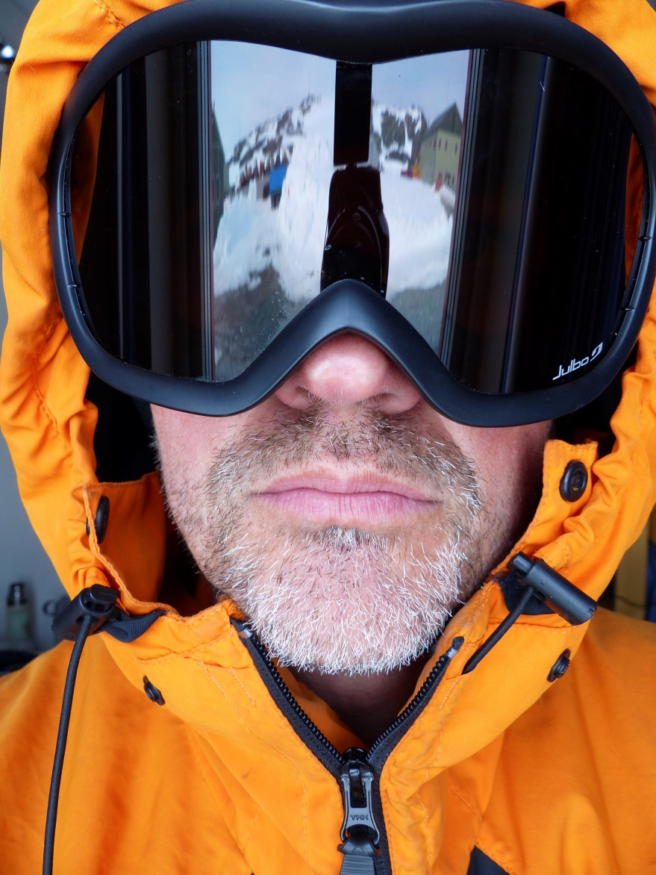
BAS pilot Jonathan Rowland
Deputy Chief Pilot, British Antarctic Survey
Flies Dash-7 aircraft, carrying people to Antarctica
Qualifications-2 A levels
Joined RAF after school to train as a pilot
Skills- show skill in flying and making decisions
Qualities-sense of humour, patience, hard working, flexible, team player
7

Slide 8
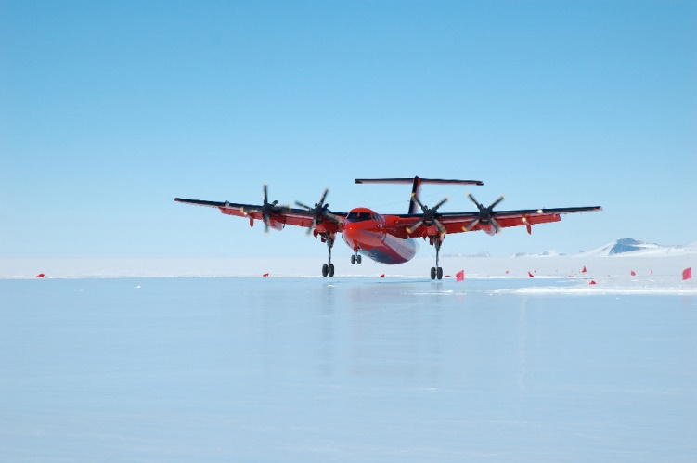
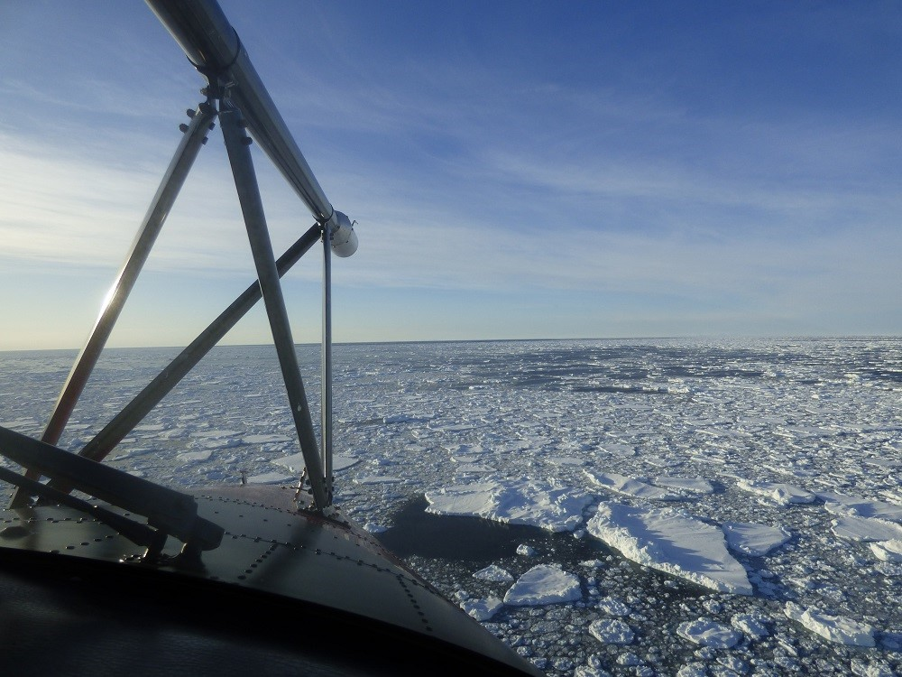
Low level flying over ice
Dash-7 aircraft
8

Slide 9
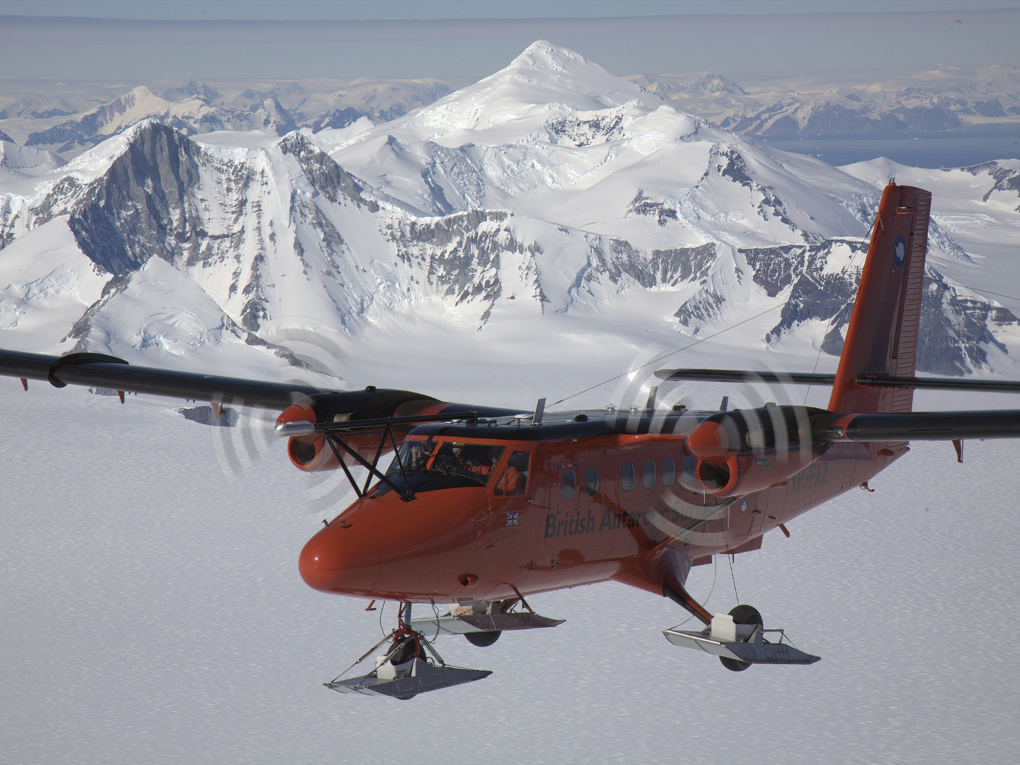
9

Slide 10
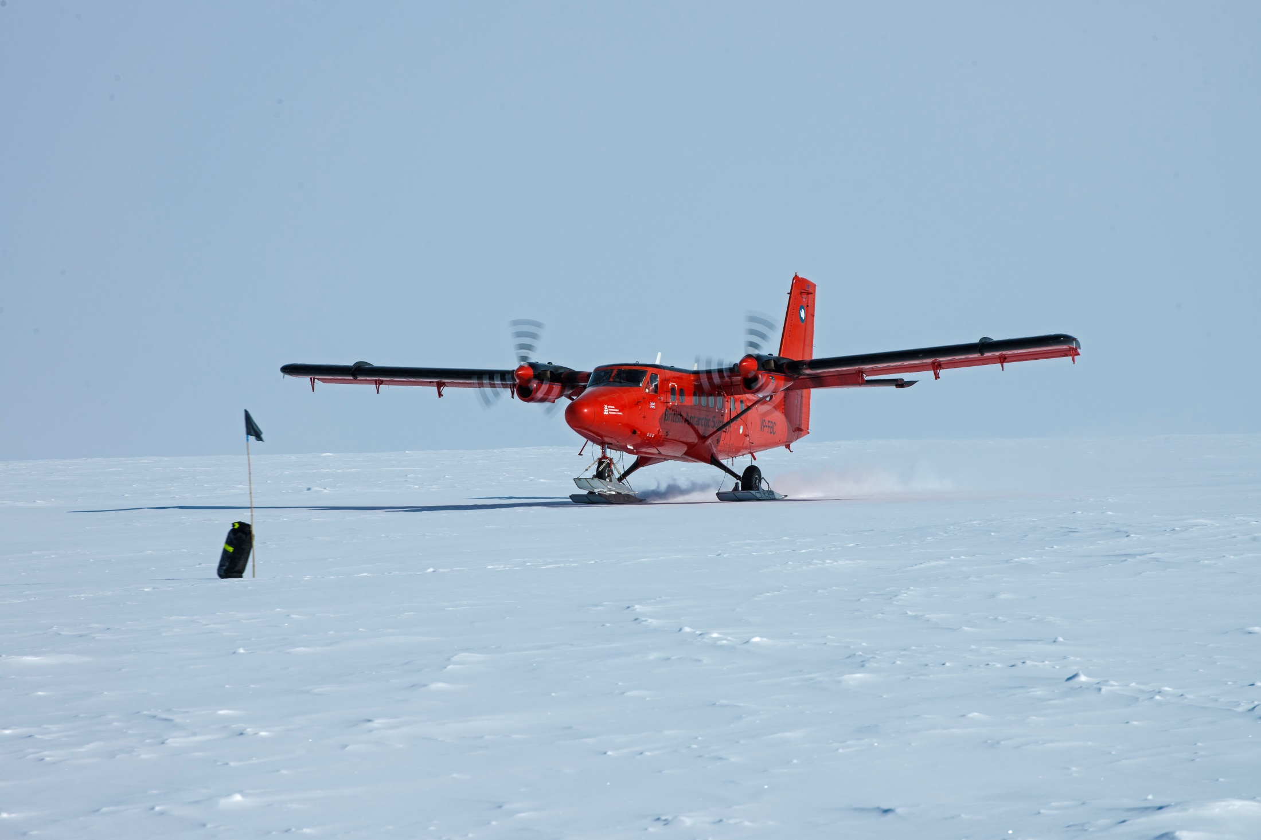
BAS Twin Otter aircraft landing using snow skis
10

Slide 11
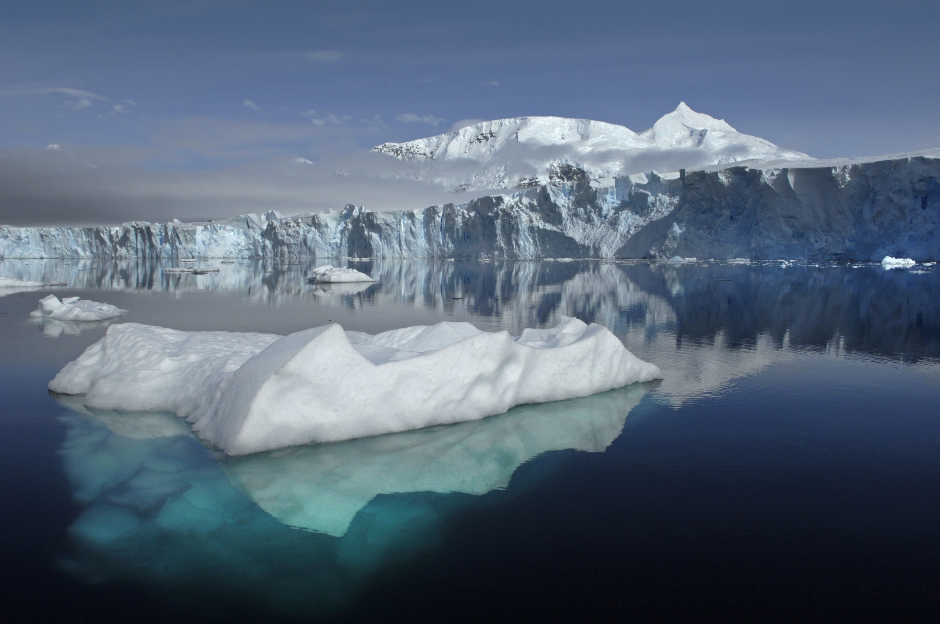
11

Slide 12
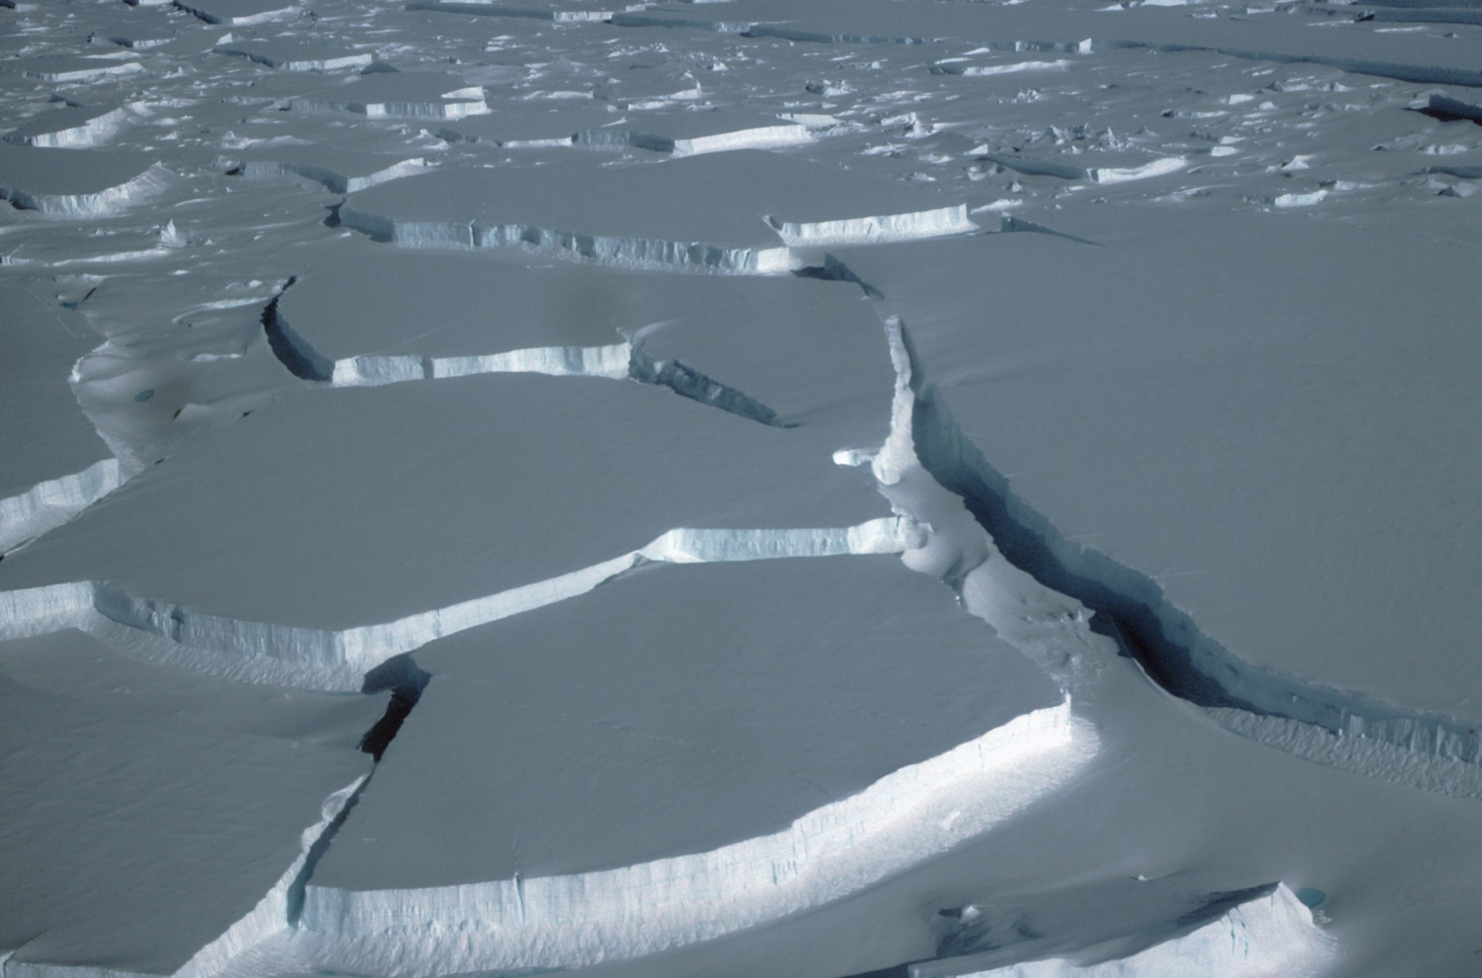
Help! We are scientists on an expedition in Antarctica.
A crack has appeared in the ice leaving one of our team stranded on the opposite side. We need to get across to her. The gap is getting wider.
The rescue helicopter is delayed by bad weather.
A bridge might be a good idea.
Can you help us by testing a few designs and advise us which is best?
12

Slide 13
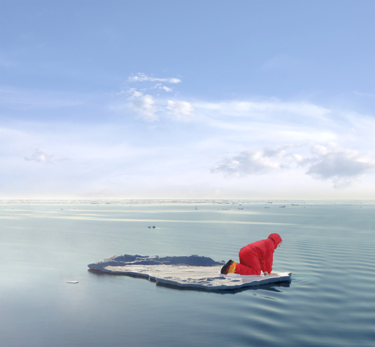
Stranded!
13

Slide 14
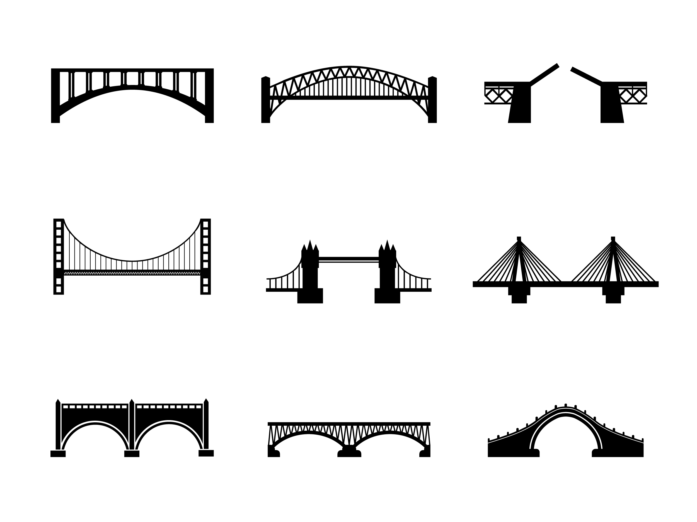
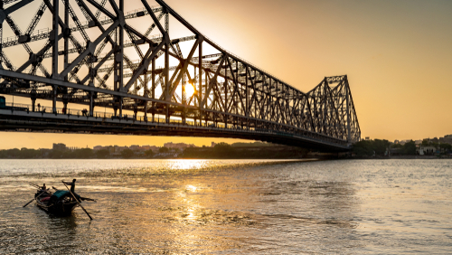
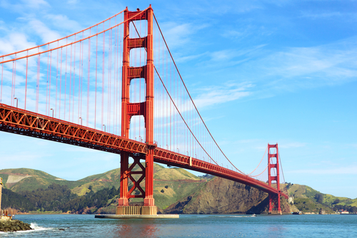
Examples of bridge designs
Can you spot a suspension bridge?
Which bridge is a cantilever?
Which one is an arch bridge?
Truss bridges have triangle shaped parts.
14

Slide 15
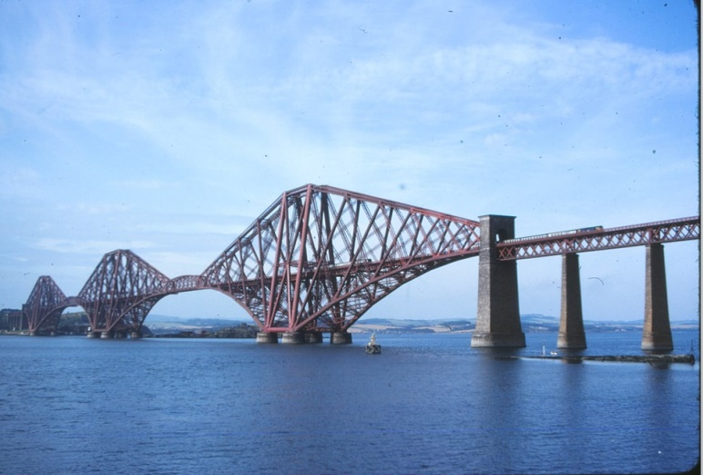
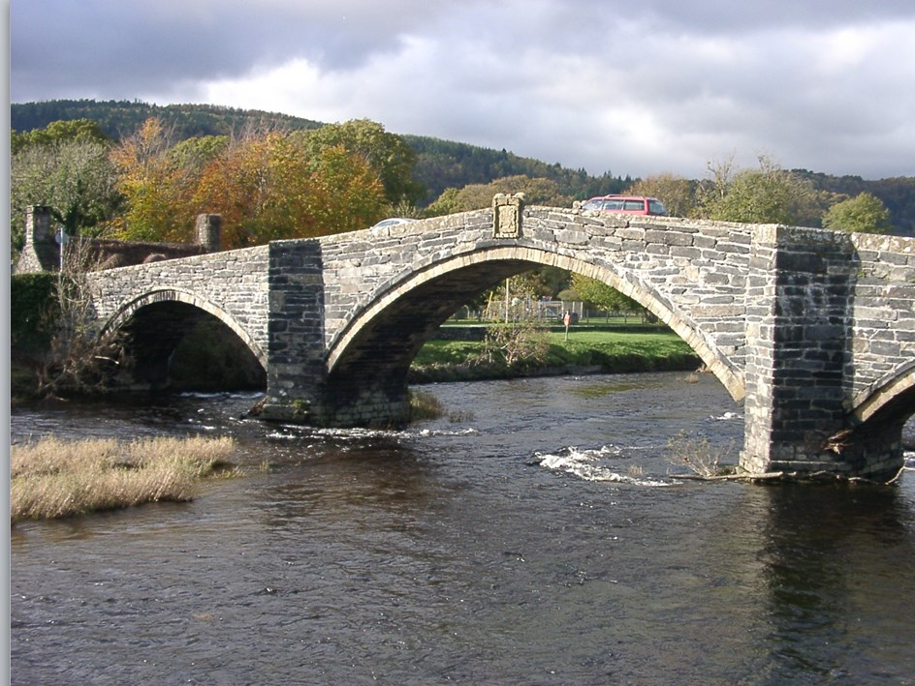
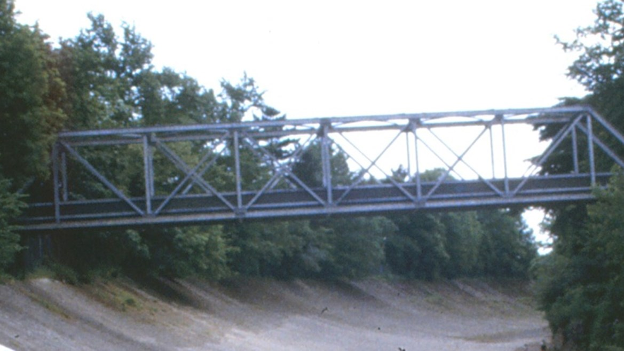
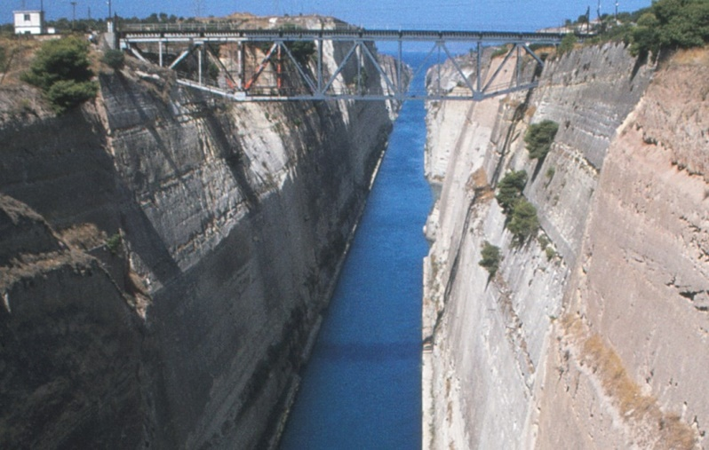
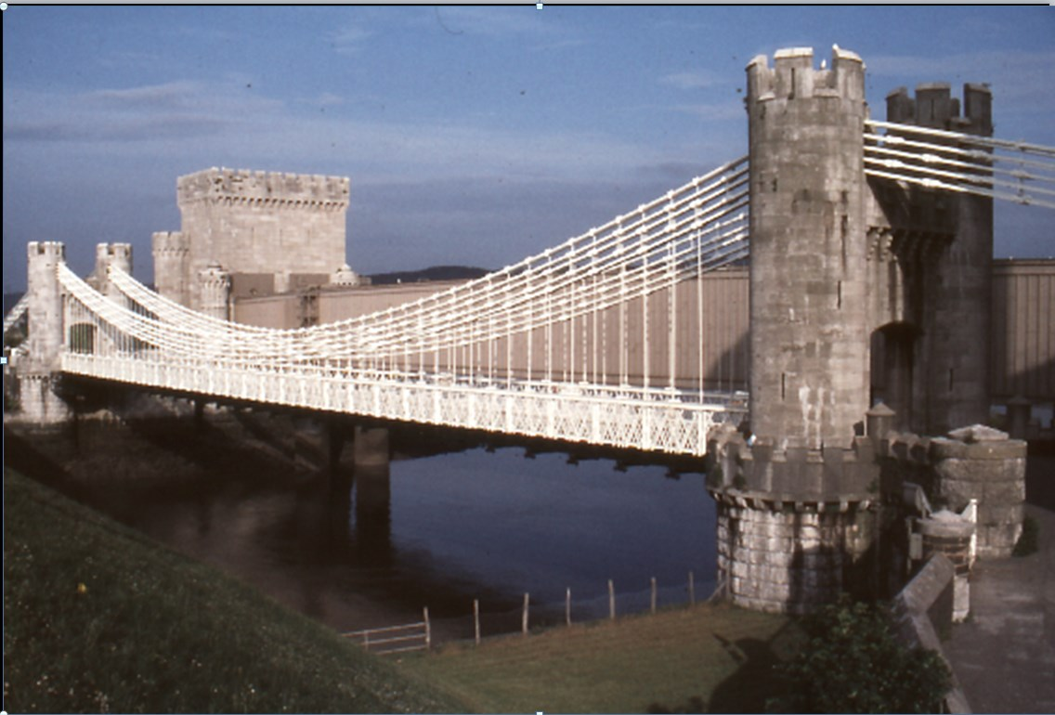
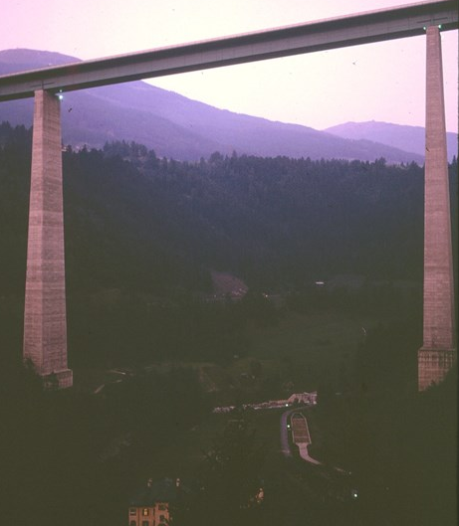
Cantilever
Arch
Truss
Truss
Suspension
Beam
15

Slide 16
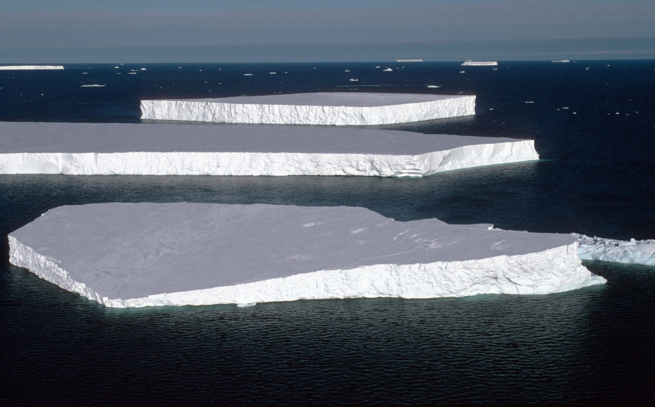
Design a bridge to span a gap of 30 cm
You will need:
A4 paper x 6
Scissors
Sticky tape x 1 metre
Straws x 10
Ruler
Paper cup
Marbles or coins
16

