Slide 1
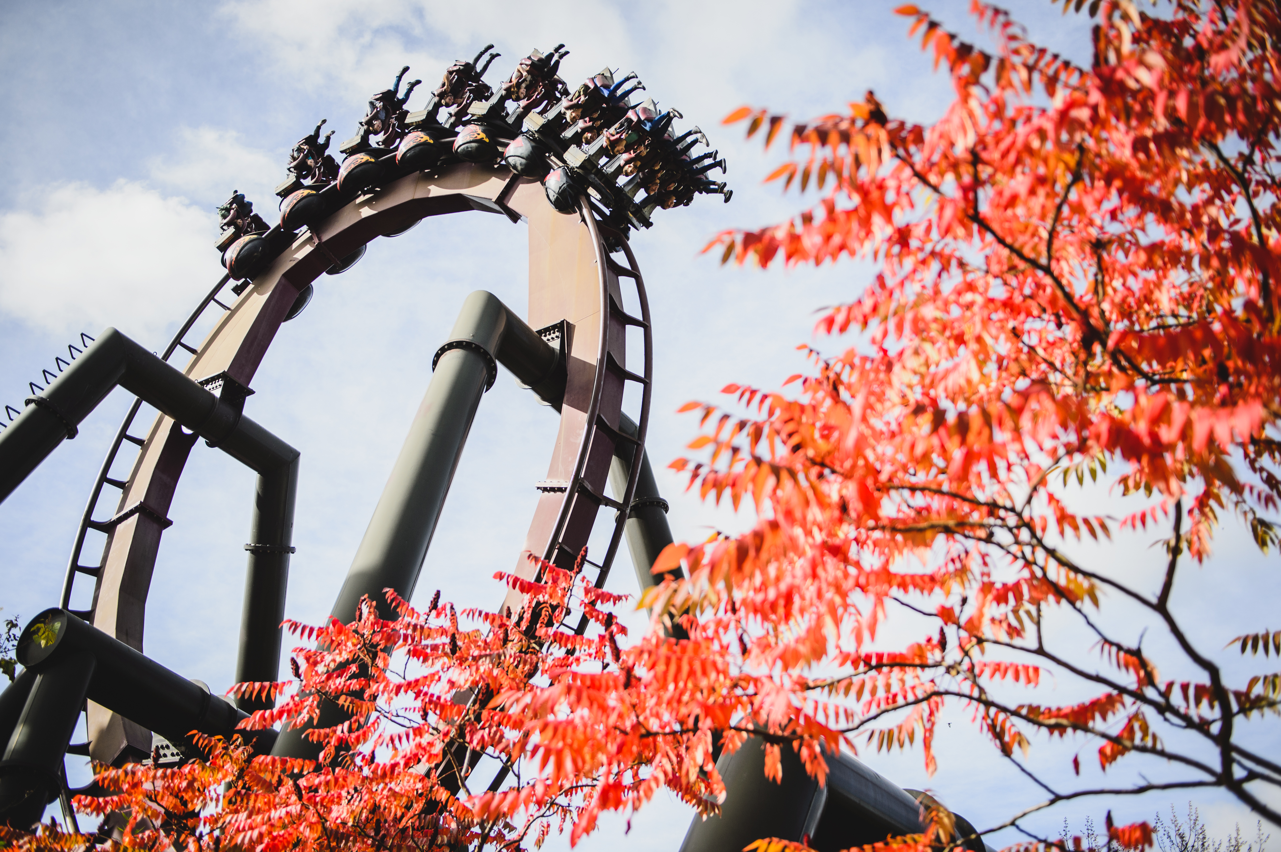
The IET Faraday Challenge Day
Notes:
9.15
As students arrive, get them to fill out Team Registration form and check they have Faradays.
9.30
SCRIPT:
Ask host school to do introduction to school and hosting (fire alarm and toilets)
Welcome to the Institution of Engineering and Technology’s Faraday Challenge Day. My name is xxxx and I will be your Challenge Leader today.
The IET Faraday is a STEM Challenge held in many schools and universities for Year 8 students across the UK, England, Northern Ireland, Wales and Scotland. For your challenge day today you will be working in partnership with Thorpe Park.
Today you are no longer Y8 students, you are teams of engineers and your challenge is to help Thorpe Park design an attraction in their leisure park.
This is a competition and we are looking for the best teams of engineers.
Tell them what they can win (if applicable).

Slide 2
Project Flow
Project brief
Planning
Team roles selection
Apprenticeship
Development
Presentation to client
Notes:
09:35
3 minutes
Script
Today you will be working as real-life engineers.
You will be following an engineering project flow as shown.
We will explain each of these stages when we get to them so you will need to listen carefully to make sure your team completes each section of the project.

Slide 3
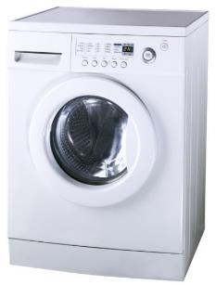
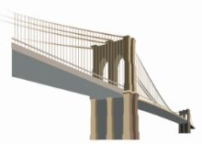
What is engineering?
“The application of knowledge and creativity to the needs of humanity”
Notes:
09.38
4 minutes
SCRIPT:
But before you can be engineers we need to know what engineers do! Ask the students the question ‘What is engineering?’ and ‘What in this room has an engineer been involved in the creation of?’ *It is up to the CL which are used based on the responses of the students and the time available.*
On click - Engineering is the application of knowledge to the needs of humanity! Engineers use science, technology and mathematics along with creativity, language and design skills to create things which help people.
There are many different areas of engineering. All require creativity and innovative problem-solving. Engineering use their knowledge and ideas to come up with new products or adapt existing products. They challenge themselves. You can use the fidget spinner as an example of a simple idea developed into a product.

Slide 4
Project Flow
Project brief
Planning
Team roles selection
Apprenticeship
Development
Presentation to client
Notes:
09:42
Minimal
We are now going straight on to the Project Brief
Watch this video carefully and take notes if you wish, it will not be shown again.

Slide 5
Briefing video
Video will need to be played from here,
https://faraday-secondary.theiet.org/resource-pages/thorpe-park-fcd/
Or downloaded from IET.tv here,
https://tv.theiet.org/?videoid=12408
Notes:
Video is not embedded and should be played from the website or downloaded prior to the event.

Slide 6
Re-cap of the challenge
Develop a detailed drawing of your attraction.
Design and engineer ONE aspect of your design as a prototype and include an electronic circuit/component.
Complete the planning and reflections sheet.
Present your idea to the IET Faraday Thorpe Park judge(s).
Notes:
SCRIPT:
Now is your chance to develop something new and make a difference!
On click: You will develop a detailed drawing of an attraction that will fill the space at Thorpe Park. Look at the map on your table to give you an idea of the space available. Remember that your attraction should complement what is already in the park and encourage a wide range of visitors.
On click: Design and engineer one aspect of your attraction. Remember what the engineers told you about the park and the things they need to consider. Read your Student Booklet [point this out] to remind you of these.
Your design will be a prototype. Does any one know what I mean when I say prototype? (Seek responses from students and emphasize that their design may not be the finished product, that the point is to try out ideas to see if they work. There may be further work to be done but we should be able to see the idea behind their design).
On click: Keep a record of your work on the Planning and reflections sheet [point this out]. Good engineers need to reflect on what they have done and how they might improve it.
On click: Finally you will need to present your product to the judge(s) this afternoon. Engineers need to be able to develop their ideas but they also need to be able to tell people about these so that they can be used in the real world – we don’t want these ideas to be a secret! We will brief you about what should be in your presentation at 12.10 so don’t start writing this until then.

Slide 7
Marking criteria
Planning
Development
Budget
Product
Presentation
Teamwork
Notes:
9:50 am
SCRIPT:
You will be scored on all of your work today. It isn’t just about your finished product, it is also about how you arrive at your prototype ideas and how you evaluate your prototypes and teamwork. The marking criteria can be found on the back pages of your Thorpe Park Team Brief (direct students to look at pages) so it is a good idea to have a look at this to see how you can score marks. You will need to do well in all the areas in order to score highly.
If we have two teams on the same number of points at the end of the challenge we will look at a combination of specific areas to decide who wins. This will not be based on how much money you have left.

Slide 8
Project tools
Engineering shop
Cutting station
Access cards
‘How to’ sheets
Thorpe Park Student Booklet
STEM consultant – We are expensive!
Notes:
9:55
SCRIPT:
Engineering Shop – This will open later. Supplies are limited. If you buy something you don’t need/want you can sell some of these back to the shop for half price as long as they unused. The shop does not negotiate and does not do deals so don’t even try! Details of what is available to buy are in your Student Handbook.
Cutting Station – Only 3 students allowed there at any one time and NONE of the tools can be taken away from the station. Please make sure you use the cutting mats and the bench hook safely.
Access cards – Each team can buy an access card which can be used for some items. You can only take one item from this list at a time.
Budget - Keep accurate records of your purchases on the Accounts sheet on your table. Use your budget carefully to make your product even better. You will not get extra marks for having Faradays left at the end of the challenge but we will be judging how wisely you spend your budget.
How To sheets – you can take these to your table but please return them to the centre table when you have finished with them. These sheets will help you with some of the aspects of your designs.
Thorpe Park Team booklet. This MUST be read if you want to have any chance of winning. There are many things in the book that are essential to score marks that your challenge leader will not tell you and you will only find out by reading.
STEM consultant – Does anyone know what STEM stands for? Elicit responses from students or tell them. We will hep you as much as we can but if you rely on us too much we will charge you some Faradays for our time. We will warn you before charging you though.

Slide 9
Health and safety briefing
Keep your work station tidy (including the floor around it).
Be careful when using the equipment at the cutting station, scissors and the staplers.
Retract the blades of the craft knives when you have finished using them.
No more than 3 people at the cutting station at any time.
Do not remove any tools from the Cutting Station
Report any spillages, accidents or potential hazards to the Challenge Leader or STEM Consultant immediately.
Do not take food or drink near the shop or cutting station.
Notes:
10.00 am
2 mins
Notes:
Go through the tips for safe working!
Re-emphasise the rules of the Cutting Station

Slide 10
Project Flow
Project brief
Planning
Team roles selection
Apprenticeship
Development
Presentation to client
Notes:
10.02
Script:
OK you have now completed the Project Brief.

Slide 11
Project Flow
Project brief
Planning
Team roles selection
Apprenticeship
Development
Presentation to client
Notes:
Now we go on to Planning.

Slide 12
Be creative!
“Failing to plan is planning to fail”
Planning
Think think think
Notes:
10.05
SCRIPT:
Planning is essential to a successful project. We have seen many teams have great ideas and rush into developing them, only to realise that they won’t work, they don’t have enough Faradays or they simply don’t have the time to develop them.
All projects have a large planning aspect. This is an important stage of your project.

Slide 13
Ideas
Draw and/or write about 3 different ideas for your attraction (6 marks).
Explain how your ideas meet the brief from Thorpe Park (6 marks).
3 minutes
4 minutes
5 minutes
11 minutes
6 minutes
7 minutes
8 minutes
9 minutes
Time is up
1 minute
2 minutes
15 minutes
10 minutes
13 minutes
12 minutes
14 minutes
Notes:
10.10
15 mins
SCRIPT:
You now have the first bit of teamwork to do. You have 15 minutes to plan out your ideas.
This is the only time I will remind you about the assessment criteria in the Student Booklet. Remember to keep looking at these throughout the day if you want to gain maximum marks.
First you need to draw and/or write about 3 ideas for your attraction. Remember the brief from Thorpe Park. You can find this in your Student Booklet.
Next you need to draw and/or write about 3 ideas for the element you could engineer. This could be an element for each of your ideas for the attraction or three elements of one of your ideas.
You must use the Planning and Reflections sheet to draw and or write about your ideas and you must give us as much detail as possible.
You have 15 minutes from now
Notes:
Clock will count down in minutes - give them 5 minute warning at 10 minutes

Slide 14
Project Flow
Project brief
Planning
Team roles selection
Apprenticeship
Development
Presentation to client
Notes:
10.25
Script:
You have now completed the Planning part of the project.

Slide 15
Project Flow
Project brief
Planning
Team roles selection
Apprenticeship
Development
Presentation to client
Notes:
10.20
SCRIPT:
In real life, engineers work in teams and their ability to work well as a team is key to their success. Today, you are going to take on real–life engineering roles to experience what it is like to be part of a problem solving team.
You will all be working as Engineers but you may decide you need to take on other roles in order to be successful.
Look at the roles and responsibilities sheet on your table and decide which roles you need and who would be best in each role. Think about how best to use the skills your team has.
There is no time to lose so you have 5 minutes to allocate roles, fill out name stickers and attach them in a sensible place where the Challenge Leader can see them
Remember we are already marking your teamwork.
Notes:
Give 1 minute warning.

Slide 16
Project Flow
Project brief
Planning
Team roles selection
Apprenticeship
Development
Presentation to client
Notes:
You have now completed the Team Roles selection.

Slide 17
Project Flow
Project brief
Planning
Team roles selection
Apprenticeship
Development
Presentation to client
Notes:
We are now moving on to The Apprenticeship

Slide 18
Engineering Apprenticeship
All teams MUST complete the Apprenticeship.
Everyone in your team must be involved.
Before you start, ensure you read the Engineering Apprenticeship sheet carefully.
Notes:
10.30 am
SCRIPT:
All engineers need to complete an apprenticeship. You will need to work as a team to develop an electrical circuit which has a sensor that detects light levels. As the light increases, an LED lights up. All the equipment you need is in the box on your table.
This apprenticeship will be helpful in making your electrical circuits today so make sure you read the explanation.
You need to read the sheet titled Engineering Apprenticeship very carefully and start building the circuit as soon as you are ready.
When you have finished this you need to show it to me and I will then allow you to move on to Development if I am happy with your team’s apprenticeship.
Make sure you do not lose anything from the pack as you will need to hand in your complete apprenticeship pack first before you can start buying things from the shop.
NOTES:
Watch for them splitting in to boys groups and girls groups – you may want to point out that each gender brings strengths and they should work across the team wherever possible.

Slide 19
Project Flow
Project brief
Planning
Team roles selection
Apprenticeship
Development
Presentation to client
Notes:
Notes:
The room may be noisy now and some teams would have started their developments a while ago but call for quiet and advise that they have all now completed the Apprenticeship.
Encourage them to give themselves a round of applause.

Slide 20
Project Flow
Project brief
Planning
Team roles selection
Apprenticeship
Development
Presentation to client
Notes:
SCRIPT:
Now you have completed your apprenticeship, Thorpe Park are happy for you to begin work on their project. Remember to keep referring to the details of the brief in your Student Booklet.
Good luck engineers!

Slide 21
Development
SHOP OPEN FOR BUSINESS
Hand in your apprenticeship pack to begin using the shop.
Begin to develop your products.
Make sure you have completed your Planning sheet.
Draw out the design for the element you are engineering today.
Notes:
10.35
SCRIPT:
Shop open for business! You MUST hand in your apprenticeship pack before you can buy anything.
You will need to choose one person who is responsible for purchasing things from the shop – this is usually the accountant. They will be the only person who can buy things from the shop but they may take one person with them for support and advice.
If we see more than two members of your team at the shop at any one time we will ban you from the shop for 15 minutes!
I will be coming round to mark your planning sheet and the product design section soon. Make sure you have completed these soon.

Slide 22
Morning break
Notes:
11.00-11.10
SCRIPT:
This is a working break so you may continue to work on your prototypes if you wish.
Keep food and drink away from the electrical components and resources please!

Slide 23
Development
Remember to complete Reflections 1 and 2, it will be marked at lunchtime
A briefing for the presentation will be held at 12:10
All team members must be involved in Development
Plan your time effectively
Notes:
11.20 am
SCRIPT:
You have one hour before lunch and it is always good as engineers to take a bit of time to regroup and reflect on your progress.
Are you working together as a whole team? Take a little bit of time to come together as a group and decide how best to proceed.
Is your approach to this challenge working – is the idea working? Can you help each other out with the any aspect of your work?
Are you keeping a record of your purchases from the shop?
Have you looked at the marking criteria to make sure you can get the highest marks?
I will brief the teams on the presentation at 12:10 so be ready to send two of your team to this when asked.
Are you keeping to time – remember you cannot work on your design over the lunch break?
Notes:
Go round to each team and mark the planning paperwork. Discuss progress with each team to ensure they are on track.

Slide 24
Notes:
11.40
SCRIPT:
Remember the brief from Thorpe Park. Look at the space you have available for your attraction.
You need to draw out your attraction on the A3 paper available on my table.
We are not looking for a pretty drawing but something which tells us you have understood the considerations and restrictions Thorpe Park needs to work within.

Slide 25
The presentation briefing
You have 7 minutes to present.
Show both your drawing of your attraction and your engineered product.
Look at the assessment criteria – really important!
Make it interesting!
Notes:
12:10
Notes:
CL to get project/marketing manager to front to talk through the pitch.
Show them the A4 paper for making notes for their presentation.
Remind them they can use role play if they wish.

Slide 26
Lunch
Tools down – take a 30 minute break
Notes:
12.30 – 1.00 pm
Notes:
Ask students to sit away from their tables if they are remaining in the room for lunch.
Ensure all tools are at the cutting station before the students leave the room
Mark paperwork

Slide 27
Final preparations
Have you produced a detailed drawing of your attraction?
Can you complete your prototype in the time left?
Have you started preparing your presentation?
Have you filled in your accounts sheet?
Do you need to buy anything else from the shop?
How can you best use the time remaining?
Notes:
13.00
Notes:
Focus the students on reflecting on what is achievable.
SCRIPT:
The shop will close at 1.30 pm so make sure you have bought or sold back any items. You must be ready to submit your accounts sheets to the shop when it closes.
You must be ready to present your pitch at 14:00. so spend time practising it. You will not be allowed to work further on your developments soon.

Slide 28
Preparing to present
The shop is now closed
Submit your accounts sheets and any remaining Faradays to the shopkeeper.
Return any items you are not using.
Practise your presentation – remember to check the marking criteria!
Notes:
13.30 pm
Notes:
Accountants to submit sheets and remaining Faradays to shop. Ask shopkeeper to note any discrepancies and then to return accountancy sheets to you and sort out Faradays in the box.
Remind teams of importance of doing an interesting, rehearsed presentation and that this is part of the marking criteria.

Slide 29
Project Flow
Project brief
Planning
Team roles selection
Apprenticeship
Development
Presentation to client
Notes:
You have now completed your development section.

Slide 30
Project Flow
Project brief
Planning
Team roles selection
Apprenticeship
Development
Presentation to client
Notes:
This is the time that the engineers would present their ideas to their client; in this case, Thorpe Park.

Slide 31
Presentation
Notes:
14:00
SCRIPT:
Telling others about your ideas is fun. There may be problems or issues with prototypes but it is important to be relaxed! Remember I am marking on a number of different things and the competition is not won or lost on the performance of the prototypes. I am using all of the sections of the marking criteria to award marks.
Notes:
Ask students to come and sit in a semi-circle around the presentation area. Leave products on tables until ready to present. Run through how the presentations will work e.g. numerical order, once the previous team has finished – round of applause and then the next team can stand up and get ready.
Remind them we will cut them off if they go over time.
There may be questions if you have time or if anything needs clarifying. Do not allow questions from students or teachers.

Slide 32
Project Flow
Project brief
Planning
Team roles selection
Apprenticeship
Development
Presentation to client
Notes:
14.45
SCRIPT:
You have now completed the whole project and worked in the way engineers work in real-life. Well done to all of you. You should be very proud of your achievements today.
Give brief feedback to each team about their strengths if there is time.

Slide 33
And the winner is...
Notes:
14.50
Notes:
Present any prizes.

Slide 34
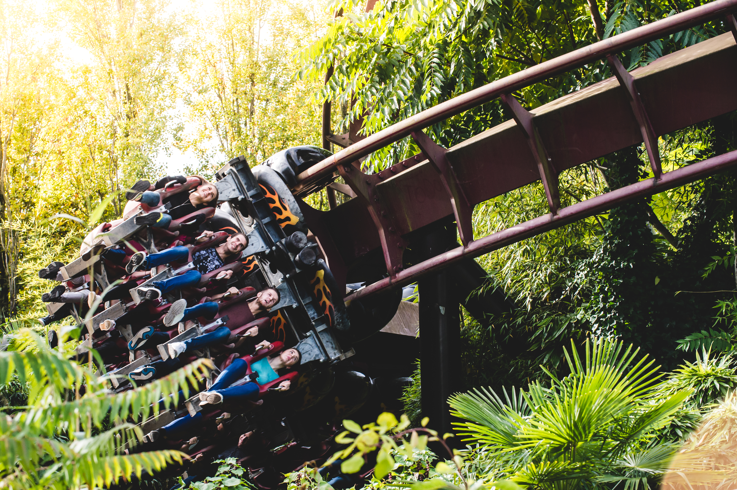
Thank you and goodbye!
Notes:
Slide to be shown as students/teachers leave

