Slide 1
Section Drawings
How to draw a section drawing

Slide 2
Section Drawings
A section drawing is a type of 2D drawing.
It shows the parts or features inside a product, as if it has been cut in half (normally along its length).
Section drawings are used to show how the parts in a product fit together.
It can also show features inside the product that cannot be seen from the outside.
We are going to create a section drawing of a helmet worn by a cyclist
Notes:
Section drawing shown is of a pen.
The analogy could also be used that a section drawing allows us to see inside the item like an ‘x-ray’, seeing things that are not visible from the outside.

Slide 3
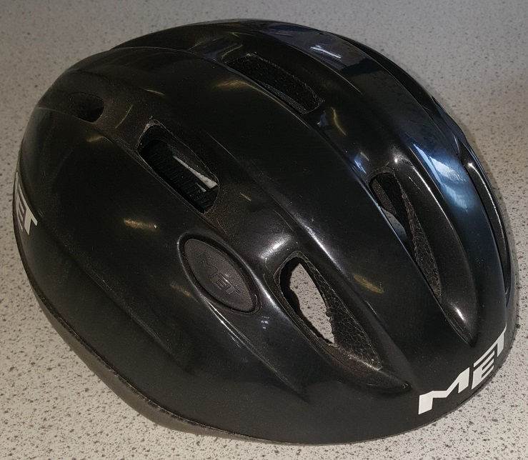
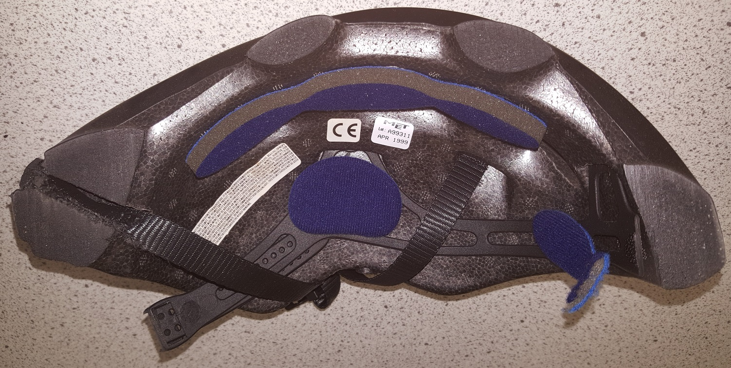
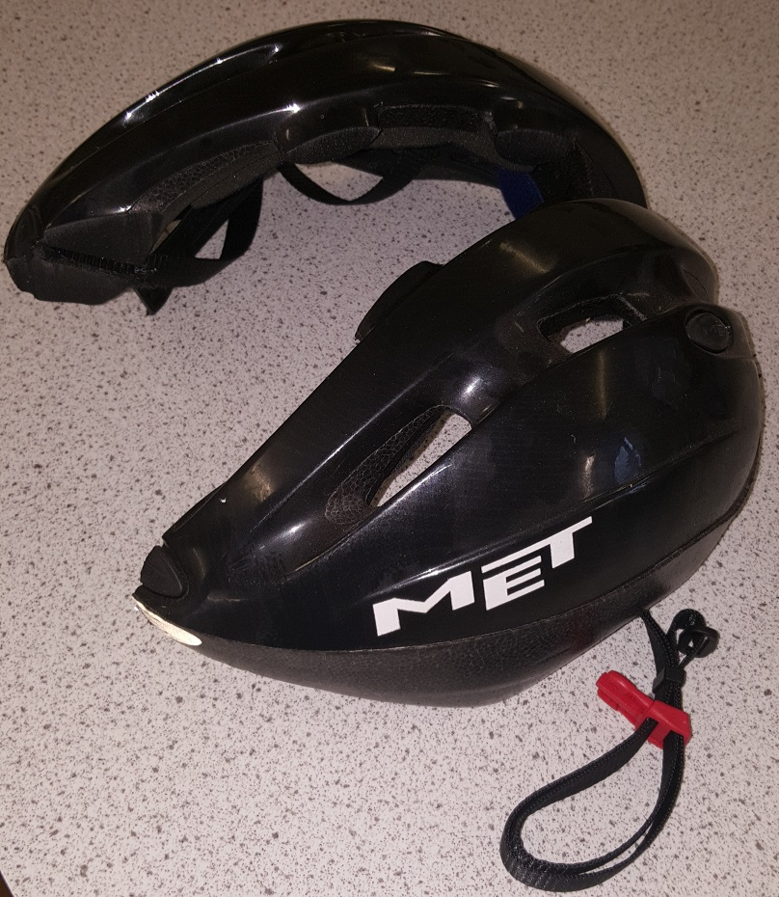
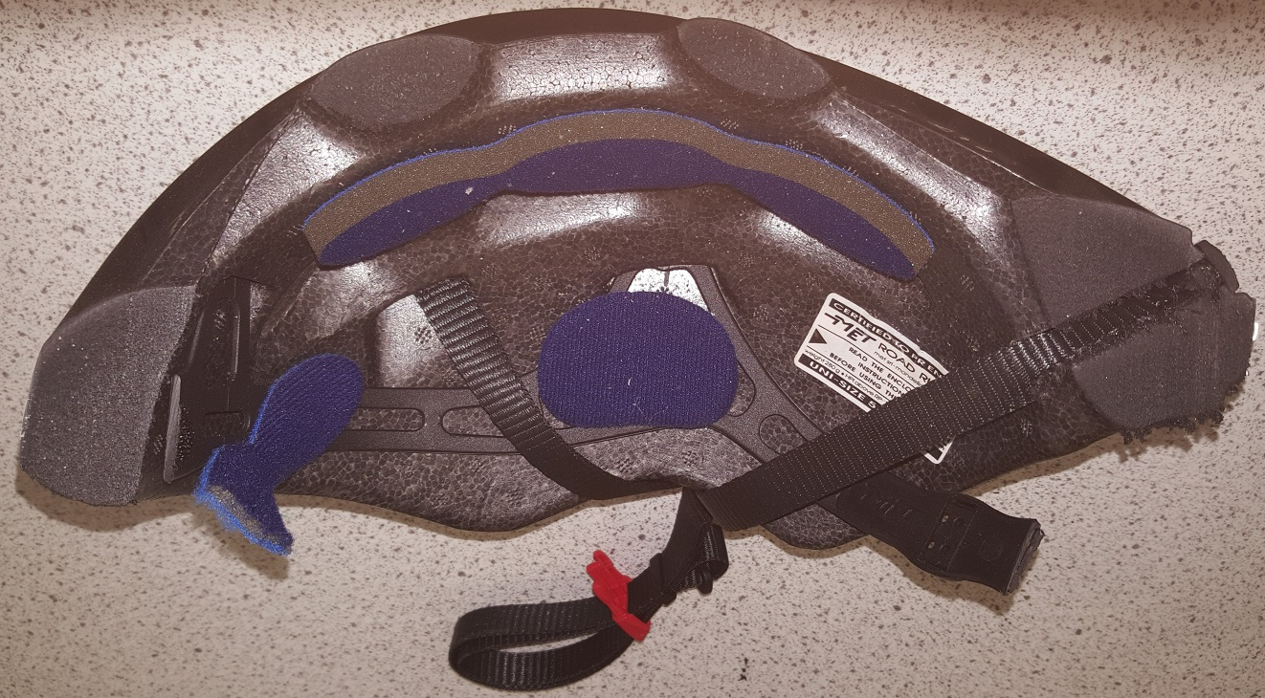
What would a section drawing of this helmet
look like if it was a photograph?
Notes:
This shows a cyclist helmet that was cut in half using a bandsaw.

Slide 4
Drawing a Helmet - Start
Polystyrene
Draw the outline.
2) Add what the polystyrene layer looks like at the section.
Notes:
The helmet in this example uses a thick layer of polystyrene foam to act as cushioning in the even of impact. This is a fairly hard but lightweight plastic. White polystyrene foam is often used as rigid packaging, especially for electrical products.
For guidance, imagine that a ‘potato-type print’ is made with the object: the drawing at this stage would be the outlines of the printed parts.

Slide 5
Drawing a Helmet – Adding Detail
4) Add any features attached to the helmet, such as the chin strap.
3) Add any other details or features that are part of the helmet

Slide 6
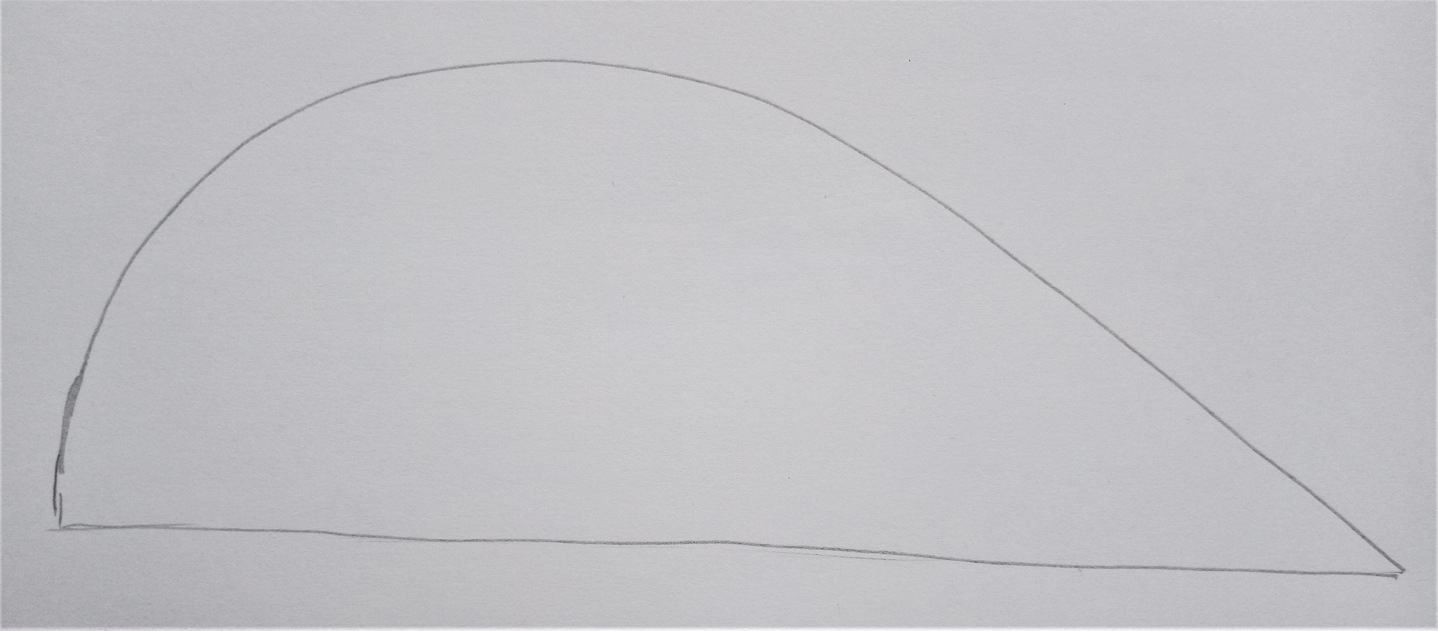
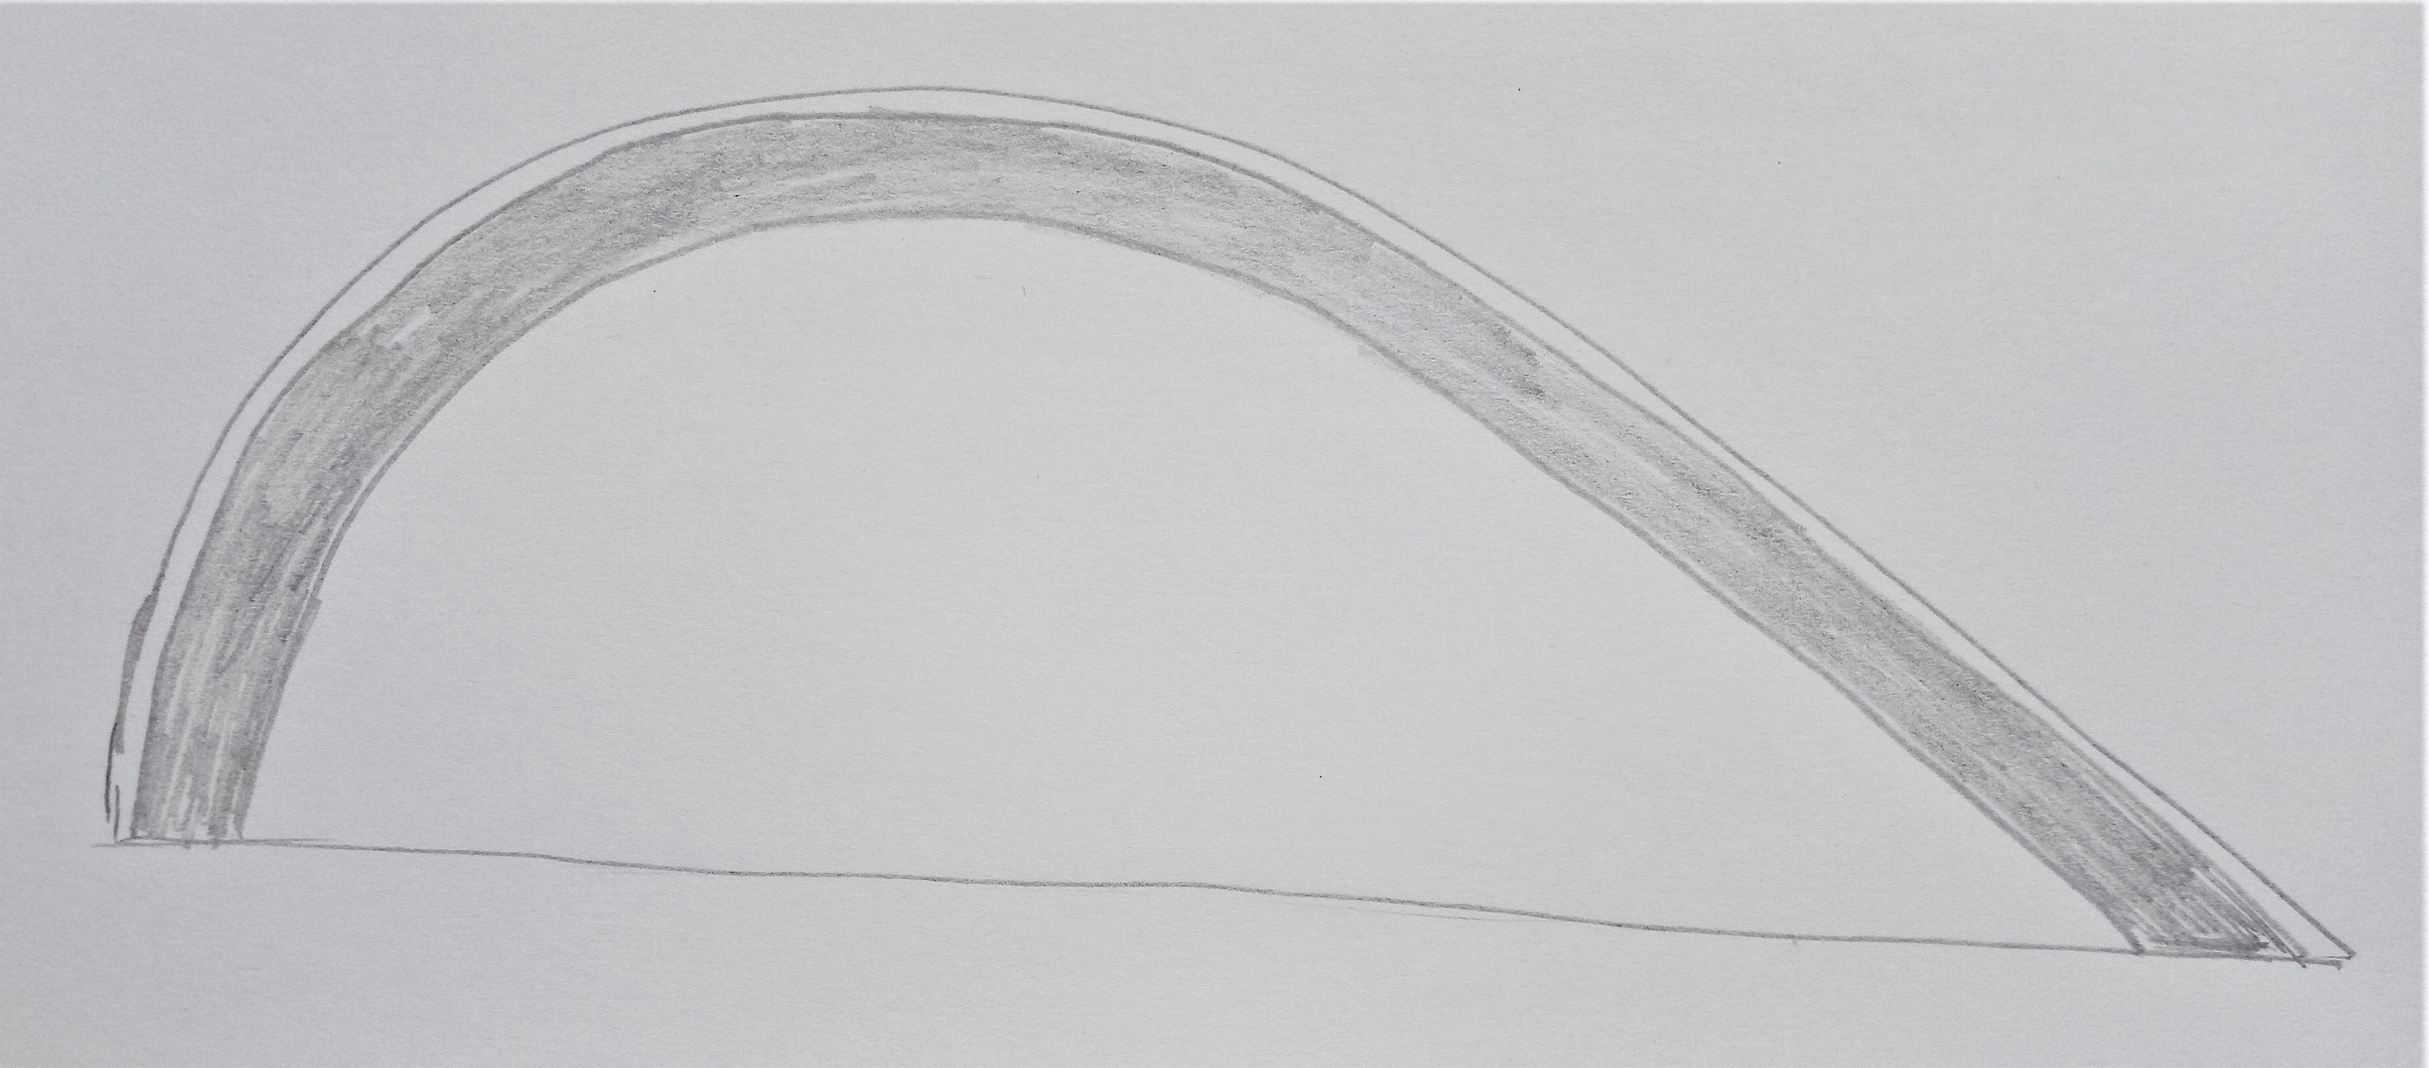
Example of a Learner’s Drawing
The drawing used in these examples was by a Year 5 called Bilal.
The outline…
2) … with the polystyrene layer added.
Case
Notes:
This drawing was produced by Bilal, aged 9, and is used with permission.

Slide 7
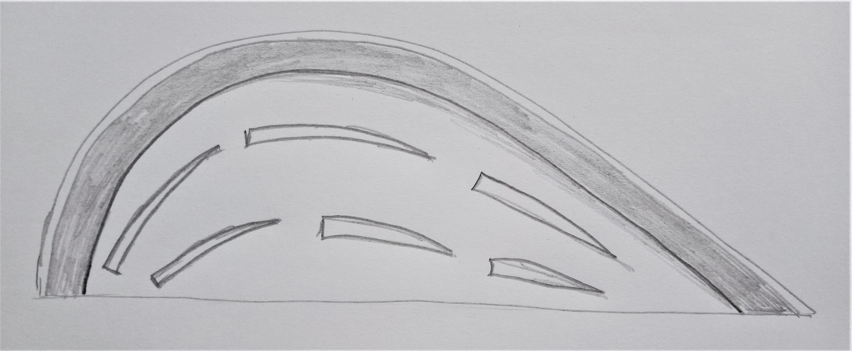
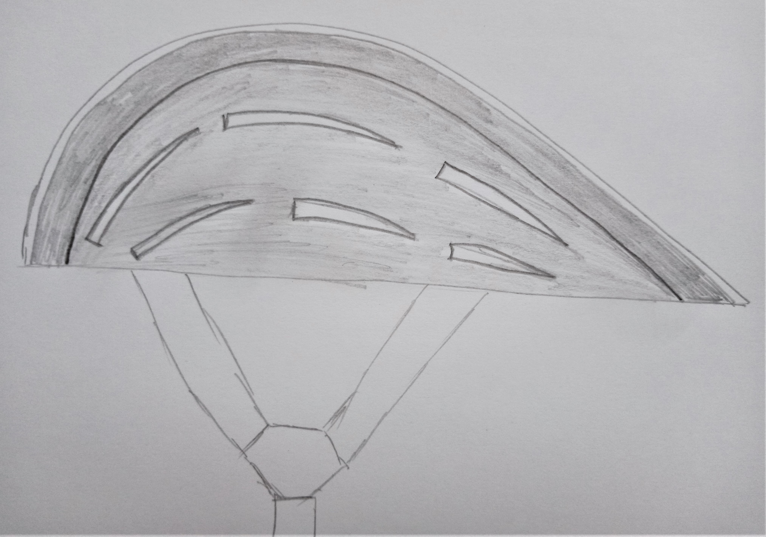
Example of a Learner’s Drawing
3) … with added detail …
4) … finished by adding the chin strap.
Case
Notes:
This drawing was produced by Ben, aged 9, and is used with permission.

Slide 8
Drawing a Pen - Start
Draw the outline of the casing.
Add the thickness of the casing.
Notes:
The ‘Drawing a pen’ activity could be carried out in conjunction with the IET Faraday ‘Exploded view’ activity, which involves drawing an exploded view of a pen.

Slide 9
Drawing a Pen - Start
Add the parts going along the centre, inside the pen.
Add the remaining parts.

Slide 10
Notes:
The image is the IET Primary poster ‘Section drawings’, available for free download from the IET Faraday primary website

