Slide 1
Mechanisms- Levers and linkages
To be aware of how they are used in Design and technology.
50% of your final examination grade.
Complete all tasks

Slide 2
What is a mechanism?
A mechanism is a system of parts working together in a machine.
What do they do?
They make jobs easier to do, change the direction, motion or speed.
How do they work?
They work in the same way as an electrical system
Input
Process
Output
The mechanical parts, react to the input and start moving.
e.g. the pedals turns the gears which turns the wheels
The input starts the system
e.g. pedaling a bike
The change in direction, motion or speed.
e.g. the bike starts moving

Slide 3
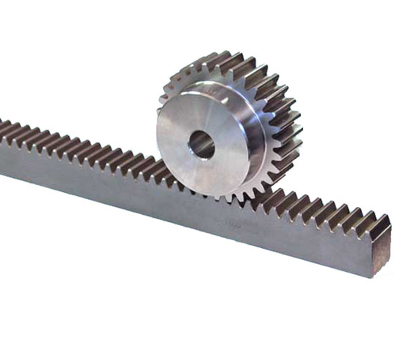
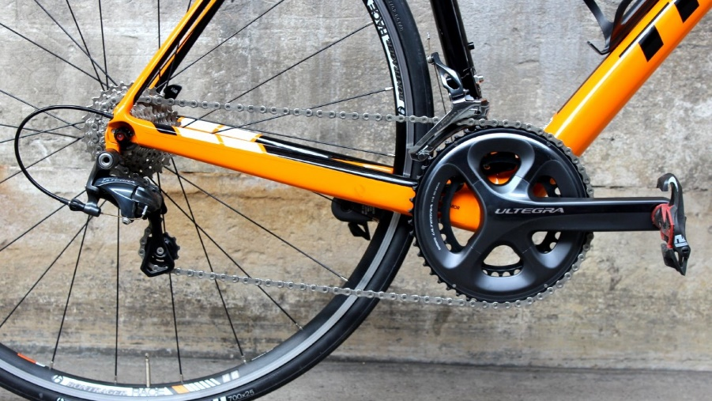
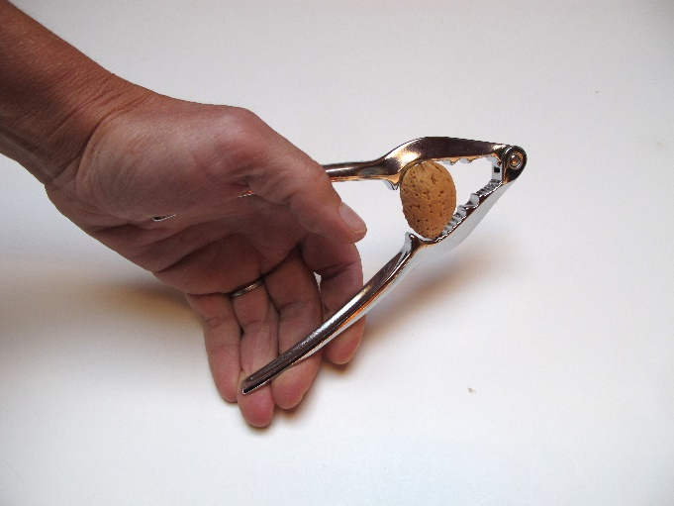
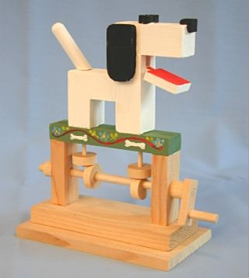
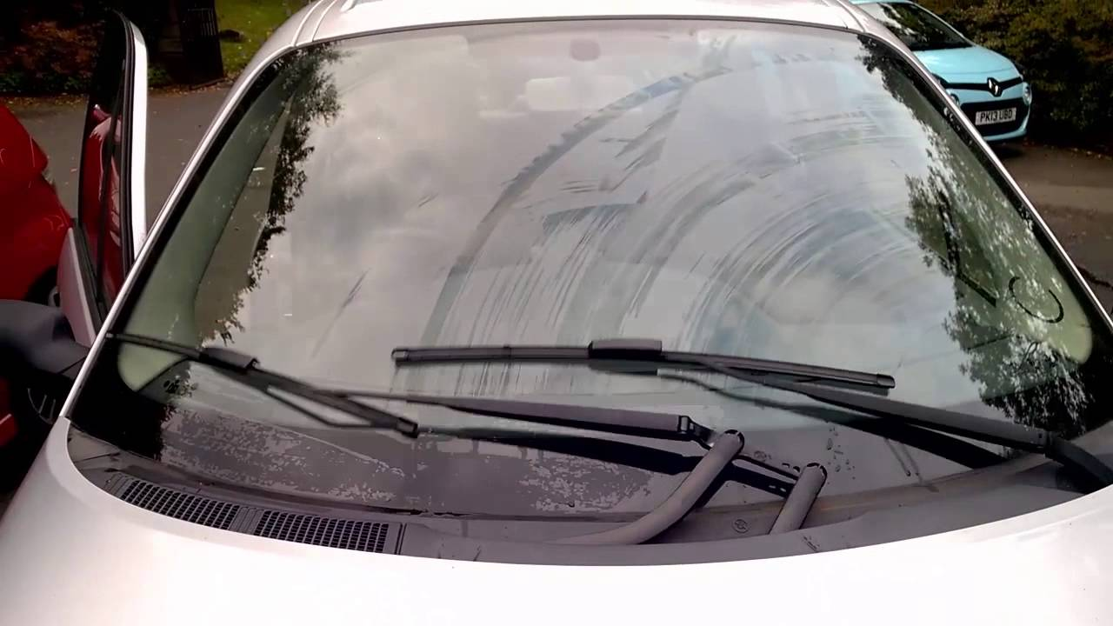
Different types of mechanisms
Can you name any types of mechanisms?
Rack and pinion mechanism
Pulley mechanism
Gear mechanism
Lever mechanism
Linkages mechanism
Cam mechanism

Slide 4
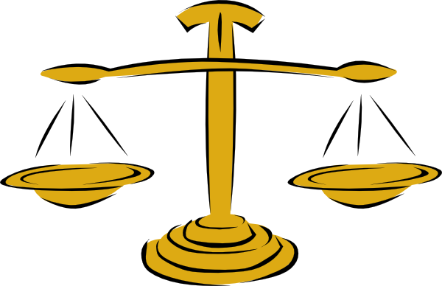
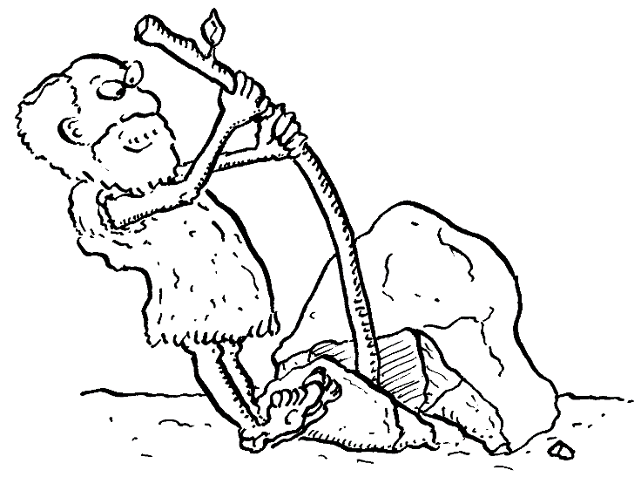
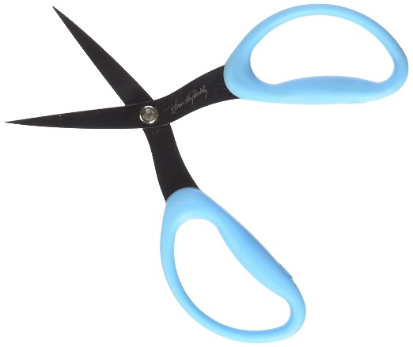
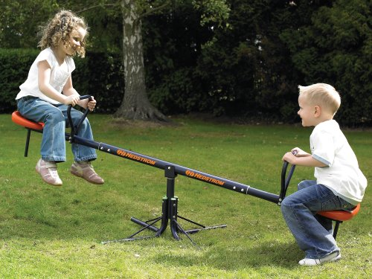
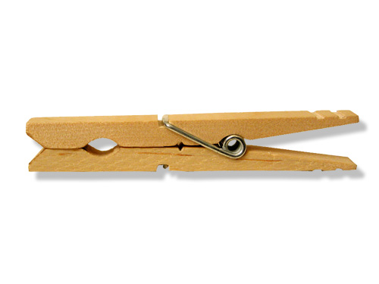
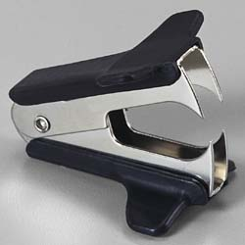
Levers
A lever is the simplest kind of mechanism, it consists of a ridged bar that pivots at a fixed point.
There are three different types of lever, usually called classes.
The class of a lever depends on the position of the load, effort and fulcrum:
Common use of a lever is to lift a heavy load.
Notes:
allows us to move things more easily by magnifying our effort.
Put your hands either side of your face.
Move your Jaw up and down. – Your Jaw is a Lever!
Our Body has many Lever mechanisms!
Arm , Neck , Jaw , Legs

Slide 5
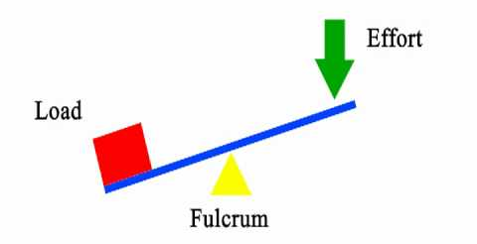
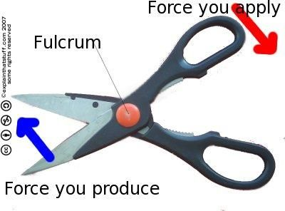
What is the load, fulcrum and effort?
The effort is the point where force is added. Usually it's where someone will push or pull on the lever.
The load is the object you are trying to move or effect.
The fulcrum is the point that doesn't move from it's spot.

Slide 6
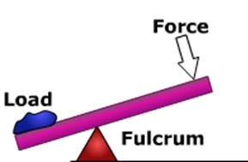
Class 1
A class 1 lever has the load and the effort on opposite sides of the fulcrum, like a seesaw

Slide 7
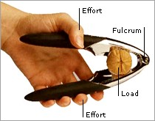
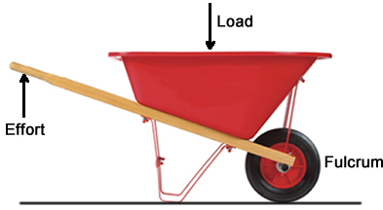
Class 2
A Class 2 lever has the load between the effort and the fulcrum

Slide 8
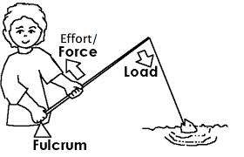
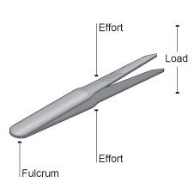
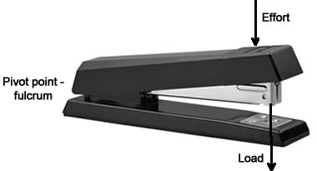
Levers
Class 3
A class 3 lever has the effort in- between the load and the fulcrum.
Notes:
Hinged door golf club
A class 4 lever has the ----------is
in between the load and the fulcrum.

Slide 9
How to remember?
F | 1 | When the fulcrum is in the middle it is a class 1 lever
L | 2 | When the load is in the middle it’s a class 2 lever
E | 3 | When the effort is in the middle it is a class 3 lever.

Slide 10
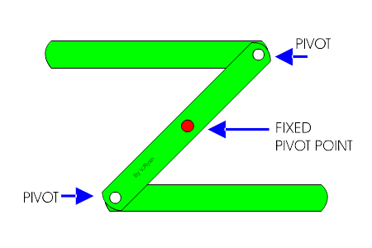
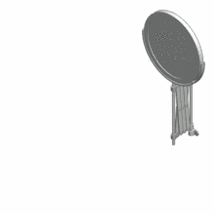
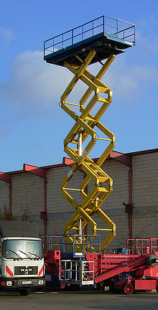
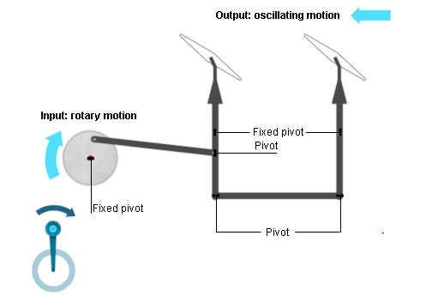
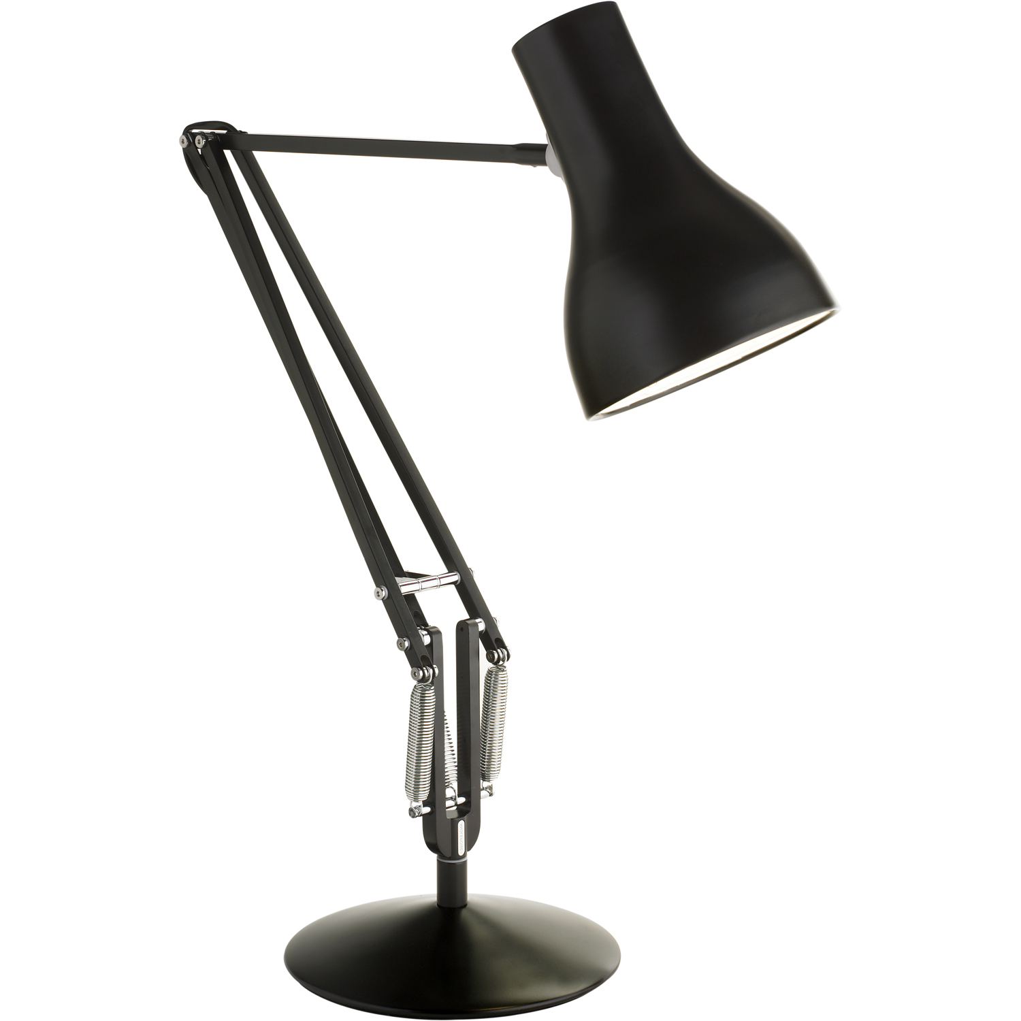
Linkages
Linkages are used to
Create a change in direction
Change the type of motion
A linkage is a mechanism made by connecting together levers.
What do you think would happen to the motion if the fixed point was not central?
Mechanical lift
As the top rod moves to the left the bottom rod moves to the right. The bars move in opposite directions.
https://www.youtube.com/watch?v=D_KIOr_TpcM
Notes:
A linkage consists of a system of rods or
other rigid materials connected by joints or pivots.
See how the central rod moves around a central fixed pivot. By pulling (or pushing) the linkage in one direction, it creates an exact opposite motion in the other direction. If the fixed pivot was not central, it would create a larger or smaller motion in the opposite direction.
A treadle linkage shows how linkages can be used to change one type of motion into another. (window screen wipers)

Slide 11
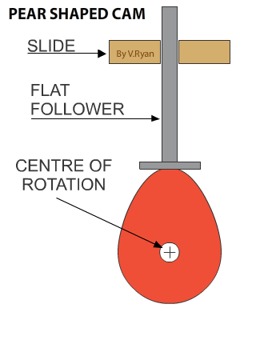
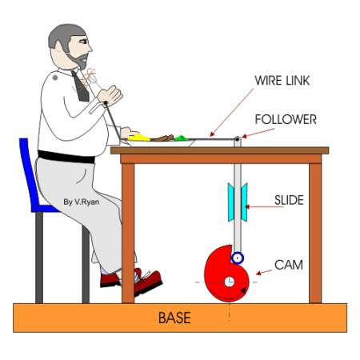
Cams are used to turn rotary motion into linear motion.
A cam is a shaped piece of metal or plastic fixed to a rotating shaft. When the cam rotates, the follower rises.
CAMS
Notes:
Follower rests on the cam- allowing it to move freely.
The follower is free to move up and down, but is prevented from moving from side to side by a slide or guide, so the follower can only do three things:

Slide 12
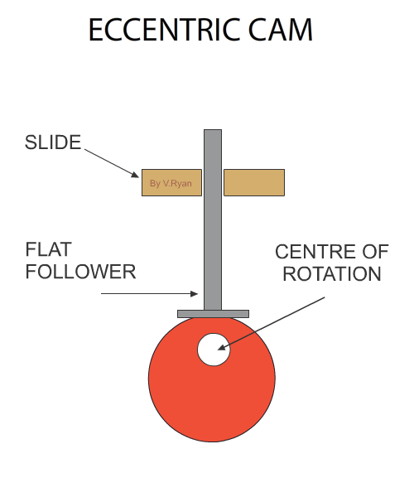
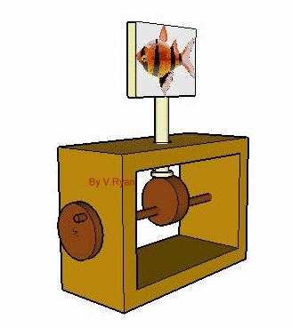
An eccentric cam is a disc with its centre of rotation positioned ‘off centre’.
The movement is smooth and at a constant speed.
What difference do you think a bigger cam will make to the speed?
Notes:
The bigger the cam- follower will move slower, small cam, follower will move faster.

Slide 13
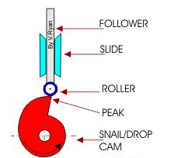
Parts of a cam mechanism.

Slide 14
Rise (move up)
Fall (move down) or
Dwell (remain stationary)

Slide 15
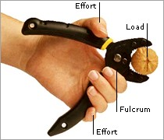
Questions
What are the 3 parts of a lever called?
What is a class one lever?
What is a class two lever?
What is a class 3 lever?
3RD CLASS
1ST CLASS
2ND CLASS

Slide 16
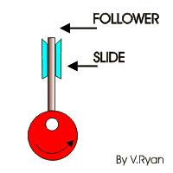
What happens if the fixed point it not central?
What is this “off centre” cam called?
How could you change the speed of the follower?
REVERSE MOTION LINKAGE
Make the cam bigger- slower speed
Make the cam smaller- faster speed.
It would create a larger or smaller motion in the opposite direction.

