Slide 1
What are you doing?
Learn about the developments in smart materials
Where does it fit in?
You will be tested on this topic.
Why are you learning this?
Smart materials are changing the future possibilities of D&T.
Believe Approach the task positively | Achieve Learn as many new things as you can! | Succeed Take quality notes and focus on the task. | Enjoy Have fun, but work Safely | Support Work independently and support each other
Notes:
Imagine not having to check the weather before you get dressed, because your clothes will adjust themselves to regulate your body temperature. Imagine your kids being able to change the color of their bedroom walls by pressing a button.

Slide 2
Starting independently without the need for assistance/help
React to something
Smart materials
SMART materials are materials that respond automatically to their changing environment.
Surrounding conditions (i.e. light/dark/warm/cold)
This change is reversible and can be repeated many times.
Notes:
THERMOCHROMIC INKS-forehead thermometer

Slide 3
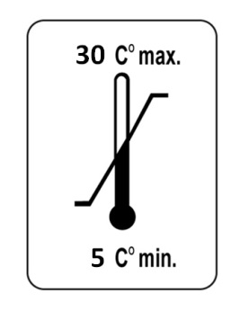
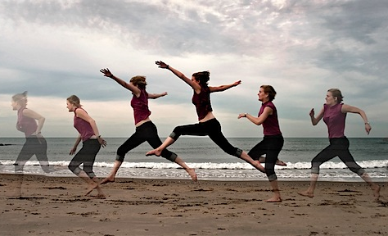
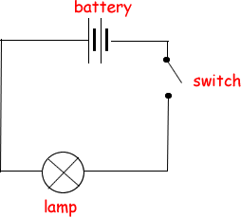
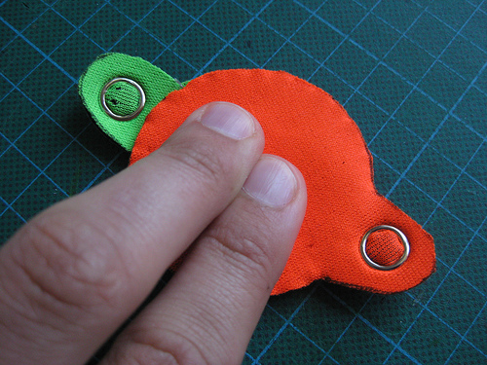
Some examples of a possible change in their surrounding/environment are???
Light
Electrical current
Temperature
Pressure
Motion

Slide 4
Fill (summarise info!) the mini mind maps
as we go along.

Slide 6
https://www.youtube.com/watch?v=3_9duPm-rzc

Slide 7
https://www.youtube.com/watch?v=uORArjZll5A
Notes:
SMA more recently used in aircraft wings- as they can change to the best shape needed at different temperatures whilst in flight.

Slide 8
https://www.youtube.com/watch?v=IhVuc6RNyaw
Notes:
It can be heated with hot water or a hairdryer and moulded by hand to create prototypes and solve manufacturing problems.
Stretch Activity Make a series of polymorph models to develop an ergonomic pen that is really comfortable to hold and use. You can mould the polymorph around an existing pen as a starting poin

Slide 9
https://www.youtube.com/watch?v=eZTfgNIiNUA
Notes:
In recent times, biometrics based on brain and heart signals have emerged. Scientists researching biometrics have found that people have certain distinct brain and heart patterns that are specific for each individual. The advantage of such 'futuristic' technology is that it is more fraud resistant compared to conventional biometrics like fingerprints.
It’s estimated that over 2 million cars in the UK use biometric technology in one form or another. This can be anything from voice recognition when using Bluetooth or entertainment systems to unlocking the vehicle itself.
Measure and analysing a persons unique characteristics

Slide 12
http://www.babyglow.uk.com/
Notes:
Thermochromics dyes: Smart textiles: Heat Reactive Jacket by Stone Island, a tracksuit top which changes colour from black to green/ blue once it has reached 27 degrees.
Coors Light uses thermochromic ink on its cans now, changing from white to blue to indicate the can is cold

Slide 13
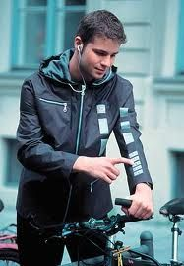
Interactive textiles
Take notes in theory books.
Electronics used in Smart materials
(Known as E- textiles)
An interactive fabric incorporates electronics that are activated by a power source. They are still smart fabrics, they just require a power source.
Bio-man
Medical devise worn by the patient that reads their blood pressure or monitors the heart rate, the information can be sent to the patient’s doctor.
Global Positioning Systems (GPS) incorporated into walking shoes which allow the user to be tracked by mountain rescues services
Mobile phones, music players
Integrated into fabric.
Notes:
Interactive textiles contain either Conductive
fibres or conductive printing inks.
• Conductive printing inks are used to print a
pattern onto fabric which can be used to
trigger electronics, such as a control panel
on ski jacket.
smart textiles and (wearable) technology go hand-in-hand,
Global Positioning Systems (GPS) incorporated into walking shoes which allow the user to be tracked by mountain rescues services. Or in Ski jackets to help locate the wearer in the event of an avalanche. They can also used to monitor the whereabouts of young children.

Slide 14
What have you learnt?
Use your coloured paper at the back of your planner/or write the correct number on a whiteboard for the correct answer.
1
2
3
Ready….set….GO!

Slide 15
S&C
Can you name a possible change in the environment?
Smart materials are..........
1
2
3
SMART materials are new materials that are very
technical.
SMART materials are materials that respond automatically to their changing environment.
SMART materials are very absorbent materials

Slide 16
S&C
What does it do?
QTC stands for………………….
1
2
3
QTC (Quantum Tunnelling composite)
QTC (Quality, tunnelling composite
QTC (Quantum, Tensile composite)

Slide 17
S&C
What can SMA be used for?
SMA (Shape memory alloys) is special because
1
2
3
It is a very tough material that can
withstand a lot
of pressure..
When bent out of shape, can be heated above a certain temperature it will return to its original shape.
When bent out of shape it can be twisted to return to its original shape.

Slide 18
S&C
What is an advantage of using polymorph?
Polymorph is small pellets which fuse together when heated to what?
1
2
3
72˚C.
62˚C.
82˚C.

Slide 19
S&C
Can you name one?
Biometrics identifies an individual from a ……………..
1
2
3
Physical characteristic
Individual account number
A high sensitive password

Slide 20
S&C
Can you name a substance they are filled with?
What is the smart material called that is filled with tiny microscopic bubbles?
1
2
3
Microplastic
Microbubble
Microencapsulation

Slide 21
S&C
Name a product that would use this
Photochromic dyes change colour in response to…………….
1
2
3
UV/Sunlight
Electronic charge
Temperature

Slide 22
S&C
Name a product that would use this
Thermochromic dyes change colour in response to…………….
1
2
3
Hot water
Temperature
Heat

Slide 23
Can you give an example of use?
Interactive textiles are…………………
1
2
3
An interactive fabric incorporates electronics that are activated by a power source.
An interactive fabric
that responds to the
wearer by changing.
An interactive fabric that communicates with the wearer

