Slide 1
Learning from last lesson review
What does LCA stand for?
What is a LCA?
What are the 5 stages of a LCA?

Slide 2
What are you doing?
Learn about sustainability and the 6R’s
Where does it fit in?
You will be tested on this topic.
Why are you learning this?
.
It is important to consider ways to reduce the environmental impact of products.
Believe Approach the task positively | Achieve Learn as many new things as you can! | Succeed Take quality notes and focus on the task. | Enjoy Have fun, but work Safely | Support Work independently and support each other

Slide 3
The 6R’s are an important checklist. They are used by designers to reduce the environmental impact of products.

Slide 4
PAIR

Slide 5
6R’s
What does each 6R mean?
Match the R to the definition

Slide 6
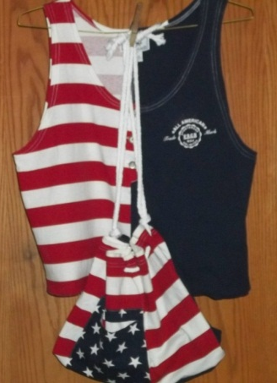
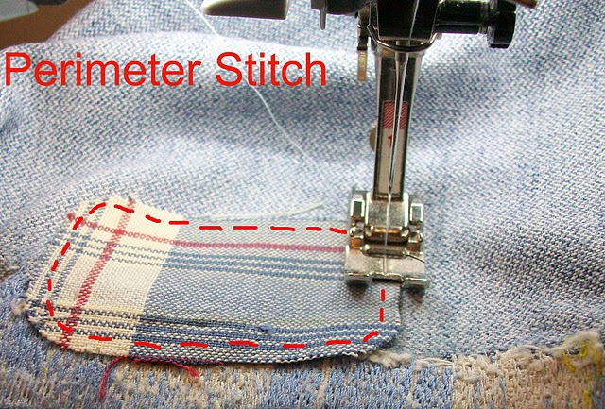
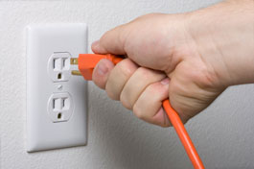
Re-cycle | Re-use
Re-think | Re-pair
Re-duce | Re-fuse
Re-processed
Cleaned
Purified
Use same thing over again (margarine tub to grow seeds)
Do we make too many products? Can we change the way they are made?
When a product rips or breaks- try to fix it.
Cut down on amount of energy/material used.
Do not use or buy products you do not need or are bad for environment
Notes:
Re-cycle- Re process (cleaned, purified, then comes back in original form

Slide 7
What is sustainable design?
Copy definition in theory books.
To create products and services that are not harmful to the environment or use up the planets natural resources, therefore protecting our planet for future generations.
Around your table, create a spider diagram with the heading “Sustainable design” in the middle.
List as many ways as you can think of, how a designer can create a sustainable product. (consider all the LCA of a product (Materials, production, distribution, use and disposal)

Slide 8
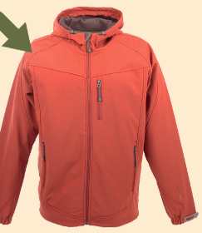
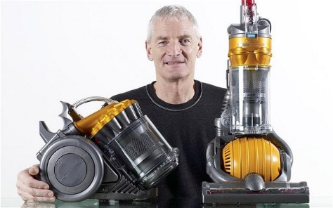
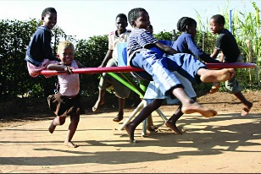
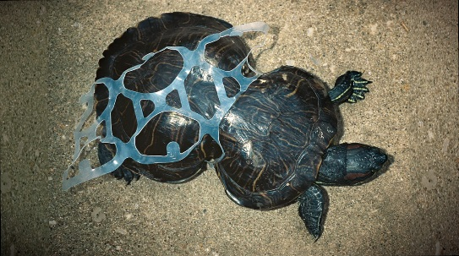
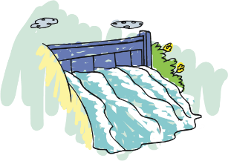
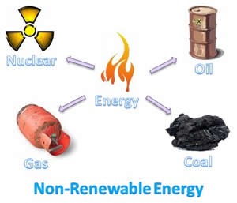
What is sustainable design?
Copy up your groups spider diagram into your book- add any from this slide you have not got.
To create products and services that are not harmful to the environment or use up the planets natural resources, therefore protecting our planet for future generations.
Design products that are easy to repair
Use recycled materials
Sustainable design
Use biodegradable materials
Don’t make products out of non renewable materials.
Run on alternative, renewable energy sources such as the sun, wind, water or human energy.
Design and make products that are built to last
Notes:
Today we get most of our energy from non-renewable sources. These include the fossil fuels— oil, natural gas, and coal. Fossil fuels were formed from the remains of dead plants and animals by heat from the Earth's core and pressure from rock and soil applied over millions of years.
The water in rivers can be used for energy. This is called hydropower.
These six-pack rings are 100 percent biodegradable and edible—constructed of barley and wheat ribbons from the brewing process, this packaging can actually be safely eaten by animals that may come into contact with it.
amazing project from South Africa. As children play on the roundabout, their energy causes water to be pumped from the underground into a tank. The tank is connected to a tap for easy access of the water.

Slide 9
There are some examples of sustainable design around the classroom. Have a look at them all. Pick your favourite one and be ready to give a reason why.

Slide 10
Question time
Can you remember the stages of LCA?
Name the 6R’s
Describe one of the 6R’s
Explain how a designer can make a product more sustainable.
What does sustainable design mean?

