Slide 1
Disease detectives: violet bramble rust
All photographs copyright Malcolm Storey, www.bioimages.org.uk
used with kind permission of the copyright holder.

Slide 2
Disease detectives: violet bramble rust
Bramble (blackberry) bushes can be infected by a disease called violet bramble rust
The disease is caused by a fungus
Infected bramble plants develop violet or brown spots on their leaves

Slide 3
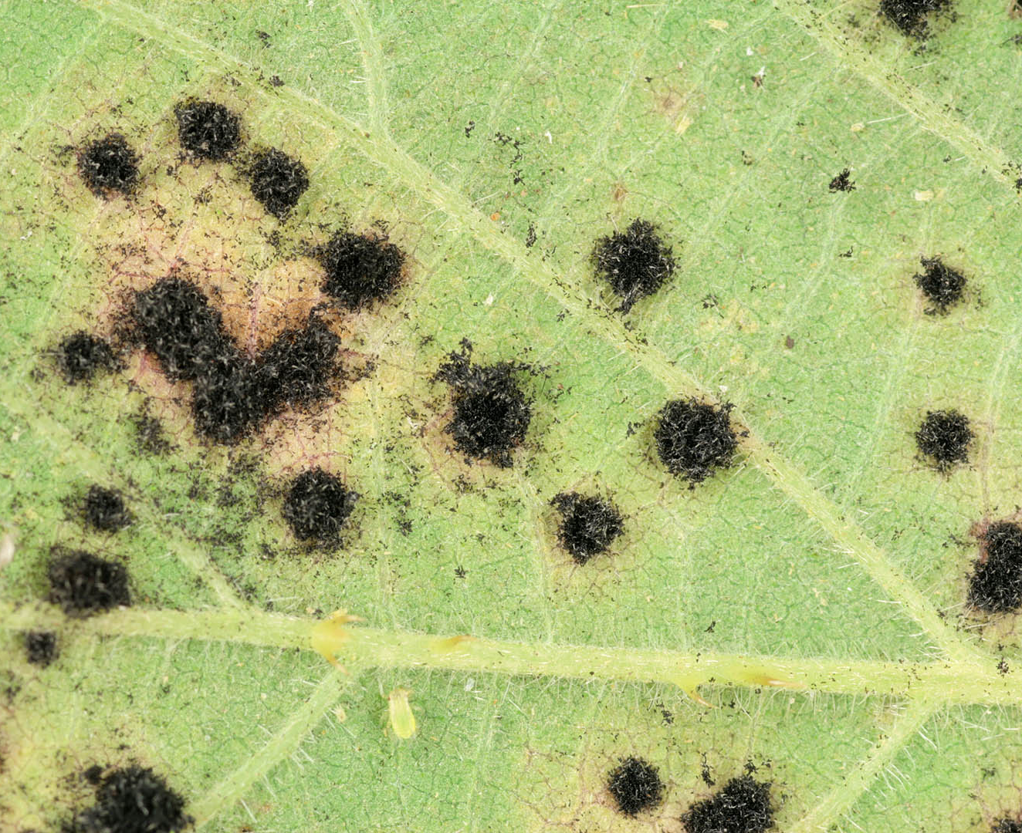
The fungus produces two different types of spores on the underside of the leaves
orange-coloured spores
(usually seen in summer)
black-coloured spores
(usually seen in winter)

Slide 4
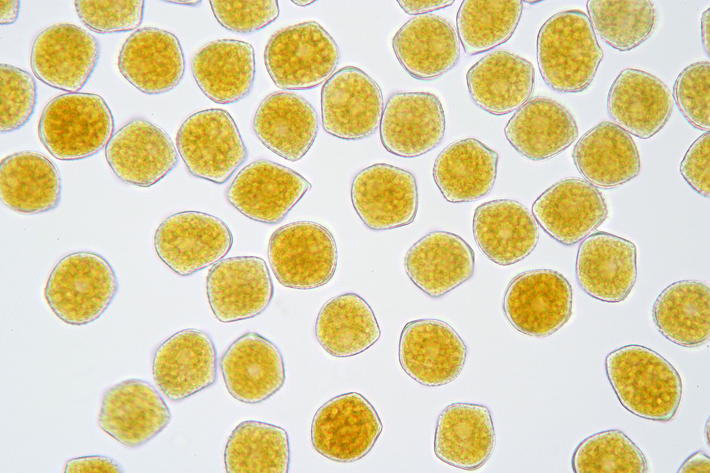
When viewed using a light microscope, the orange-coloured spores appear roughly spherical, orange and grainy

Slide 5
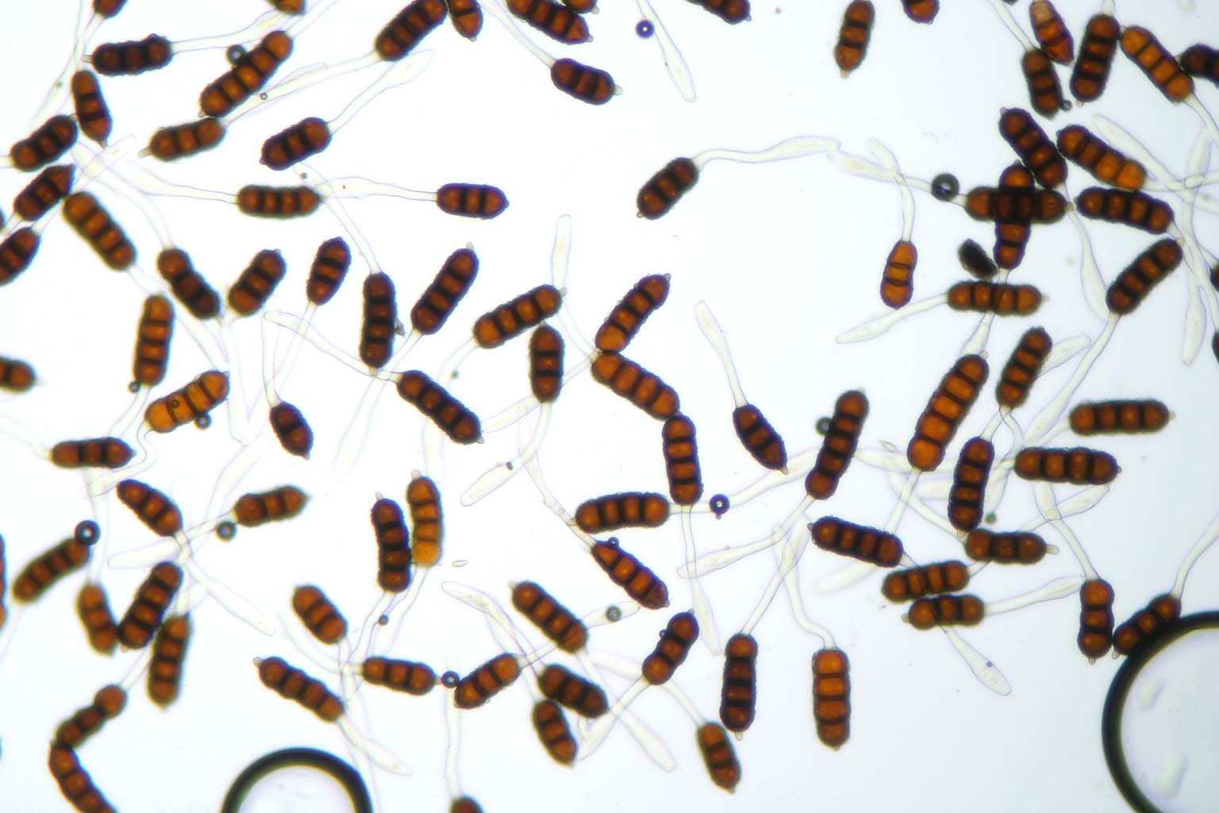
When viewed using a light microscope, the black-coloured spores appear to be short multicellular chains with a transparent “tail”

