Slide 1




Code Smart
Computing I Ages 7-11
Lesson 7
Designing our smart city pt. 1

Slide 2
§
Designing our smart city pt. 1
Lesson 7
Main Enquiry
How can we use code and robotics to design our smart city?
Learning Outcomes
01
02
03
Understand that design is a process
Name at least one job associated with design
Understand that issues affect people in different ways
04
05
06
Empathise with different people and describe how they might see the world
Think creatively to generate solutions to problems
Share and evaluate ideas

Slide 3
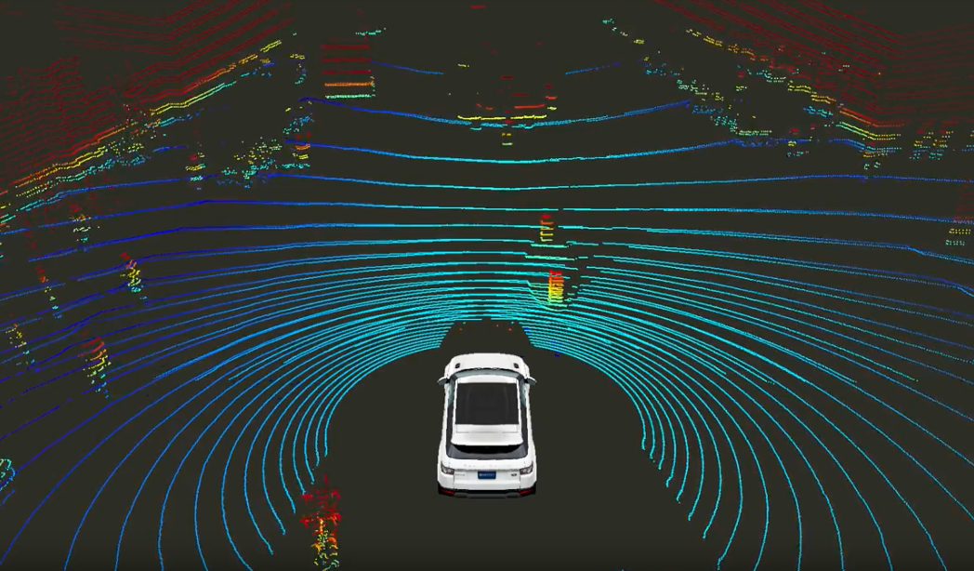
§
Designing our smart city pt. 1
Lesson 7
Introduction to design thinking
Challenge: use design to solve the problems of citizens living in a city of the future
Design thinking

Slide 4

Designing our smart city pt. 1
Lesson 7
How do
you know where you are?
What is the purpose of design?
How can we design a transport project using robot vehicles that will benefit different people?
Do we all experience our world in the same way?

Slide 5
§
Designing our smart city pt. 1
Lesson 7
Think carefully about how each user…
Thinks and feels
What they might say and do
What they could hear and see
What their pains and gains are

Slide 6
Designing our smart city pt. 1
Lesson 7
How do
you know where you are?
How can we make people’s lives better using our robot vehicles?
Don’t interrupt
Wild ideas are encouraged
Keep your end users in mind
Stay focused
Let everyone have a say
Work together and build on other people’s ideas
Quantity over quality
Make notes so you don’t forget great ideas

Slide 7
§
Designing our smart city pt. 1
Lesson 7
Reflect on your work
What are your best three ideas?
What was your worst idea?
What was your funniest idea?

