Slide 1
Spirit of
Innovation
STEAM
RESOURCES
Spirit of Innovation
Year Four
PowerPoint– Conductors & Insulators

Slide 2
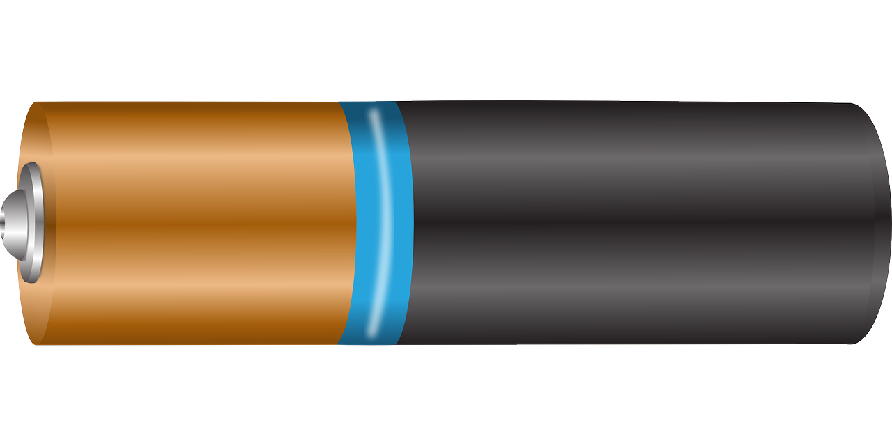
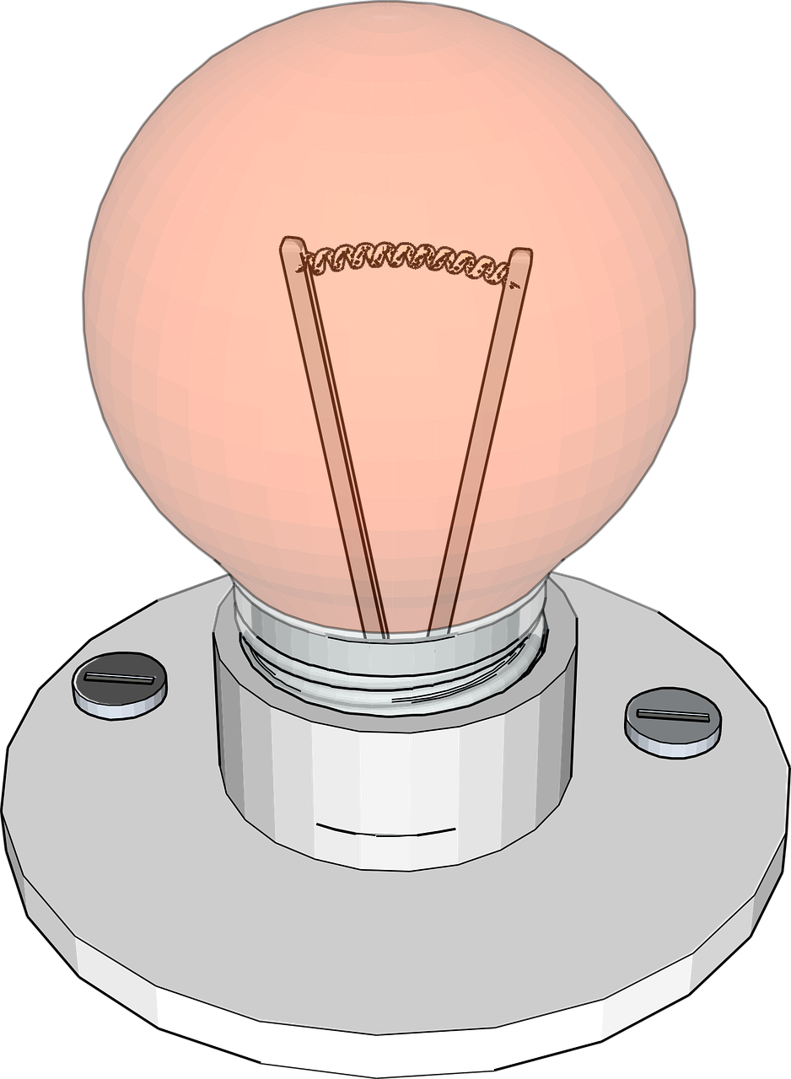
_
+
Power Cell
Which items will
conduct electricity?

Slide 3
_
+
Power Cell
A silver spoon?

Slide 4
_
+
Power Cell
A piece of string?

Slide 5
_
+
Power Cell
A copper plate steel penny?

Slide 6
_
+
Power Cell
A steel paperclip?

Slide 7
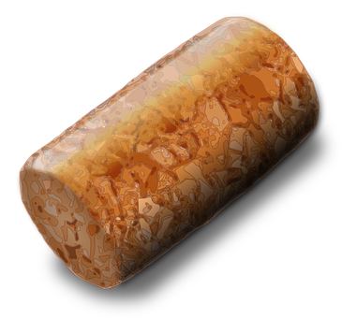
_
+
Power Cell
A cork?

Slide 8
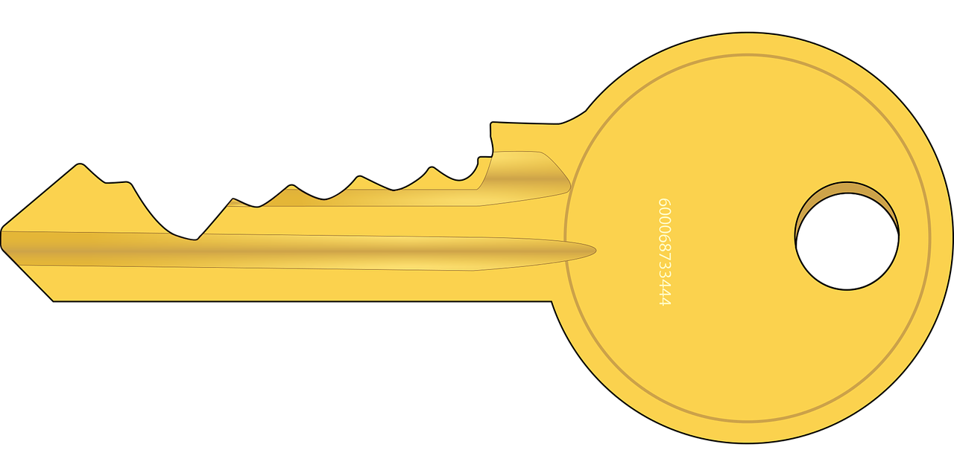
_
+
Power Cell
A brass door key?

Slide 9
_
+
Power Cell
A rubber band?

Slide 10
These resources have been brought to you by

