Slide 1
PLASTICS
CHALLENGE
A STEM and enterprise challenge to reduce the impact of waste plastic.
Notes:
Introduce the challenge
Explain to your pupils that they will be using their STEM skills to try and solve a problem linked to the impact of plastic waste around the world.

Slide 2
What do you see?
Spend a few minutes looking at the photographs of plastic waste.
In your groups discuss the following questions:
What do you see?
What questions do the photographs raise for you?
What do think might be the problems for people and the environment?
Notes:
What do you see?
To be used in conjunction with the Pupil sheet Starter Activity What do you see? The photographs from Nepal show a range of people (including children) picking through waste from ‘waste’ tip site on the outskirts of Kathmandu (the capital city of Nepal). The collectors often live in extreme poverty. Throughout the Plastics challenge pupils will find out how Practical Action’s work in Nepal is supporting waste collectors.

Slide 3
Rubbish facts… in the UK
The average household produces more than a ton of waste every year
We produce 5 million tons of plastic waste every year
We produce 5 million tons of plastic waste every year
Some plastic can take up to 500 years to decompose
Notes:
Rubbish facts…in the UK
The website http://www.wrap.org.uk/content/fast-facts-plastics has great facts about plastic waste in the UK.

Slide 4
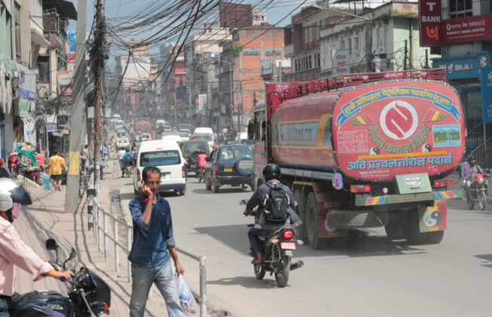
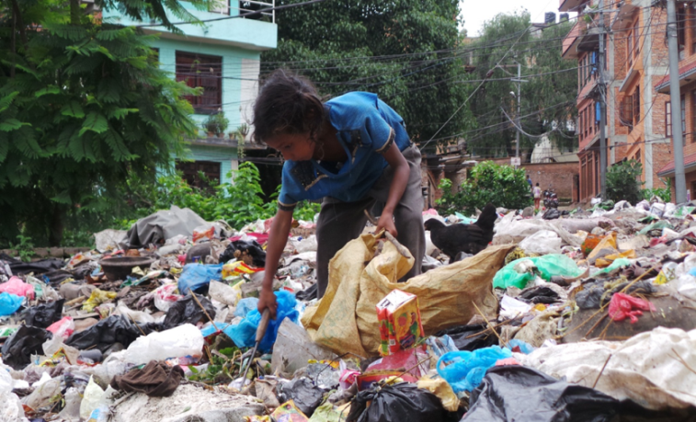
Kathmandu – Nepal
Private companies collect waste from homes but not everyone can afford to pay for the service. Those who don’t have the option of taking their waste to selected areas within the city or leaving it out on the streets.
Informal street collection and waste areas provide opportunities for up to 15,000 people (including children) to make a living from waste.
Notes:
Kathmandu - Nepal
Kathmandu is the capital city in Nepal. It has a population of 1,376,000 (in 2020) people. You might want to ask pupils if they know anything about people and the environment in Nepal.

Slide 5
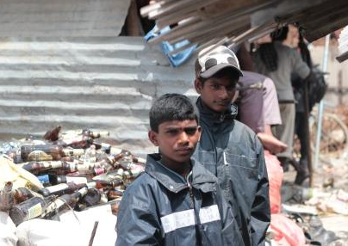
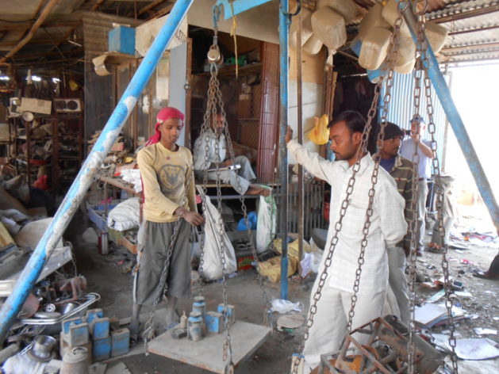
Sayeed and Sunil
Sayeed and Sunil aged 13 and 15 collect waste from the streets of Kathmandu.
They then sort the waste into different materials types, including plastics to sell on to scrap dealers. Sorting through mixed materials is a dangerous job so the boys wear protective clothing to keep themselves safe.
Notes:
Sayeed and Sunil
Sayeed and Sunil received their protective clothing from a project that Practical Action funds in Nepal. The project aims to support waste collectors and pickers to have better working conditions.

Slide 6
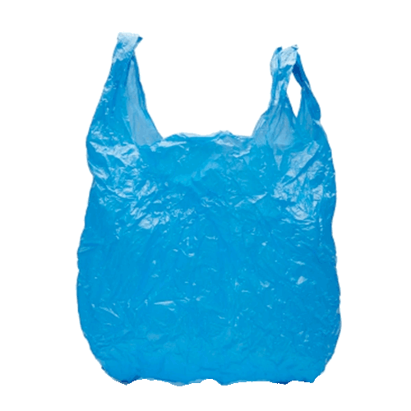
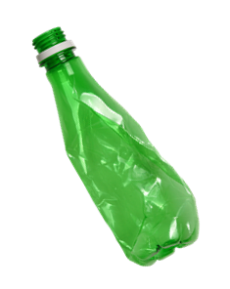
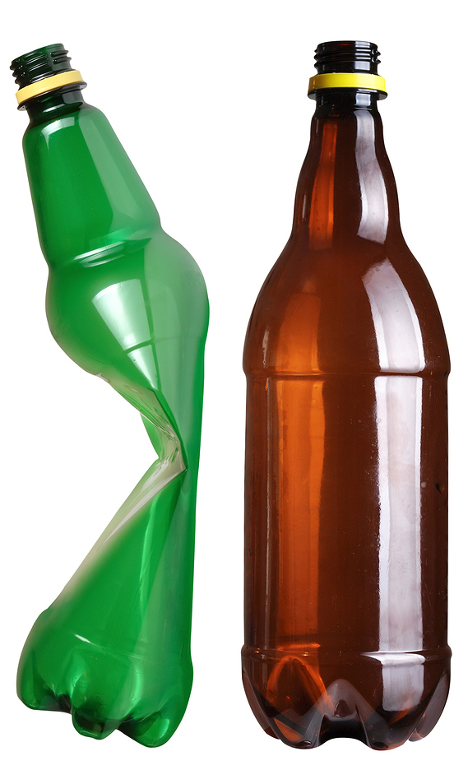
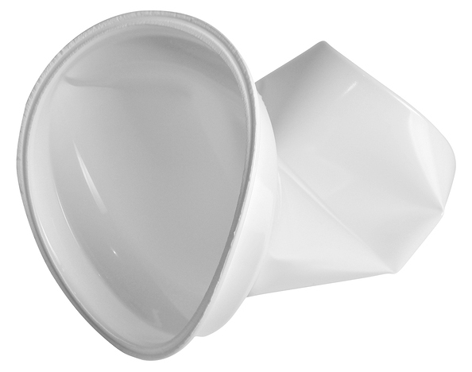
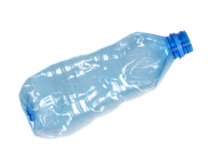
Sorting plastics
Look through your bag of waste plastics and decide as a group the best way to sort them.
Think about what might generate the most income for you if you took them to a plastic dealer for reuse or recycling
Notes:
Sorting plastics
Different plastics have different symbols which tells us the polymers they are made from and whether they can be recycled.
At recycling plants, plastics get sorted by the polymers as it gives the biggest financial return and increases the potential uses for this material after recycling.

Slide 7
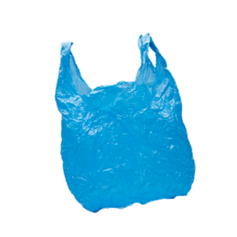
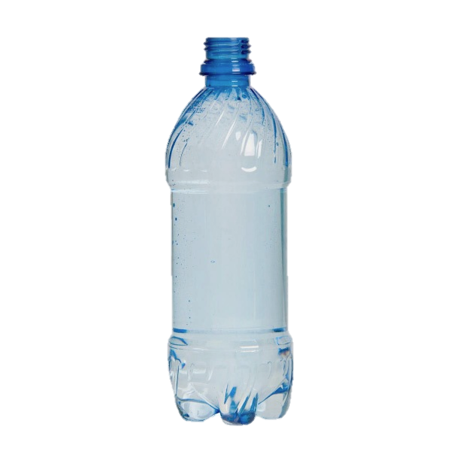
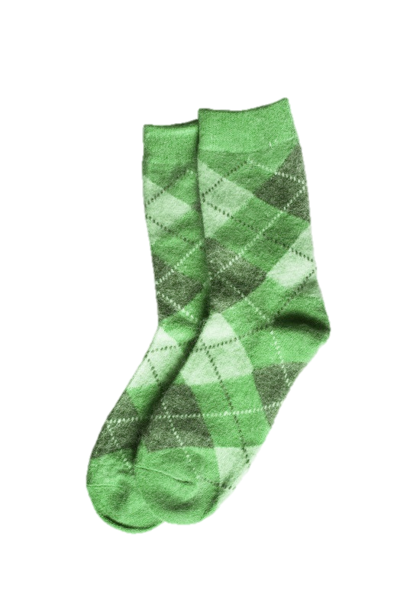
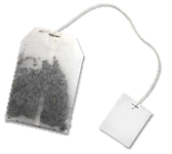
Waste timeline
You have given been eight picture cards.
Place them in a timeline on your desk, from the fastest to the slowest item to decompose.
2020
3020
Notes:
Waste timeline
For this activity you can use either the Waste timeline cards from the pupil activity sheets or the actual items. Tell the pupils that they are to assume the items have been thrown away in a household bin and therefore decompose at a landfill site.

Slide 8
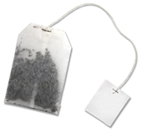
Check your timeline
Fastest to decompose
Slowest to decompose
Did you get them in the right order?
How long do you think it would take each item to decompose on a landfill site?
Notes:
Check your timeline
Check pupils understanding of the term ‘decompose’. The time items take to decompose will depend on the climate and other environmental conditions in a landfill site.
If you had time and wanted this activity to have more impact, you might choose to put some of these items under soil in the school grounds and observe their decomposition after a month, etc.

Slide 9
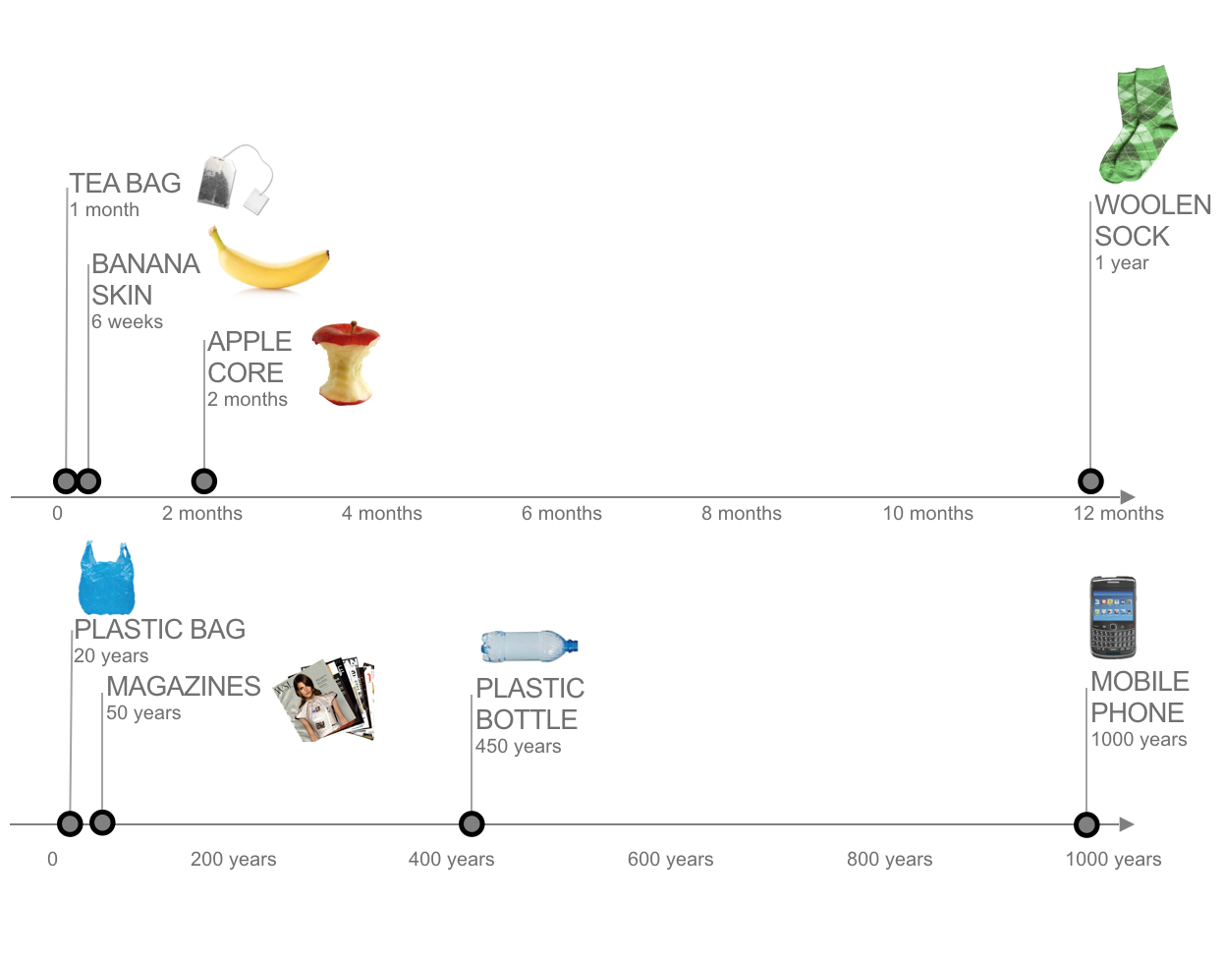
Time to decompose
Notes:
Time to decompose
There are many website which give timings for decomposition of different materials. They include https://www.down2earthmaterials.ie/2013/02/14/decompose/

Slide 10
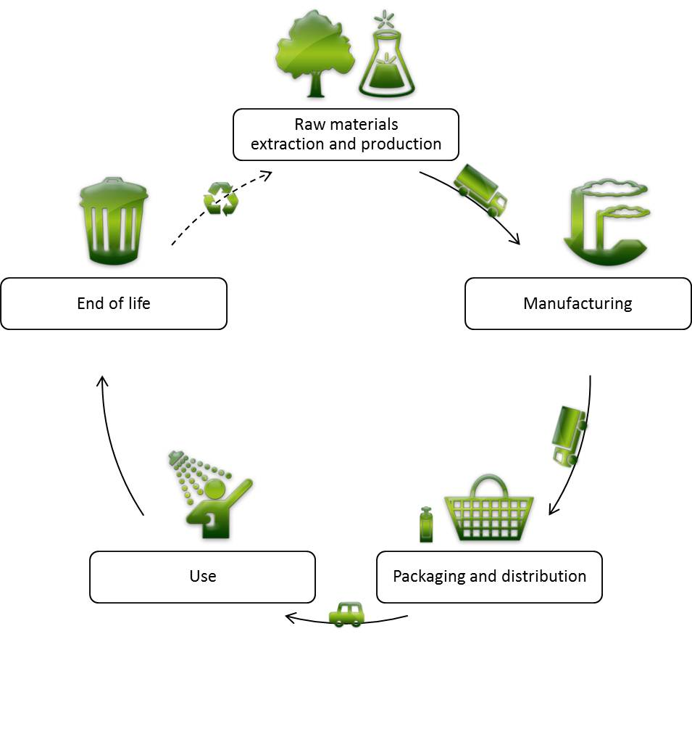
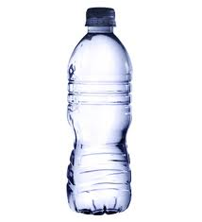
Lifecycle of plastic
A lifecycle analysis (LCA) is used to work out the environmental impact of a product throughout its whole life.
Why might a designer, engineer or scientist be interested in the LCA of a plastic bottle?
9
Notes:
Lifecycle of plastic
Pupils have the chance to carry out a LCA of a plastic bottle as a way to reduce the environmental impact of the product. They can record their activity on the pupil sheet Lifecycle analysis.
It’s possible to do a LCA on any product – so you might choose to differentiate this activity by selecting ‘simpler’ and more ‘complex’ plastic items.

Slide 11
4Rs
?
?
The 4Rs (Rethink, Reduce, Reuse and Recycle)
can be used to develop ideas to reduce the negative impact a product has on the environment.
What ideas do you have to make plastic better for people and the environment?
Notes:
4Rs
The 3Rs Reduce, Reuse and Recycle are likely to be very familiar to pupils. Rethink gives the opportunity to look at the bigger picture of the product to ask questions such as, do we need this product at all? How else could the problem be addressed?
To extend the LCA activity and for definitions that explain the difference between reuse and recycle go to www.practicalaction.org/schools/dt-engineering

Slide 12
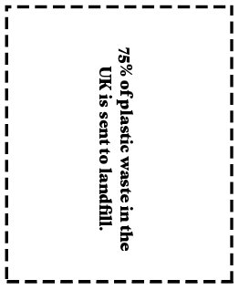
Recycling plastics: True or false?
Read the statements on each of the True or false cards. Then decide whether you think the fact is true or false. Make two piles
True?
False?
Notes:
Recycling plastics: True or false?
All of the fact cards are true! To extend this activity ask pupils to research facts around plastics and get them to make their own set of true or false cards.

Slide 13
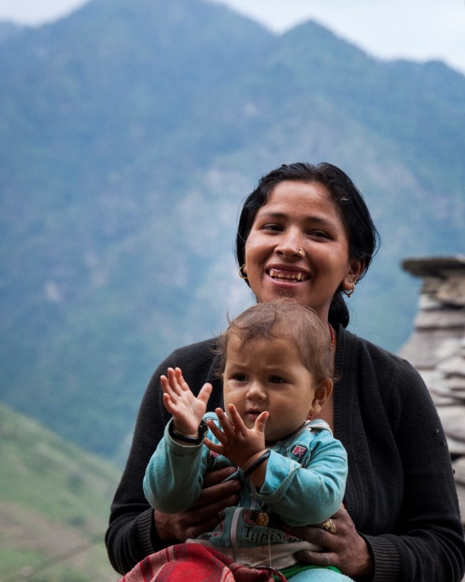
The Sustainable Development Goals So many people around the world are affected by climate change and living in poverty that the United Nations (UN) called a meeting with leaders from over 30 countries to form an action plan to address these big issues.
The leaders agreed on 17 areas that needed to be sorted. They called them the Sustainable Development Goals (SDGs) or Global Goals for short.
Notes:
The Sustainable Development Goals
The Sustainable Development Goals (SDGs) also known as the Global Goals are introduced to give pupils information about a set of 17 targets to address global problems. For further information go to www.practicalaction.org/schools/sdgs.

Slide 14
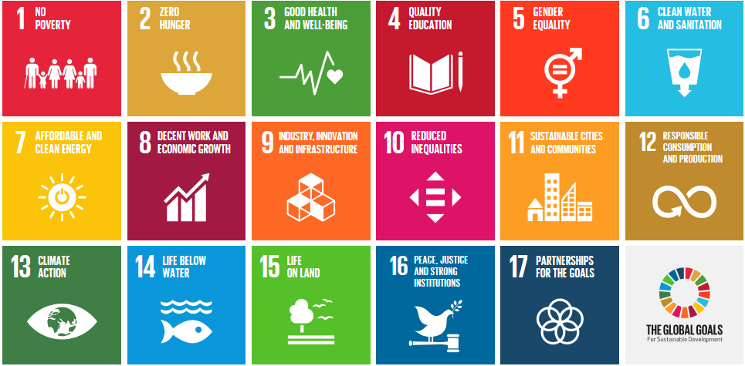
The Sustainable Development Goals
Notes:
The Sustainable Development Goals (SDGs)
This is the full set of Global Goals.
We recommend that you use the pupil sheet Sustainable Development Goals, so that pupils can consider which of the goal targets could be reached by addressing problems caused by plastic waste.

Slide 15
Mystery plastics
All plastics should be marked with a symbol so that they can be identified as to which type of plastic they are.
But if there is no obvious symbol then tests can be carried out to identify the different plastic types.
Your investigation
You will be given four ‘mystery’ plastics. Carrying out the tests below and record your results on the Identifying plastics sheet.
Test for:
Whether it floats or sinks in water
Flexibility
How it cuts or marks.
Now use the Plastics sorting key to identify the four plastics.
Notes:
Mystery plastics
If you choose to run this Science investigation then you might choose to demonstrate safe ways to cut or mark the plastics. After the pupils have recorded their test results on the Mystery plastics sheet they can use the Sorting key to work out the different plastics they have investigated.
You might want to show them the items that you cut the samples from e.g: Plastic milk carton, etc.

Slide 16
Mystery plastics - results
The mystery plastics are:
1: Low density polyethylene (LDPE)
2: High density polyethylene (HDPE)
3: Polypropylene (PP)
4: Un-plasticized polyvinyl chloride (UPVC).
Notes:
Mystery plastics – results
When you reveal the mystery plastics, you might want to extend the activity by asking the pupils to match up their mystery plastics with the relevant Chemistry of Plastics cards (pupil sheets) so that they can see the recycling codes, compound names, other uses, etc..

Slide 17
Plastics
challenge
Your Plastics challenge is to develop a solution to tackle the environmental problems caused by plastic waste either in Nepal or the UK.
17
Notes:
Now that the pupils have a good understanding of the problems caused by waste plastic their own challenge begins!
You may want to choose to present the Nepal or UK Design contexts or allow the pupils to choose. The following three slides show the specific contexts as described on the Pupil sheet Design contexts.

Slide 18
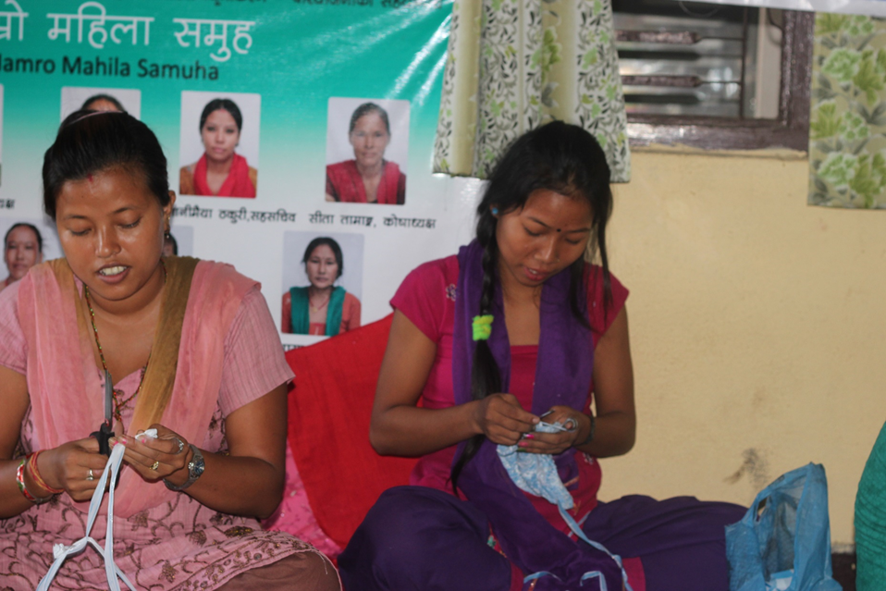
.
Plastics into profit
The Hamro Mahila Women’s Group was set up to support women living in poverty to earn a living. The group received training in making quality crafts from ‘waste’ plastic.
In their workshop the women have a sewing machine, iron and basic craft tools. At the moment they make pencil cases, coasters and baskets, but are looking forward to expanding their range of products.
Notes:
Plastics into profit
To introduce this context you might like show the pupils snips from the videos of some of the women’s group producing their crafts. They can be viewed here.

Slide 19
Plastics
Challenge - Nepal
Your challenge is to design and make a product that the Hamro Mahila women’s group can make to increase their appeal to international markets.
19
Notes:
Plastics challenge - Nepal
The Nepalese and UK challenge contexts are both available for the pupils on the Design contexts sheet.

Slide 20
Plastics
Challenge -UK
A new Eco-enterprise company has decided to take on the £5 challenge which aims to create a business idea with a start-up fund of £5. is to design and make a high quality product that reuses plastic and can be
Your challenge is to design and make a high quality product that reuses plastic and can be sold to a consumer of your choice.
20
Notes:
Plastic challenge - UK
This UK context for reusing plastic for products is an alternative for teachers and pupils who prefer a local context.

Slide 21
Present your work
At the end of your challenge you will be asked to give a mini presentation to the rest of the class.
Your presentation should include a bit about the following.
Teamwork: how well did you work together to get the different tasks done?
Research: what were your findings from any areas of research?
Design ideas: what different ideas did you come up with and what was your final idea?
Product: how well does your product meet your design criteria? How is the overall quality of the product?
Notes:
Present your work
If you are planning for your pupils to enter their Plastics challenge work for a CREST Award, then it is essential that they present their work. You will find the pupil Feedback sheet enables pupils within the class to provide peer feedback.
To make the feedback activity more fun, you might choose to ask pupils to present their work in a ‘Dragon’s Den’ style.

Slide 22
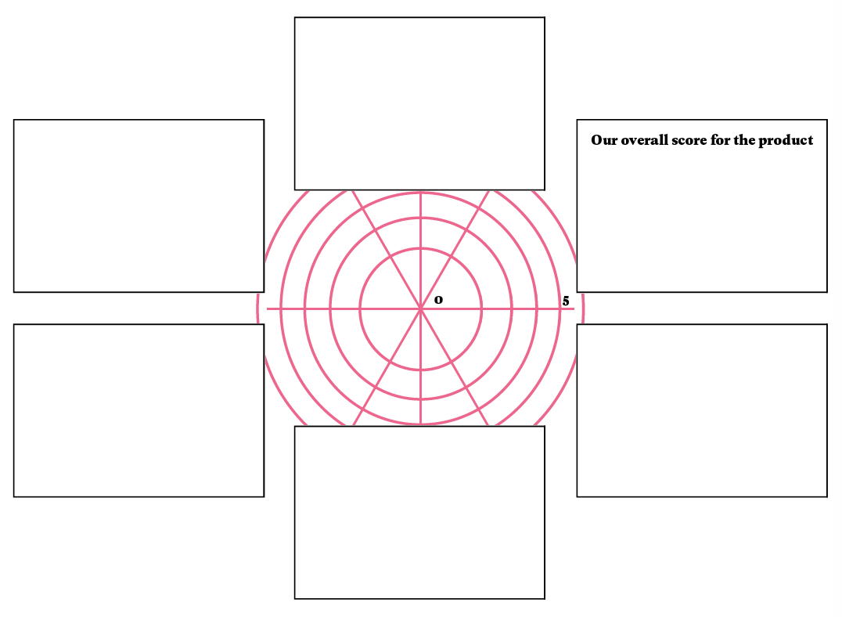
Product evaluation
Notes:
Product evaluation
This is one way of pupils evaluating their products against their original design criteria. For other product evaluation tools go to www.practicalaction.org/schools/dt-engineering.

Slide 23
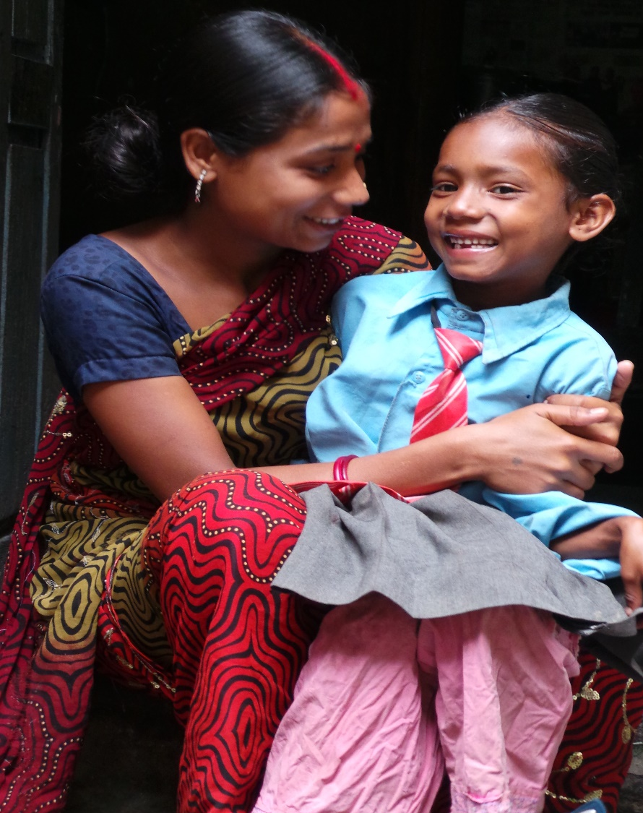
Ingenious solutions
The Hamro Mahila group is making a big difference not only to the lives of the woman in the group but to their wider families to.
Their enterprise allows them to work in a safe workshop and their business is thriving. They are earning enough money to feed their families, buy school uniforms and invest in developing their enterprise.
Notes:
Ingenious solutions
The women’s business is thriving. It’s important to stress that when people secure an income that not only does it enable them to feed themselves and their families it also provides opportunities to lift themselves out of poverty longer term. Families enjoy better health and can send their children to school.

Slide 24
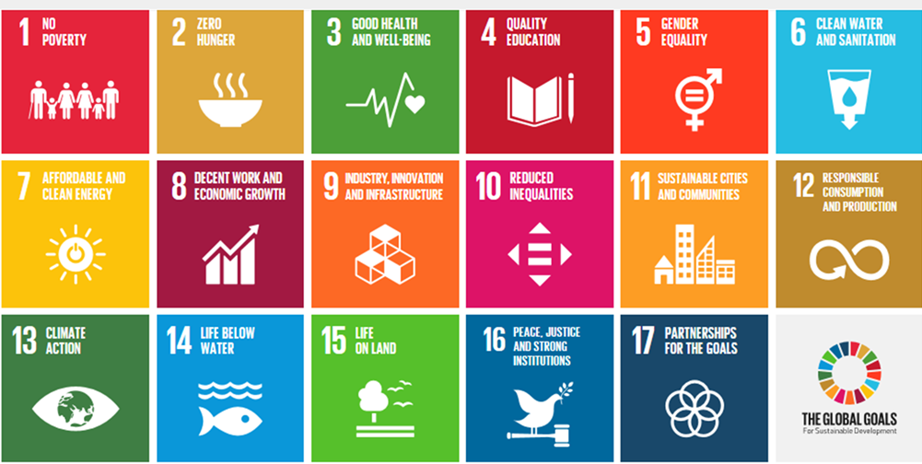
Which Global goals?
Now that you have learnt about the reuse of plastics for enterprise in Nepal, how do you think that project is helping people and the environment?
Which of the goals do you think are being worked on through the ‘waste collectors and Women’s enterprise project?
Notes:
Which Global goals?
As shown and discussed in the previous PPT slide the impact of securing an income from reusing plastics has wide reaching benefits. Share the Sustainable Development Goals pupil sheet and encourage the pupils to think of how the enterprise has helped reached a range of goal targets. We suggest that at least ten of the goals are impacted by this project including Goals of No Poverty, Zero Hunger, Good Health, Quality Education, Gender Equality, Sustainable Cities, Responsible Consumption, etc.

Slide 25
Celebrating Success
Notes:
Celebrating success
There are a number of ways in which pupils can gain acknowledgement for their work on the challenge. Firstly certificates are available for each pupil taking part in the Plastics challenge.
More formally, other opportunities are explained on the following slide.

Slide 26
CREST Awards The Plastics challenge is perfect for a CREST Discovery Award. It can also be used to gain as a context for Bronze, Silver and Gold Awards. Big Bang Competition You can also enter your challenge into the Big Bang Competition. Pupils are chosen every year to attend the national Big Bang Fair in Birmingham. Prizes include industrial/scientific site visits.
Notes:
CREST Awards
Taking part in the Squashed tomato challenge is a great way for pupils to gain a CREST Award. The challenge is aligned to the Discovery Award, but can be used to gain a Superstar Award or as the starting point for a Bronze, Silver or Gold Award. More details in the Teacher’s Guide.
Big Bang Fair and competition
Pupils who have taken part in a STEM challenge can enter their work into the Big Bang competition. This is a great way for pupils to showcase their work to other pupils and adults at a regional Big Bang event.
If they become finalists they will be invited to attend the National Big Bang Fair which takes place in March each year. Both of these are amazing, inspiring experiences for young people.
competition.thebigbangfair.co.uk

Slide 27
We hope you enjoyed the Plastics challenge.
For more information and resources go to:
practicalaction.org/schools
Notes:
Practical Action
If you and your pupils have enjoyed the challenge, then please look at our other STEM challenges based on Practical Action’s international work. They can be found here www.practicalaction.org/stem

