Slide 1
Solar panels: Modelling and Data Analysis
Lesson 1: Solar Array Design

Slide 2
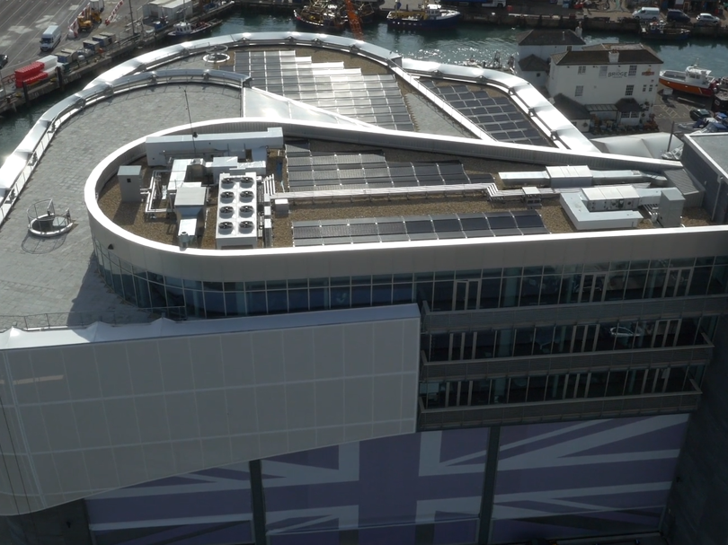
Solar Panels: Modelling and Data Analysis
Learning Objectives
Know how to take measurements from scale drawings
Solve a problem using your measurements
Calculate areas of composite shapes
Analyse your solution to understand its effects
Learning outcomes:
Ability to make accurate measurements
Accurate calculations of area
Create an effective solution to the problem
Clearly explain the reasoning for your solution
Notes:
KS3 National Curriculum
model situations mathematically
use scale factors, scale diagrams and maps
draw, measure and interpret scale drawings
calculate areas of composite shapes
KS4 National Curriculum
compare lengths, areas and volumes using ratio notation and/or scale factors; make links to similarity
calculate and solve problems involving areas of composite shapes
convert between related compound units
interpret and use fractional (and negative) scale factors for enlargements
interpret plans
calculate surface areas

Slide 3
Solar Panels: Modelling and Data Analysis
Key Words
Sustainability: development that meets the needs of the present without compromising the ability of future generations to meet their own needs
Solar panel: converts light energy into electrical energy
Solar array: lots of solar panels linked together
Power: how much energy is produced every second, measured in Watts or kiloWatts (1kW = 1000W)
Efficiency: amount of power that can be used, compared to the total power that is available (%)
Notes:
Sustainability definition is the most commonly used version, from United Nations Brundtland Commission report ”Report of the World Commission on Environment and Development: Our Common Future” (1987).
Ask students to suggest examples of what this means to them. Prompts: use of natural resources, disposal of waste – what will happen if we don’t think about where our resources come from and where our waste goes?
In 2015, the UN developed 17 ‘Sustainable Development Goals’ (SDG) aiming for a sustainable future for the planet and humankind by 2030.

Slide 4
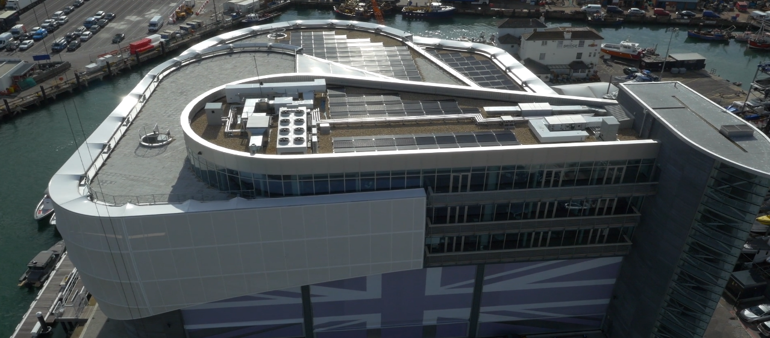
Solar Panels: Modelling and Data Analysis
Notes:
To help contextualise the lesson, you could watch the film on maths and solar energy.

Slide 5
Solar Panels: Modelling and Data Analysis
Introducing the Challenge
Imagine you are a Renewable Energy Consultant. That means that you improve the sustainability of people’s energy use by:
using maths to solve problems
communicating with people to help them make good choices.
Notes:
Explain that students are to take the role of renewable energy consultants (they could invent names for their consultancies).

Slide 6
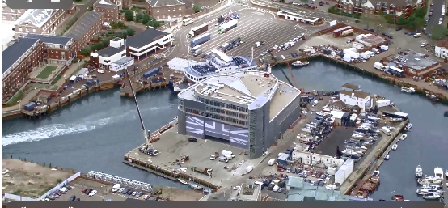
Solar Panels: Modelling and Data Analysis
Introducing the Challenge
Your client is James Stagg, Head of Operations at INEOS TEAM UK
James raced in the 2003 America’s Cup with GBR. He moved into project management and is responsible for the base and team’s operations. He is looking for a renewable energy source to power the INEOS TEAM UK base in Portsmouth.
INEOS TEAM UK use electricity to power everything from computers to the machines used to make their boats.
They want to be as sustainable as possible, so they need you to help come up with a solution to power the team’s base using as much renewable energy as possible.
Notes:
INEOS TEAM UK is the America’s Cup team, based in Portsmouth, UK.
The INEOS TEAM UK base is in an exposed coastal, but city, position.
Ask students to think (individually or in groups) about renewable energy options. The exposed coastal nature could suggest local wind or wave power, and the flat roof allows for solar panels. The National Grid provides options for renewable energy from an external provider.

Slide 7
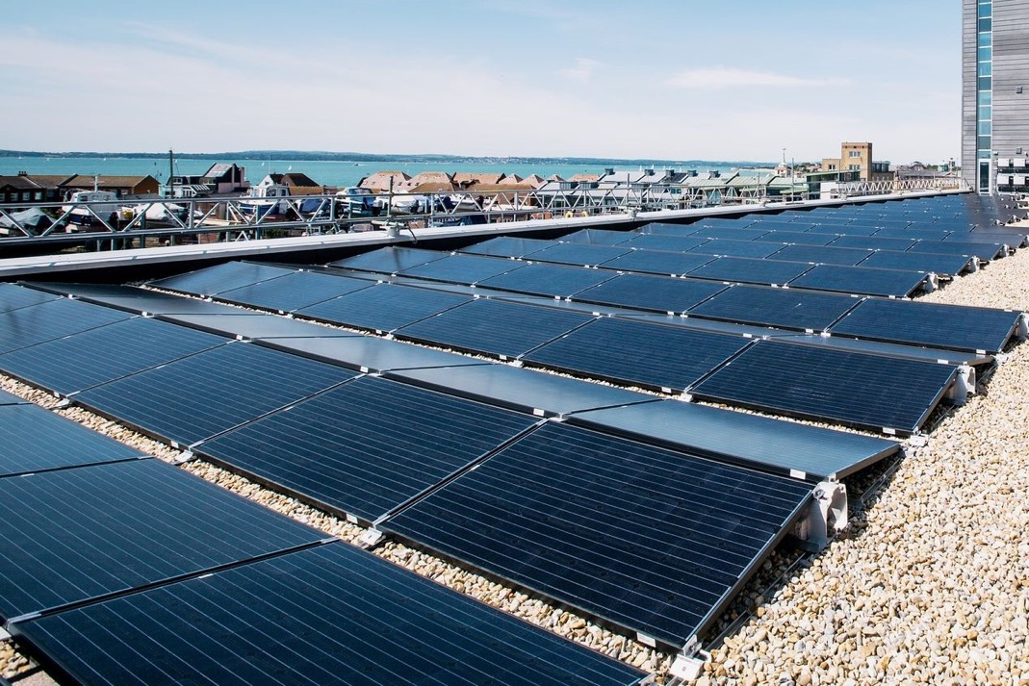
Solar Panels: Modelling and Data Analysis
Design a Solar Array for the Base
Task 1: Use the blueprint and your worksheet to explore a solar array for the INEOS TEAM UK base.
You’ll need to use and interpret scale drawings to find the best solution.
Notes:
Introduce main activity: solar array design
Students follow instructions on worksheets (11-14 L/H, 14-16) to design a solar array.
Materials:
1 base blueprint per group
1 worksheet per group
pencils, rulers
There are a number of ways in which students can calculate the area available – the simplest is by counting squares: 1 small square = 1 square metre. Alternatives depending on student ability and knowledge could be to draw and measure geometric areas. A full-screen copy of the blueprint is on the next page – you could use it to demonstrate approaches.
Worksheet differentiation:
11-14 L uses square-counting with guidance
11-14 H uses area and ratio with guidance
14-16 gives an open-ended task and students can select their approach

Slide 8
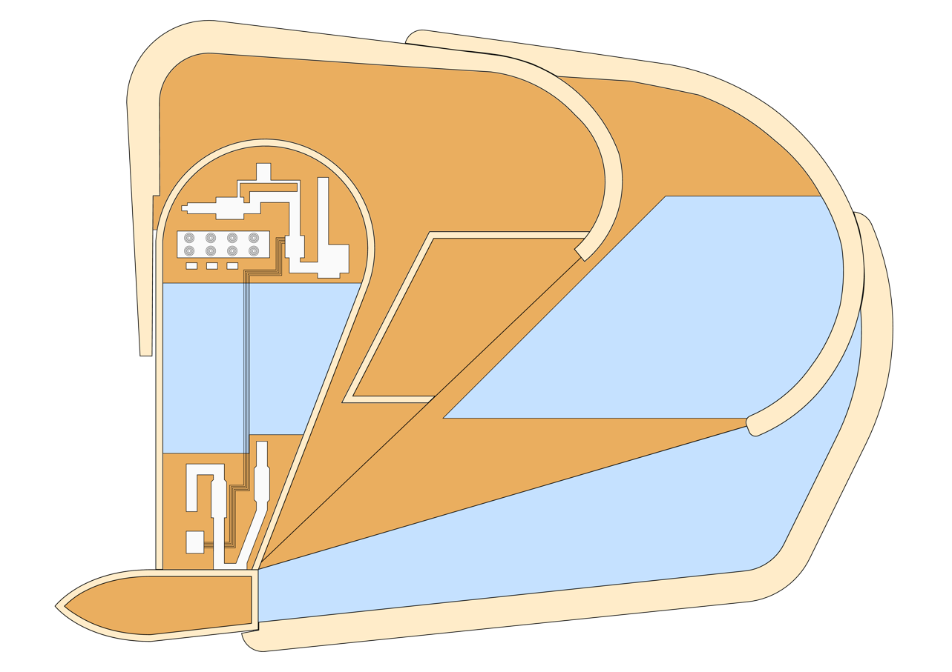
Solar Panels: Modelling and Data Analysis
INEOS TEAM UK: Base Blueprint
service ducts etc. – keep clear
terraces for events, access etc. – keep clear
area available for panel installation
Notes:
This is the base plan the students will be using in their activities.

Slide 9
Solar Panels: Modelling and Data Analysis
Choosing the Best Solar Panels
Task 2 (14-16): Select a type of solar panel to use that fits within your budget.
Prepare an explanation of which panels you chose and why, how many you will buy, and the maximum power output. Remember to also explain why you didn’t choose the other models.
Manufacturer | Model | Installation cost (£/m²) | Maximum output (W)
SunnyTech | VBHN325 | 180 | 80
Fusion | SPR-X20-445 | 210 | 100
AZ Electronics | AZ325N1C-G4 | 300 | 150
PowerSun | SPR-E20-327 | 510 | 230
Easthouse | WTW-250 | 1200 | 300
Notes:
After an initial discussion of how to choose the solar panels, students may want to consider how many solar panels could be bought for £400,000 and, consequently, what the maximum output over the whole array would be.
For example, £400,000 divided by 180 (SunnyTech panel installation cost) = 2222.2. This means 2222 SunnyTech panels could be purchased.
2222 SunnyTech panels x 80W (maximum output of SunnyTech panels) = 177,760W is the maximum output for the whole array.
This figure can then be compared with the other solar panels in the table.

Slide 10
Solar Panels: Modelling and Data Analysis
Plenary: Client Discussion

Slide 11
Solar Panels: Modelling and Data Analysis
Client Discussion (11–14)
James Stagg
Head of Operations
How many solar panels could we fit on the roof?
Why can’t we fit more solar panels?
What would need to change if we wanted to produce more power?
What might affect how well our panels work?
Notes:
Plenary
Ask students to justify designs and approaches. Could use a visualiser to display their designs.
Children could use paired or group talk to discuss challenging questions.
Ideas for question 3: decrease terrace space on roof, cover skylight, use better panels, rotate panels towards sun, use car park space, use additional source of energy e.g. wind power…
Ideas for question 4: weather, dirt (seagulls!), shadow from parts of building.

Slide 12
Solar Panels: Modelling and Data Analysis
Client Discussion (14–16)
James Stagg
Head of Operations
Why did you choose the solution that you did?
Why can’t we fit more solar panels?
What would need to change if we wanted to produce more power?
What might affect how well our panels work?
Notes:
Plenary
Ask students to justify designs and approaches. Could use a visualiser to display their designs.
Children could use paired or group talk to discuss challenging questions.
Ideas for question 3: decrease terrace space on roof, cover skylight, use better panels, rotate panels towards sun, use car park space, use additional source of energy e.g. wind power…
Ideas for question 4: weather, dirt (seagulls!), shadow from parts of building.

Slide 13
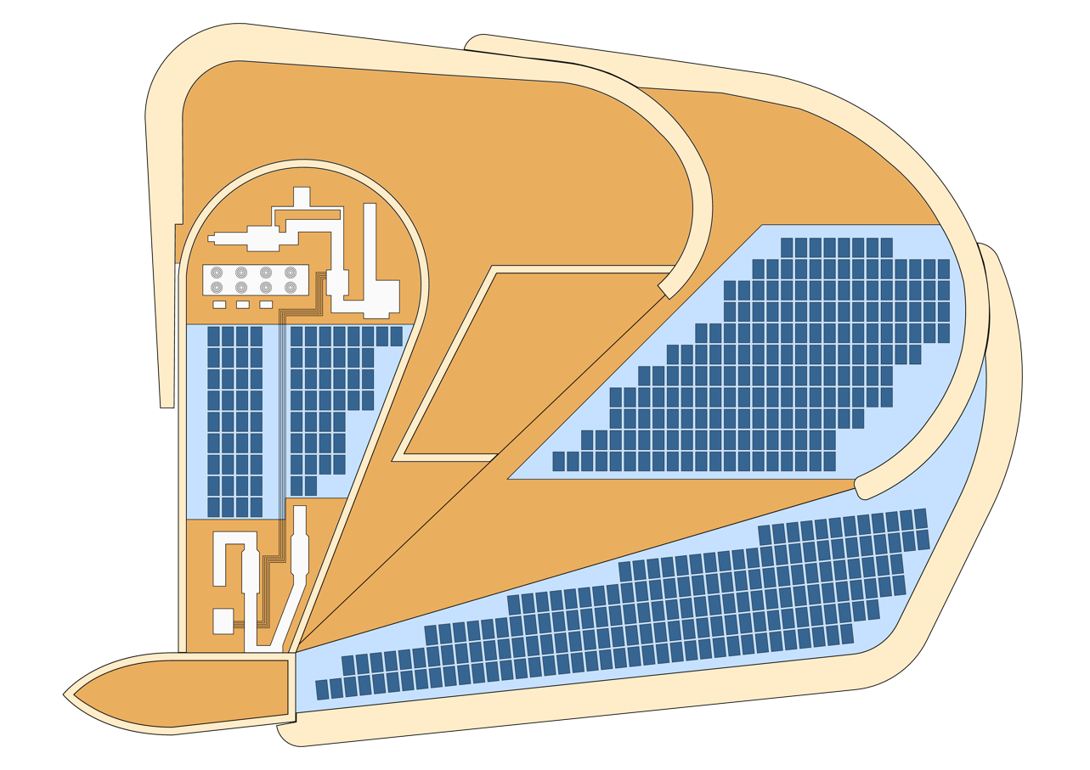
Solar Panels: Modelling and Data Analysis
INEOS TEAM UK: Base Blueprint
service ducts etc. – keep clear
terraces for events, access etc. – keep clear
area available for panel installation
Analysis:
Maximum possible area = 1265m²
Actual solar panel area = 707m²
= 432 panels
Notes:
Actual panel installation – from aerial photo.
Ask students to suggest why panels do not fill maximum possible area. (Access routes required for cleaning and maintenance, simplifies connections between panels, cost?).
Students are likely to get a range of values (~1,000-1,375 m², 500-687 panels) depending on approach used and accuracy.
The base uses 100% of the available roof space for solar panels.

Slide 14
Solar Panels: Modelling and Data Analysis
Extension Discussion
Now you have worked out the numbers, what do you need to know to make firm recommendations to the client?
You could consider:
How much is saved by generating their own electricity instead of buying from the National Grid?
How can we compare cost of installation vs money saved on electricity?
How can we determine the effect on the environment?
Notes:
Questions that students may come up with, or can be prompted to discuss:
What is the cost per kWh of electricity from grid?
Over what time period should the installation costs be offset?
How much CO₂ output is saved per kWh by using solar power?

Slide 15
Solar Panels: Modelling and Data Analysis
Worksheet Answers

Slide 16
Solar Panels: Modelling and Data Analysis
Answers for Worksheet 11–14 L
Answers will vary depending on solar panel arrangement.
Sensible arrangement of solar panels.
Around 1,000–1,375 grid squares
Around 1,000–1,375m²
Around 500–687 panels
Around 100,000–137,400W
No. Answers could include: sun moving throughout day; sun going down at night; clouds/weather; sun lower in the winter; panels might get dirty; etc.
Around £300,000–£412,200
Notes:
Discuss answers with students – will vary depending on printer scaling, student accuracy.
Discussion opportunity – why are answers different? If you have access to a visualiser, could display student work for discussion.
Q2b – wide range of possible answers – discuss as class, are there any additional ideas?

Slide 17
Solar Panels: Modelling and Data Analysis
Answers for Worksheet 11–14 H
Answers will vary depending on solar panel arrangement.
Assuming approx. 6cm = 10m (printed on A3):
Sensible arrangement of solar panels.
Around 360–495cm²
6cm : 10m; 36cm² : 100m²
Around 1000–1375m²
Around 100,000 – 137,400W
No. Answers could include: sun moving throughout day; sun going down at night; clouds/weather; sun lower in the winter; panels might get dirty; etc.
Around £300,000 – £412,200
Notes:
Discuss answers with students – will vary depending on printer scaling, student accuracy.
Discussion opportunity – why are answers different? If you have access to a visualiser, could display student work for discussion.
Q2b – wide range of possible answers – discuss as class

Slide 18
Solar Panels: Modelling and Data Analysis
Answers for Worksheet 14–16 (1)
Answers will vary depending on solar panel arrangement.
Total area on plan = around 360–495cm² Scale is approx. 6cm : 10m So total solar panel area is around 1000–1375

Slide 19
Solar Panels: Modelling and Data Analysis
Answers for Worksheet 14–16 (2)
Divide £400,000 by the installation cost and multiply by the maximum output to reach a maximum output per solar array to compare between different brands (see table below).
AZ Electronics panels have best cost/output ratio. More efficient panels are much more expensive, so will not be able to cover area. Lower-cost panels will save money but will produce less power.
Manufacturer | Installation cost (£/m²) | Number of solar panels in array (rounded down) | Maximum output (W/m²) | Maximum output of whole array (/W)
SunnyTech | 180 | 2,222 | 80 | 177,760
Fusion | 210 | 1,904 | 100 | 190,400
AZ Electronics | 300 | 1,333 | 150 | 199,950
PowerSun | 510 | 784 | 230 | 180,320
Easthouse | 1,200 | 333 | 300 | 99,900
Notes:
Discuss answers with students – will vary depending on printer scaling, student accuracy.
Discussion opportunity – why are answers different? If you have access to a visualiser, could display student work for discussion.
Additional discussion: why does the base only have 432 panels, when the plan shows room for up to 500-600? Could be cost constraint, or additional space required for access/maintenance/supporting structure and equipment.

Slide 20
Solar Panels: Modelling and Data Analysis
Answers for Worksheet 14–16 (3)
Answers will vary depending on solar panel arrangement.
(Cont.) AZ panels have best cost/output ratio. More efficient panels are much more expensive, so will not be able to cover area. Lower-cost panels will save money but will produce less power.
Notes:
Discuss answers with students – will vary depending on printer scaling, student accuracy.
Discussion opportunity – why are answers different? If you have access to a visualiser, could display student work for discussion.
Additional discussion: why does the base only have 432 panels, when the plan shows room for up to 500-600? Could be cost constraint, or additional space required for access/maintenance/supporting structure and equipment.

Slide 21
Solar Panels: Modelling and Data Analysis
How did you do?
Know how to take measurements from scale drawings
Solve a problem using your measurements
Calculate areas of composite shapes
Analyse your solution to understand its effect
Make accurate measurements
Draw an area of solar panels
Find a good solution to the problem
Make a clear explanation of the impact of your work
Notes:
Ask students to self or peer assess on whether they achieved learning objectives and outcomes.

