Slide 1
Solar Panels: Modelling and Data Analysis
Lesson 2: measuring and monitoring

Slide 2
Solar Panels: Modelling and Data Analysis
Learning Objectives
Read and describe data from bar charts
Compare data from similar charts
Consider how concepts could be applied in everyday life
Learning outcomes:
Methodical and precise measurements
Explanations with reasons based on data
Good ideas with sensible justifications.
Notes:
KS3 National Curriculum
model situations by using graphs
interpret appropriate tables, vertical bar charts for grouped numerical data
describe simple relationships between 2 variables
KS4 National Curriculum
interpret data using bar charts
interpret diagrams for grouped discrete data
interpret, analyse and compare the distributions of data sets

Slide 3
Solar Panels: Modelling and Data Analysis
Key Words
Sustainability: development that meets the needs of the present without compromising the ability of future generations to meet their own needs
Solar panel: converts light energy into electrical energy
Solar array: lots of solar panels linked together
Power: how much energy is produced every second, measured in Watts or kilowatts (1kW = 1000W)
Efficiency: amount of power that can be used, compared to the total power that is available (%)
Notes:
Sustainability definition is the most commonly used version, from United Nations Brundtland Commission report ”Report of the World Commission on Environment and Development: Our Common Future” (1987).
Ask students to suggest examples of what this means to them. Prompts: use of natural resources, disposal of waste – what will happen if we don’t think about where our resources come from and where our waste goes?
In 2015, the UN developed 17 ‘Sustainable Development Goals’ (SDG) aiming for a sustainable future for the planet and humankind by 2030.

Slide 4
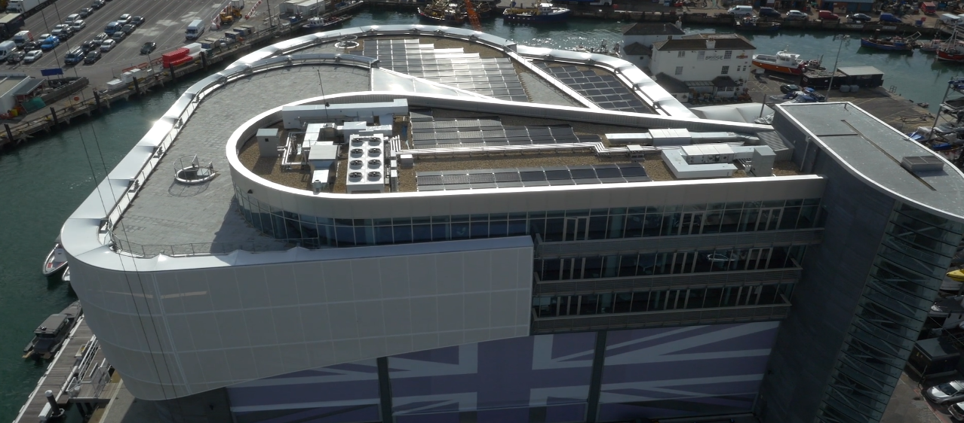
Solar Panels: Modelling and Data Analysis
Notes:
This video is the same as lesson 1. It provides real-life context for the installation and monitoring of solar panels.

Slide 5
Solar Panels: Modelling and Data Analysis
Introducing the Challenge
Imagine you are a Renewable Energy Consultant. That means that you improve the sustainability of people’s energy use by:
Using maths to solve energy problems
Communicating with people to help them make choices
Improving the sustainability of people’s energy use.
Now that the solar arrays are in place, you need to help INEOS TEAM UK to:
Understand solar data over the course of one day
Calculate values to help make decisions
Compare data at different times of the year.
Notes:
(Reminder from lesson 1)
Explain that students are to take the role of renewable energy consultants (they could invent names for their consultancies).

Slide 6
Solar Panels: Modelling and Data Analysis
Introducing the Challenge
Your client is Mark Rogers: Facilities Manager at INEOS TEAM UK
Mark helps to ensure the INEOS TEAM UK base is as energy efficient as possible.
The INEOS TEAM UK base has a fantastic solar array on the roof. To ensure they are reaching their sustainability goals, the team wants to make sure it’s working at its best, and understand the impact that it has.
Notes:
Introduce Amy Munro as a member of INEOS TEAM UK. In this exercise, students will get a taste of the kind of responsibilities a Sustainability Manager has.
The solar panel installation from the previous lesson is now in operation. INEOS TEAM UK want to understand the impact that this has on their energy use, both in terms of cost and impact.

Slide 7
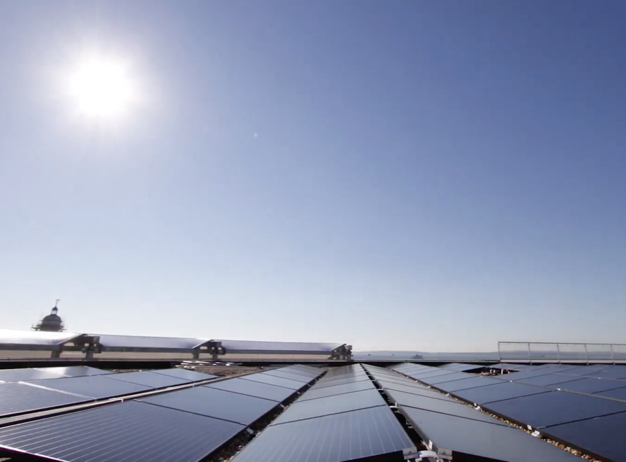
Solar Panels: Modelling and Data Analysis
Measuring Impact
What do we mean by ‘impact’?
What impact do we want our solar array to have?
What would good impact look like?
How could we measure it?
Notes:
Ask students what the point of having a solar array is.
Possible answers:
Provide free energy/electricity
Reduce cost of electricity
Reduce use of non-renewable energy
Impact – need to measure how much energy the array is producing, and how much the base is using. Good impact could be all energy used comes from array.

Slide 8
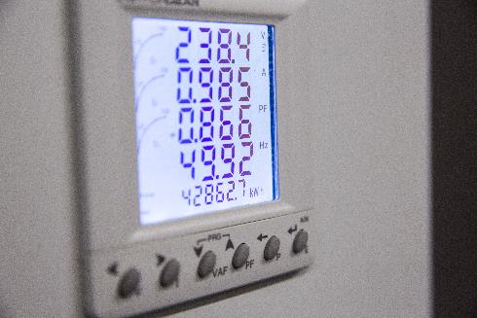
Solar Panels: Modelling and Data Analysis
Measuring Impact
The unit for power is Watts (W). It tells us how fast energy is being produced or used.
1000 Watts (W) = 1 kilowatt (kW).
The total amount of energy used depends on how long an appliance is left on. For example, if you used a computer for an hour, you’d use twice as much energy as if you only used it for half an hour.
One way to measure total energy use is in kilowatt hours (kWh). This is what is shown on your electricity bill.
Notes:
Energy and power units are often confusing. One helpful approach is to compare time-based examples.
More detail:
Power (in Watts) is the number of Joules of energy that a device uses in one second – the rate of transfer of energy. 1 W = 1 J/s
To calculate the total amount of energy used (which your electricity company will want to bill you for), we need to multiply by time.
If we multiply by the number of seconds, we’ll get an answer in Joules (which scientists like – standard units)
However electricity companies bill in kWh, so we need to multiply by the number of hours. This makes sense for non-scientists – you probably leave your fridge on 24h/day, so the calculations are easier if they are left the units like that.

Slide 9
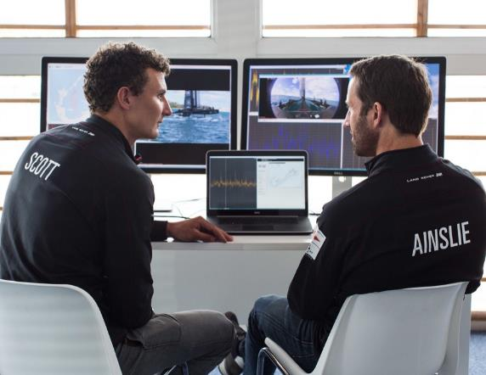
Solar Panels: Modelling and Data Analysis
Measuring Energy – Example
A desktop computer uses 80W of power and you use it for two hours. How many kWh of energy do you use?
80W = 0.08kW (divide by 1000)
0.08kW for two hours = 0.08kW x 2h = 0.16kWh
Top tip: you can multiply units!
kW x h = kWh
Notes:
Walk students through example, use additional cases if necessary.
Values for energy consumption of household devices can be found online e.g.
https://www.cse.org.uk/advice/advice-and-support/how-much-electricity-am-i-using
https://www.energuide.be/en/questions-answers/how-much-energy-do-my-household-appliances-use/71/

Slide 10
Solar Panels: Modelling and Data Analysis
Measuring Energy – Your Turn
If one computer needs 80W of power, and one solar panel produces 200W on a sunny day how many computers can one solar panel power?
200W per solar panel ÷ 80W per computer = 2.5 computers per solar panel
Notes:
Ask students whether this means that we can use the computer for free (no electricity bill) if we get a solar panel? Why wouldn’t everyone do this? (Initial cost, variability of sunlight – what happens at night?)
What does that answer mean? 2.5 computers? What does half a computer mean? Because there is a solar array, we can scale up e.g. 2 panels = 5 computers. Alternatively the extra energy could be used for something else, or it might get wasted.

Slide 11
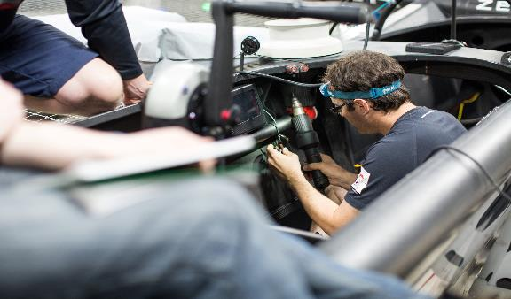
Solar Panels: Modelling and Data Analysis
Measuring Energy – Your Turn
An electric drill uses 900W of power and you use it for 30 minutes. How many kWh of energy do you use?
900W = ___ kW (divide by 1000)
30 minutes = ___ hours
___ kW for ___ hours = ___ kW x ___ h = ____ kWh
This is the total amount of energy used, in kWh
Notes:
900 W = 0.9kW (divide by 1000)
30 minutes = 0.5 hours
0.9kW for 0.5 hours = 0.9kW x 0.5 h = 0.45kWh

Slide 12
Solar Panels: Modelling and Data Analysis
Measuring Energy – Your Turn
If one electric drill needs 900W of power, and one solar panel produces 200W on a sunny day how many solar panels do you need to power one drill?
___ W per drill ÷ ___ W per solar panel = ___ solar panels per drill
Notes:
Note that this question is the opposite way round from the example – one drill needs multiple solar panels to power it.
900W per drill / 200W per solar panel = 4.5 solar panels per drill

Slide 13
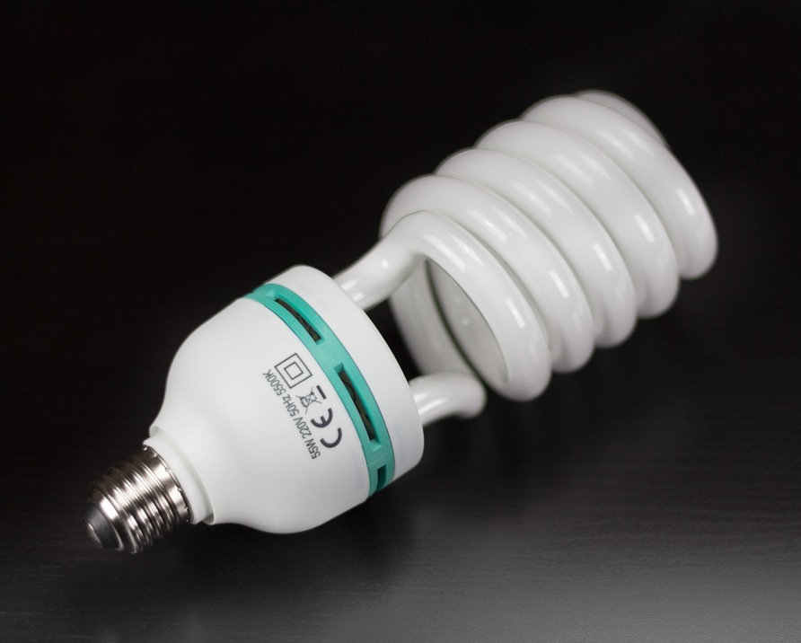
Solar Panels: Modelling and Data Analysis
Measuring Energy – Your Turn
An energy-saving light bulb uses 25W of power, and it’s on for 4 hours. How many kWh of energy does it use?
25W = ___ kW (divide by 1000)
___ kW for ___ hours = ___ kW x ___ h = ____ kWh
Notes:
25W = 0.025kW (divide by 1,000)
0.025kW for 4 hours = 0.025kW x 4h = 0.1 kWh

Slide 14
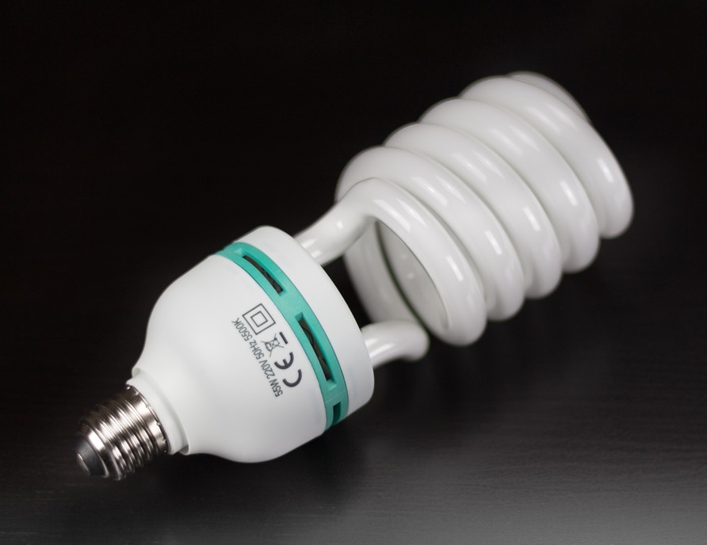
Solar Panels: Modelling and Data Analysis
Measuring Energy – Your Turn
If one energy-saving bulb needs 25W of power, and one solar panel produces 100W on a cloudy day how many solar panels do you need to power 22 bulbs?
25W per bulb x ___ bulbs = ___ W total power needed
___ W total ÷ ___ W per solar panel = ___ solar panels
Notes:
25 W per bulb x 22 bulbs = 550 W total power needed
550 W total ÷ 100 W per solar panel = 5.5 solar panels

Slide 15
Solar Panels: Modelling and Data Analysis
Solar Panels
Advantages | Disadvantages
Notes:
Ask students to suggest pros and cons of solar power. Could think/pair/share.
Advantages:
‘Free’ energy
Renewable energy – will not run out
Sustainable energy – no carbon emissions
Can be used off-grid/portable
Disadvantages:
Up-front setup cost can be high
Variable production – weather, daylight
Needs suitable place to install
Takes up space
Can get dirty, reduces output

Slide 16
Solar Panels: Modelling and Data Analysis
Measuring and Monitoring Solar Panels
Complete the tasks on the Measuring and Monitoring worksheets:
Task 1
changes with time
Task 2
Task 2
changes with season
Notes:
Ask students to work independently or in small groups to complete tasks on the worksheets.
Differentiated sheets are available (11-14 L/H, 14-16), with activities following a similar pattern and using similar data.
An extension/homework sheet includes data for common household appliances to link concepts to students’ home experiences.
The following slides contain charts and figures from the worksheets for whole-class discussion.
Depending on class, could introduce each task separately or have a longer period of uninterrupted work.
Data used in charts is available for download as a spreadsheet.
Task 3 is an extension where students evaluate home use of electricity in a similar way.

Slide 17
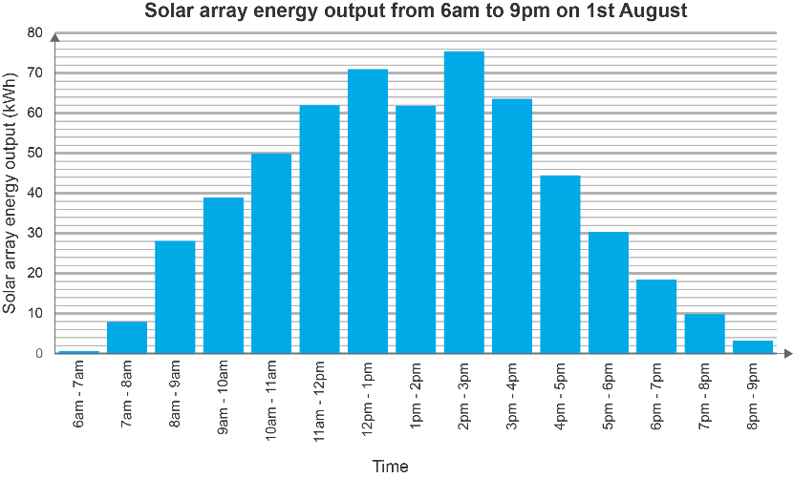
Solar Panels: Modelling and Data Analysis
Task 2
You can assume that the power output throughout each hour is constant, i.e. 75kWh means 75kW for the whole hour.
Notes:
Output over one summer day, for the whole INEOS TEAM UK array.
The graph uses real data but it may be useful for students to round values to the nearest kWh for ease when answering questions or calculating solutions.
Students are asked to use values in calculations, and reflect on why output changes throughout the day, and in particular on the dip at 1–2pm (this is most probably caused by cloud cover).
They are also asked to determine whether equipment can be powered solely by solar energy.
Notes on non-standard chart format: the presentation of this data is based on ‘real life’ energy usage charts on consumer electricity bills.
Along with the challenge of explaining the non-SI unit ‘kWh’, the data used in this activity does not fit into the usual clear ‘bar chart’ or ‘histogram’ categories KS3&4 students may expect. The y-axis is a continuous variable, as opposed to a discrete count. The x-axis is also continuous (it could be argued that there shouldn’t be gaps between bars, but that causes problems in clarity for the comparison chart on the next slide). The labelling of the columns is also ambiguous – the technically correct way to present this would be ‘6:00 ≤ t < 7:00’, but this format is not used to avoid confusing students.
For the instantaneous power calculations (where values in kW are required), it’s assumed that the output over that hour is constant, therefore the instantaneous power (in kW), at any point during that hour period, is the same numerical value as the total energy output (in kWh) over that hour – to convert from kWh to kW you divide by the time, which is 1 hour. Teachers should choose whether to go into this much detail.

Slide 18
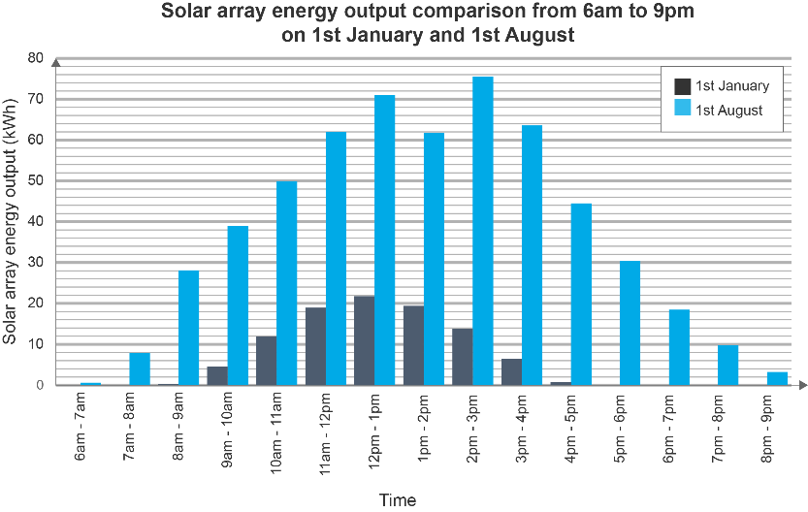
Solar Panels: Modelling and Data Analysis
Task 3
Notes:
Output comparison between January and August, for the whole of the INEOS TEAM UK solar array.
The graph uses real data but it may be useful for students to round values to the nearest kWh for ease when answering questions or calculating solutions.
Students are asked to perform further calculations, and compare seasonal variation. They are also asked to calculate amount and cost of additional energy required from the National Grid.
If excess electricity is sold back to the National Grid, then the Grid effectively acts like a battery. Assuming sale and purchase prices cancel one another out (which they wouldn’t quite do in a real example) then we can ignore ‘lost’ excess production and only consider additional energy required.

Slide 19
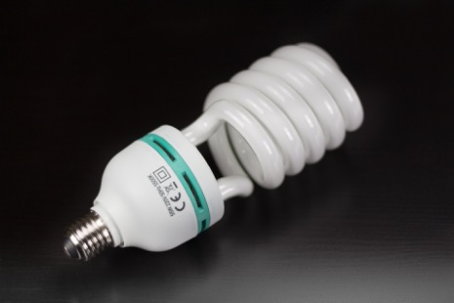
Solar Panels: Modelling and Data Analysis
Task 2
Equipment | Quantity | Energy used in 1hour (Wh) | Quantity x energy (Wh)
Desktop computer | 80 | 110
TV screen | 12 | 75
Lights | 22 | 25
Air conditioner | 8 | 1000
Total energy over 1h =
Notes:
Task 2
Values for base devices required to be powered throughout the day.
Calculations on answer sheet. Total power required to run equipment = 18,250 W (18.25kW). Total energy produced 9am-5pm = 161.2 kWh
Values in this table are in Wh or kWh, measuring total energy rather than instantaneous power, for ease of reference to the charts. Most devices are actually rated in W, instantaneous power. If a device is left on for one hour, the energy used (in Wh or kWh) is the same value as the instantaneous power (in W or kW).

Slide 20
Solar Panels: Modelling and Data Analysis
Reporting Back - Findings

Slide 21
Solar Panels: Modelling and Data Analysis
Reporting Back – Findings
Mark Rogers:
INEOS TEAM UK Facilities Manager
Write down three interesting things that you found out ready to feedback to INEOS TEAM UK.
What do these mean for the base’s energy use?
Do you have any recommendations or questions?
How might this apply to your home?
What could you do to reduce your electricity bill?
Notes:
Plenary session
Ask students to think/pair/share to highlight key points for INEOS TEAM UK.
These could include things like:
most equipment can be powered all day in the summer, but additional energy is required in the winter.
there is a higher charge for renewable energy – do INEOS TEAM UK want to pay this?
more information on the base’s power use could be useful e.g. is everything on all the time? What other equipment is used?
What could you do to reduce your electricity bill at other times?
Reducing home electricity use:
Install solar panels
Use energy saving devices
Turn off devices when not in use

Slide 22
Solar Panels: Modelling and Data Analysis
Worksheet Answers

Slide 23
Solar Panels: Modelling and Data Analysis
Answers for Worksheet 11–14 L (1)
62kWh
2pm–3pm = 76kWh, 1pm-2pm = 64kWh 76kWh – 64kWh = 12kWh
12pm-1pm and 2pm-3pm
As the sun comes up, the power output increases until the middle of the day. After that, as the sun goes down, the power output decreases.
The dip at 1-2pm could have been caused by clouds passing in front of the sun.
See table.
18,250Wh = 18.25kWh
Horizontal line should be drawn at 18.25kWh (see later slide).
The solar panels produce power from 8am–7pm (6pm–7pm is 19kWh)
i) 50kWh ii) 12kWh
38kWh
7 hours (8am–9am and 4pm–5pm have values under 1kWh)
True, the base produces more than 3 times the solar output on 1st August than 1st January for that hour 1st Aug = 71kWh, 1st Jan = 22kWh. 22 x 3 = 66. 71 is more than 66.
Equipment | Quantity | Energy used in 1hour (Wh) | Quantity x energy (Wh)
Desktop computer | 80 | 110Wh | 8,800Wh
TV screen | 12 | 75Wh | 900Wh
Lights | 22 | 25Wh | 550Wh
Air conditioner | 8 | 1000Wh | 8000Wh
Total energy over 1h = |  |  | 18,250Wh

Slide 24
Solar Panels: Modelling and Data Analysis
Answers for Worksheet 11–14 L (2)
In the summer, the power output from the solar panels is higher than in the winter. This is because he sun is higher in the sky during the summer.
In the winter, the solar array produces electricity for fewer hours than in the summer. This is because the sun rises later and sets earlier in the winter than in the summer.
Device | Power requirement | Can run for free? | Number of panels needed
42” TV | 75W | Yes/No | 1
Xbox One | 110W | Yes/No | 1
PlayStation 4 | 137W | Yes/No | 2
Laptop | 70W | Yes/No | 1
Washing machine | 500W | Yes/No | 5
Kettle | 2200W | Yes/No | 20

Slide 25
Solar Panels: Modelling and Data Analysis
Answers for Worksheet 11–14 H (1)
71kWh
2pm–3pm = 76kWh, 9pm–10pm = 39kWh 76kWh – 39kWh = 37kWh
11am–12pm and 1pm–2pm
12pm –1pm and 2pm –3pm
Starts low (as sun rises) at around 7 am, increases to a maximum at 2pm –3pm, decreases (as sun sets) until 9pm. Dip likely caused by cloud/rain.
See table.
18,250Wh = 18.25kWh
Horizontal line should be drawn at 18.25kWh (see later slide)
Can run equipment from solar energy 8am–7pm.
1st Aug = 50kWh, 1st Jan = 12kWh 50kWh-12kWh = 38kWh
7 hours (ignore 8am–9am and 4pm-5pm as below 1kWh)
2pm–3pm with a difference of 62kWh
True, the base produces more than 3 times the solar output on 1st August than 1st January for that hour 1st Aug = 71kWh, 1st Jan = 22kWh. 22 x 3 = 66.71 is more than 66.
Equipment | Quantity | Energy used in 1hour (Wh) | Quantity x energy (Wh)
Desktop computer | 80 | 110Wh | 8800Wh
TV screen | 12 | 75Wh | 900Wh
Lights | 22 | 25Wh | 550Wh
Air conditioner | 8 | 1000Wh | 8000Wh
Total energy over 1h = |  |  | 18,250Wh

Slide 26
Solar Panels: Modelling and Data Analysis
Answers for worksheet 11–14 H (2)
Maximum in summer is 75kWh, in winter is 22kWh. Maximum happens earlier in winter. Power produced for 15h in summer, and 9h in winter. Explanation: Sun is up for less time, and is lower in the sky in the winter.
11am and 2pm

Slide 27
Solar Panels: Modelling and Data Analysis
Answers for Worksheet 11–14 H (3)
No, the power will be less earlier in the morning and later in the afternoon.
Add more panels, use energy saving devices, turn unused devices off, add a different renewable energy source e.g. wind power.
Device | Power requirement | Number of panels required 1st Aug | Number of panels required 1st Jan
42” TV | 75W | 0.7 | 2.5
Xbox One | 110W | 1.0 | 3.7
PlayStation 4 | 137W | 1.2 | 4.6
Laptop | 70W | 0.6 | 2.3
Washing machine | 500W | 4.5 | 16.7
Kettle | 2200W | 20.0 | 73.3

Slide 28
Solar Panels: Modelling and Data Analysis
Answers for Worksheet 14–16 (1)
Starts low (as sun rises) at around 7 am, increases to a maximum at 2pm –3pm, decreases (as sun sets) until 9pm. Dip likely caused by cloud/rain. Students should include some precise information, e.g. Maximum kWh
Cloud/rain.
62+71+62+75+64 = 334kWh
334/5 = 67kWh
4 hours 6am–10am (1+8+28+39 = 76)
See table. Total power requirement = 18.25kW. Sufficient supply 8am–6pm. See later slide for chart.
No problem – enough power is produced during working hours.
Couldn’t run earlier/later in the day, or if the weather was cloudy, or in other seasons. Panels could become damaged, faulty of dirty

Slide 29
Solar Panels: Modelling and Data Analysis
Answers for Worksheet 14–16 (2)
19+22+19+14+6 = 80kWh
80/5 = 16kW
1st Aug = 72kWh, 1st Jan = 22kWh. 72kWh – 22kWh = 50kWh
Total and average much lower due to sun being lower in sky, and up for less time. Possibility of worse weather. Average and total outputs lower. Peak output in winter only 29% of summer peak, and occurs earlier in the day.
11am–2pm
Total power 9am–5pm = 18.25kWh x 8h = 146kWh Total solar power output = 4+12+19+22+14+6 = 96kWh Additional purchase required = 146kWh – 96kWh = 50kWh Cost = 50kWh x 25p = 1250p = £12.50
Equipment | Quantity | Energy used in 1hour (Wh) | Quantity x energy (Wh)
Desktop computer | 80 | 110Wh | 8800Wh
TV screen | 12 | 75Wh | 900Wh
Lights | 22 | 25Wh | 550Wh
Air conditioner | 8 | 1000Wh | 8000Wh
Total energy over 1h = |  |  | 18,250Wh
Notes:
Q2: Students may benefit from the ‘Averages and Range’ resources, available on the STEM Crew site at:
https://stemcrew.co.uk/resources/averages-and-range
Note for Q2e:
For a long time, renewable energy was more expensive (to produce, and for consumers) than fossil fuels. A ‘green tariff’ from your electricity provider was more expensive than a ‘standard tariff’.
In early 2017, renewable energy became cheaper than fossil fuels for the first time.
Electricity companies vary their ‘spot prices’ based on a number of factors, but many are now passing on these savings to consumers.
Further note for Q2e (may wish to use with G&T):
The base does not store energy e.g. in a battery bank, as is used in some installations. Excess energy is sold to the National Grid (generally for a lower price than energy can be purchased).
At a constant consumption of 18.25 kW, the base would need 18.25 x 8 = 146 kWh of energy of the course of the day (9am–5pm).
If we take the total solar energy production (4, 12, 19, 22, 19, 14, 6, 0) over this period, this is 96 kWh total, and 50 kWh would need to be purchased, at a cost of £12.50.
However, if we disregard production over 18.25 kW, as this ‘excess’ sold back to the National Grid, the base produces 92.75 kWh of ‘useful’ solar energy (the hourly graph would then read 4+12+18.25+18.25+18.25+14+6 = 92.75kWh). The base would need to buy in 55.25kWh (146kWh – 90.75kWh ) at a total cost of £13.81.
One step further would look at the savings made by ‘selling’ the ‘excess’ energy back to the National Grid. In reality, excess production is highly infrequent.

Slide 30
Solar Panels: Modelling and Data Analysis
Answers for Worksheet 14–16 (3)
i. 11am–4pm ii. 8am–7pm iii. Never
20% of £540 = £108, £540 - £108 = £432
3.6p x 1400kWh = 5040p = £50.40
Add more panels, use energy saving devices, turn unused devices off, add a different renewable energy source e.g. wind power.
Device | Power requirement | Number of panels required 1st Aug | Number of panels required 1st Jan
42” TV | 75W | 1 (0.7) | 3 (2.7)
Xbox One | 120W | 2 (1.0) | 4 (4.0)
iPhone | 25W | 1 (0.2) | 1 (0.8)
Washing machine | 500W | 5 (4.5) | 17 (16.7)
Kettle | 2200W | 20 (20.0) | 74 (73.3)

Slide 31
Solar Panels: Modelling and Data Analysis
18.25kWh
Notes:
For 11–14 question 3b; 14–16 question 1f.
The graph uses real data but it may be useful for students to round values to the nearest kWh for ease when answering questions or calculating solutions. This may lead to slight variations in answers.

Slide 32
Solar Panels: Modelling and Data Analysis
How did you do?
Read and describe data from bar charts
Compare data from similar charts
Consider how concepts could be applied in everyday life
Make methodical and precise measurements
Give explanations with reasons based on data
Give good ideas with sensible justifications
Notes:
Ask students to self or peer assess on whether they achieved learning objectives and outcomes.

