Slide 1
Years 7-9
3 hours
Notes:
Teacher notes
Watch the film below in order to inspire and set the context for students before beginning the lesson.
https://www.youtube.com/watch?v=iu2c1P_oCgE

Slide 2
What does it take to run a marathon in
Under 2 hours?
Notes:
Teacher notes
Explain we will be answering the Big Question above as a series of 3 STEM challenges that students will undertake.

Slide 3
JOIN THE TEAM!
Imagine you work for INEOS 1:59. Your task is to repeat a sub- 2 hour marathon with your team.
You will need to carry out a series of experimental investigations in order to meet this challenge.
There are 3 areas to consider:
Pacemakers
Nutrition
Course Selection
Notes:
Teacher notes
This lesson may be done in isolation or as part of a series of 3 as per the slide above,

Slide 4
What force slows things down and how can we minimise it?
LEARNING OBJECTIVES
Forces
To understand air resistance is a force which slows things down
To investigate how air resistance can be minimised
Working scientifically
How can I investigate the best way of minimising air resistance for a runner?
Ask questions and develop a line of enquiry based on observations of the real world, alongside prior knowledge and experience
Make predictions using scientific knowledge and understanding
Use appropriate techniques, apparatus, and materials during fieldwork and laboratory work, paying attention to health and safety
Present observations and data using appropriate methods, including tables and graphs
Notes:
Teacher Notes
Explain that for the first STEM challenge we will be investigating the impact of air resistance on long distance running.

Slide 5
Air resistance
Upthrust
Gravity
Friction
Forward thrust
Method
Conclusion
Investigation
KEYWORDS
What force slows things down and how can we minimise it?
Notes:
Teacher Notes
Explain that for the first STEM challenge we will be investigating the impact of air resistance on long distance running.

Slide 6
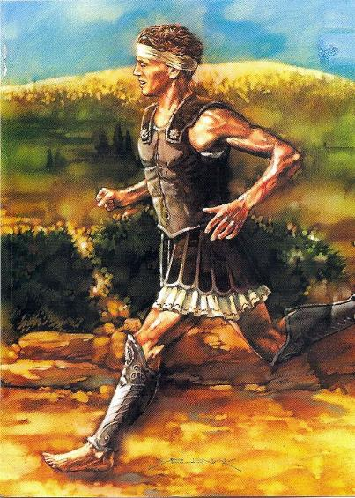
What is a marathon?
The Legend of Pheidippides
The origin of the marathon begins around 490BC at the time when the Persians were invading Greece. The most popular legend tells of a Greek messenger: Pheidippides who was tasked with the mission of informing the peoples of Athens that the Greeks have defeated the Persians at the Battle of Marathon. The distance of this epic run was 25 miles and according to legend as soon as he had delivered the message Pheidippides died of exhaustion. The original footrace was called a marathon in honour of the legend and as a result it also covered 25 miles. The marathon ran from the original site in Marathon to the Olympic Stadium in the city of Athens.
And this was also the route used during the first Olympic Games back in 1896. Ever since, the marathon has been part of the Olympics and it is also an endurance event to end the games. The standard distance for a marathon is now 42.195km or 26.2 miles.
Notes:
Teacher notes
Have students heard of a marathon before? Has anyone run a marathon? How long is it and why is it such an achievement?
Average time for men is 4 hours 30 min and for women 4 hours 45 min.

Slide 7
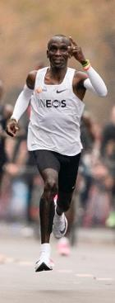
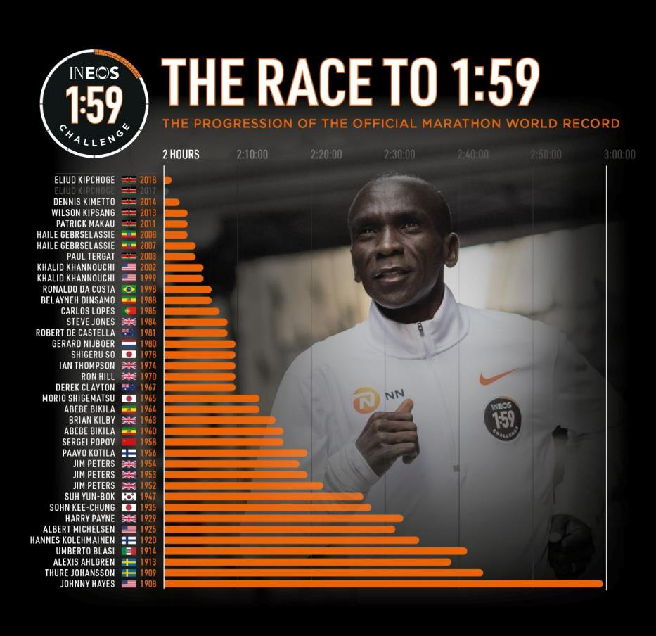
How hard is it to run a marathon in under 2 hours?
Eliud Kipchoge ran the 26.2 miles of the marathon 1:59:40 that’s the same as running at 21.1km per hour or running 100m in 17.1 seconds and then repeating it 422 times!
Notes:
Teacher notes
Getting students to understand quite how fast you must run to complete a sub 2hr marathon will help them appreciate the scale of the achievement and engage with their learning.
Depending on the space you have available, some timings have been provided above for regulation size courts, however it would be worth checking the actual size of any courts being used and encourage students to do the speed distance time calculation to establish the exact time they need to run the distance in.
It also provides excellent opportunities for scientific thinking; how can we make sure we are working accurately? Measurements, SI units repeat readings, control variables, external factors wind direction etc.

Slide 8
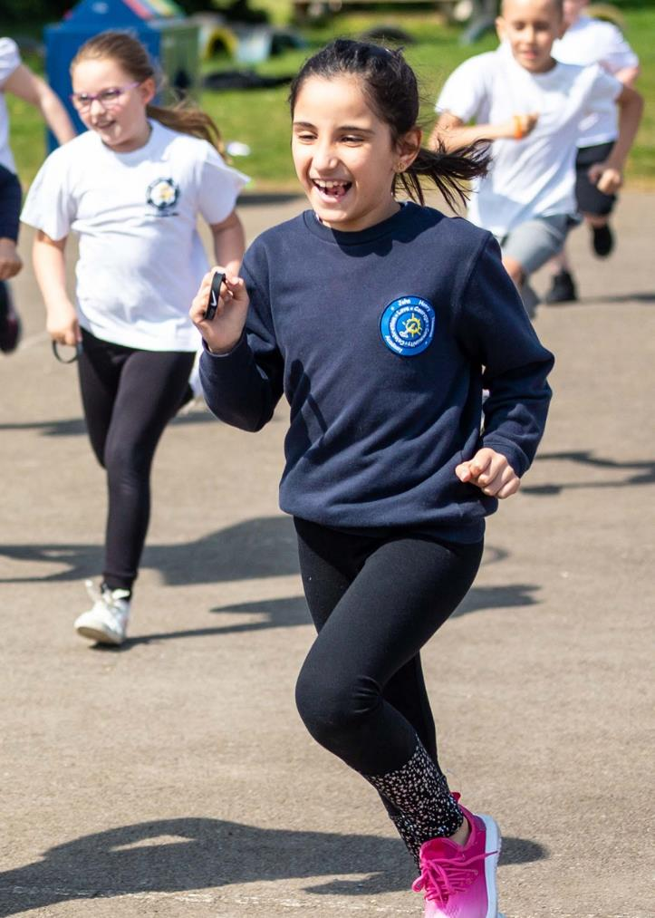
Try it yourself
Can you run at the pace of a sub- 2 hour marathon?
Run the length of a:
Badminton court in 2.3 seconds
Tennis court in 4.1 seconds
Netball court in 5.2 seconds
Football pitch in less than 16 seconds
or Measure your own distance calculate the time you would have to cover the distance by running at 5.86 m/sec
Notes:
Teacher notes
Try the mini practical above to get students to gain an understanding of the speed at which Eliud needed to run.
NB: a football pitch is normally 105m in length, though they can vary in size.

Slide 9
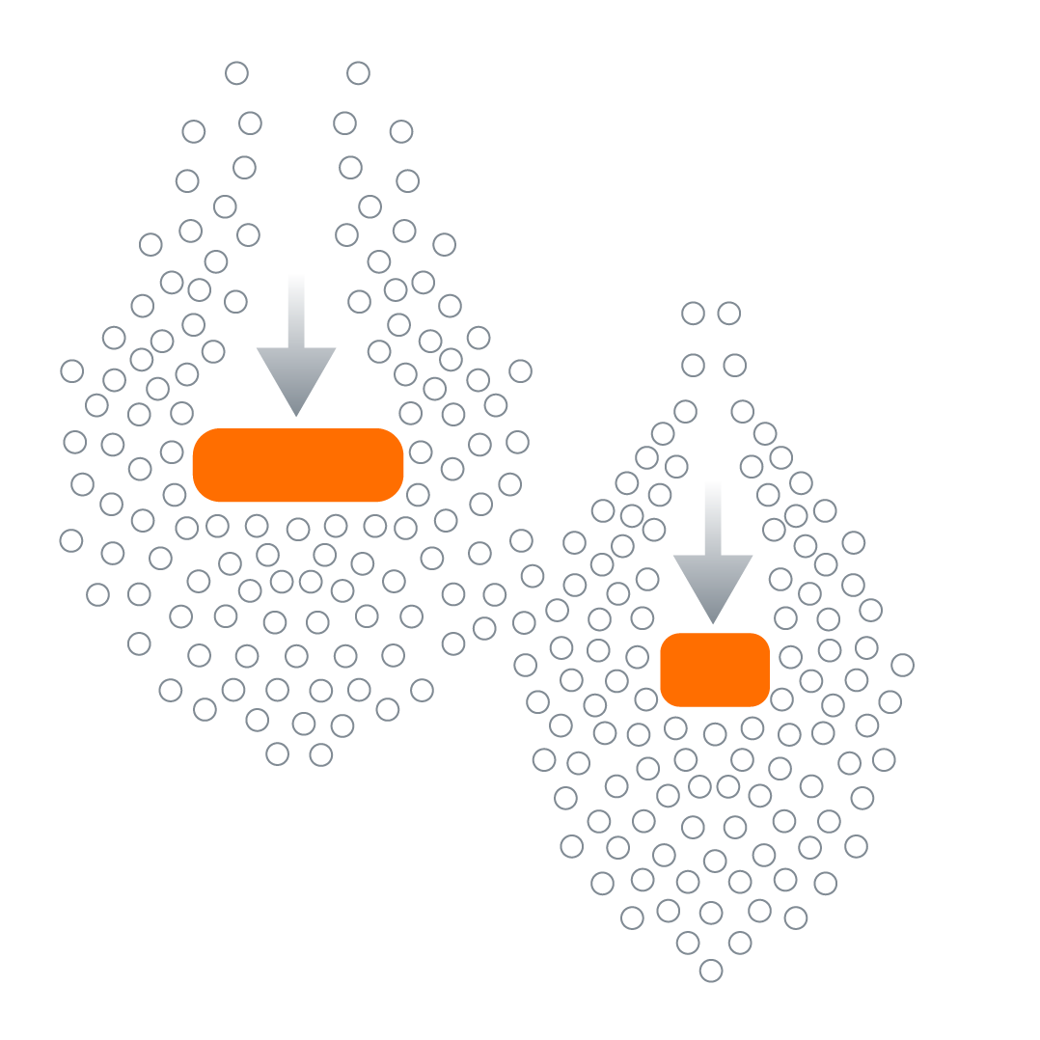
AIR RESISTANCE
Wind, temperature, and altitude all have a common link, they all affect the air resistance acting on the runner.
WHAT IS AIR RESISTANCE?
Whenever an object moves through air it hits air particles. The larger the object the more particles hit the object.
But what effect do these particles have on the speed of a moving object?
Notes:
Teacher note
Make the link between balanced and unbalanced forces here.

Slide 10
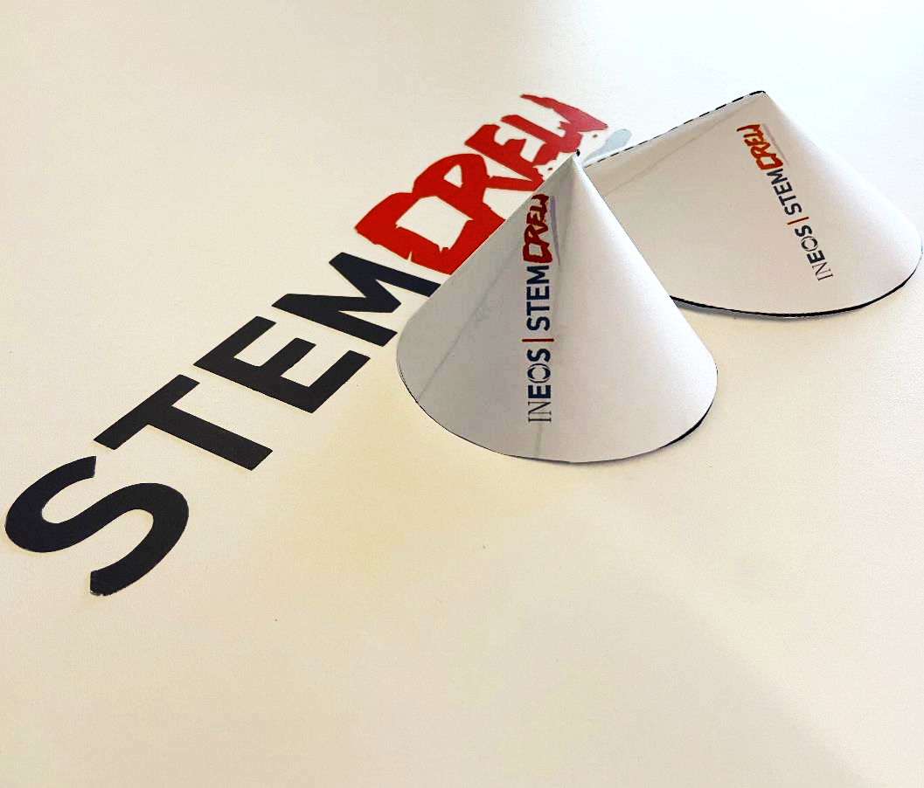
QUICK FORCES ACTIVITY
Use the paper cone template to carefully cut out the disk and make one radius cut along the dotted line as indicated.
Make the paper disk into a cone shape by overlapping the radius cut up to line 1.
Tape in place using masking tape.
Drop the cone point down from a known height and accurately record the time taken to drop.
Repeat twice more for each cone size.
USING THE SAME PIECE OF PAPER, adjust the size of cone and repeat steps 1 to 5.
Notes:
Teacher Notes
Students should work in twos or threes to carry out this investigation.
The idea is to demonstrate that although we can’t see air particles air resistance makes a big difference to the speed of an object moving through it.
You will need to identify a set height that students can drop their cone from or provide them with a tape measure to determine their own drop height.
Possible questions to ask before the investigation:
Which shape of cone do you predict will have the lowest air resistance and why?
What sort of height would give the most accurate results? Why is this important?
How else can we ensure the accuracy of our results?
Students should be encouraged to think scientifically about the need to produce reliable results including; repeat testing, consistent release height, accurate timing systems, using the same cone and tape every time etc.
Students will need to draw up an appropriate results table, building on skills learnt in the previous lesson.
Apparatus;
Scissors
One cone template from STEM Crew website per group. (The template has 2 per sheet to save printing costs!).
10mm of masking tape per group (not sticky tape as students will need to reuse the tape as they adjust the size of their cone to re-test).
Stopwatch, watch or phone to accurately time the drop.
Calculator.
One tape measure per group if giving students the option to determine their own height for the cone drop.

Slide 11
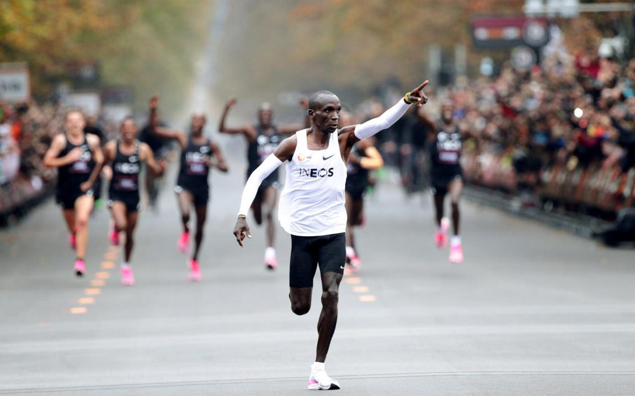
RESISTIVE
FORCES
What is air resistance?
Some objects are streamlined so they can travel more smoothly through the air.
Less air resistance means objects are able to travel faster.
Talking partners
So what is air resistance?
Discuss with a partner
Notes:
Teacher notes
Students to communicate their answers to the question as a class and use for discussion prior to the next slide.

Slide 12
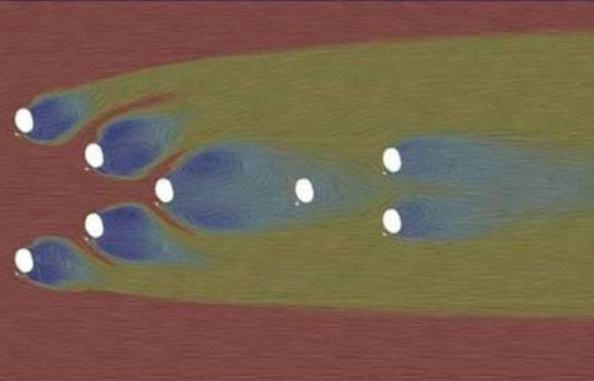
What is air resistance?
Key:
More air particles
Less air particles
Air resistance is particles of air hitting the surface of an object (push force)
As an object goes faster it will hit more air particles every second, so more push forces on it means more air resistance.
By creating a human ‘barrier’ between air particles and Eliud means less air resistance at the same speed.
Graphic shows the airflow on each member of the 1:59 formation.
Which ‘dot’ represents Eliud and why?
Notes:
Teacher notes
How the ‘inverted v’ formation works;
The pacemaker on the outside of the V takes air.
Half of the air goes to one side (out of the formation). Other half goes the other way (inside the formation onto the next pacemaker).
That then repeats essentially ‘funnelling’ the air until it hits the captain (the pacemaker right in front of Eliud). The captain throughout was effectively taking quite a beating, taking on a lot of air.
But what that meant was there was a perfectly still pocket behind Eliud.

Slide 13
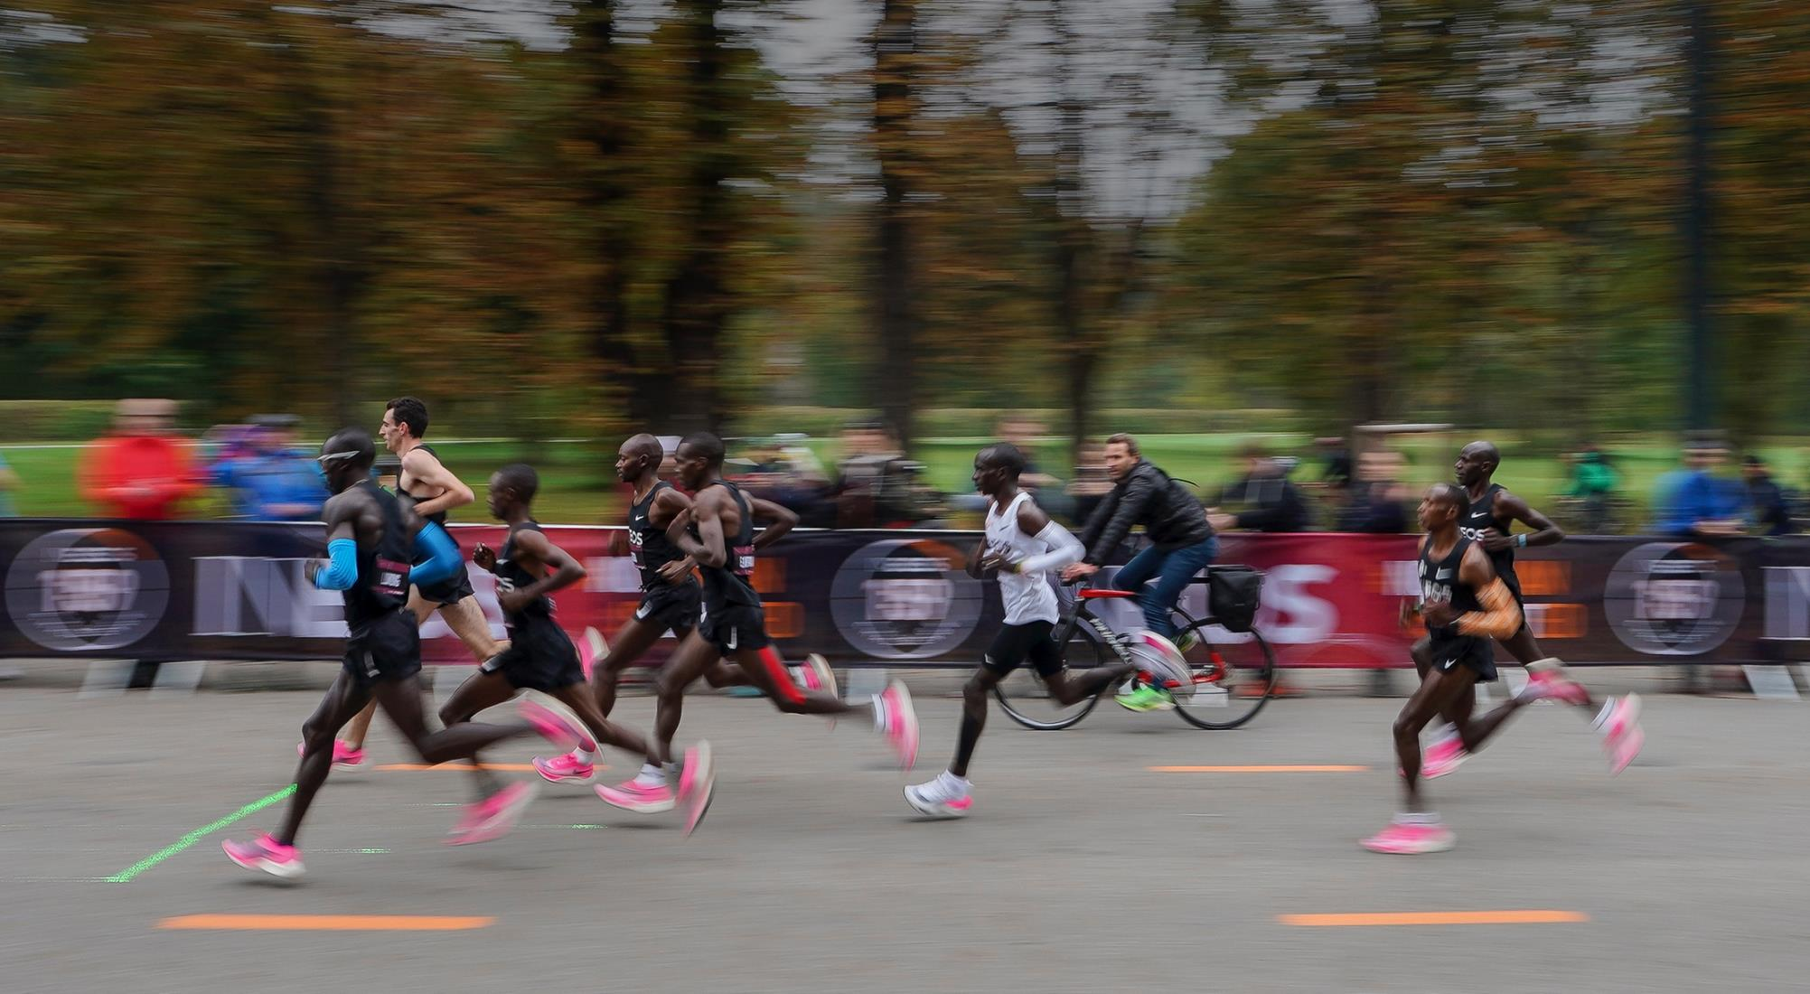
Upthrust
What forces are acting on the runners?
Air resistance
Friction
Forward thrust
Gravity
Notes:
Teacher notes
Ask students to label the arrows as a brief recap on types of forces

Slide 14
Pacemakers
What is a PACEMAKER?
Eliud
A pacemaker runs at a pre-determined speed in a race, typically a long-distance event. Other runners follow or stay with the pacer, to ensure that they’re running at their desired speed. A good pacemaker must be a steady, consistent runner who is focused on maintaining his speed and helping other runners realise their goals.
How does a pacemaker help a runner go faster?
The pacemaker encounters the air resistance first, pushing the air out of the way as they move through it, allowing other runners to tuck in behind them and gain the benefit of what’s called drafting. Drafting behind other competitors or pacemakers has helped set many records over the years, including Roger Bannister’s original four-minute mile.
Notes:
Teacher notes
Watch short video here;
https://www.youtube.com/watch?v=uWwkqBMVCfo

Slide 15
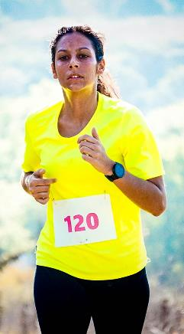
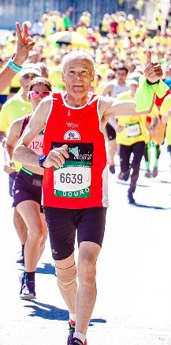
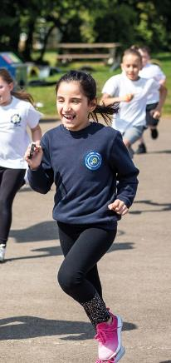
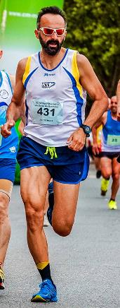
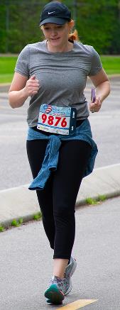
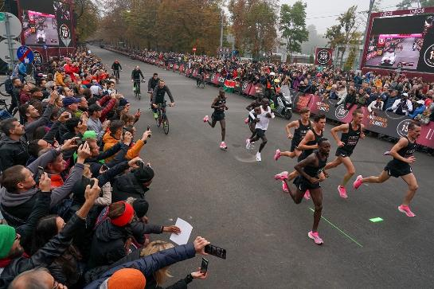
What factors affect how fast you run?
Other than fitness, how many other things can you think of that might affect how fast you are able to run a marathon?
2:50 minute challenge
You have got the time it takes Eliud to run 1 km, to work with your talking partner to think of as many factors that affect running speed as possible.
Tip: think scientifically and use the images to help you.

Slide 16
What factors affect how fast you run?
Age
Think about the following areas;
Muscle mass
Individual
Equipment
Environment
Psychological
Heart rate
strength
Altitude
weight
gender
Tightness of bends
Clothing
slope
Running surface
Wind strength
Running shoes
mood
mindset
temperature
How many did you get?
crowd
Notes:
Teacher notes
Encourage students to think scientifically about factors other than fitness that affect running speed, Including:
Physical environment – Running surface, wind, temperature, tightness of bends, slope and altitude.
Equipment – clothing, running shoes,
Psychological – self-belief, determination, Crowds
Individual – Genetics, age, gender

Slide 17
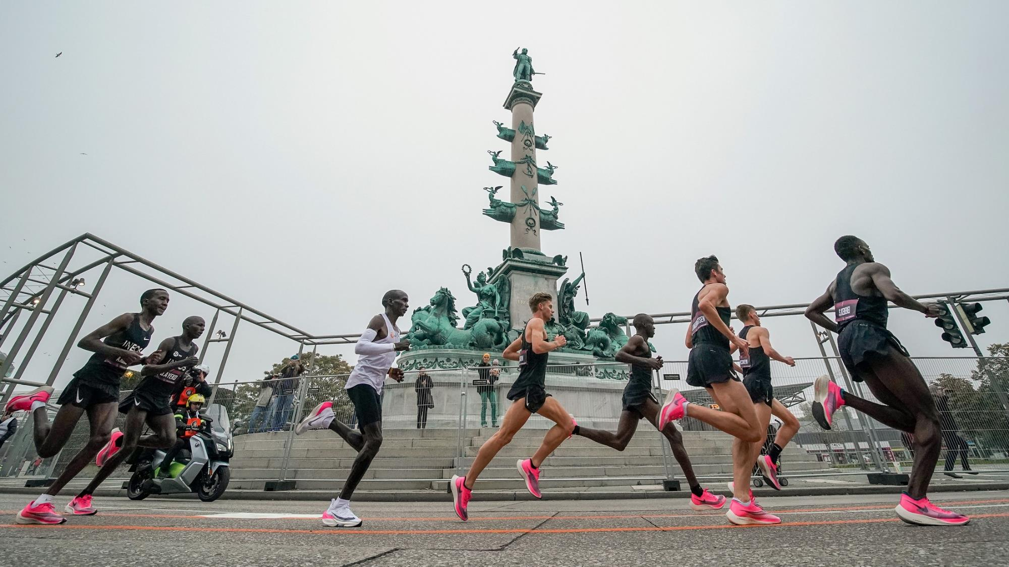
pacemakers
https://www.youtube.com/watch?v=KIzZgDXfm18
Watch the film and discuss the role of the pacemakers during the 1:59 challenge
Notes:
Teacher notes
The image above shows the effect on air flow of a car ahead of the runners.
Students to communicate their answers to the question as a class and use for discussion prior to the next slide.

Slide 18
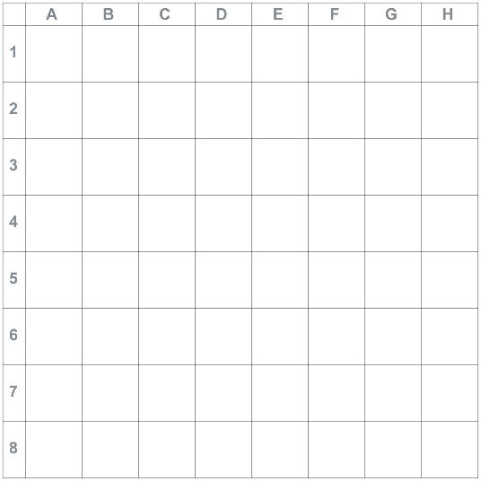
Air resistance investigation
You cannot make your runner smaller to reduce the amount of air resistance acting against them, but you can use the pacemakers to try and reduce the air particles hitting your runner and therefore reduce the air resistance.
You have up to six pacemakers that you can use.
Field testing the ‘v’ formation
Notes:
Teacher notes
The image above is a short film of formation training.

Slide 19
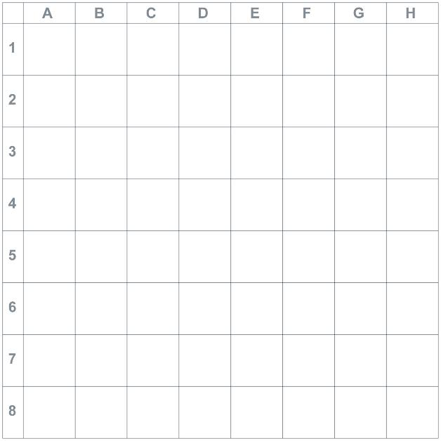
investigate How can we reduce the forces acting on the runners?
Your task is to investigate how to minimise the air resistance operating on your marathon runner.
You will be provided with the following equipment;
A grid
Runner templates
Notes:
Teacher Notes
A grid template is provided you will need to print one per group.
Ask students to make their 7 paper runners using the templates provided.
The arrow represents the direction of air flow.

Slide 20
predict
A prediction is a guess at what may happen based on an observation. Predictions are important because they provide a reference point for the scientist. If the prediction is proved or disproved, then the scientist has increased their knowledge of the process.
Task:
Task: with your partner/ team write a prediction about your pacemaker formation e.g. I predict an ‘inverted v’ will minimise air resistance the most.
Remember- your prediction may be proved or disproved in your investigation.

Slide 21
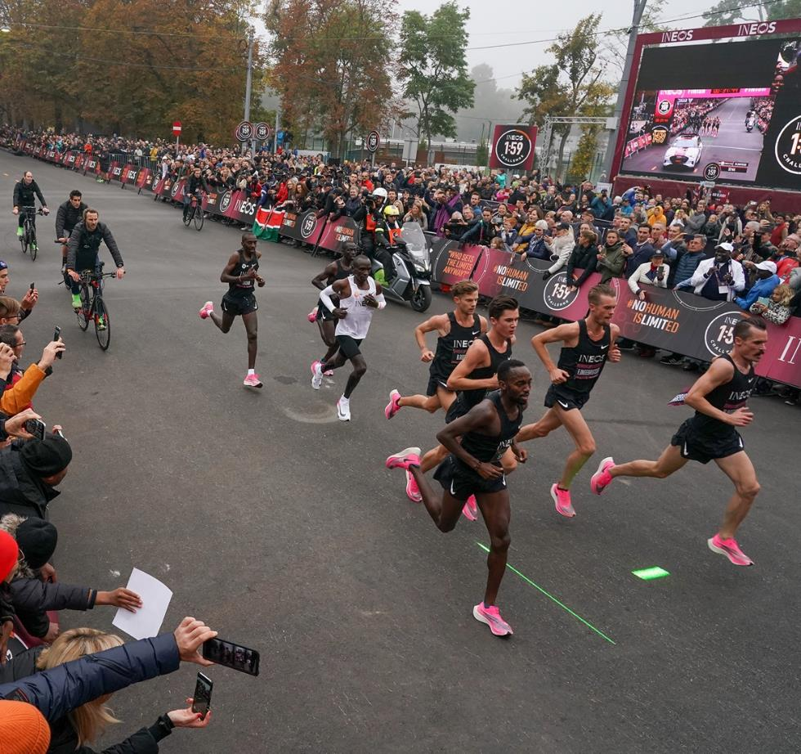
What predictions did the 1:59 team make about pacemakers?
Pacemakers will ensure Eliud runs at the correct speed
Pacemakers will ensure Eliud doesn’t waste any energy
Pacemakers will decrease the air resistance acting on Eliud
An inverse ‘V’ formation will decrease air resistance acting on Eliud the most

Slide 22
How to use the grid and cones
Use your paper runners to represent your pacemakers, you have up to six that you can use.
Choose where you are going to place them holding them in place with bluetack and note their position by recording the coordinates.
Place your runner on the grid but do not stick down and again note their position by recording the coordinates.
Place the desk fan 30cm from the front runner and turn it on at the lowest setting. Does your runner get blown over or out of position?
Repeat steps 1 to 4 choosing a new placement until you have found the best placement of your pacemakers to reduce the air resistance acting on your runner.
Pacemaker
Runner
Notes:
Teacher Notes
You may find that a fan is too powerful for the test, therefore try a hairdryer with a variety of settings or ask the students to blow the runners.
Blowing the runners will be less accurate and this can form part of a discussion with students regarding fair testing.

Slide 23
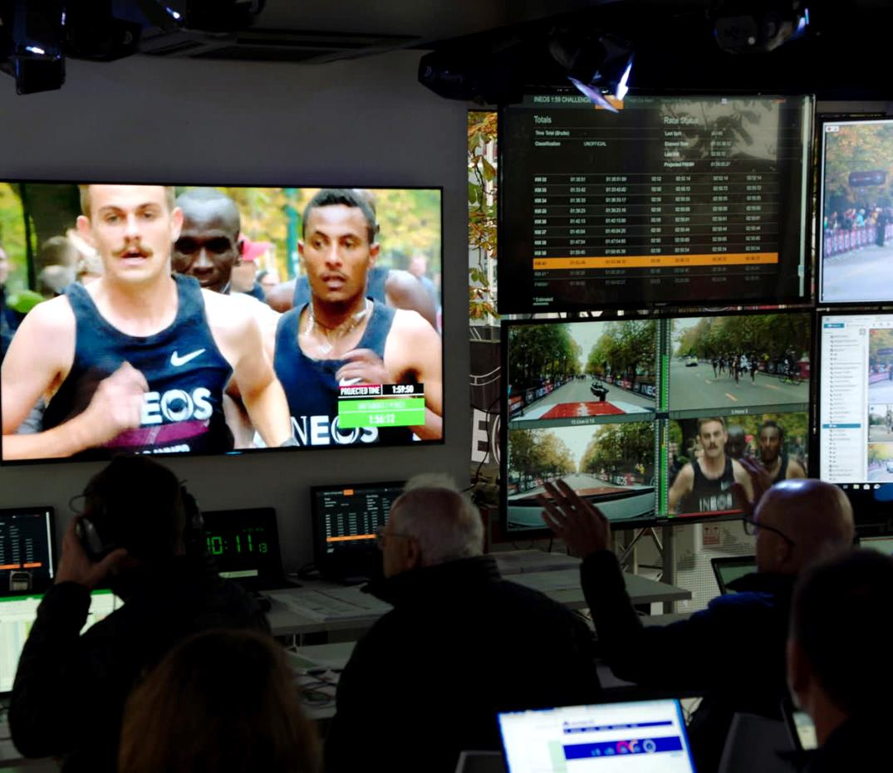
Writing a method
The method should explain exactly what you are going to do in detail. Scientific experiments should be repeatable so that anyone could pick up your work and repeat it to check their results against yours. The more results we have the more accurate the conclusions. How do we go about writing a method?

Slide 24
Model method
Model method
Sentences should be concise and to the point
Include all the detail needed
Chronological order
Repeatable
Choose 4 formations for your cones on the grid.
Set up your first formation.
Stick your pacemakers down with blutack.
Make sure your ‘runner’ is free to move.
Set up your fan 30cm from the start of the grid.
Turn the fan on and measure how far the red cone travels.
Make a note of its new position.
Repeat 3 times for accuracy.
Notes:
Teacher notes
Model writing a method here. Explain what makes a good method and ask students to take turns to write the next instruction in the list.

Slide 25
results
You will need to draw a table to record your results in. For example;
Formation | Location of runner at start | Location of runner trial 1 | No. of mm | Location of runner trial 2 | No. of mm | Location of runner trial 3 | No. of mm | Average of 3 trials (mm)
V shape | F 10 | E5 | 46 | F4 | 35 | E6 | 41 | 40.66
Semicircle
M shape
Straight line
Notes:
Teacher notes
The formation shapes in the table are suggestions and your students may come up with their own ideas.
You may wish to furnish the students with a table or get your more able to design their own.
Suggest that at least 3 readings are taken for each formation for accuracy.
Tip: Make sure students have stuck down their pacemakers- you only want the runner to move.

Slide 26
Results 2
In order to analyse your results you will need to draw a graph to show movement of your runner against formation type. How do you know which formation was the most effective at minimising air resistance?
Movement (mm)
Formation type
Notes:
Teacher notes
On the slide, model drawing a graph using a set of data collected from the class. Discuss which graph is most appropriate – line graph for continuous data, bar chart for discrete data which they have collected. . Model drawing a scale and plotting points on a line graph. Ensure all axis are labelled and the graph has a title.

Slide 27
Drawing conclusions
Which pacemaker formation is most effective at minimising air resistance?
Writing a conclusion should have 2 parts and should answer your original question.
The ‘x’ formation was the most effective. This is because, from my results….
The ‘y’ formation is the least effective. I know this because…
Notes:
Teacher notes
Explain that when concluding results, students will need to write their conclusion in 2 parts as demonstrated above. They should always state their findings and then the counter argument to their findings. They must also ensure they have answered the original question they posed when starting the investigation. They should always refer back to their original question they posed.

Slide 28
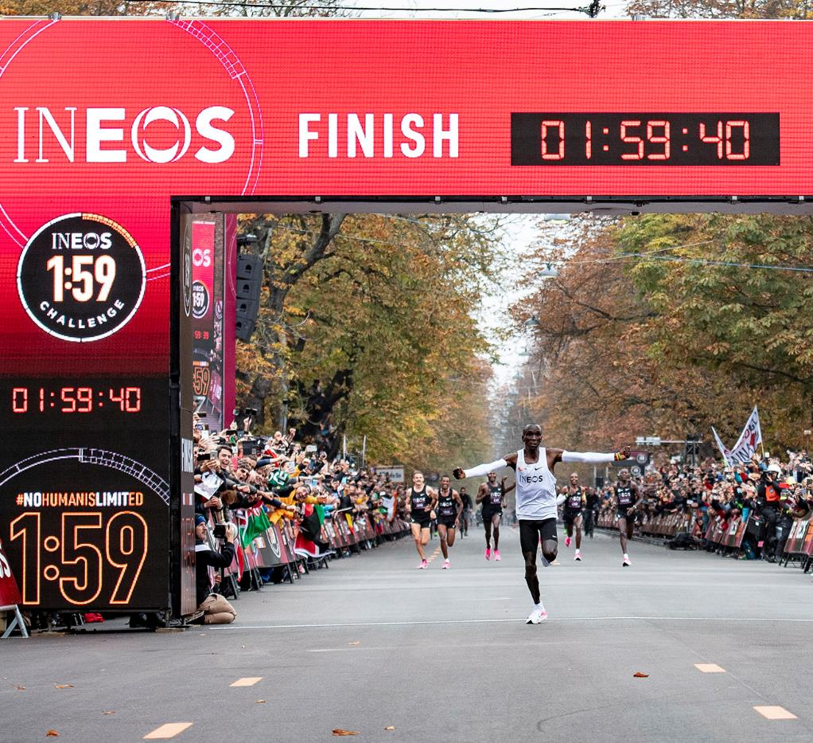
Breaking 2 vs INEOS 1:59
INEOS 1:59 was not the first time Eliud Kipchoge had attempted to run a marathon in under 2 hours. His first attempt was in 2017 with Nike. Watch the documentary Breaking 2.
Research Task:
Compare Breaking2 with INEOS 1:59. What changes did the scientists make in order to ensure success in 2019?
Notes:
Teacher notes
This longer research task may be set as a homework or longer class project. The idea is that students gain an understanding of real-life sporting challenges- they aren’t always successful first time round.
Explain to the students that success does not always come first time round and that scientists gained many insights during the Breaking 2 project which allowed them to plan for success during INEOS 1:59.
As a longer task/ homework, set students the research project above. They will need to watch the documentary https://www.nike.com/gb/running/breaking2 make notes and compare to the INEOS 1:59 projec;t; https://www.youtube.com/watch?v=7XW63dM_1d0&list=PLEW_k71ouSK51ShZ3e3gqNtYmjy55ozGL
Students may present their findings in a variety of ways; a Powerpoint, fact sheet, Prezi etc. Encourage them to link back to their own experiment in which to gain more accuracy they would need to consider more variables.

Slide 29
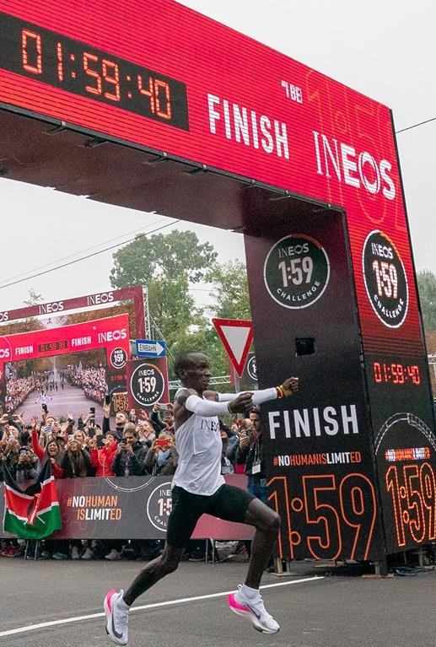
How successful were you?
How well do you understand the following;
Forces
To understand air resistance is a force which slows things down
To investigate how air resistance can be minimised
Working scientifically
Ask questions and develop a line of enquiry based on observations of the real world, alongside prior knowledge and experience
Make predictions using scientific knowledge and understanding
Present observations and data using appropriate methods, including tables and graphs

