Slide 1
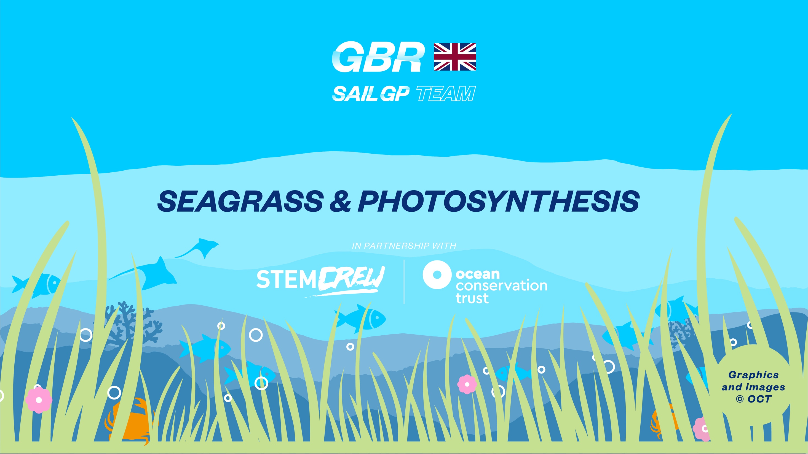

Slide 2

Big question: How can plants help combat climate change?

Slide 3
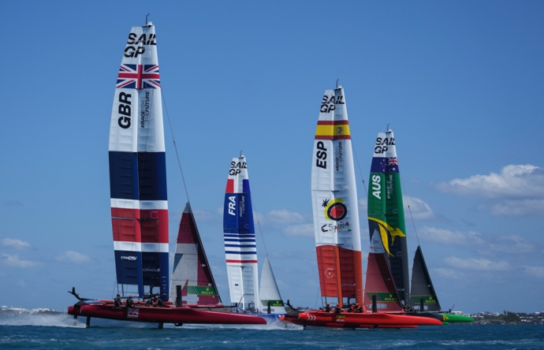
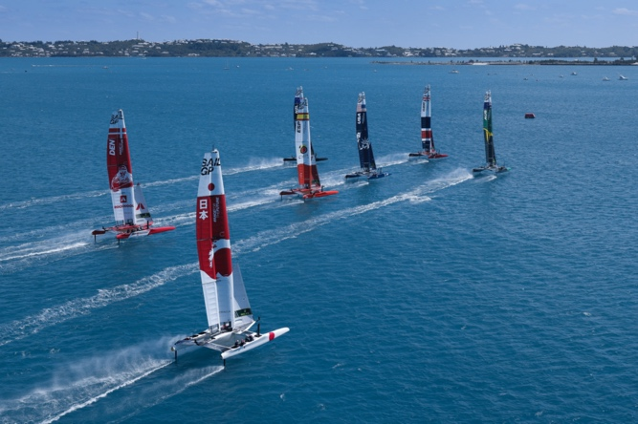
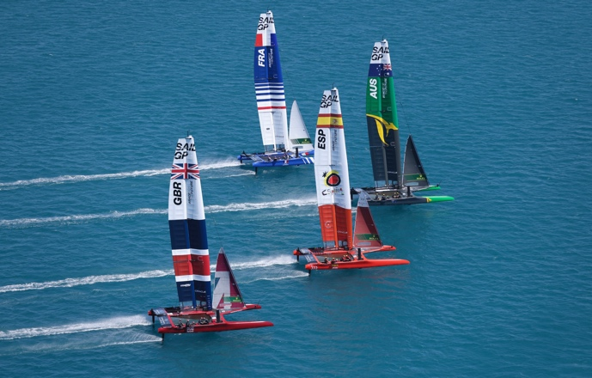

Sail GP is a sailing championship taking place at events around the World.
The international teams sail the super fast, hydro-foiling F50 catamarans.
Leading the team from Great Britain is the most successful Olympic sailor in history, Sir Ben Ainslie.

Slide 4
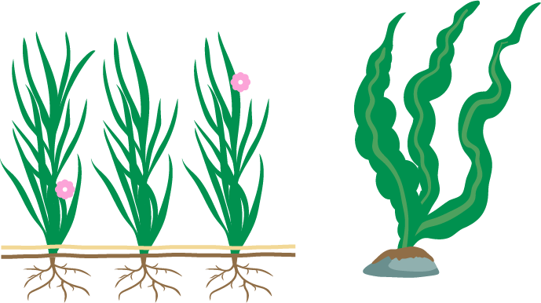
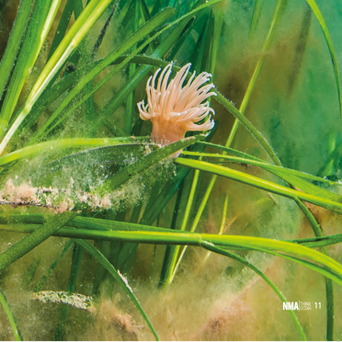
Compare the diagrams
One is a species of seagrass, the other is a species of seaweed.
What features do you notice
that are different between the two organisms?

Slide 5


Learning objectives
Gain knowledge of seagrass structure.
How it uses photosynthesis
to produce oxygen for humans to breathe.
Be able to describe some of the factors that can impact its growth.

Slide 6
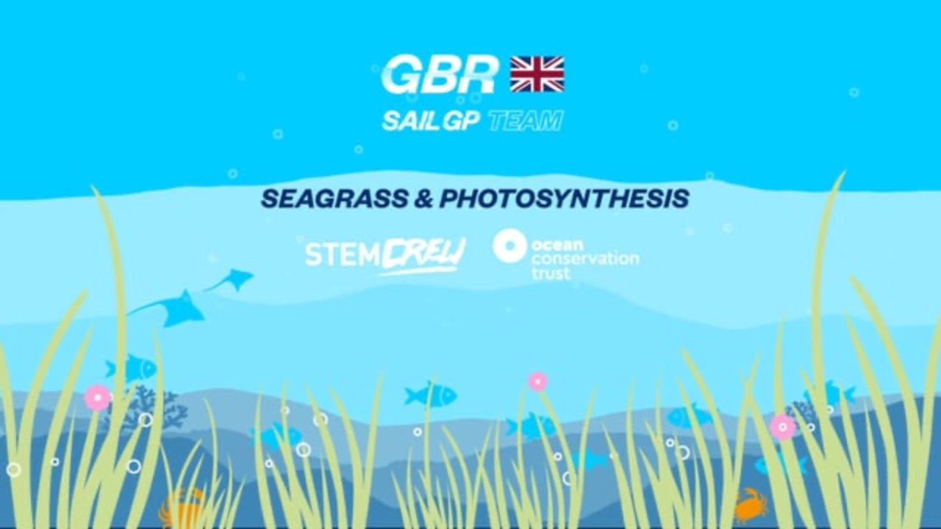
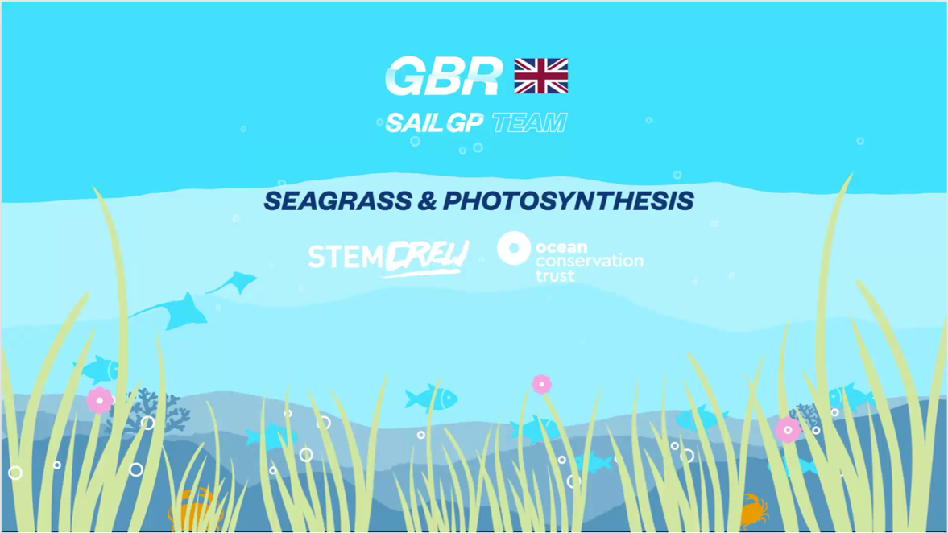
Seagrass/SailGP

Slide 7
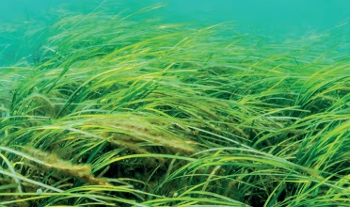
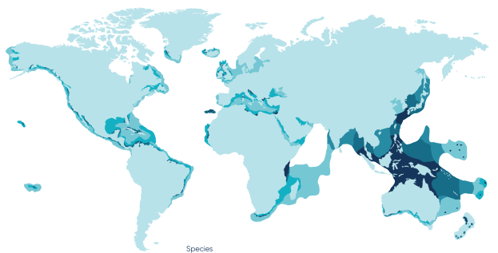
What is seagrass
Seagrass is a plant which grows in many areas of the world’s oceans.
There are around 60 different species of marine seagrasses.
They are found growing in areas of sandy and muddy sea bed.
It is the only flowering plant that grows in the ocean.
It requires light to photosynthesise and provide energy for growth.
Species
1-2
3-6
7-9
10-11
12-15

Slide 8
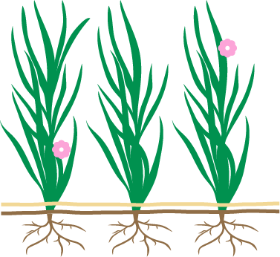
Correct answers
Seagrass activity
In this activity you need to identify the parts of the seagrass plant and add the names of the organs.
Extension
What do you think the function of the organs are?
Seabed
Leaves
Flower
Roots
Rhizome

Slide 9
Correct answers
Seagrass activity
In this activity you need to identify the parts of the seagrass plant and add the names of the organs.
Extension
What do you think the function of the organs are?
Flower
Leaves
Seabed
Rhizome
Roots

Slide 10
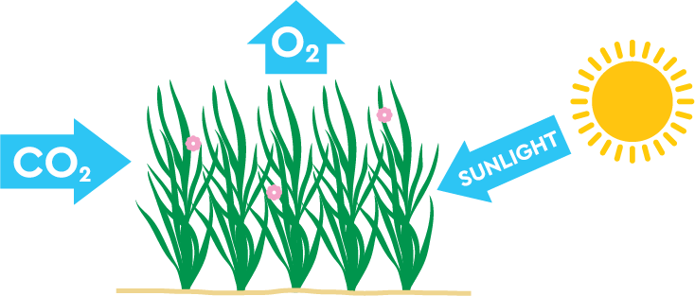
Photosynthesis in seagrass
Like plants on the Earth’s surface, seagrass uses photosynthesis to create a food source that it can use for growth.
Photosynthesis is a chemical process.
Input: carbon dioxide and water.
Uses visible light from sunlight and chlorophyll in the leaves.
Output: oxygen and glucose for energy.
Photosynthesis uses Carbon
Dioxide and releases Oxygen

Slide 11

Photosynthesis in seagrass activity
In this activity you need to add the missing parts to the word equation.
Add the name and the chemical formula into the boxes.
Glucose
H2O
Oxygen
Water
CO2
Light
O2
C6H12O6
Carbon Dioxide

Slide 12
Correct answers: Photosynthesis in seagrass activity
In this activity you need to add the missing parts to the word equation.
Add the name and the chemical formula into the boxes.
Light
CO2
H2O
C6H12O6
O2
Carbon Dioxide
Water
Glucose
Oxygen

Slide 13
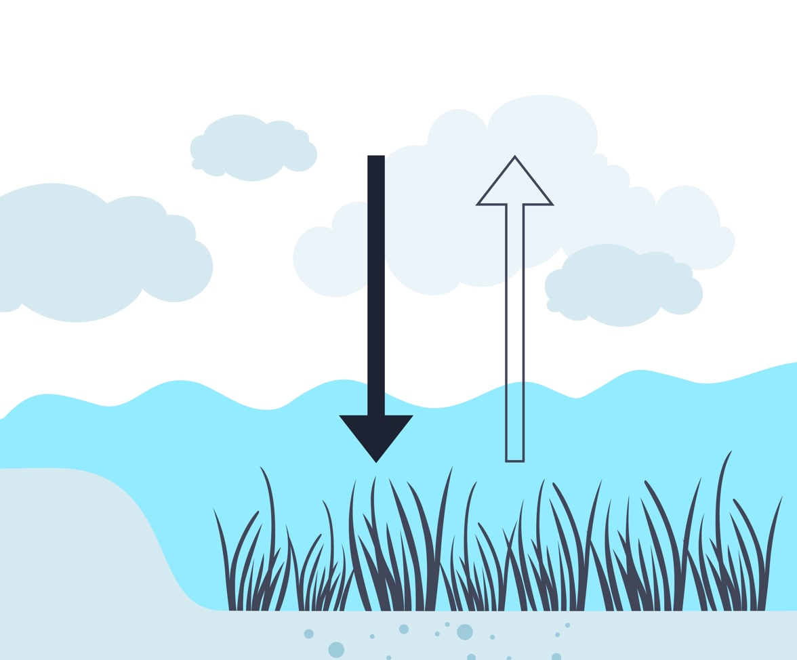
Carbon in photosynthesis
There are many ways to reduce the amount of carbon in the Earth’s atmosphere.
One of the methods is using photosynthesis.
As we looked at previously, we know that photosynthesis uses carbon dioxide.
The carbon from the gas is used by the plant for making vital organic compounds.
This means that the carbon is taken out of the atmosphere as it is not released from the plant.
When the plant breaks down after death the carbon is fixed into the soil.
CO2
O2
Carbon
uptake by
photosynthesis
O2 provided by
photosynthesis
Sequestration
into sediment
Carbon

Slide 14
Carbon in photosynthesis: Fill in the gaps
Photosynthesis takes place in the _____ of seagrass. The plant also takes in _____ _____ to use during photosynthesis. The plant creates _____, which is used for ____. Carbon dioxide is made up of ____ _and _____, the plant takes in carbon to create _____ _____ and only the oxygen is released as gas. This means that the carbon does not return to the _______ , therefore reducing the carbon levels.
atmosphere
glucose
carbon dioxide
carbon
organic compounds
growth
leaves
oxygen

Slide 15
Carbon in photosynthesis: Fill in the gaps
Photosynthesis takes place in the _____ of seagrass. The plant also takes in _____ _____ to use during photosynthesis. The plant creates _____, which is used for ____. . Carbon dioxide is made up of ____ and _____, the plant takes in carbon to create _____ _____ and only the oxygen is released as gas. This means that the carbon does not return to the _______, therefore reducing the carbon levels.
leaves
carbon dioxide
glucose
growth
carbon
oxygen
organic compounds
atmosphere

Slide 16

Factors affecting seagrass photosynthesis
and growth
As well as the availability of carbon dioxide, the growth of seagrass also depends on other factors, these include:
Water craft often anchor in areas where seagrass is growing. An anchor dragging through the seabed can cause a large amount of damage to the plant.
Some areas of seabed are too deep below the oceans surface, which means that not enough sunlight can penetrate through the water to the plant.

Slide 17
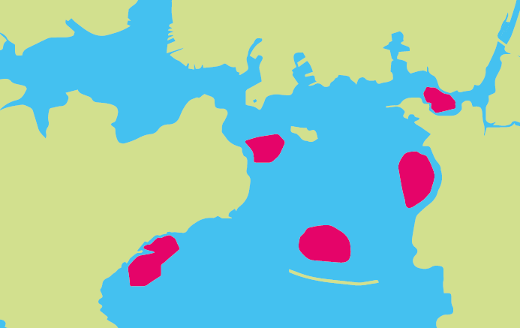
Factors affecting seagrass
photosynthesis and growth
In this activity you will use your knowledge of seagrass and photosynthesis to plan where in Plymouth Sound to plant new seagrass meadows.
D
B
C
A
E

Slide 18
Review your learning
Learning objectives
Gain knowledge of seagrass structure.
How it uses photosynthesis to produce oxygen for humans to breathe.
Be able to describe some of the factors that can impact its growth.

Slide 19
Plenary misconceptions
Use your new knowledge of seagrass and photosynthesis to correct the following statements.
Circle the wrong words and write the correct words above.
Seagrass is a type of seaweed which grows in the ocean.
Photosynthesis takes in oxygen and releases carbon dioxide.
Seagrass does not help against climate change as it releases carbon into the atmosphere.
The plant uses photosynthesis to create starch which is used for growth.
Areas of seabed with low levels of sunlight are good for plants that photosynthesise.

Slide 20
Plenary misconceptions
Use your new knowledge of seagrass and photosynthesis to correct the following statements.
Circle the wrong words and write the correct words above.
Seagrass is a type of plant which grows in the ocean.
Photosynthesis takes in carbon dioxide and releases oxygen.
Seagrass does help against climate change as it does not release carbon into the atmosphere.
The plant uses photosynthesis to create glucose which is used for growth.
Areas of seabed with high levels of sunlight are good for plants that photosynthesise.

Slide 21
