Slide 1
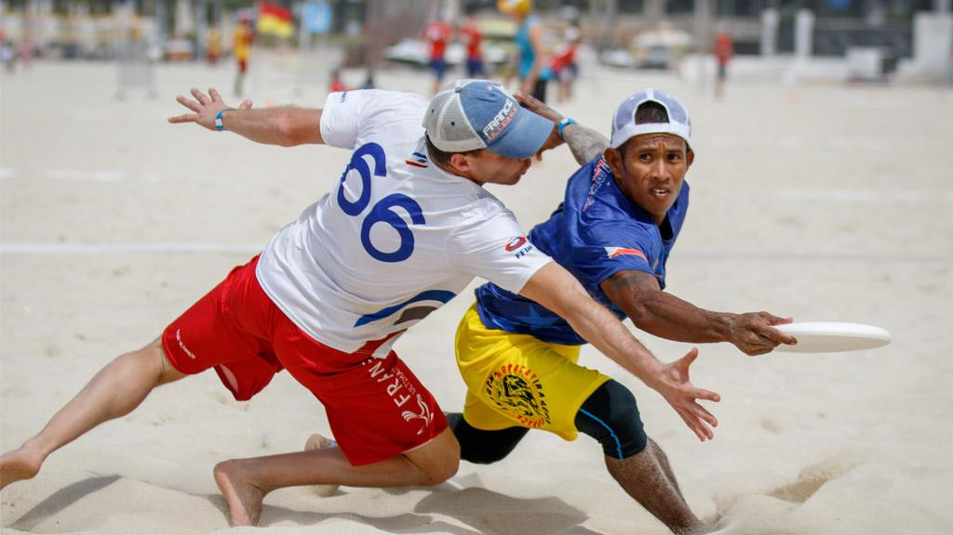
Lesson one
Ultimate Frisbee Spirit Scoring
Delivered by
Notes:
Teacher notes

Slide 2
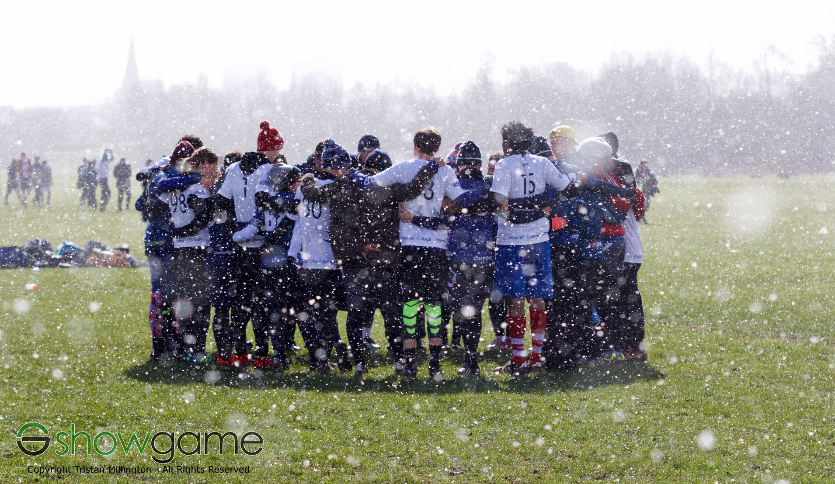
What is
Ultimate Frisbee?
It’s a team game played with a flying disc.
Catch the disc in the endzone to score.
You can’t run when you have the disc.
Ultimate is self-refereed and relies on the Spirit of the Game scoring system.
Schools Ultimate is growing across the UK, come and join in.
Delivered by
Notes:
Teacher notes
- Slides 3 and 4 are optional and included to give background context on what ultimate Frisbee is and for pupils who want to know what Ultimate Frisbee is and idea of the game

Slide 3
What is
Ultimate Frisbee?
Delivered by
Notes:
Teacher notes:
- Slides 3 and 4 are optional. These are included to give a background context on what Ultimate Frisbee is and for pupils who want to know more about the game.

Slide 4
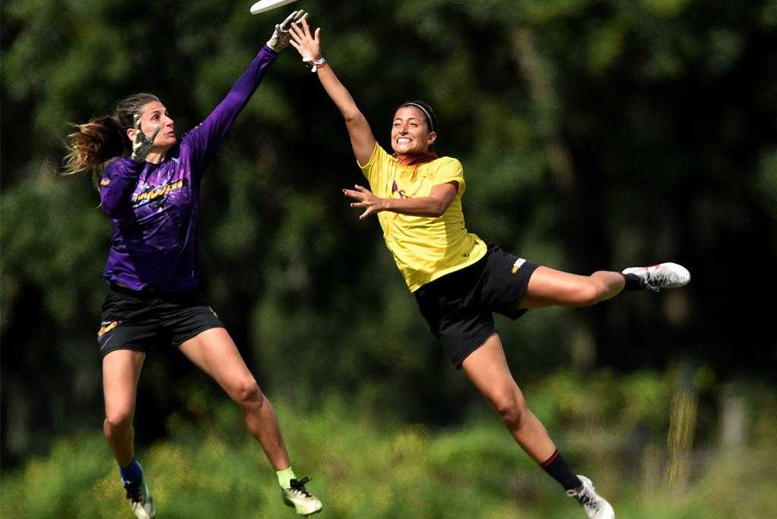
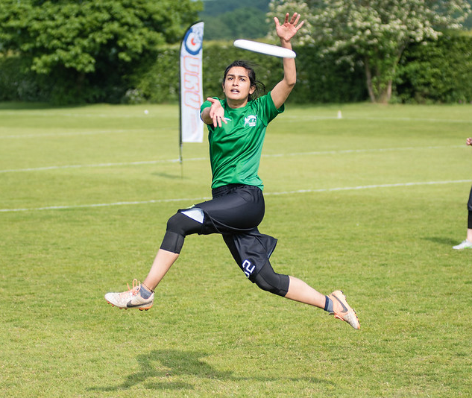
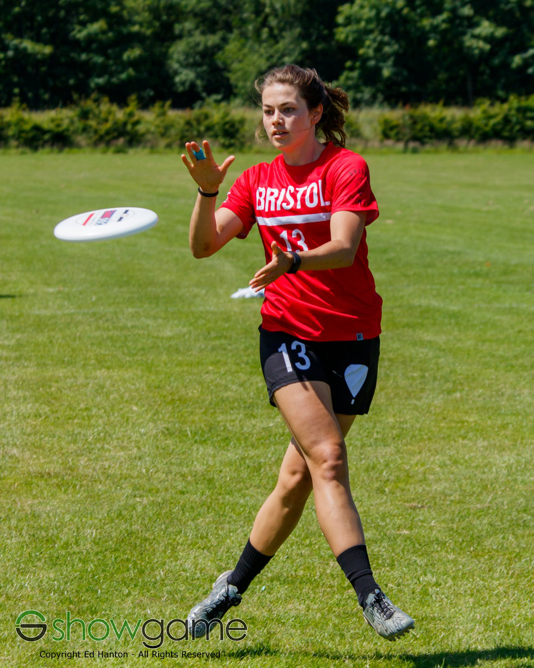
Create, reuse, revise and repurpose
Design, use and evaluate
computational abstractions that model the state and behaviour of real-world problems and physical systems.
digital artefacts for a given audience, with attention to trustworthiness, design and usability.
Undertake creative projects
that involve selecting, using and combining multiple applications, preferably across a range of devices, to achieve challenging goals, including collecting and analysing data and meeting the needs of known users.
Notes:
Teacher notes
How the series of lessons links to the government curriculum.

Slide 5
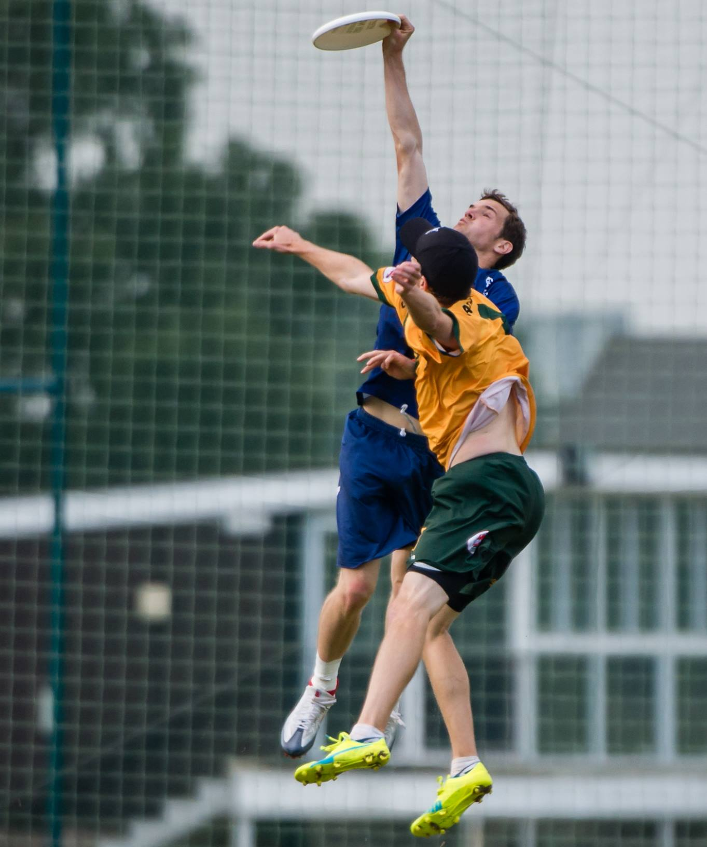
Learning objectives
To be able to organise a spreadsheet on Excel.
To be able to use the SUM and AVERAGE functions on Excel.
To explain why spreadsheets are better than paper questionnaires.
To apply knowledge to create an Excel spreadsheet for the Spirit scoring system in Ultimate Frisbee.
Delivered by
Notes:
Teacher notes
- The learning objectives outlined in this slide are to inform students of the areas they are focusing on.
- It also provides teachers with criteria for assessing progress.

Slide 6
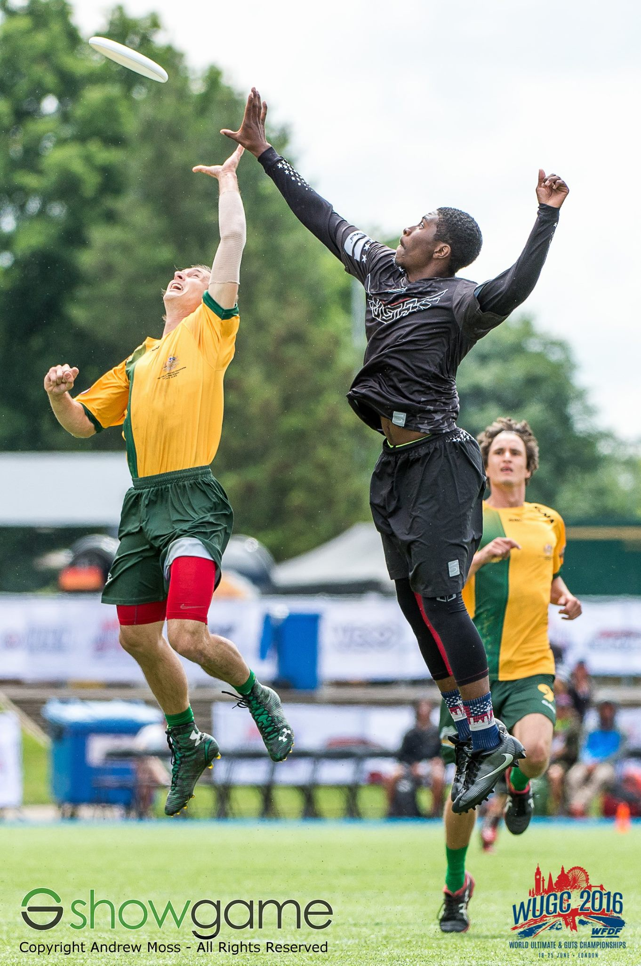
Starter
What is Ultimate Frisbee?
Have you ever played Ultimate Frisbee?
What is Spirit of the Game?
Talking partners
Discuss with your partner what you think Spirit of the Game could mean.
Delivered by
Notes:
Teacher notes:
Get ideas from the students what is ultimate frisbee. Have they ever played before? Do they know what it is?
Do they know about Spirit scoring? Get ideas of what Spirit of the Game means.
Watch from video – asking them to note the scoring system
Spirit of the game video taken from youtube by Huddle. https://www.youtube.com/watch?v=O_f15Q1ecwA&t=36s

Slide 7
Spirit of the Game
Rules knowledge and use
Fouls and body contact
Fair mindedness
Positive attitude and self-control
Communication
After the game, the teams create a Spirit Circle to thank each other for the game.
Afterwards, within their own team huddles, each player holds up 0-4 fingers to score the opposing team on five key areas:
Talking partners
Why are these things important in sport?
Delivered by
Notes:
Teacher notes:
Explain the five disciplines of the Spirit scoring system

Slide 8
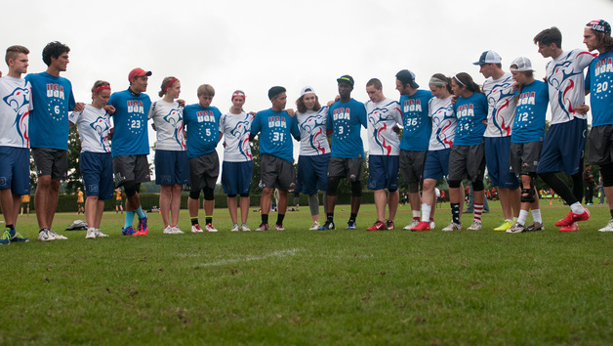
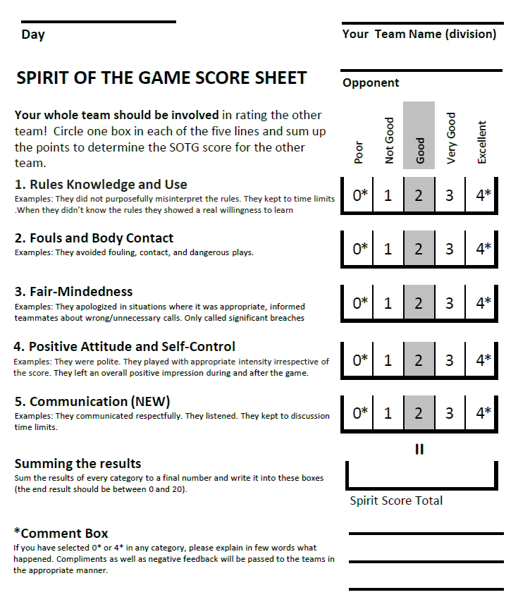
the
Scoring system
The Spirit scoring system is 0-4 in each of the categories.
The average Spirit score for a team in a tournament is normally 2.
The team with the highest Spirit score at the end wins the Spirit prize.
Remember that a score of 2 is still considered to be a ‘Good’ score. A score of 4 means that the team did something REALLY well!
Delivered by
Notes:
Teacher notes
Spirit of the Game score sheet taken from https://nswultimate.com.au/spirit-of-the-game
Explain this is a normally scoring sheet, it helps for teams to rank their opponents and to judge the games fairly. They all vote in a circle and the average is taken.
If a player votes 0 or 4 they must justify why they have given that score to the rest of the team

Slide 9
Scoring System
Score
 | 0 | 1 | 2 | 3 | 4
 | Poor | Not so good | Good (normal) | Very good | Excellent
Rules knowledge and use | They repeatedly broke the rules or weren’t willing to learn them. | They didn’t know all the main rules and didn’t try to learn them. | They had good knowledge of the rules or were willing to learn them. | They knew advanced rules and helped us to understand them. | They knew advanced rules and clearly explained them if we didn’t.
Fouls and body contact | They repeatedly fouled us or played dangerously. | There was a bit too much body contact. | There was very little or no body contact. | They actively tried to avoid body contact. | They changed their movements to avoid body contact.
Fair mindedness | They made several calls which were unfair and never listened to our points of view. | They made a couple of calls which seemed unfair and didn’t always listen to us. | They only made fair calls and listened to our points of view. | They were willing to accept that they were wrong and support our views. | They often supported our calls and accepted our opinions.
Positive attitude and self-control | They were often rude or aggressive towards us or each other. | They were rude or aggressive towards us or each other sometimes. | They were generally friendly and positive during and after the game. | They were very friendly and didn’t get angry when things didn’t go well for them. | They were very friendly and celebrated with us when we did something well.
Communication | They refused to discuss calls or got angry in discussions. | They didn’t listen to us when discussing calls. | They clearly explained their point of view and waited their turn when we spoke. | They were polite during calls and provided examples to help us to understand their point of view. | They were very polite during calls and helped us if we were struggling to explain ourselves.
CATEGORY
*Revised from original WFDF document for use at Schools Dames Events Summer 2018.
Delivered by
Notes:
Teacher notes
Grid teams use to score the other team
Break down to see why teams may score each team a certain way

Slide 10
THE
Ultimate Goal
The Ultimate goal for this lesson is to digitalise the Spirit scoring system.
Produce an Excel spreadsheet so that teams can input their scores for the Spirit scoring system.
The spreadsheet should work out the totals and the averages for each team.
Notes:
Teacher notes
This the the ultimate goal for the end of the 2nd lesson
Introduced now to see the link between what they are learning and what they will have to apply their knowledge to

Slide 11
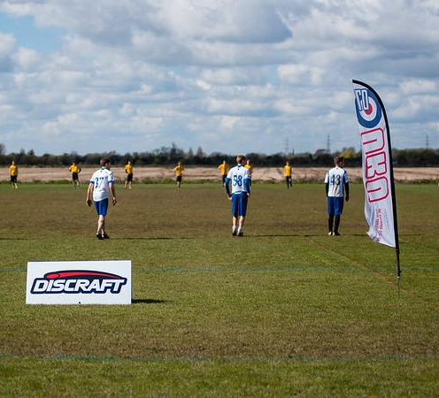
But first,
We must learn three skills:
How to:
Organise a spreadsheet
Work out sum (totals)
Work out averages (mean)
Delivered by
Notes:
Teacher notes:
Just highlighting the key skills that students must know to be able to complete the tasks set
Outlining what skills they will learn in these lessons

Slide 12
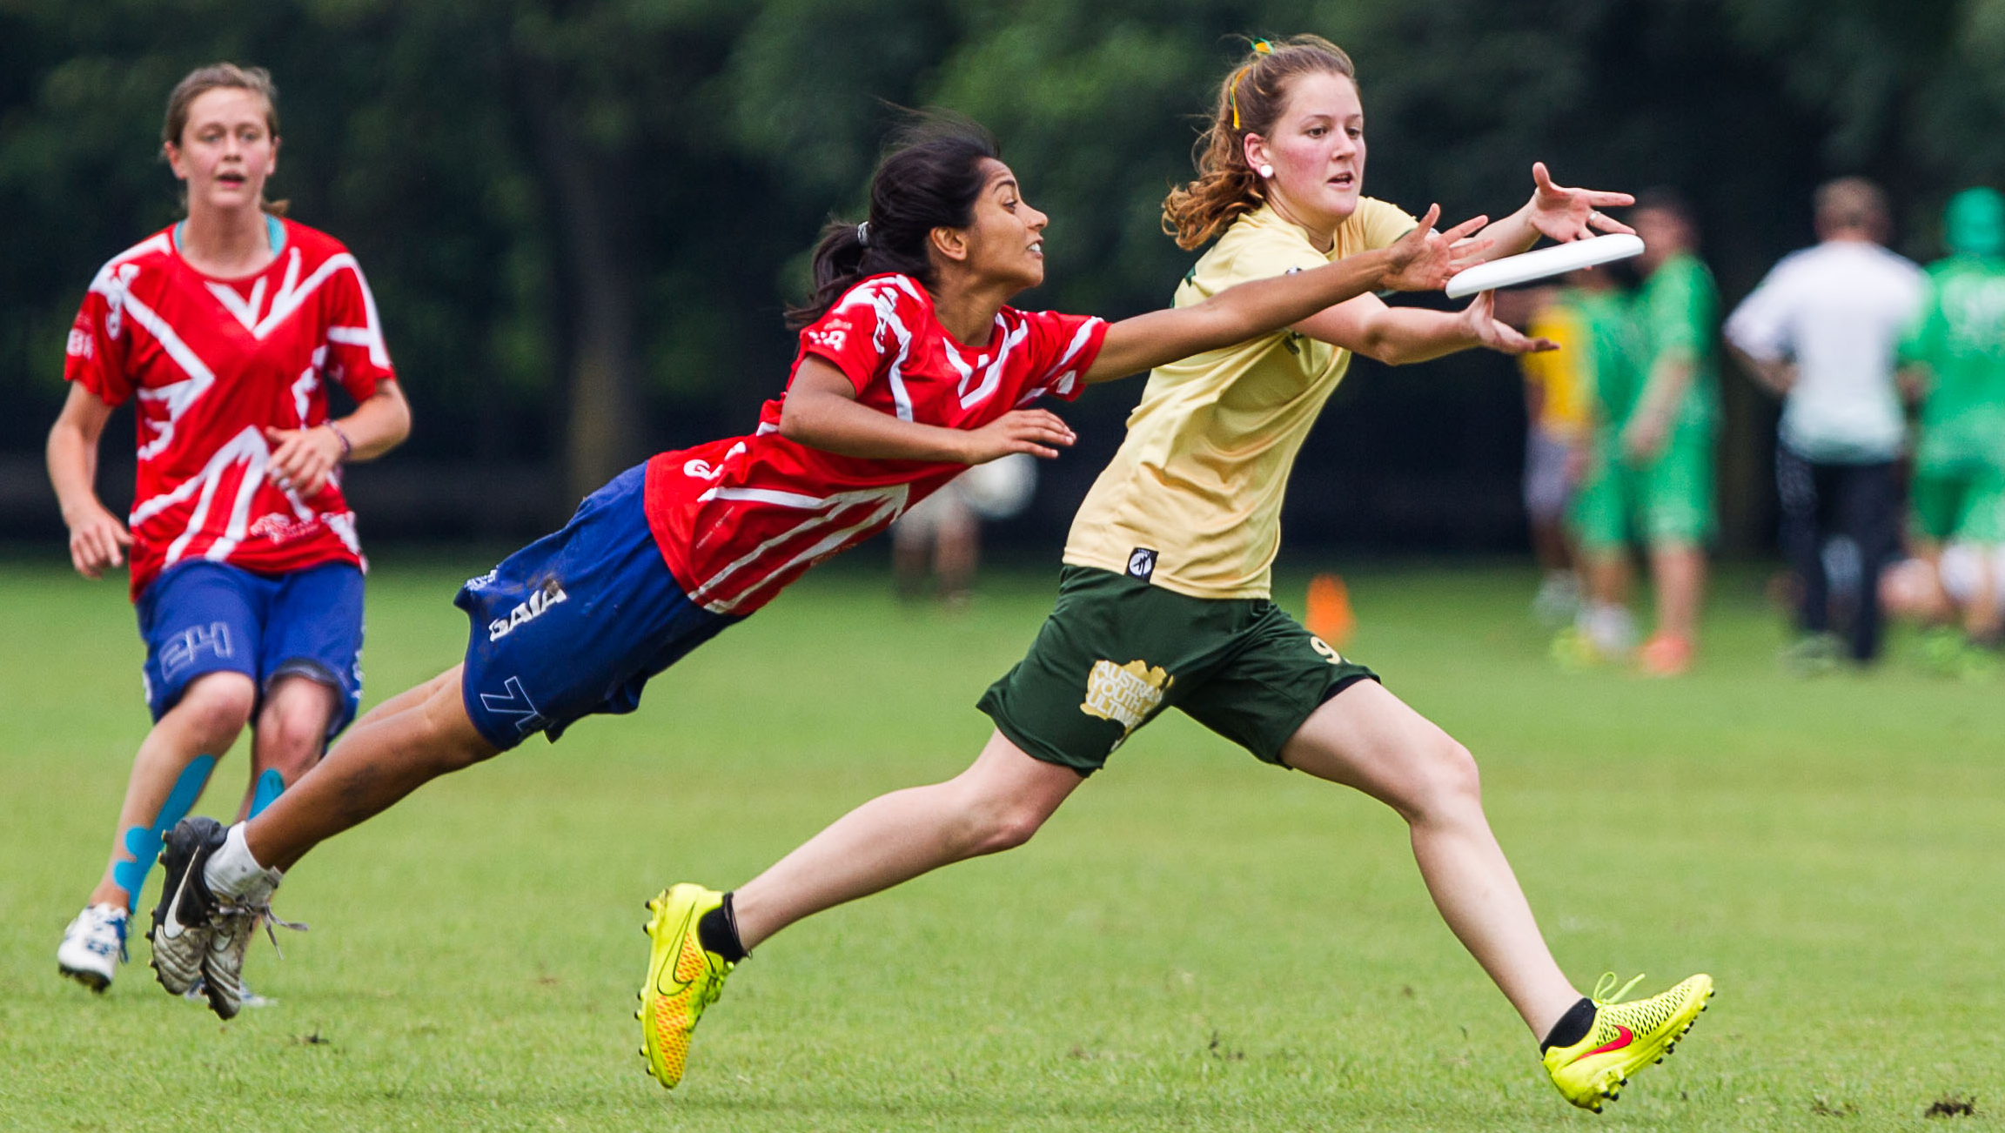
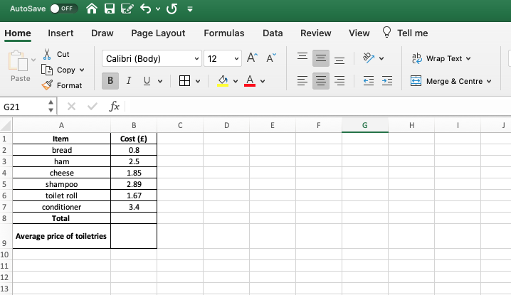
organising
A spreadsheet
What do you notice about how this spreadsheet is laid out?
Wrap Text can be used to fit words in to boxes
Words centred in column
Titles in bold
Grid lines to create table
Size of column adjusted
Delivered by
Notes:
Teacher notes
Talk about grid lines to make it neat
Titles in bold
Wrap text to fit in one box
Adjusting the size of columns to fit the writing
Centering words- personal preference
Making it look neat so that someone else can follow your work

Slide 13
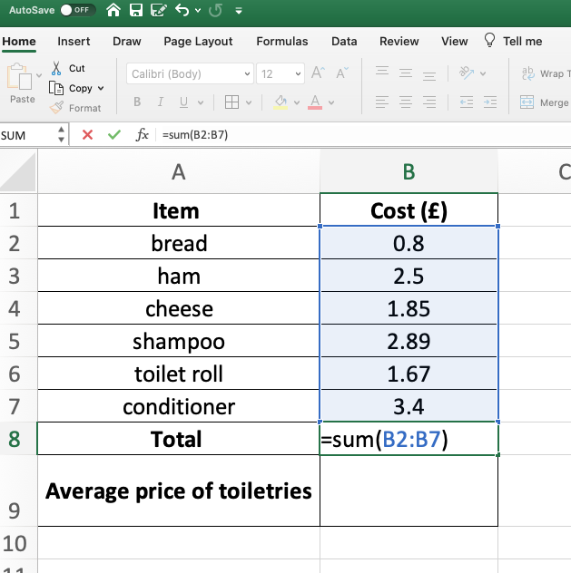
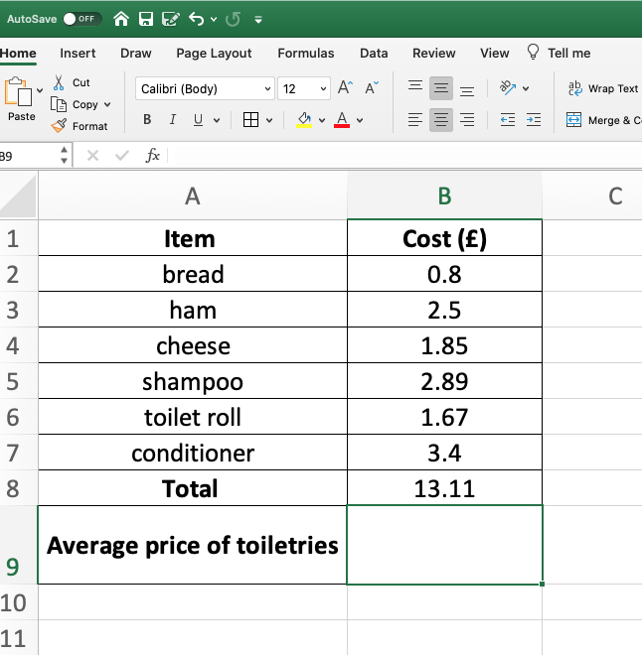
Working out
the Sum
To work out the SUM (total):
Click on the cell you would like your answer in (B9 in this case)
Write =SUM(
Highlight the cells you want to calculate
Close the brackets with )
Press Enter.
Delivered by
Notes:
Teacher notes
Teaching how to work out the Sum of a list
Simple explanation and pictures to show what is actually happening in Excel
Could show them a real live version in Excel

Slide 14
Using
Auto-Sum
Click in the cell you want.
On the ribbon at the top choose Auto-sum.
This will automatically work out the sum in the column.
Delivered by
Notes:
Teacher notes
Using auto sum as an easier quicker way – can be left out for high ability or used for low ability

Slide 15
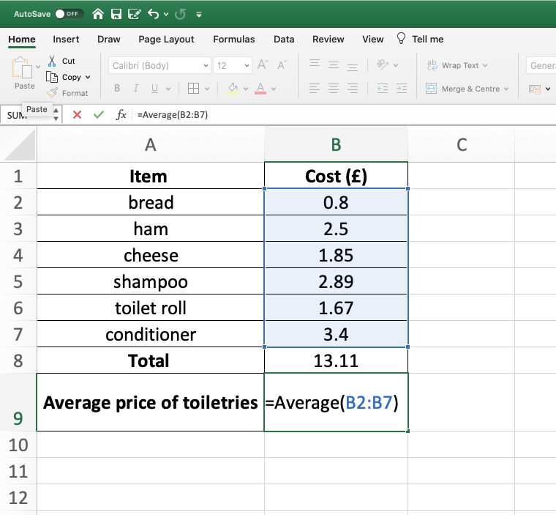
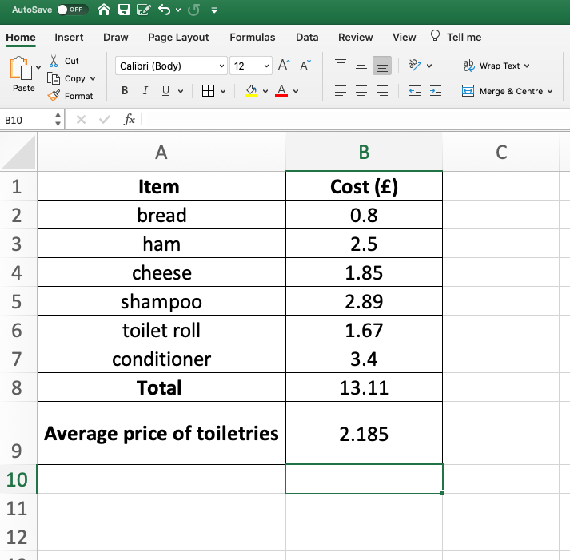
Working out
the Average
To work out the Average (Mean):
Click into cell you would like your answer in (B10 in this case)
Write =AVERAGE(
Highlight the cells you want to calculate
Close the brackets with )
Press Enter.
Delivered by
Notes:
Teacher notes
Teaching how to work out the average of a list
Simple explanation and pictures to show what is actually happening in Excel

Slide 16
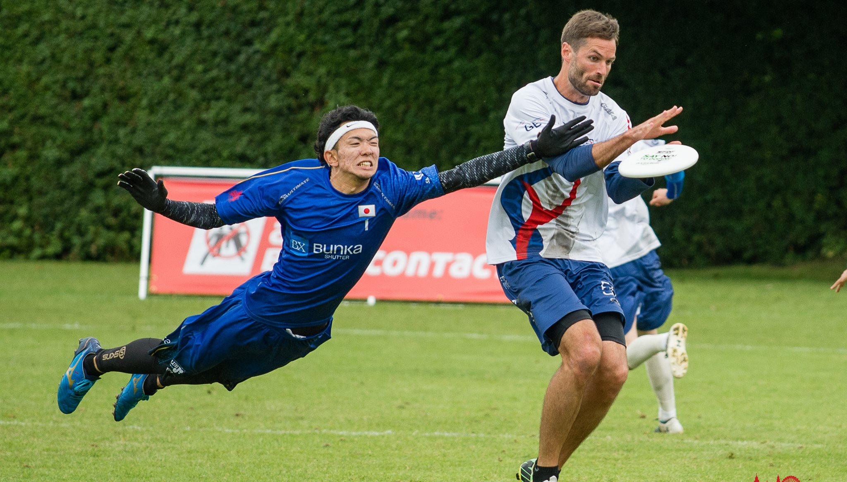
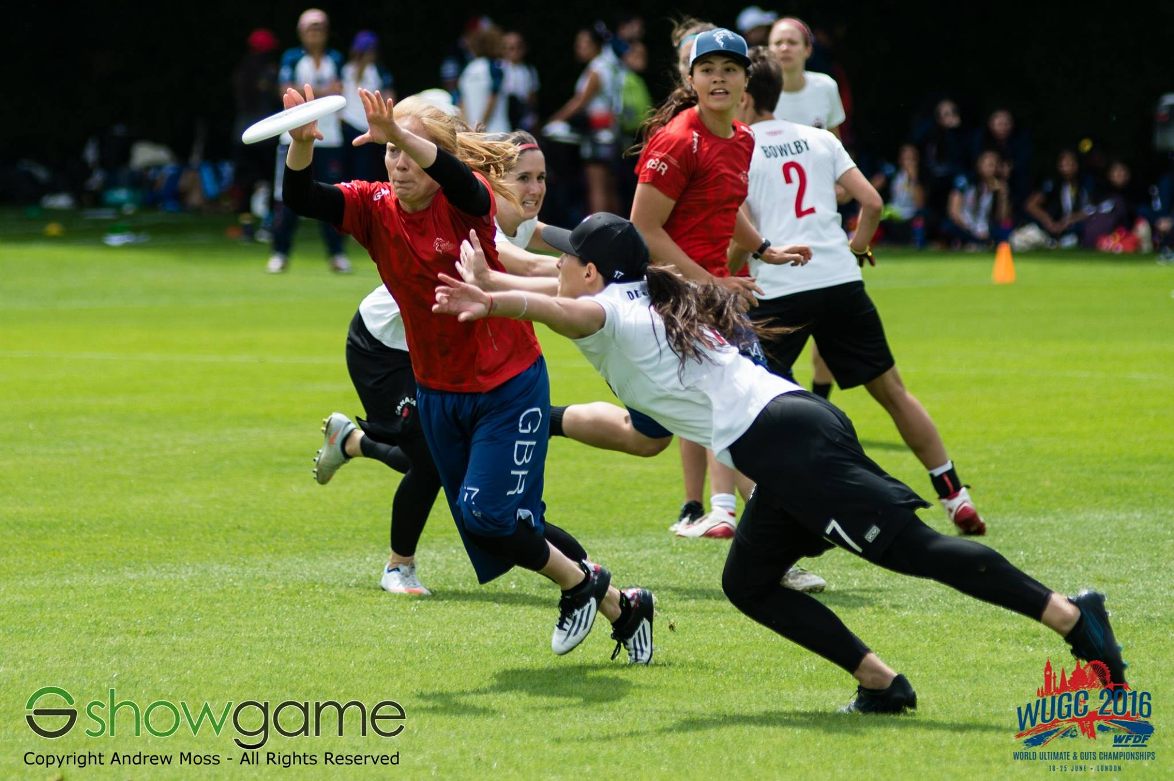
Student task
Follow the instructions on the student task worksheet to complete a shopping list.
1
2
3
Make sure your work is organised and laid out appropriately
Work out the total
Work out the averages.
Notes:
Teacher notes
Student task is to make a shopping list – first of all doing everything manually and then doing it in Excel
The students will have to work out the sum of the shopping list and then the average of different items
They will also be asked to organise their spreadsheet in a specific manner.

Slide 17
Learning objectives
To be able to organise a spreadsheet on Excel.
To be able to use the SUM and AVERAGE functions on Excel.
To explain why spreadsheets are better than paper questionnaires.
To apply knowledge to create an Excel spreadsheet for the Spirit scoring system in Ultimate Frisbee.
Delivered by
Notes:
Teacher notes
- The learning objectives outlined in this slide are to inform students of the areas they are focusing on.
- It also provides teachers with criteria for assessing progress.

Slide 18
Plenary/check point task
What is better: using a spreadsheet or completing the tasks manually with a calculator?
Why?
VS
Spreadsheet
Manual
Delivered by
Notes:
Teacher notes
This is for them to gauge the ease of automated programs – takes time to set up but then it does it all for you
Manually takes more time and may have to use a calculator if sums are not simple

Slide 19
Lesson TWO
Ultimate Frisbee Spirit Scoring
Delivered by
Notes:
Teacher notes

Slide 20
Learning Objectives
To be able to organise a spreadsheet on Excel.
To be able to use the SUM and AVERAGE functions on Excel.
To explain why spreadsheets are better than paper questionnaires.
To apply knowledge to create an Excel spreadsheet for the Spirit scoring system in Ultimate Frisbee.
Delivered by
Notes:
Teacher notes
Same as previous lesson

Slide 21
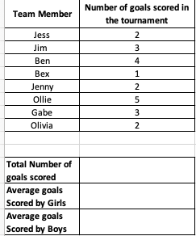
Starter
Can you remember how to find the sum and average?
On the starter spreadsheet work out the sum and the averages.
Use the functions we learnt in the previous lesson.
Talking partners
How could we use this to create a spreadsheet for the Spirit scoring system?
Delivered by
Notes:
Teacher notes:
Brief recap of how to use the Excel functions
They all have spreadsheet which is filled in with data they need to find the answers to the sum and the averages
Take ideas – some top ability may have an idea of how they want to layout a spreadsheet and how they will find the averages and means
Explanations available on next 3 slides hidden but can unhide depending if class need recap
There is a help box on the spreadsheet this could be hidden before distributing and then if struggling guided to unhide to jog memory

Slide 22
the
Scoring System
The Spirit Scoring system is 0-4 in each of the categories.
The average Spirit score for a team in a tournament is normally 2.
The team with the highest spirit score at the end wins the Spirit prize.
Our task is to make this smoother and more efficient by making it digital.
Delivered by
Notes:
Teacher notes
Spirit of the game score sheet taken from https://nswultimate.com.au/spirit-of-the-game
Recap of scoring system – Remind them of the task and how to spirit score
Explain this is a normally scoring sheet, it helps for teams to rank their opponents and to judge the games fairly. They all vote in a circle and the average is taken.
If a player votes 0 or 4 they must justify why they have given that score to the rest of the team
Video to recap quickly the values of spirit of the game
https://www.youtube.com/watch?v=8puxi4_Vw74

Slide 23
THE
Ultimate goal
The Ultimate goal for this lesson is to digitalise the Spirit scoring system.
Produce an Excel spreadsheet that teams can input their scores for the Spirit scoring system.
The spreadsheet should work out the totals and the averages for each team.
Notes:
Teacher notes
This the the ultimate goal for the end of the 2nd lesson
Introduced now to see the link between what they are learning and what they will have to apply their knowledge to

Slide 24
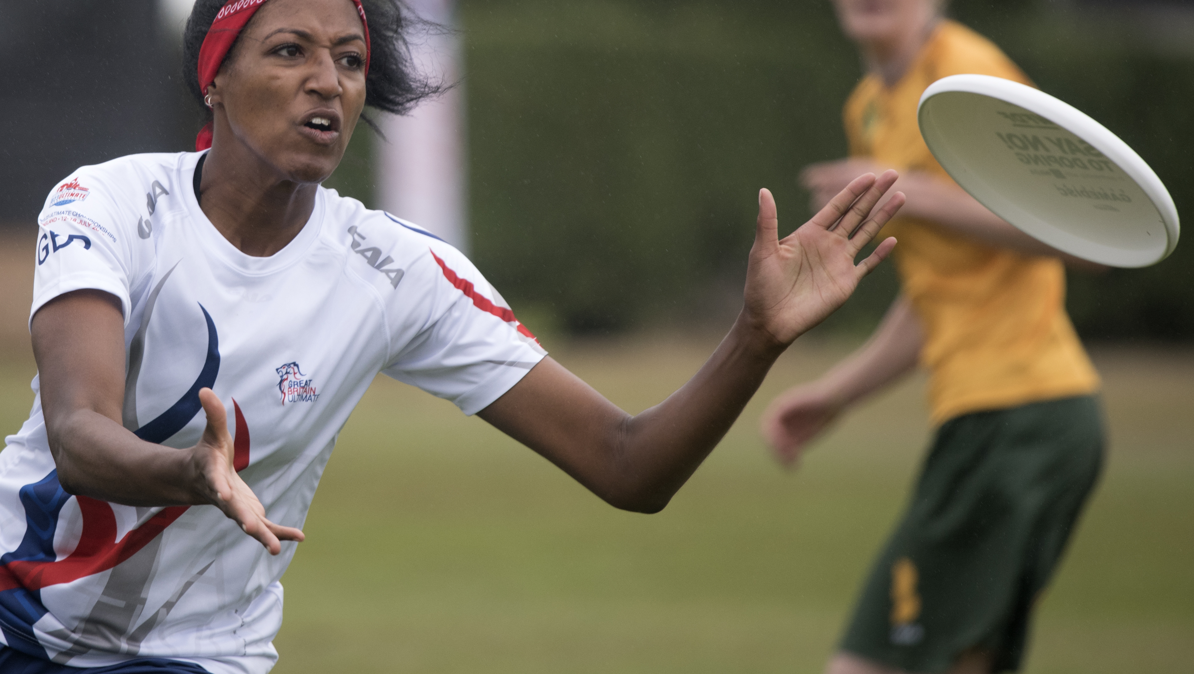
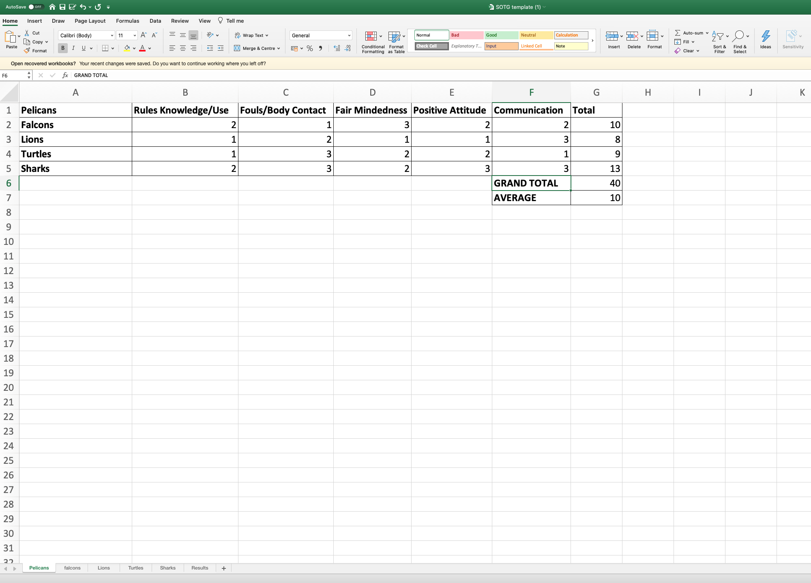
The
Ultimate goal
Team names down the left-hand side
SOTG five categories along the top row
Use function =sum(
Find total score for each team
Use function =sum(
Find the grand total score
Use the function =average(
Find the average of the totals
Check your spreadsheet works by inputting numbers
Extension: Multi tab
Delivered by
Notes:
Teacher notes
Overview of spreadsheet what should they be trying to achieve
Layout – bold titles
Names of team down side
5 rules along the top
Totals and averages
Functions inputted
explain this is one team sheet that the other teams can input their spirit score on to when they play them ( downsides they can see everyone elses scores will this impact them? Do you need official to hide other scores so they just see their column when completing) could show them how to hide rows
Multi tab High ability copy and paste and change the names of the teams to ensure all are involved

Slide 25
Student task
Follow the instructions on the student task worksheet to complete a score card for Spirit of the Game.
1
2
3
Make sure your work is organised and laid out appropriately.
Work out the total
Work out the averages
Notes:
Teacher notes
Student task is to make a shopping list – first of all doing everything manually and then doing it in Excel
The students will have to work out the sum of the shopping list and then the average of different items
They will also be asked to organise their spreadsheet in a specific manner.

Slide 26
The
Ultimate goal RAG
How does your spreadsheet look?
Have you put numbers in (0-4)?
Did your functions work?
How confident do you feel making a spreadsheet?
How confident do you feel using the functions =SUM and =AVERAGE?
Delivered by
Notes:
Teacher notes
Self assess skills

Slide 27
The
Ultimate goal RAG
How does their spread sheet look?
Have they put numbers in (0-4)?
Did their functions work?
Delivered by
Notes:
Teacher notes
Get students to send their spread sheet to another class member for them to look at it and mark it.
Or walk around room and look at each others spreadsheet.
Or give them post it notes get them to write something that is good and something they could improve

Slide 28
Learning objectives
To be able to organise a spreadsheet on Excel.
To be able to use the =SUM and =AVERAGE functions on Excel.
To explain why spreadsheets are better than paper questionnaires.
To apply knowledge to create an Excel spreadsheet for the Spirit scoring system in Ultimate Frisbee.
Delivered by
Notes:
Teacher notes
Same as previous lesson

Slide 29
Plenary
Do you think it would be better to fill in questionnaires and work out the averages manually or fill in a spreadsheet?
Why?
Is there a better way to collect this data?
VS
Write a guide so a tournament organiser can create their own spreadsheet for SOTG
Spreadsheet
Manual
Delivered by
Notes:
Teacher notes
This is for them to gauge the ease of automated programs – takes time to set up but then it does it all for you
Manually takes more time and may have to use a calculator if sums are not simple
Could use forms quick and efficient and anonymous gets rid of the need to hide teams, goes straight to Excel but would need to still add functions for it to work out the scores, stops having to set up or layout- just filter.

