Slide 1
EAL Nexus Resource
Beginners’ version
Adaptation to different habitats
Subject(s): | Science and Geography
Key Stage: | KS3, KS4
Topic: | Adaptation to different habitats
© Bell Educational Trust 2020
This resource was originally developed by Alison Fisher and has been adapted for EAL Nexus.

Slide 2
Adaptations to different habitats

Slide 3
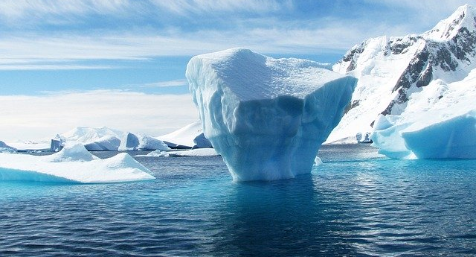
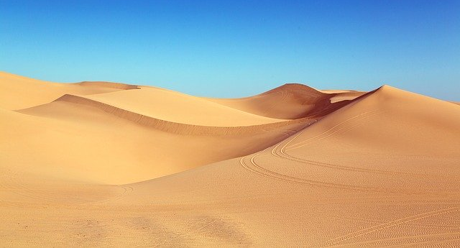
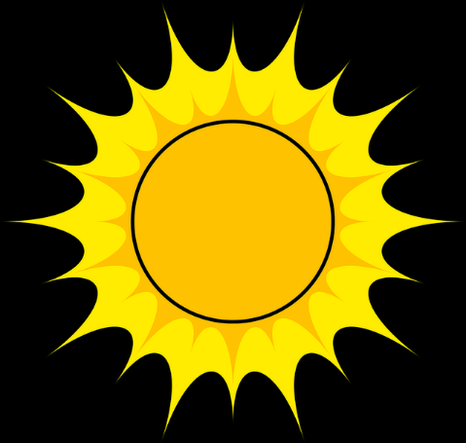
Differences between the Arctic and the desert Put the words into the correct boxes
Arctic
Desert
Temperature
cold
hot
snowy
Temperature
dry
sandy
arid
freezing
Other
Other
frosty
scorching

Slide 4
Similarities between the 2 habitats Put the words in the correct boxes
Arctic
Desert
Climate
harsh weather
Landscape
no trees
monotonous
sparse vegetation
extreme temperatures

Slide 5
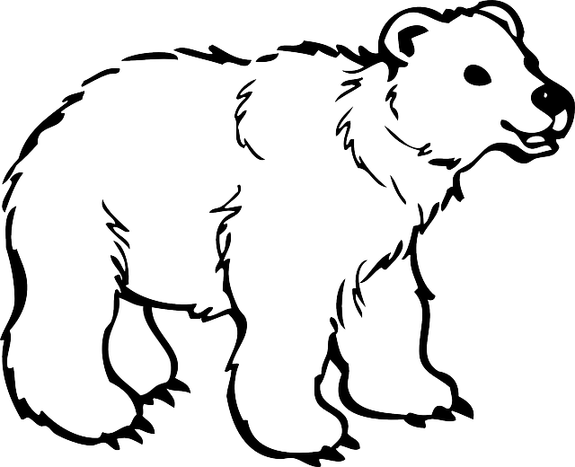
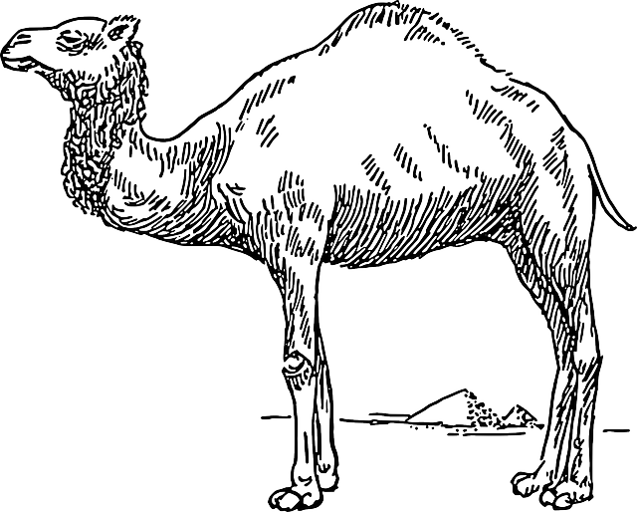
Match the adaptation to the correct animal
Polar bear
Camel
long eyelashes
fur covered soles of feet
long legs
brown fur
nostrils can close
transparent fur
stores fat in hump
black skin
covered in blubber (fat)
does not sweat
thick fur
small ears and tail
large feet

Slide 6
Make sentences from the table to explain the adaptations
A polar bear | has | fat in its hump | to keep it warm.
 |  | lots of blubber | to absorb heat.
 |  | long eyelashes
 |  | small ears and tail | to stop water going in its nose.
 |  | black skin | to help it walk on soft ground.
A camel
 |  | large feet | to protect it from the sun.
 |  | nostrils that can close
 |  | thick fur | to help when there is no water.
 |  | fur covered feet
 | does not sweat |  | to stop sand hurting it.

Slide 7
Some example sentences
A polar bear has large feet to help it walk on soft ground. A camel has long eyelashes to stop sand hurting it. A polar bear has lots of blubber to keep it warm. A camel does not sweat to help it when there is no water. A camel has fat in its hump to help when there is no water. A polar bear has black skin to absorb heat.
A polar bear has small ears and tail to keep it warm.
A camel has nostrils that can close to stop sand hurting it.
A camel has large feet to help it walk on soft ground.
A polar bear has nostrils that can close to stop water going in its nose.
A camel has thick fur to protect it from the sun.
A polar bear has thick fur to keep it warm.

Slide 8
Change the words in bold so that the sentences are true.
extreme
cold
The Arctic and the desert are both environments.
The desert is scorching hot. This is the Arctic which is very
They both have vegetation.
A camel has thick fur to
This is the polar bear, although a polar bear needs the fur to keep warm.
Camels and polar bears are the same because they have big feet which they need to help them walk on soft ground.
the same as
different from/unlike
cold
hot.
a lot of
sparse
keep it warm.
protect it from the sun
different from
the same as
not
also/both
protect it from the sun
sparse
also/both
cold
the same as
different from/unlike
extreme

Slide 9
Change the words in bold so that the sentences are true - answers.
The Arctic and the desert are both extreme environments.
The desert is scorching hot. This is different from/unlike the Arctic which is very cold.
They both have sparse vegetation.
A camel has thick fur to protect it from the sun.
This is the same as the polar bear, although a polar bear needs the fur to keep warm.
Camels and polar bears are also/both the same because they have big feet which they need to help them walk on soft ground.

Slide 10
Check your work
In my sentences I have written about: | ✓ or ✗
the desert and the Arctic using at least four of the words from my list
at least three adaptations for the polar bear and the camel
the reasons for the adaptations
at least one adaptation that is the same and two that are different for the camel and the polar bear using some of these words : the same as/unlike/both/as well as/different from/but/although/and

Slide 11
Appendix – Images in this resource
1. Iceberg - Antarctica
No description (https://pixabay.com/photos/iceberg-antarctica-polar-blue-ice-404966/)
By 358611 (https://pixabay.com/users/358611-358611/)
Available under Pixabay License. For more information see https://pixabay.com/service/license/.
2. Camel - Pyramid
No description (https://pixabay.com/vectors/camel-pyramid-travel-hump-desert-48307/)
By Clker-Free-Vector-Images (https://pixabay.com/users/clker-free-vector-images-3736/)
Available under Pixabay License. For more information see https://pixabay.com/service/license/.
3. Desert - Dunes
No description (https://pixabay.com/photos/desert-dunes-algodones-dunes-1654439/)
By Falkenpost (https://pixabay.com/users/falkenpost-1987955/)
Available under Pixabay License. For more information see https://pixabay.com/service/license/.
4. Bear - Cub
No description (https://pixabay.com/vectors/bear-cub-animal-fur-polar-baby-30787/)
By Clker-Free-Vector-Images (https://pixabay.com/users/clker-free-vector-images-3736/)
Available under Pixabay License. For more information see https://pixabay.com/service/license/.
5. Snowflake - Christmas
No description (https://pixabay.com/vectors/snowflake-christmas-winter-flake-29366/)
By Clker-Free-Vector-Images (https://pixabay.com/users/clker-free-vector-images-3736/)
Available under Pixabay License. For more information see https://pixabay.com/service/license/.
© Bell Educational Trust 2020
This resource was originally developed by Alison Fisher and has been adapted for EAL Nexus.

Slide 12
6. Sun - Astro
No description (https://pixabay.com/illustrations/sun-astro-vector-ray-lights-1789653/)
By DavidRockDesign (https://pixabay.com/users/davidrockdesign-2595351/)
Available under Pixabay License. For more information see https://pixabay.com/service/license/.
© Bell Educational Trust 2020
This resource was originally developed by Alison Fisher and has been adapted for EAL Nexus.

