Slide 1
EAL Nexus Resource
Learning about magnetism
Words and picture cards
Subject(s): | Science
Key Stage: | KS2 KS3 KS4
Topic: | Forces
© Bell Educational Trust 2020
This resource was developed by EAL Nexus.

Slide 2
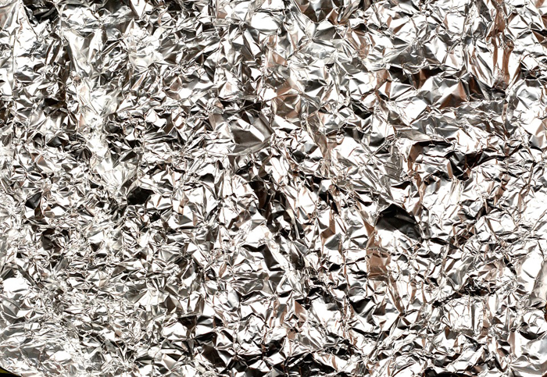
cooking foil

Slide 3
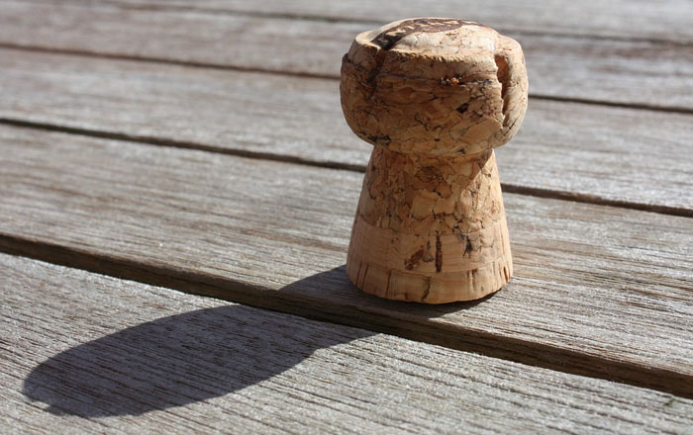
cork

Slide 4
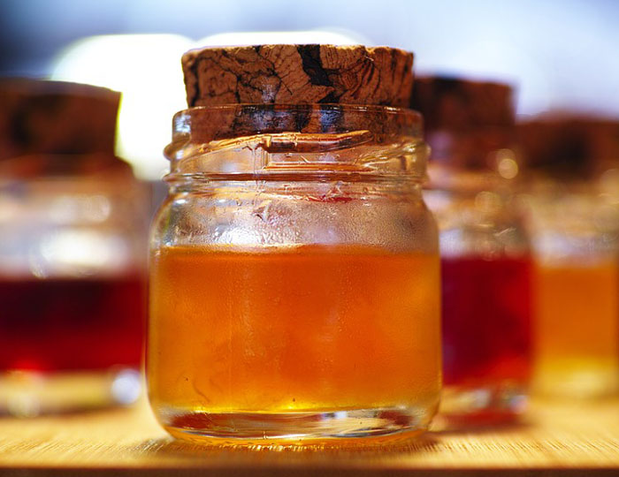
jar of jam

Slide 5
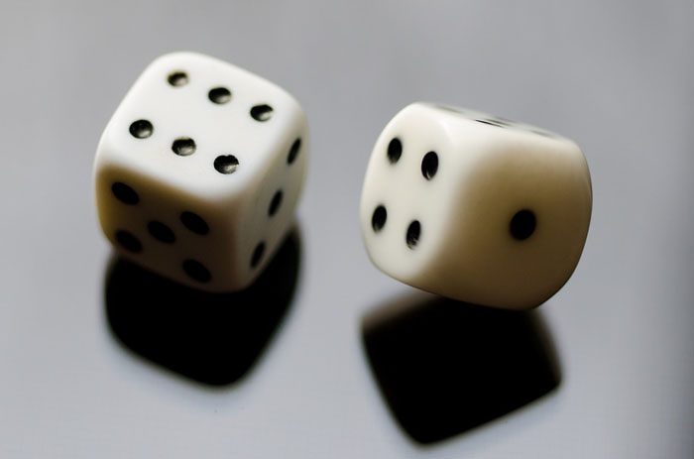
dice

Slide 6
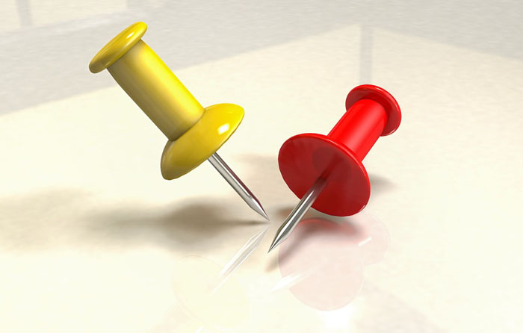
drawing pin

Slide 7
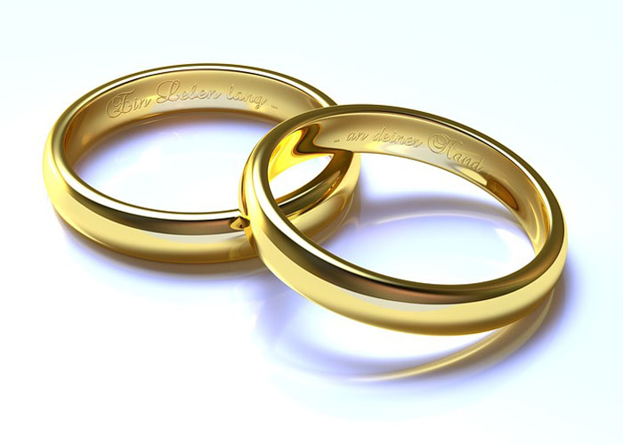
wedding ring

Slide 8
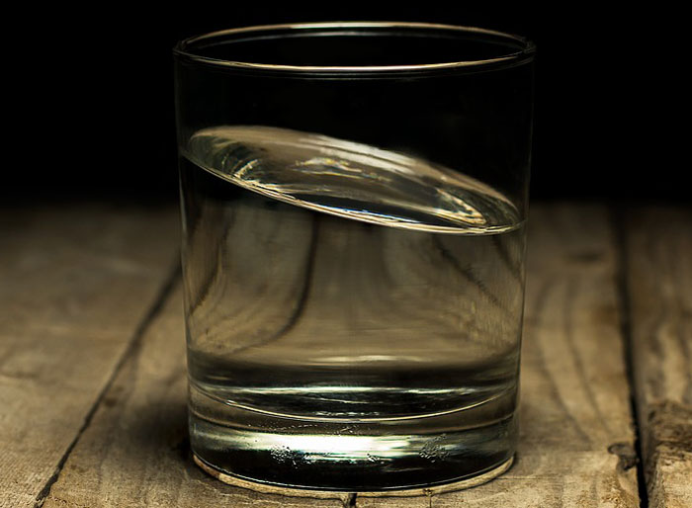
glass of water

Slide 9
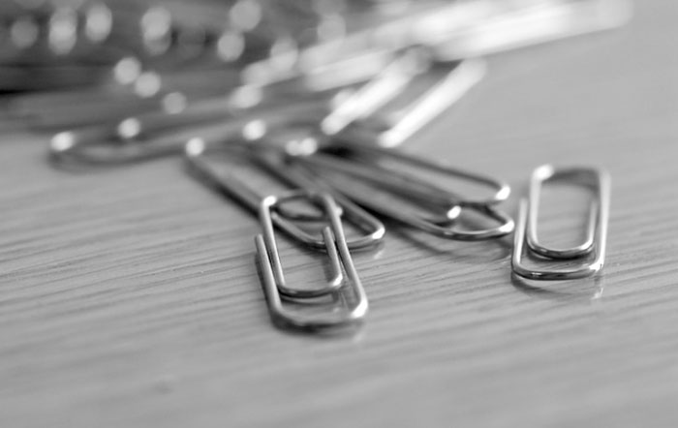
paper clip

Slide 10
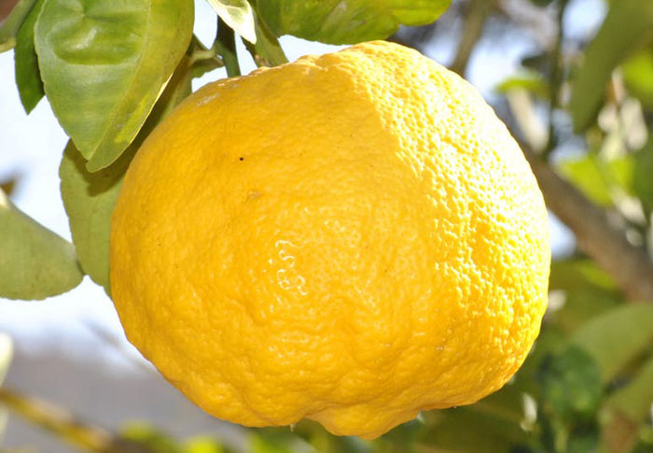
lemon

Slide 11
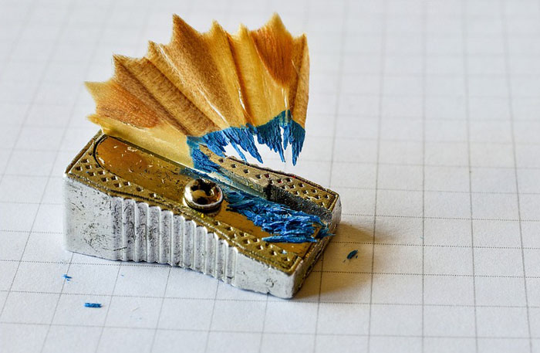
sharpener

Slide 12
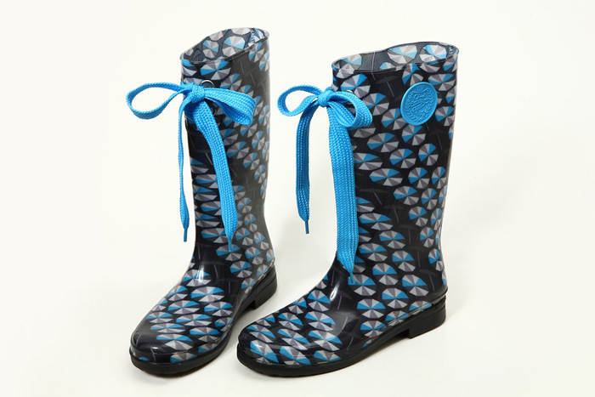
wellingtons

Slide 13
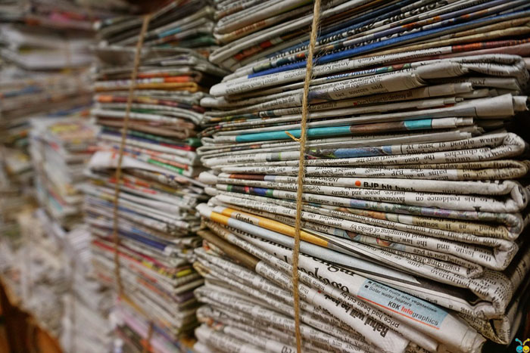
newspaper

Slide 14
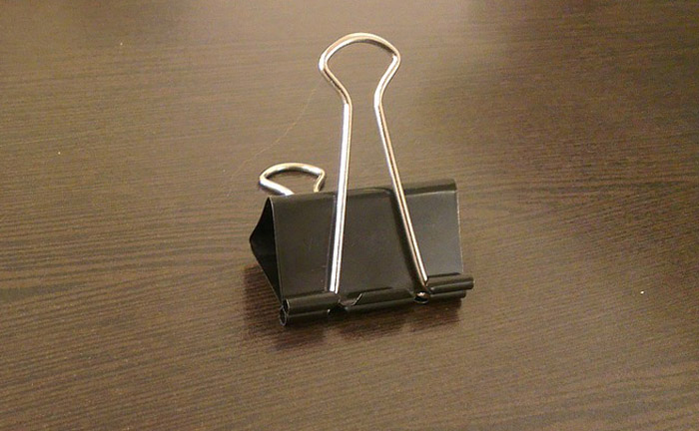
bulldog clip

Slide 15
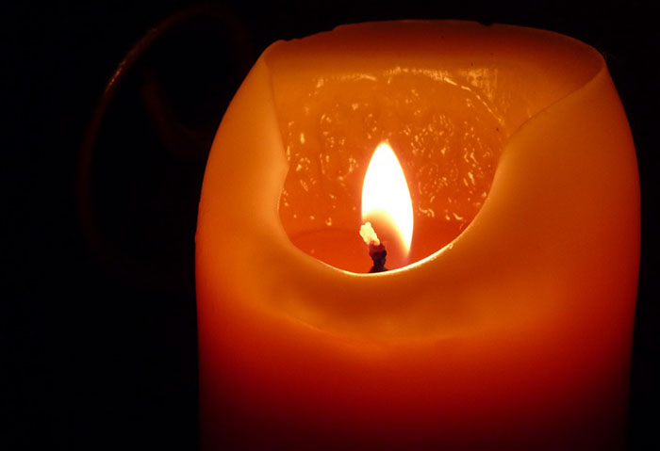
candle

Slide 16
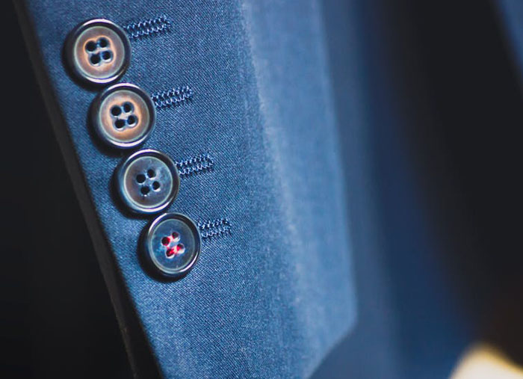
button

Slide 17
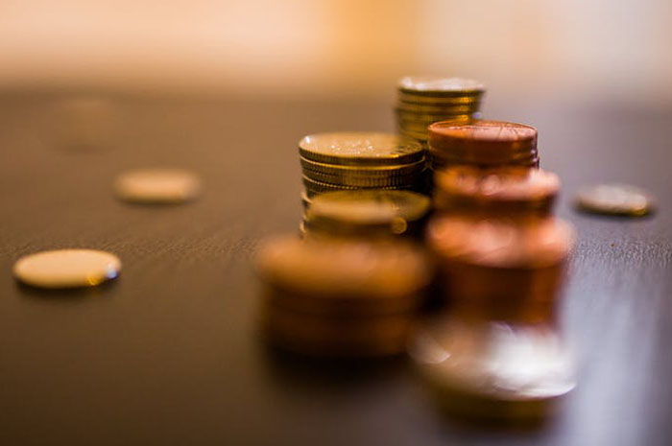
10p coin

Slide 18
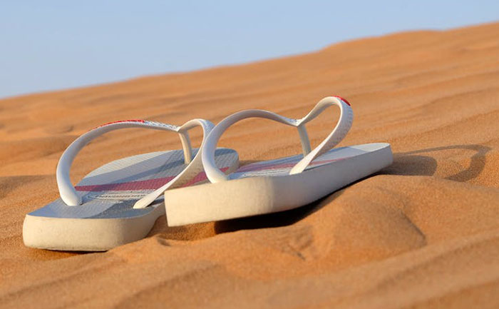
flip-flop

Slide 19
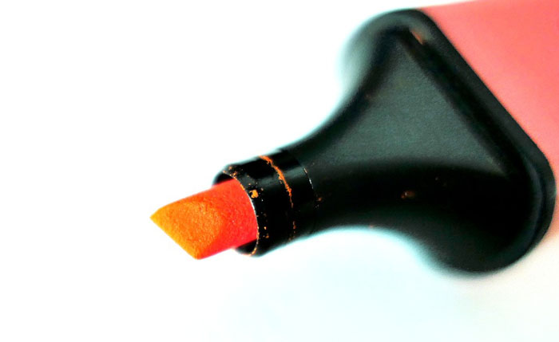
felt pen

Slide 20
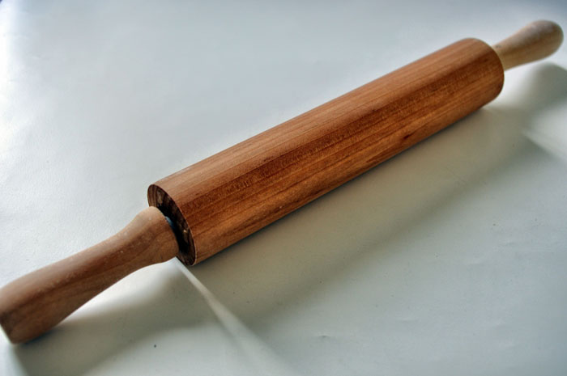
rolling pin

Slide 21
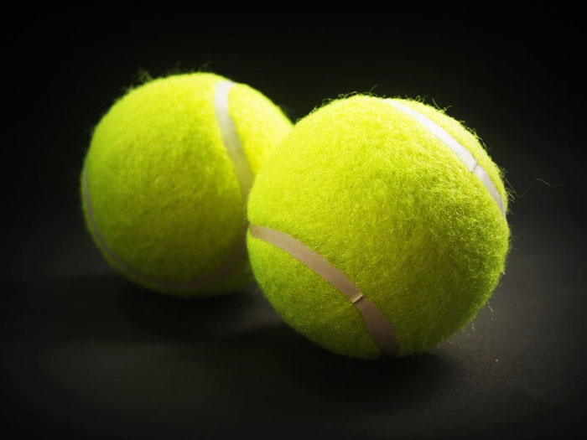
tennis ball

Slide 22
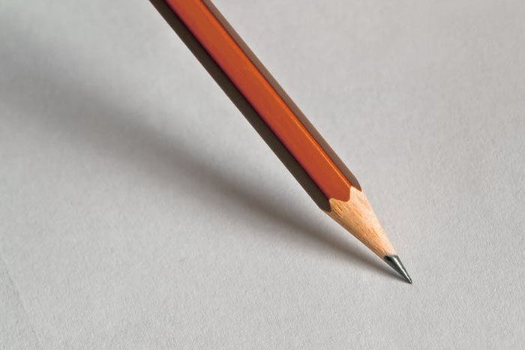
pencil

Slide 23
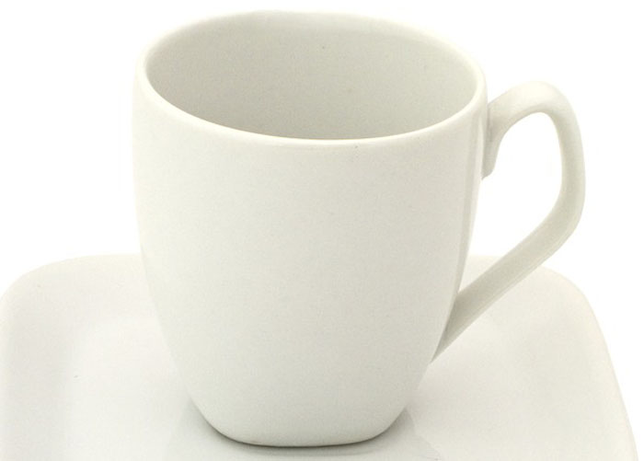
mug

Slide 24
safety pin

Slide 25
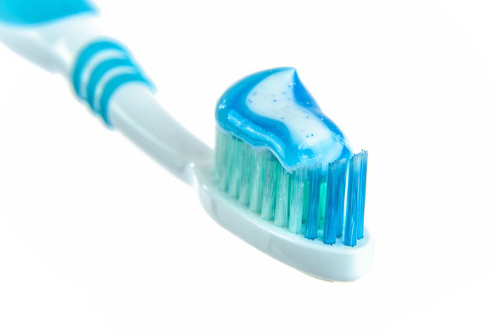
toothbrush

Slide 26
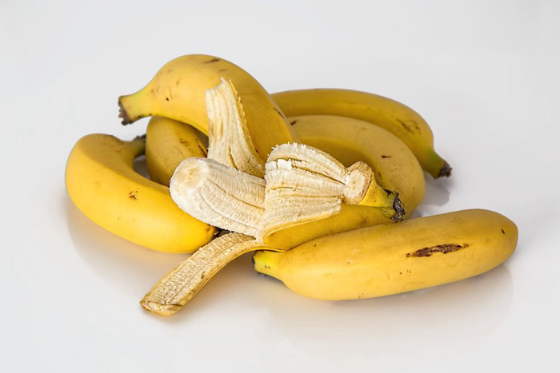
banana

Slide 27
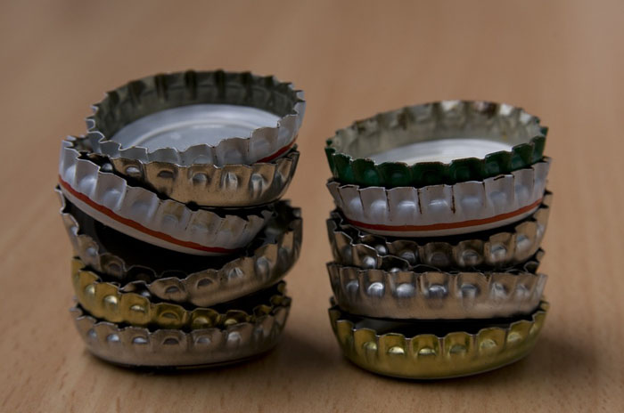
bottle top

Slide 28
2p coin

Slide 29
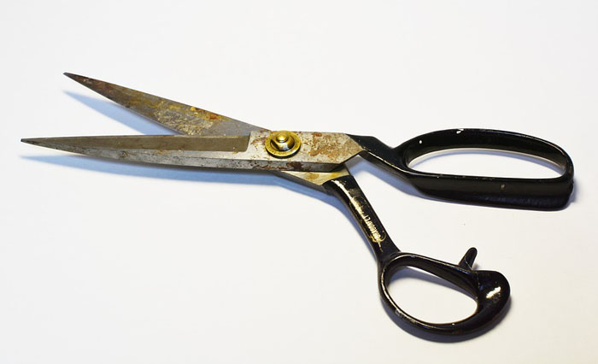
scissors

Slide 30
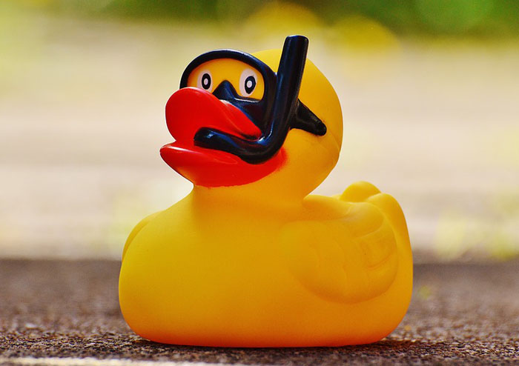
rubber duck

Slide 31
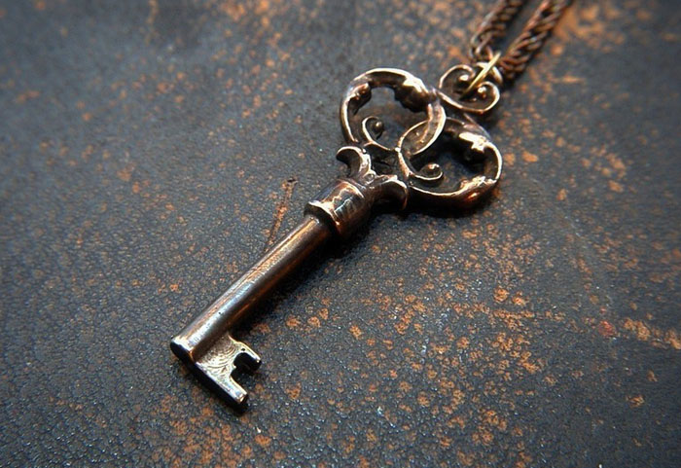
key

Slide 32
Image attributions
Tinfoil - https://pixabay.com/en/aluminum-foil-alu-hell-crumpled-647228/ CC0 Public Domain
Cork - https://pixabay.com/en/cork-champagne-drink-party-toast-678017/ CC0 Public Domain
Jar - https://pixabay.com/en/jam-the-jar-macro-color-sweet-2333414/ CC0 Public Domain
Dice - https://pixabay.com/en/dice-reflection-six-eyes-rolling-672985/ CC0 Public Domain
Pins - https://pixabay.com/en/pinches-pins-useful-bed-bugs-656719/ CC0 Public Domain
Rings - https://pixabay.com/en/wedding-rings-gold-3d-blender-1246897/ CC0 Public Domain
Water - https://pixabay.com/en/calm-clear-drink-filling-glass-2315559/ CC0 Public Domain
Clips - https://pixabay.com/en/paper-clip-office-stationery-desk-400821/ CC0 Public Domain
Lemon - https://www.pexels.com/photo/lemon-fruit-on-branch-during-day-time-66261/ CC0 Public Domain
Sharpener - https://pixabay.com/en/sharpener-pencil-office-school-2246670/ CC0 Public Domain
Wellies - https://pixabay.com/en/boots-rain-boots-ribbon-shoes-1059555/ CC0 Public Domain
News - https://pixabay.com/en/bundle-jute-rope-newspaper-1853667/ CC0 Public Domain
Art clip - https://pixabay.com/en/brown-desk-clip-paper-clip-wood-179454/ CC0 Public Domain
Candle - https://pixabay.com/en/candle-flame-wax-candle-event-197248/ CC0 Public Domain
Buttons - https://www.pexels.com/photo/shallow-focus-photography-of-black-button-on-formal-suit-jacket-sleeves-85873/ CC0 Public Domain
Coins - https://www.pexels.com/photo/working-business-money-coins-34204/ CC0 Public Domain
Slippers - https://www.pexels.com/photo/beach-vacation-sand-desert-40737/ CC0 Public Domain
Highlighter - https://pixabay.com/en/marker-mark-office-highlighter-2245644/ CC0 Public Domain
Roller - http://www.publicdomainpictures.net/view-image.php?image=55527 CC0 Public Domain
Tennis - https://www.pexels.com/photo/balls-bright-equipment-game-226586/ CC0 Public Domain
Pencil - https://www.pexels.com/photo/pencil-on-white-paper-159752/ CC0 Public Domain
Cup - https://pixabay.com/en/cup-coffee-empty-white-porcelain-549084/ CC0 Public Domain
Safety-pin - https://pixabay.com/en/safety-pin-needle-sew-hand-labor-949149/ CC0 Public Domain
Toothbrush - https://www.pexels.com/photo/blue-and-white-toothpaste-on-toothbrush-216729/ CC0 Public Domain
Banana - https://www.pexels.com/photo/healthy-yellow-banana-fresh-39566/ CC0 Public Domain
Bottle cap - https://pixabay.com/en/crown-seals-crown-caps-stack-pile-298232/ CC0 Public Domain
Coin - https://pixabay.com/en/business-cash-coin-concept-credit-18107/ CC0 Public Domain
Scissors - https://pixabay.com/en/scissors-tool-old-cutting-incision-1785401/ CC0 Public Domain
Rubber duck - https://pixabay.com/en/rubber-duck-bath-duck-quietscheente-1361280/ CC0 Public Domain
Key - https://pixabay.com/en/key-pendant-iron-2310246/ CC0 Public Domain

