Slide 1
EAL Nexus Resource
Specialised cells
Reference booklet
Subject(s): | Science
Key Stage: | KS3 KS4
Topic: | Cells, organs and life processes
© Bell Educational Trust 2020
This resource was originally developed by Z. Davies and has been adapted by EAL Nexus.

Slide 2
Glossary
to absorb
to contain
electric signals
function
to join
messages
minerals
soil
specialised
specific
surface area
to transmit
Notes:
Ask the EAL learners to translate the keywords into their first languages

Slide 3
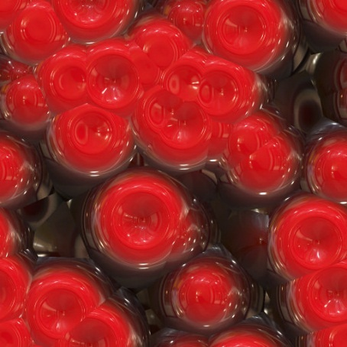
Red blood cells are specialised animal cells
Red blood cells
have no nucleus
have haemoglobin which joins with the oxygen
have large surface area
Function: to carry oxygen around the body.

Slide 4
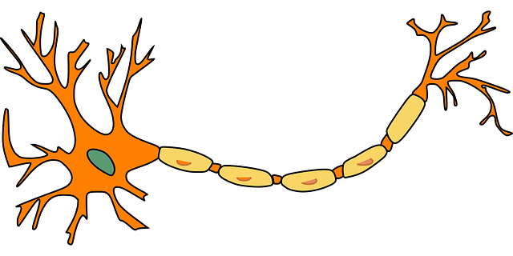
Nerve cells are specialised animal cells
Nerve cells
have connections at all ends
have long shape
can carry electric signals
Function: to transmit (=carry) messages from one part of your body to another

Slide 5
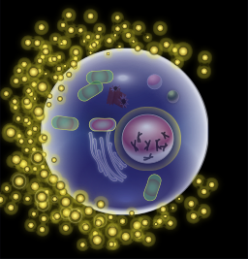
Egg cells are specialised animal cells
Egg cells
are large in size
contain a lot of cytoplasm
Function: to join with a sperm cell and to provide food for the new formed cell

Slide 6
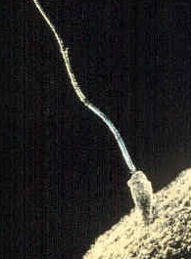
Sperm cells are specialised animal cells
Sperm cells
have a pointed head for getting into the egg cell
have a long tail
can swim
Function: to reach the egg cell, join with it and fertilise it

Slide 7
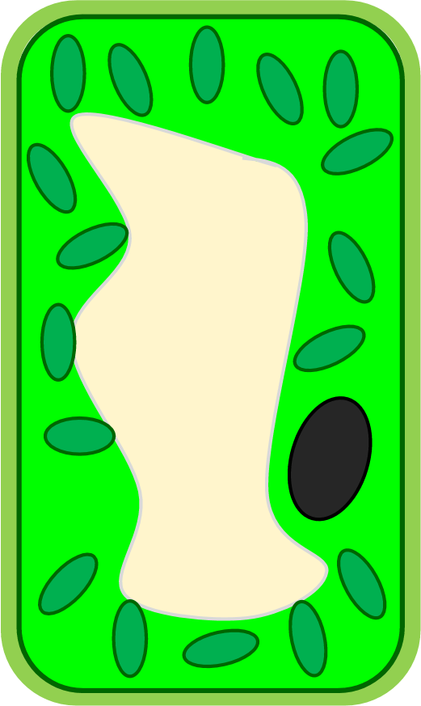
Leaf cells are specialised plant cells
Leaf cells
have a large surface area
contain lots of chloroplasts
Function: to absorb sunlight for photosynthesis

Slide 8
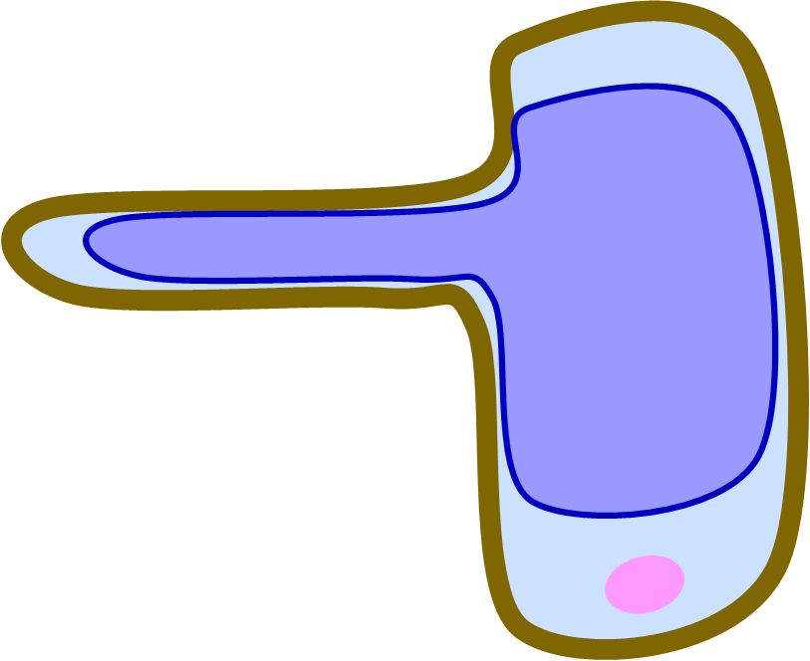
Root hair cells are specialised plant cells
Root hair cells
have a large surface area
have a specific shape, with a long bit like a finger
Function: to absorb water and minerals from the soil

Slide 9
Image attributions
Red blood cells: https://www.flickr.com/photos/filterforge/16701439376 Creative commons public domain via Flickr
Nerve cell: https://pixabay.com/en/neuron-nerve-cell-axon-dendrite-296581/ Public domain via Pixabay
Egg cell: https://en.wikipedia.org/wiki/Egg_cell By KDS444 (Own work) [CC BY-SA 3.0 (http://creativecommons.org/licenses/by-sa/3.0)], via Wikimedia Commons.
Sperm cell: https://commons.wikimedia.org/wiki/File:Sperm-egg.jpg Author unknown [Public domain], via Wikimedia Commons
Leaf cell: Drawn by R Wilson on behalf of The Bell Foundation
Root hair cell: Drawn by R Wilson on behalf of The Bell Foundation

