Slide 1
EAL Nexus Resource
Specialised cells
Substitution tables
Subject(s): | Science
Key Stage: | KS3 KS4
Topic: | Cells, organs and life processes
© Bell Educational Trust 2020
This resource was originally developed by Z. Davies and has been adapted by EAL Nexus.

Slide 2
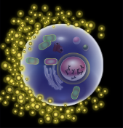
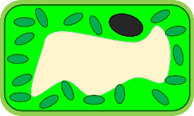
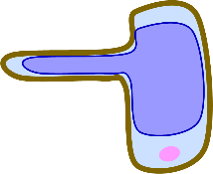
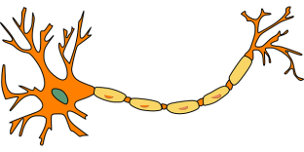
Write statements about specialised cells
a specific shape.
A
has
connections at all ends.
a large surface area.
haemoglobin.
An
contains
a long tail and a pointed head.
lots of chloroplasts.
Notes:
The EAL learners can match the specialised cells to their specific features and use as a substitution table for formulating some statements about the specialised cells, first orally and then in writing

Slide 3
Describing cells
swim.
Red blood cells
carry electric signals.
have
connections at all ends.
Nerve cells
a section like a long finger.
no nucleus.
Egg cells
are
a lot of cytoplasm.
a pointed head.
Sperm cells
large.
contain
a large surface area.
Leaf cells
a long shape.
haemoglobin.
can
a long tail.
Root hair cells
lots of chloroplasts.

Slide 4
The functions of specialised cells
reach the egg cell, join with it and fertilise it.
carry oxygen round the body.
a
The function of
absorb water and minerals from the soil.
is to
join with a sperm cell and provide food.
an
absorb sunlight for photosynthesis.
transmit (= carry) messages around your body.
Notes:
The EAL learners can match the specialised cells to their specific functions and use as a substitution table for formulating some statements about the specialised cells, first orally and then in writing

Slide 5
Describing the function of cells
absorb water and minerals from soil.
red blood cells
reach an egg cell and fertilise it.
nerve cells
join with sperm cells.
egg cells
The function of
is to
absorb sunlight for photosynthesis.
sperm cells
carry oxygen around the body.
leaf cells
transmit messages around the body.
root hair cells

Slide 6
Useful language for more detailed explanations
Nerve cells have connections at all ends and can carry electric signals. This enables them to transmit messages around the body.
This enables them to…
This allows them to…
This makes it possible to…
This helps them to…
This means they are able to…

