Slide 1
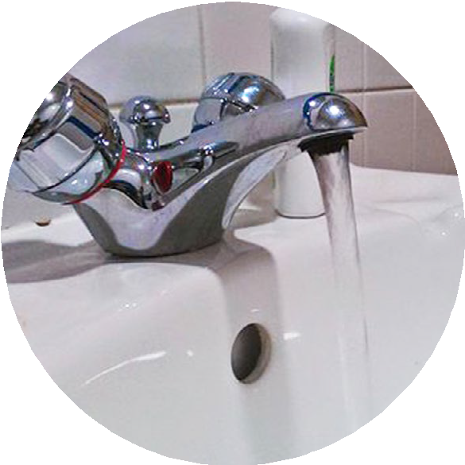
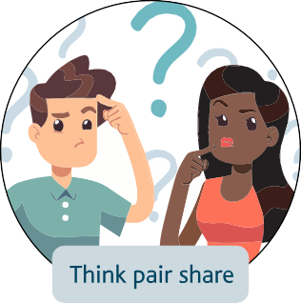
STEM
LEARNING
Notes:
What ways do you think we waste water?
Think – Give pupils a minute to think in silence
Pair – After a minute get pupils to pair up and discuss their ideas with a partner
Share – Encourage the pupils to share their ideas with the class.
Choose a few pupils to share their ideas with the whole class. Collect ideas from pupils and for those that were common record on a whiteboard or flip chart. Tell the pupils they are going to look at an everyday activity which wasted water. It may be that the pupils have already mentioned it in the Think-Pair-Share session.
If you are an Environment Agency Stem Ambassador or a teacher using a Stem Ambassador it is a good idea to insert a slide before this one with the name of the Ambassador and if possible a picture of them at their workplace in their work clothes. Use this to introduce the STEM Ambassador. There is a sample slide at the end of this presentation.

Slide 2
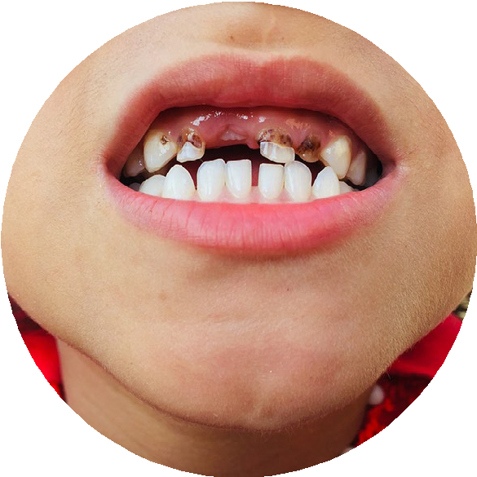
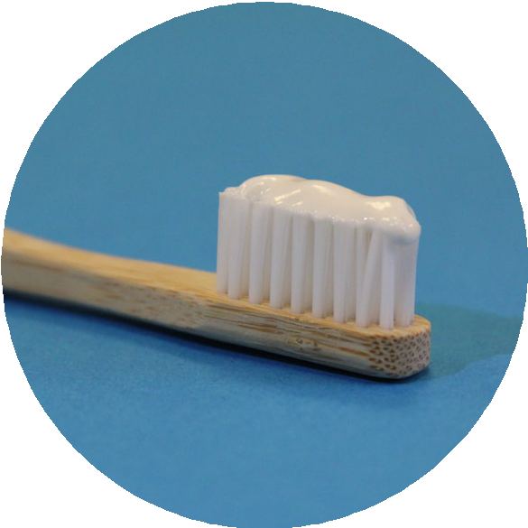
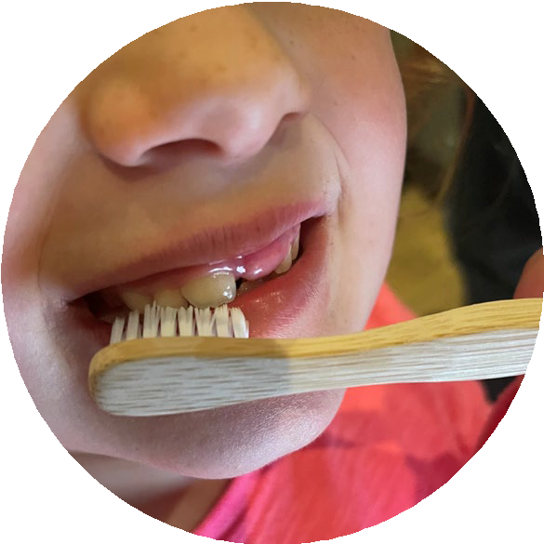
STEM
LEARNING
Notes:
Tell the pupils they will be looking at how much water we waste when we clean our teeth. Ask pupils to put their hand up if you clean your teeth each day?
Ask pupils why do we need to clean our teeth?

Slide 3
STEM
LEARNING
Notes:
Ask the pupils this question, ‘How long should we brush our teeth each day? ‘ Perhaps get them to discuss it with a partner first and then ask a few pupils to share their answers. Or for older pupils perhaps get them to write it on a whiteboard to show to you. Arrive at the conclusion that it should be 2 mins

Slide 4
STEM
LEARNING
+
Notes:
Share the answer as 2 minutes twice a day after you have eaten.

Slide 5
STEM
LEARNING
Notes:
Ask pupils to act out brushing their teeth. If you can see any pupils replicating the use of a tap and highlight what these pupils are doing with the tap.

Slide 6
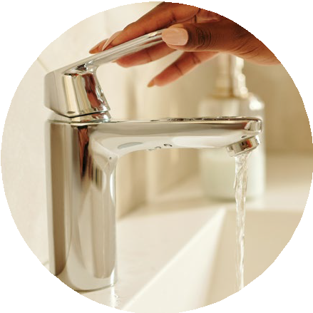
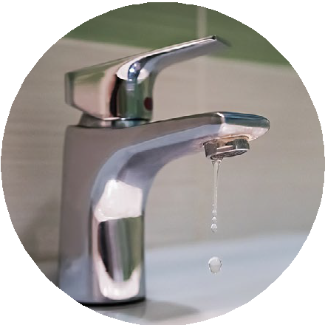
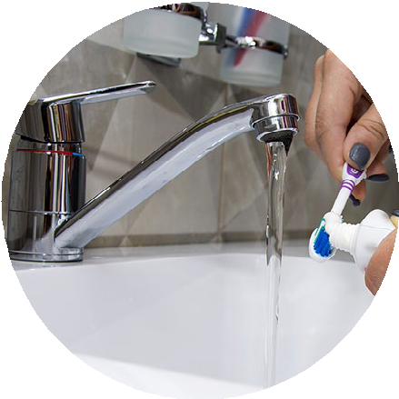
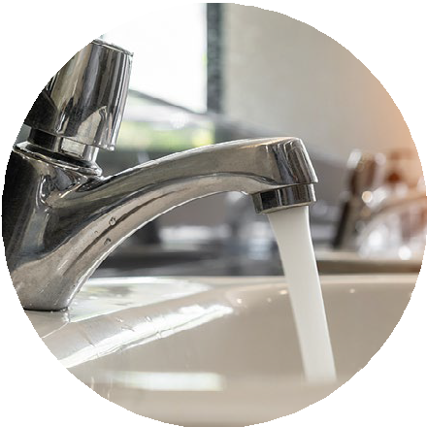
STEM
LEARNING
Notes:
At this point introduce the investigation the pupils are going to do. They are going to measure how much water comes from a tap at 4 different rates of water flow shown in the slide.
Ask them to predict the volume of water that will come from each type of tap opening method in 2 minutes. They can write their predictions on the worksheet found in the activity guidance. Think about the units the pupils will be familiar with. Younger pupils may only be able to relate to numbers of buckets or plastic bottles. Older pupils will be able to measure the volume in litres and millilitres.

Slide 7
STEM
LEARNING
Notes:
Obtain ideas from the pupils as to what equipment they might use to measure the volume of water. For younger pupils it may be better to hold up a cup and ask them if it is suitable for measuring water from a fast flowing tap.

Slide 8
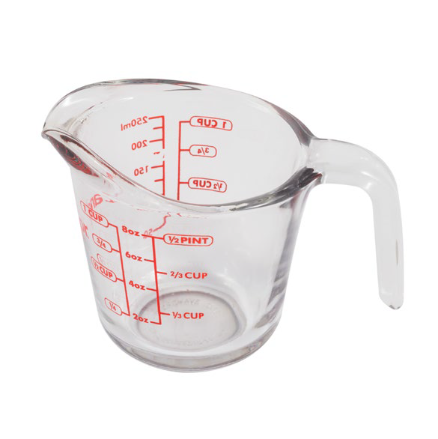
STEM
LEARNING
Notes:
This slide can be used to give pupils an idea of what they can use, but it would be better to have examples to hand.

Slide 9
STEM
LEARNING
Turning tap off and on
Notes:
Now the pupils are going to do the investigation. Tell them they are going to be told to move in a certain way to demonstrate how the water flows through the tap for each different tap situation. They will have to do this for 2 minutes each time.
Firstly get all the pupils to stand behind their chairs (in advance check there is enough space in the classroom to do this activity safely). You could do the activity outside if there is an accessible tap in which case instead of doing the activity on the spot the children could walk/run around a circuit or the school playground / field etc.
Before each different 2 minute session ask them to think about what equipment they might need to measure it based on their predictions for the volume of water that will come from the tap.
The 2 minute sessions the take place as follows:
Get the pupils to walk on the spot for two minutes stopping and starting like a tap being turned on and off. The stopping and starting can be controlled by the teacher or STEM Ambassador. A a pair of children collect the water from the tap, but they must turn it on and off as instructed. Measure the volume after 2 minutes and record it on the predictions and results worksheet.
Get the pupils to slowly lift one leg then the other for two minutes like a dripping tap whilst a different pair of children collect the water from the dripping tap. Measure the volume after 2 minutes and record it on the predictions and results worksheet.
Get the pupils to walk on the spot for two minutes like a gently running tap whilst a different pair of children collect the water from the gently running tap. Measure the volume after 2 minutes and record it on the predictions and results worksheet.
Ask the pupils to run on the spot for two minutes like a fast running tap whilst a pair of children collect the water from the fast flowing tap and then measure the amount after 2 minutes. Record the results on the predictions and results worksheet.

Slide 10
STEM
LEARNING
Water flow
Predicted volume of water to be collected in 2 minutes
Actual volume of water collected in two minutes
Turning tap on/off
Drip Gentle running Rapidly flowing
Notes:
Once the pupils have recorded their results they can then compare them with their predictions.

Slide 11
STEM
LEARNING
Volume wasted brushing our teeth twice a day
(2 times a day x 2mins)
Volume wasted brushing our teeth twice a day (daily volume x7 days)
Water flow
Volume collected in 2 minutes
Turning tap on/off
Drip Gentle running Rapidly flowing
Notes:
Look at the results. Possibly just use the first two columns for younger children or let them hold the number of 1 litre bottles they filled up so that they can compare the differences of water wasted on a daily basis when we clean our teeth.
For older children they can then work in pairs to calculate the amount of water wasted each day, week, month , year for themselves, their family, class school etc. The calculations can be extended depending upon the mathematical capabilities of the pupils.

Slide 12
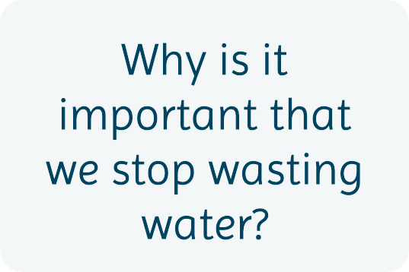
STEM
LEARNING
Notes:
Group discussion activity. Think back to the start of this lesson.
What ways do you think we waste water? How might we reduce or even stop the water we waste? Hopefully after this activity pupils will realise that one way to reduce wasting water is by turning the tap off as we brush our teeth.
The discussion can be extended to ask ‘Why is it important that we stop wasting water?’
Choose a few pupils to share their ideas with the whole class.

Slide 13
STEM
LEARNING
Insert name here
Notes:
This slide can be adapted to add in details at the beginning of the presentation about an Environment Agency STEM Ambassador if one is present. If possible a picture of them at their workplace in their work clothes.

Slide 14
STEM
LEARNING
© Environment Agency 2022. This content is available under Open Government Licence v3.0.

