Slide 1
There will be rain
What are floods and why do they happen?
1 minute to think 1 minute to pair
1 minute to share
Think pair share
Notes:
Get pupils to think for 1 min about the question ‘What are floods and why do they happen? ‘ in silence on their own.
Then allow 1 minute for the pupils to discuss it with a partner.
Pupils can then share their thoughts with the class.
The idea behind this exercise is to see how much the pupils already know and understand. Their responses can then guide you as to how much you need to cover the different types of floods mentioned in slide 3

Slide 2
There will be rain
Date, name of presenter (if applicable)
Notes:
Once the think-pair-share-activity is completed the Environment Agency STEM Ambassador can introduce themselves (if one is available) and the title of the session. The aims of the session can also be introduced which are initially to understand what floods are, explain why they happen, why they are a problem and the impact of climate change on flooding. This leads to the main part of the activity which is a team challenge to solve a flooding problem. The challenge introduces pupils to the role of the Environment Agency, the problems they have to deal with and the skills that are needed by Environment Agency employees.
The Environment Agency STEM ambassador may insert an image in this slide of them at their workplace with any equipment they might use and in their work clothing.
If no Environment Agency STEM ambassador is available then a teacher can leave the title on the slide as the title of the activity and delete the other content.

Slide 3
What are floods and why do they happen?
Floods occur when there is an overflow of water, this can come from:
Surface water – This type of flooding comes from rain falling on surfaces like roads, roofs and saturated ground which cannot absorb the rainwater and local drainage systems cannot remove it fast enough.
The Sea – this is called coastal flooding and can be the result of extreme weather or high tides which causes sea water to spill over onto the land.
Rivers – This type of flooding occurs when the volume of water draining into the river is too high for the size and flow of the river and often happens when heavy rain falls on saturated ground.
Groundwater – This type of flooding happens when water levels in the ground rise above the surface. The water comes from underground.
Notes:
Use the comments from the pupils in the think-pair-share activity in slide 1 to highlight the different types of flooding. Most will probably think about rainwater in rivers, but maybe not flooding from the sea. You can also introduce the terms groundwater and surface water. Flash flooding might be used by some pupils which is caused by large volumes of surface water appearing very quickly. River flooding can happen when a lot of rain falls on saturated ground or when a river is blocked so water cannot flow away. Highlight that coastal and river flooding can be predicted, but surface water flooding is much harder to predict.

Slide 4
Why are floods a problem?
1 minute to think 1 minute to pair
1 minute to share
Think pair share
Notes:
Get pupils to think for 1 min about the question ‘Why are floods a problem? ‘ in silence on their own.
Then allow 1 minute for the pupils to discuss it with a partner.
Pupils can then share their thoughts with the class.
The idea behind this exercise is to see how much the pupils already know and understand about the problems of flooding. Some pupils may have experienced flooding or be aware from the news or media. Their responses can then guide you as to how much more you need to cover in slides 5 and 6.

Slide 5
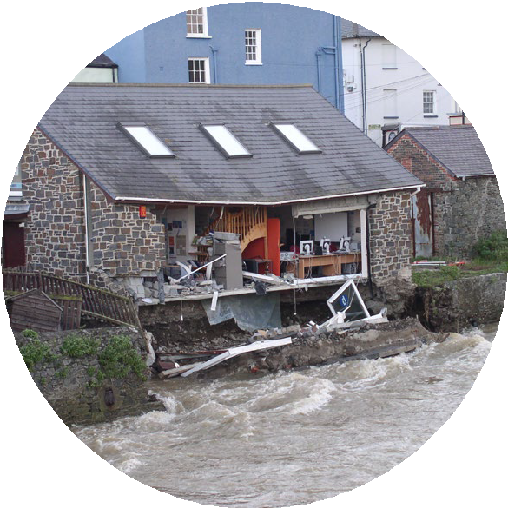
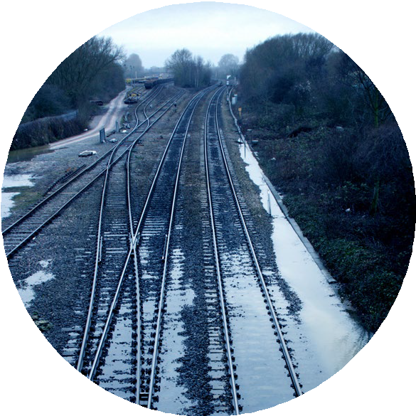
Why are floods a problem?
Economic damage –
it costs a lot to fix the damage caused to homes and businesses.
Also the damage done to infrastructure such as railways, roads and bridges.
Notes:
Use the comments from the pupils in the think-pair-share activity in slide 4 to highlight the economic damage of floods. It may be that pupils will have come up with these answers themselves. Don’t forget to check the pupils’ understanding of some of the higher tier words like ‘economic’ and ‘infrastructure’.
If you are an Environment Agency STEM Ambassador you might have some good real life examples.

Slide 6
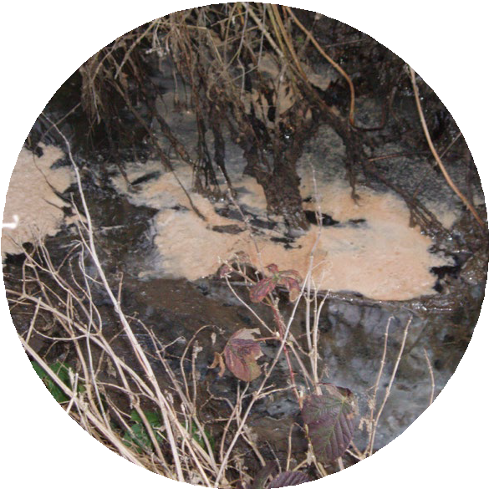
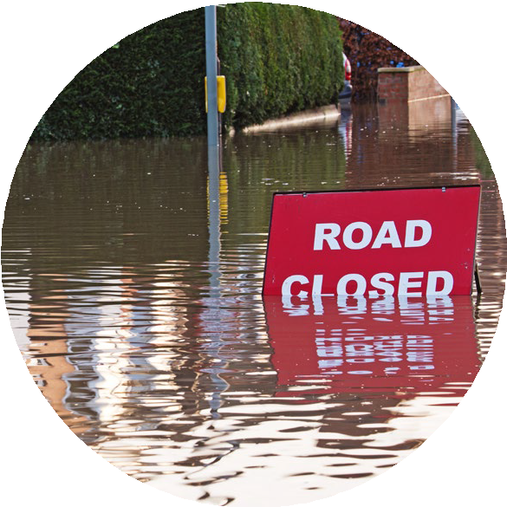
Why are floods a problem?
Impact on humans – flooding affects people’s health, wellbeing, lives and jobs. The loss of essential services like electricity and transport systems make it difficult to live and to get to school or work. It may even lead to loss of life.
Impact on the environment – flood waters can wash pollutants, such as sewage, into the water. This can contaminate the water and lead to poor water quality, affecting people and wildlife.
Notes:
Use the comments from the pupils in the think-pair-share activity in slide 4 to highlight the impact of floods on humans and the environment.
If you are an Environment Agency STEM Ambassador you might have some good real life examples.

Slide 7
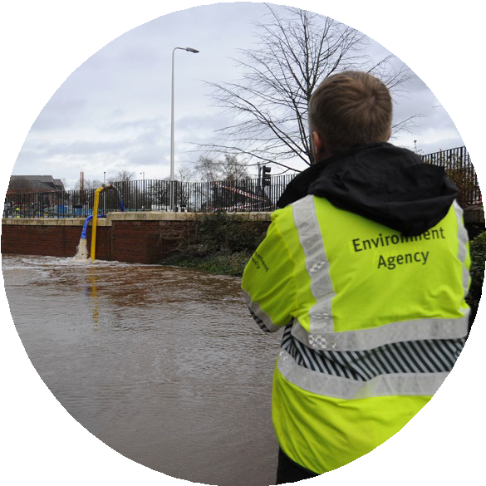
What affect does climate change have on flooding?
How can the Environment Agency help?
Holding back the flood video.
Notes:
The video clip (3 mins 20 sec) ‘Holding back the flood’ highlights that flooding is getting worse due to climate change both from the point of view of increased rainfall but also rising sea levels which are caused by the ice caps melting and the volume of the sea expanding as the temperature rises. The second part shows what the Environment Agency is doing to help mitigate the affects of flooding to protect people and businesses.
Click on the link to play the video.

Slide 8
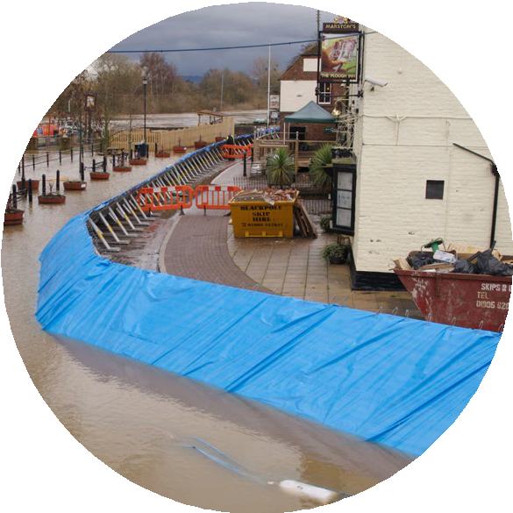
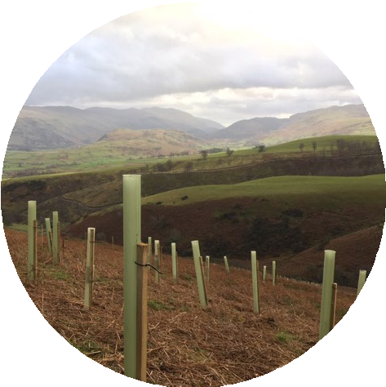
How can we reduce flooding in a town?
To protect properties in a town from flooding, permanent or temporary flood barriers can be used, but these are expensive and can have an impact on the environment.
There is another way to protect a town and that is to slow the rate of flow of water down a
hillside when it rains. This enables drainage systems in the town to remove the water fast enough to prevent flooding.
Notes:
This slide gives pupils the background they need to undertake the challenge. Most pupils will be aware of physical flood barriers being used to protect properties from flooding in a town. This slide introduces the idea of natural flood management systems which is a natural and sustainable method to reduce the flow of water down a hillside so reducing the risk of flooding.

Slide 9
What is your challenge?
You are challenged to create a model natural flood management system for a town.
The ramp represents a hillside
The marbles represent water
What equipment can I use:
Rules
The winning team must have:
Modelling clay / Plasticine / Blutak
Newspaper
Straws
Tin foil
Scissors
Sellotape
Cocktail sticks
Half of the marbles fall to the bottom whilst the other half must remain somewhere on the ramp.
The marbles travelling to the bottom of the ramp travel down in the longest possible time (so are the slowest).
Notes:
This slide introduces the challenge. Organise the class into groups of up to 4 pupils per group. Each group will be given a wooden ramp to represent a hillside and 12 marbles or other spherical objects such as molymods to represent rainwater. The challenge is for pupils to add structures to this ramp to retain half of the marbles on the ramp but allow half of the marbles to run down the ramp in the slowest possible time. The winning group gets half the marbles to the bottom in the slowest time. The other half of the marbles must stay on the ramp to win.
Give the pupils an allotted time to create their models (20 minutes minimum) and then ask each group to test their model one by one in a timed run off at the end. There are certificates available in this resource, if required, for all participants and the winning team.
Add or delete equipment available as required to the slide text.

Slide 10
Reflection
How successful were you in stopping all the marbles rolling down the ramp?
Could you make any improvements to your design to slow the marbles down even more?
What work related skills have you used in this challenge?
Notes:
It is important that pupils reflect on what they have done in order to obtain the most from the session. In their teams ask pupils to discuss these questions and get a team spokesperson to feedback to the class.
Highlight to the pupils that the work related skills they have used in this challenge; problem solving, team work, communication, working under pressure, organisation, and using your initiative (listed on the certificates) are used by Environment Agency employees in their roles, especially engineers.

Slide 11
Natural flood management systems
You have created model of a natural flood management
Natural flood management systems hold back or slow rainwater flow to reduce the risk of flooding.
Your marbles represented rainwater.
The materials you used on the ramp represented different methods to slow the flow of water down a hillside.
How does natural flood management make a difference?
For more information on natural flood management systems watch this video.
Notes:
This slide explains in more detail how the pupils’ models represent natural flood management and gets them to think why this type of flood management is useful.
The video ‘Natural flood management’ (6 minutes long ) goes onto explain more about natural flood management with an excellent model showing the effect of water run off and how different environments can reduce the amount of water that travels down a hillside.

Slide 12
© Environment Agency 2022. This content is available under Open Government Licence v3.0.

