Slide 1
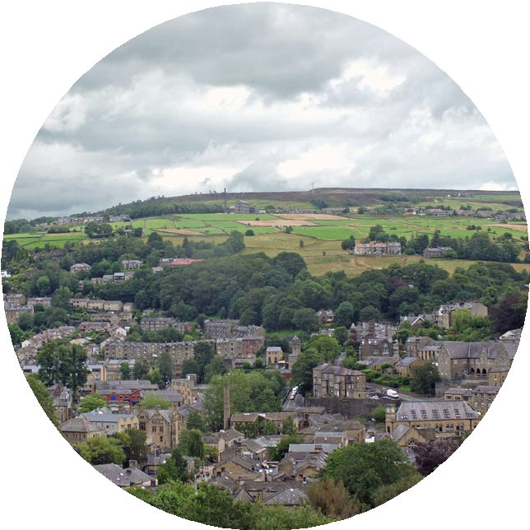
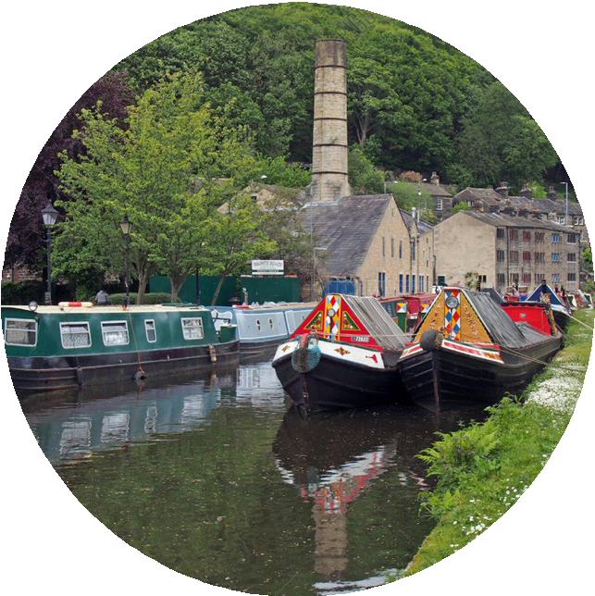
Who can save Stemville?
Notes:
Explain to pupils that in this session they are going to work together in teams to protect the residents of houses and in the town of Stemville from flooding.
Initially they will learn more about the causes and consequences of flooding and how climate change is causing more flooding.
They will then split into teams and find out about various types of flood management system and evaluate them.
From this information they will have to devise a plan to protect Stemville from flooding within a certain budget.
Once they have come up with a plan they have to prepare a presentation to explain their ideas to the rest of the class and the judges (the teacher and an Environment Agency STEM Ambassador if one is present) and a winning team chosen. (Fellow pupils could also be the judges)

Slide 2
Who can save Stemville?
What are floods and why do they happen?
1 minute to think 1 minute to pair
1 minute to share
Think pair share
Notes:
Get pupils to think for 1 min about the question ‘What are floods and why do they happen? ‘ in silence on their own.
Then allow 1 minute for the pupils to discuss it with a partner.
Pupils can then share their thoughts with the class.
The idea behind this exercise is to see how much the pupils already know and understand. Their responses can then guide you as to how much you need to cover the different types of floods mentioned in slide 3

Slide 3
Who can save Stemville?
Date, name of presenter (if applicable)
Notes:
Once the think-pair-share-activity is completed the Environment Agency STEM Ambassador can introduce themselves (if one is available) and the title of the session. The aims of the session can also be introduced which are initially to understand what floods are, explain why they happen, why they are a problem and the impact of climate change on flooding. This leads to the main part of the activity which is a team challenge to help the fictitious town of Stemville install flood management systems to protect itself from flooding. The challenge introduces pupils to the role of the Environment Agency, the problems they have to deal with and the skills that are needed by Environment Agency employees.
The Environment Agency STEM ambassador may insert an image in this slide of them at their workplace with any equipment they might use and in their work clothing.
If no Environment Agency STEM ambassador is available then a teacher can leave the title on the slide as the title of the activity and delete the other content.

Slide 4
What are floods and why do they happen?
Floods occur when there is an overflow of water, this can come from:
Surface water – This type of flooding comes from rain falling on surfaces like roads, roofs and saturated ground which cannot absorb the rainwater and local drainage systems cannot remove it fast enough.
The Sea – this is called coastal flooding and can be the result of extreme weather or high tides which causes sea water to spill over onto the land.
Rivers – This type of flooding occurs when the volume of water draining into the river is too high for the size and flow of the river and often happens when heavy rain falls on saturated ground.
Groundwater – This type of flooding happens when water levels in the ground rise above the surface. The water comes from underground.
Notes:
Use the comments from the pupils in the think-pair-share activity in slide 1 to highlight the different types of flooding. Most will probably think about rainwater in rivers, but maybe not flooding from the sea. You can also introduce the terms groundwater and surface water. Flash flooding might be used by some pupils which is caused by large volumes of surface water appearing very quickly. River flooding can happen when a lot of rain falls on saturated ground or when a river is blocked so water cannot flow away. Highlight that coastal and river flooding can be predicted, but surface water flooding is much harder to predict.

Slide 5
Why are floods a problem?
1 minute to think 1 minute to pair
1 minute to share
Think pair share
Notes:
Get pupils to think for 1 min about the question ‘Why are floods a problem? ‘ in silence on their own.
Then allow 1 minute for the pupils to discuss it with a partner.
Pupils can then share their thoughts with the class.
The idea behind this exercise is to see how much the pupils already know and understand about the problems of flooding. Some pupils may have experienced flooding or be aware from the news or media. Their responses can then guide you as to how much more you need to cover in slides 5 and 6.

Slide 6
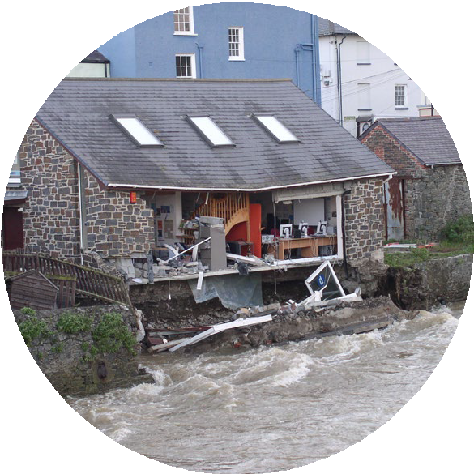
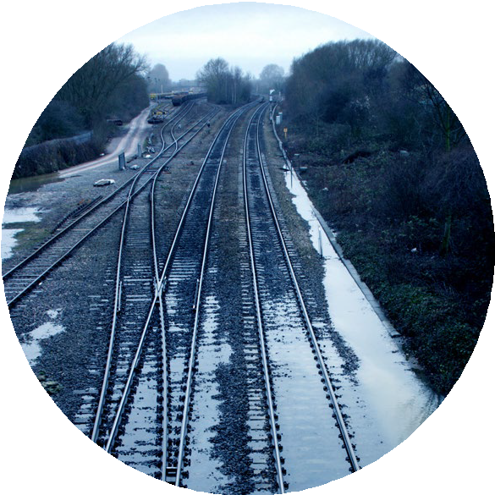
Why are floods a problem?
Economic damage – it costs a lot to fix the damage caused to
homes and businesses. Also the damage done to infrastructure such as railways, roads and bridges.
Notes:
Use the comments from the pupils in the think-pair-share activity in slide 4 to highlight the economic damage of floods. It may be that pupils will have come up with these answers themselves. Don’t forget to check the pupils’ understanding of some of the higher tier words like ‘economic’ and ‘infrastructure’.
If you are an Environment Agency STEM Ambassador you might have some good real life examples.

Slide 7
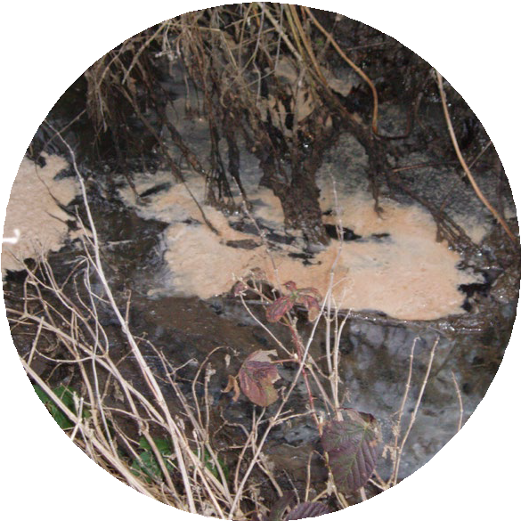
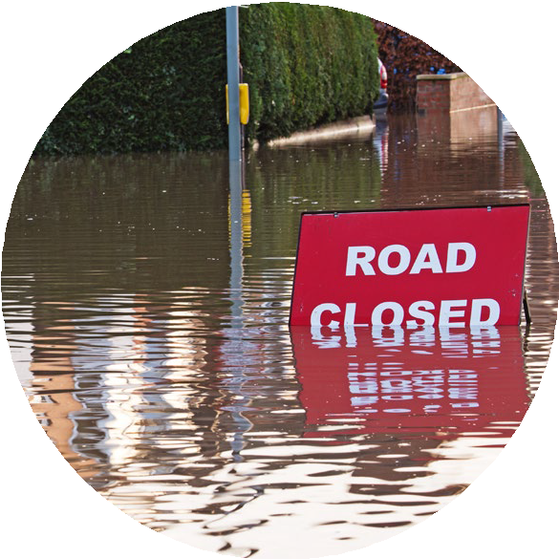
Why are floods a problem?
Human Impact – flooding affects people’s health, wellbeing, lives and jobs. The loss of essential services like electricity and transport systems make it difficult to live and to get to school or work. It may even lead to loss of life.
Environmental impact – flood waters can wash pollutants, such as sewage, into the water. This can contaminate the water and lead to poor water quality, affecting people and wildlife.
Notes:
Use the comments from the pupils in the think-pair-share activity in slide 4 to highlight the impact of floods on humans and the environment.
If you are an Environment Agency STEM Ambassador you might have some good real life examples.

Slide 8
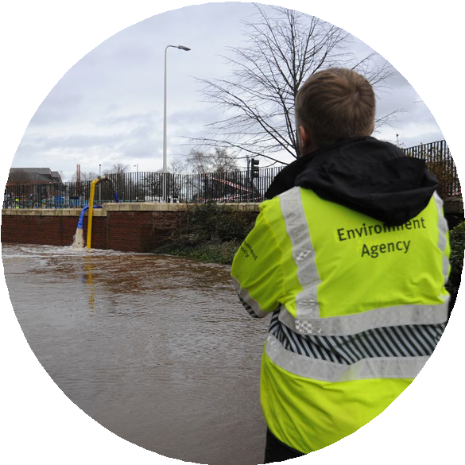
What affect does climate change have on flooding?
How can the Environment Agency help?
Holding back the flood video.
Notes:
The video clip (3 mins 20 sec) ‘Holding back the flood’ highlights that flooding is getting worse due to climate change both from the point of view of increased rainfall but also rising sea levels which are caused by the ice caps melting and the volume of the sea expanding as the temperature rises. The second part shows what the Environment Agency is doing to help mitigate the affects of flooding to protect people and businesses.
Click on the link to play the video.

Slide 9
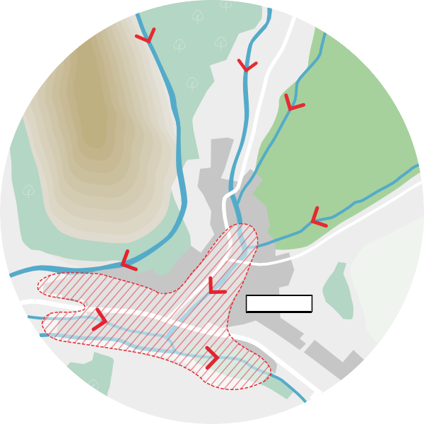
Where is STEMVILLE?
Stemville is a town in the North of England with
a population of 15,000 people.
River Crane
River Leawell
Far
Steep hills
It sits on 3 rivers: River Moore, River Crane, River Leawell.
Most of the town is surrounded by land used for farming cattle, but to the west of the town are steep hills.
Steep hills
STEMVILLE
Farmland
River M
Notes:
Before introducing the challenge organise the students into groups of 3 to 5 students. Then explain that before finding our about the challenge pupils need to understand more about the setting and geography of Stemville. Give students an A3 copy of the plan so they can see what Stemville looks like. Go through some of the details on this slide and the next to indicate where the hills, rivers, properties are located and where the flooding occurs on the plan. The image on the left show that Stemville is at the bottom of a steep hill on the west side and higher level farmland to the east so water will flow down the hill and accumulate (gather) in the valley where the town is located.

Slide 10
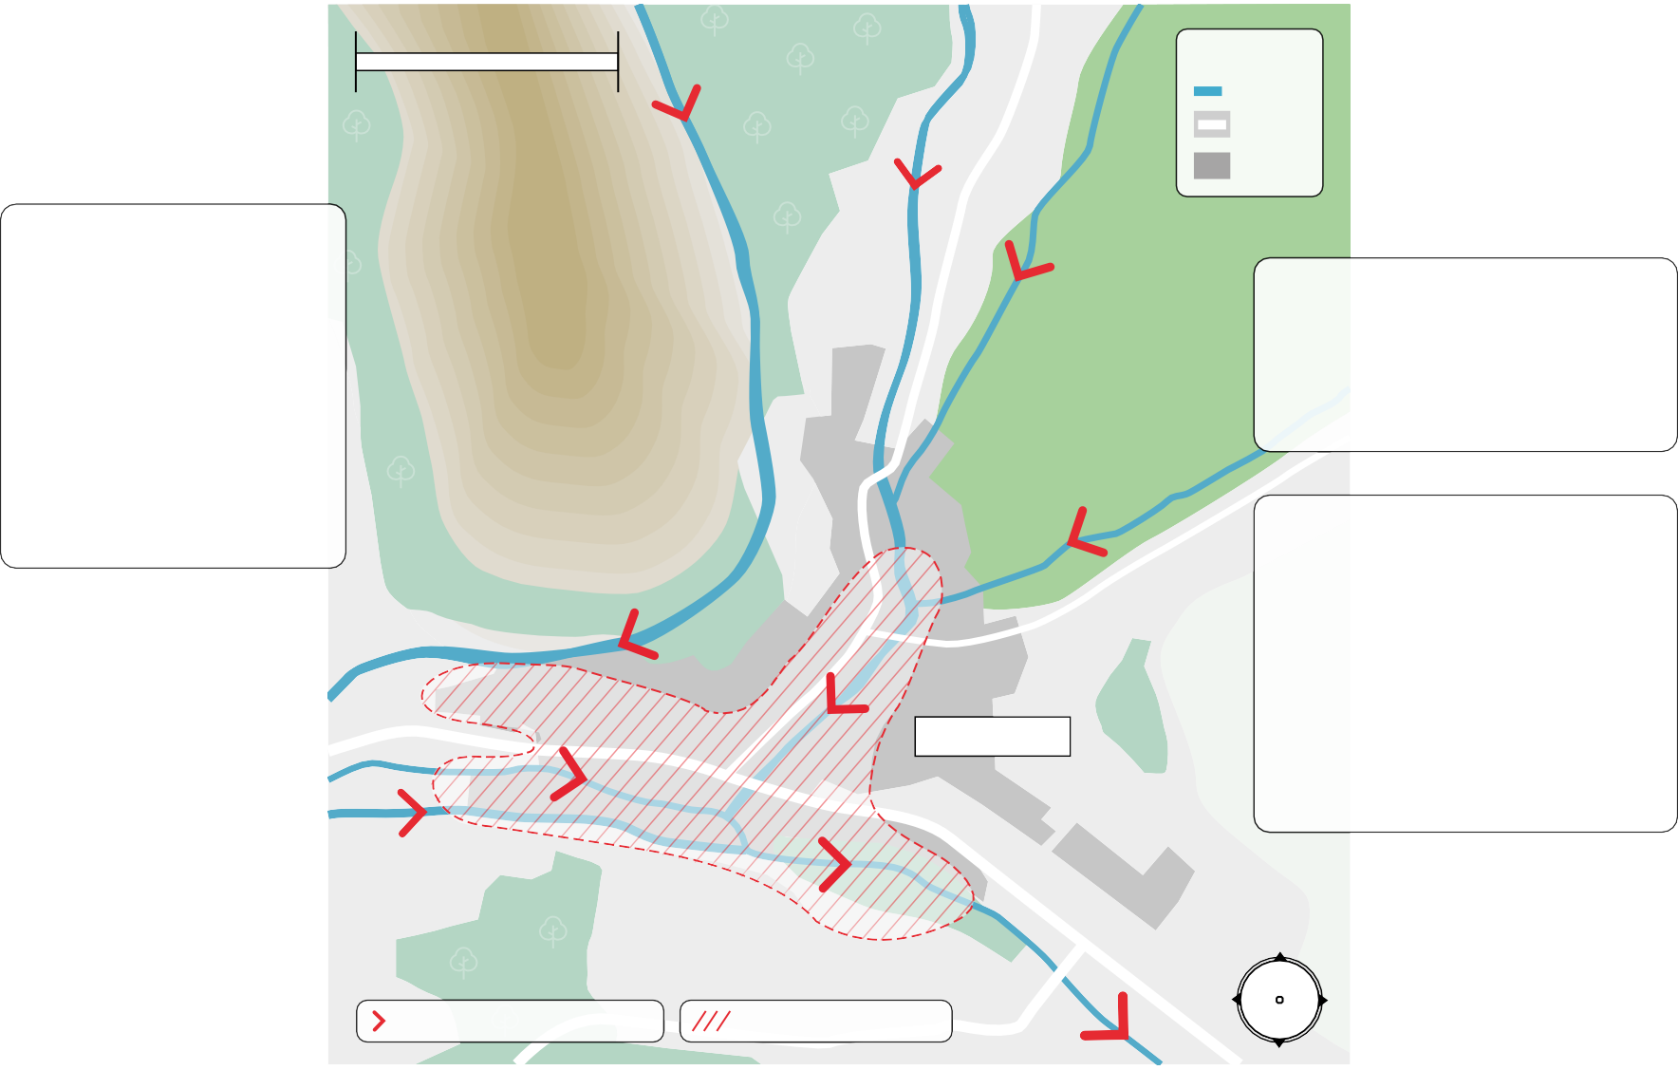
Key
Scale 500m
River Road
Buildings
River Crane
River Leawell
Farmland
To the West of the town there are steep hills which were recently cleared of their trees as they had a disease.
Steep hills
The area surrounding the town is mostly used for farming animals.
The town sits on three rivers: River Moor, River Crane, River Leawell
These areas are prone to flooding when it rains heavily.
STEMVILLE
River Moor
N
Direction of water flow in river
Areas prone to flooding
W E
S
Notes:
This slides help to explain the geography of Stemville.

Slide 11
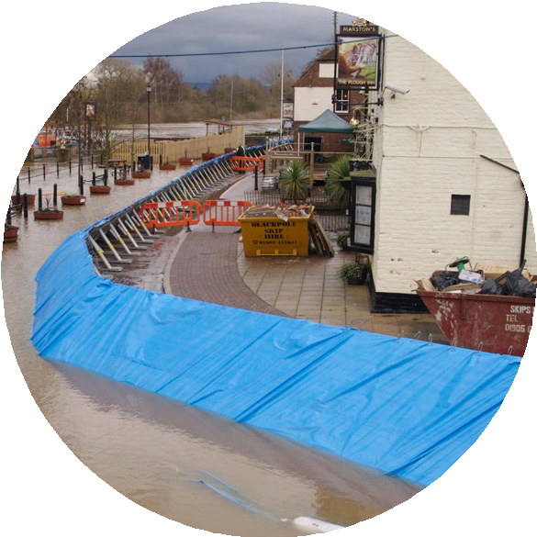
The Stemville Floods
According to records Stemville has experienced floods since 1615.
The floods have been getting more regular and more severe, due to climate change and the town has flooded 11 times in the last 8 years.
Enough is enough.
The council and Environment Agency are ready to invest £20 million in a flood management system for the town. Can you help?
Notes:
Following from the previous slide this highlights the flooding problems that Stemville has experienced in the past, but how it is now getting worse and the town council need to take action as homes and businesses are being damaged which has a negative impact on the economy and people’s well being.

Slide 12
Can you save Stemville?
The council need help and they have called in your team of planners to devise a plan to prevent homes and businesses from flooding. Your task:
First step:
Find out about the various flood management systems and evaluate which will be the best in terms of:
Next steps:
You must choose a package of flood management systems and ensure that you can afford them within your £20 million budget.
Mark on your plan of STEM Ville where you will put the systems.
Create a short pitch to the council, explaining which flood management systems you have chosen and why.
Protecting homes and businesses from flooding
How easy the flood management system is to install or build
The environmental impact
The Carbon footprint (delete if not looking at this criteria)
Notes:
Introduce the task. Tell pupils they will be provided with a list of flood management system information cards and they need to work as a team of specialists to evaluate the systems and come up with a plan for protecting the town. They can collate the information on a student flood evaluation sheet for each version of the activity.
They then need to select the appropriate flood management systems for their plan that are within the budget and they can summarise their choices and its cost on the flood management system budgeting sheet.
Get them to mark on their plan where they would put their flood management systems.
Keep this slide up as pupils evaluate the flood management systems so they are clear about what they have to do .
Remind them that once they have made their choices about the flood defence management systems they will have to prepare a presentation for the judges.

Slide 13
What is in a pitch?
Teams will be graded on the following criteria, so consider them in your planning:
Numeracy skills - Ensure your costing is correct and within the £20 million budget
Communication skills – Explain your plan clearly.
Answer follow up questions confidently.
Use a good range of flood management systems
Justify your choices of flood management systems
Notes:
Go through this slide to tell students what the councillors are looking for in a good pitch. Keep this slide up as the students work on their pitch.

Slide 14
Let’s hear your pitch!
Tell us which flood management system you chose
Show us on your town plan the position
of your flood management systems
Tell us the total cost of your plan
Tell us why you
have chosen this plan
Notes:
Use this slide as the pupils are doing their pitch. In order to keep students engaged it might be worth giving them pitch grading sheets so they can comment on each of the pitches and perhaps have a vote for the best.

Slide 15
What is the carbon footprint?
The carbon footprint is the total amount of carbon dioxide and other greenhouse gases emitted over the full life cycle of a product, service, event or person.
The flood management systems have been given a carbon footprint rating given out of 10.
1 being the lowest carbon footprint which is good
10 being the highest, which is bad for the environment.
When choosing your flood management systems, as well as the financial cost consider the carbon cost.
Notes:
Insert this slide in between slides 11 and 12 if it is to be used. This slide along with the carbon footprint on the flood management systems cards can be used as an extension for more able pupils or if there is more time. This helps students to understand that the carbon footprint of a flood management system is a very important factor in selecting an appropriate flood management system.

Slide 16
© Environment Agency 2022. This content is available under Open Government Licence v3.0.

