Slide 1
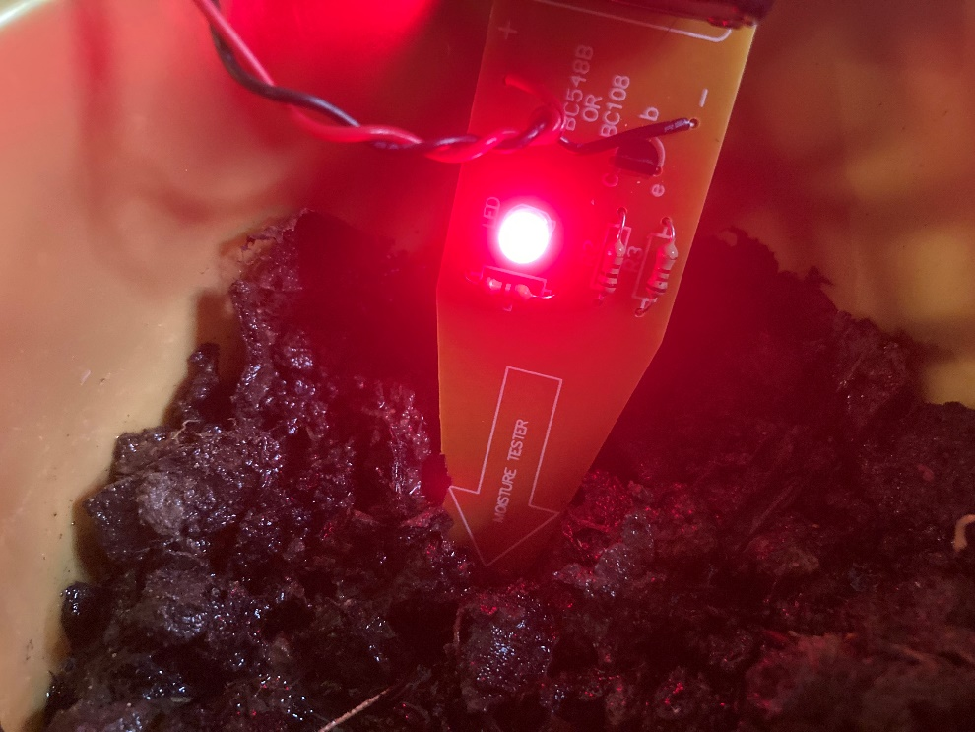
Make a sensor to test waterlogged pitch
Making a moisture sensor that a football referee can use to check that the pitch is fit to play on

Slide 2
Stay safe
Whether you are a scientist researching a new medicine or an engineer solving climate change, safety always comes first. An adult must always be around and supervising when doing this activity. You are responsible for:
ensuring that any equipment used for this activity is in good working condition
behaving sensibly and following any safety instructions so as not to hurt or injure yourself or others
Please note that in the absence of any negligence or other breach of duty by us, this activity is carried out at your own risk. It is important to take extra care at the stages marked with this symbol: ⚠

Slide 3
Brief
The men’s football world cup is due to be played in Qatar in November and December 2022. This is the start of the rainy season in the country.
Your task is to make a waterlogging sensor that a referee can use to check whether the pitch is fit to play on. It should indicate when the pitch is too wet for play to safely take place.

Slide 4
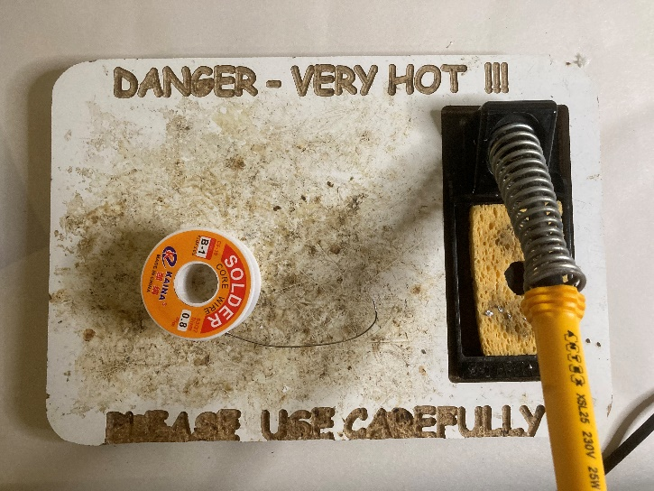
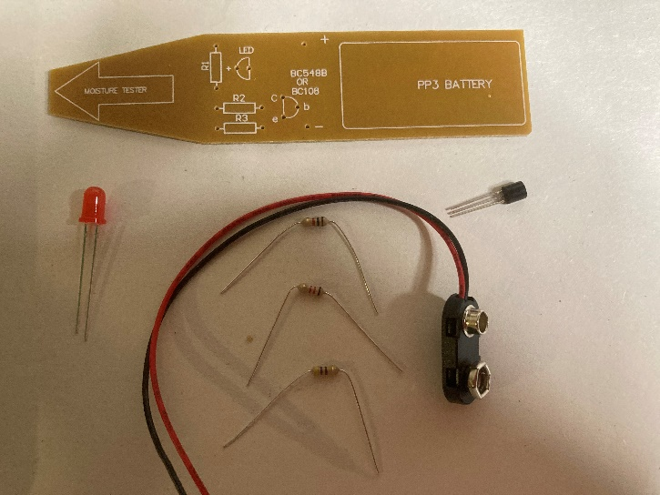
Resources
A soldering iron, stand, sponge and mat/base
Solder
Moisture sensor circuit board
A 9 volt battery and battery snap
A 470 ohm, 1 kiloohm and 1.2 kiloohm resistor
A transistor
A 5 mm red LED
A sticky pad
Notes:
Lead free solder should be used for safety. If permanent fume extraction is not present in the room then portable extraction units will be needed. Safety glasses should be worn during all soldering and wiring activities.
The circuit board used in this example is the Rapid Electronics Moisture sensor PCB, available here: https://www.rapidonline.com/Catalogue/Product?Id=70-0040
Alternatively a custom made PCB based around a simple transistor switching circuit could be produced, or stripboard could be used.
A BC548B or BC108 transistor could be used depending what is in stock or easily available – both will work fine.

Slide 5
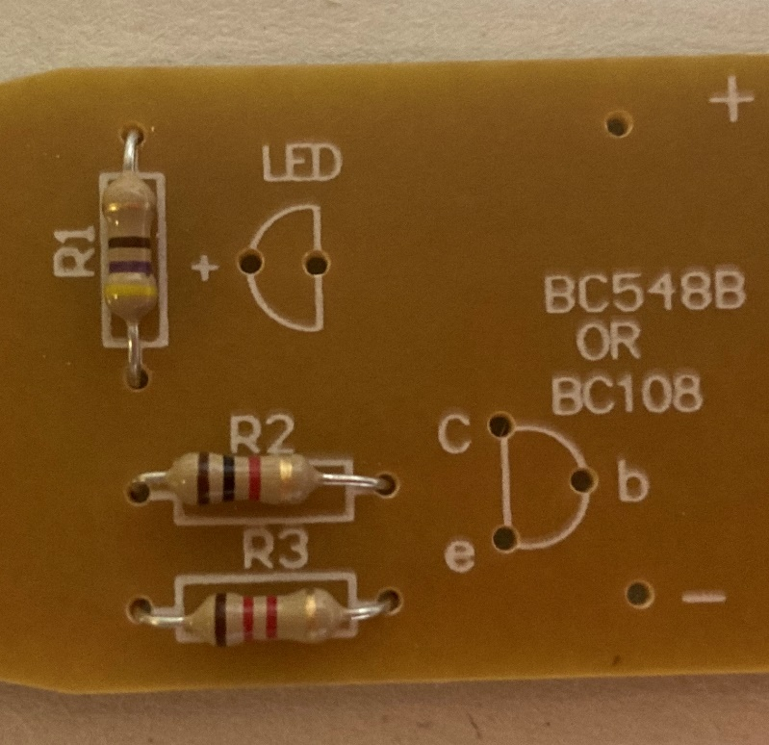
Step 1a – Mounting the resistors
Mount the 470 ohm resistor (yellow, violet, brown) into the holes labelled ‘R1’ on the plastic side of the PCB
Mount the 1 kiloohm resistor (brown, black, red) through the holes labelled ‘R2’
Mount the 1.2 kiloohm resistor (brown, red, red) through the holes labelled ‘R3’
Notes:
The resistors should be mounted as flat as possible on the plastic side of the PCB. As they are non-polarised it does not matter which way around they are placed, but usual convention is to place them with the gold tolerance band to the right.

Slide 6
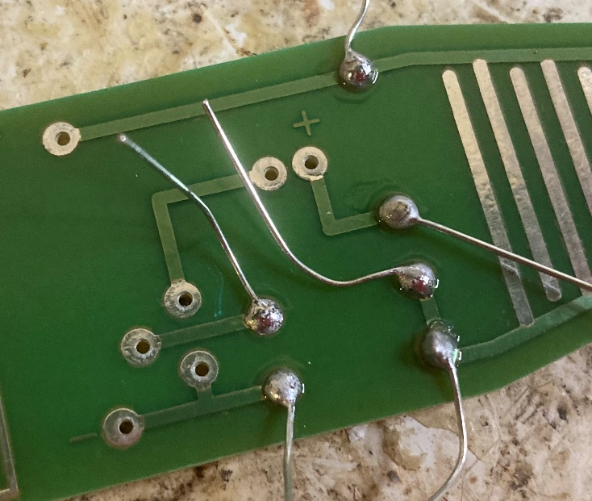
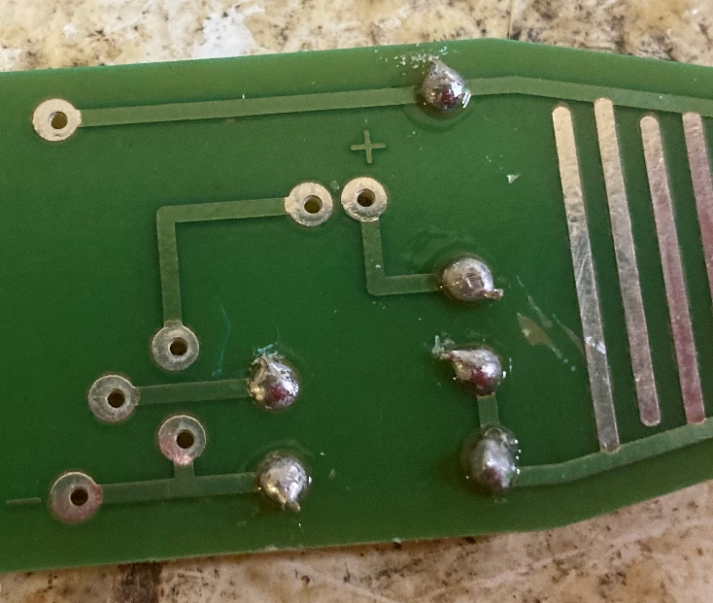
Step 1b – Soldering the resistors
⚠
Solder the resistor legs to the pads on the track side of the PCB
Use wire cutters to cut away any excess wire
Notes:
Demonstrate safe use of soldering equipment prior to learners attempting this step. A visualiser or small webcam linked to a projector screen would help with this. Safety glasses should be worn at all times. All soldering should be done on a mat or board to avoid damage to desks. A sponge should be used to regularly clean the soldering iron tip. The iron should be placed in its stand at all times when not in use.

Slide 7
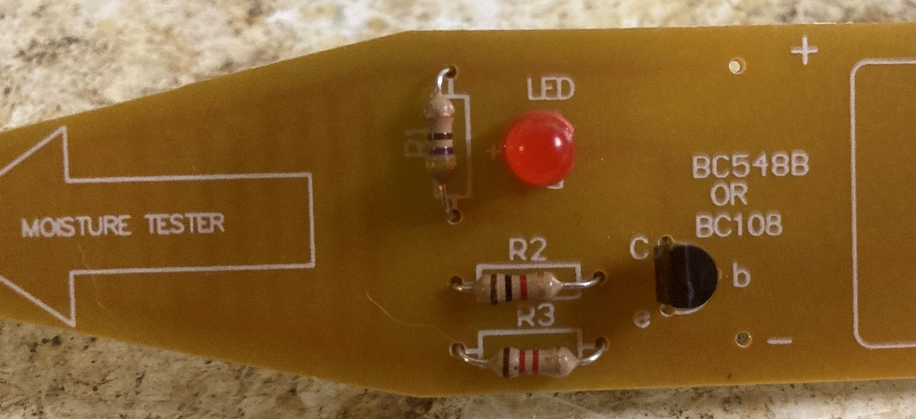
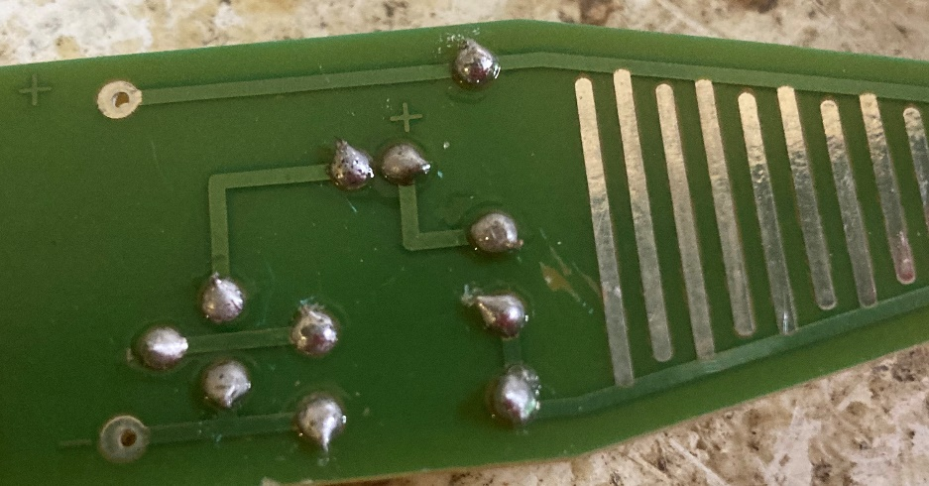
Step 2 – Transistor and LED
⚠
Mount and solder the transistor and LED to the PCB
Make sure that the round and flat sides of each component match the markings on the board!
Snip the ends when soldered
Notes:
The transistor and LED are polarised components so must be connected the right way round – as shown on the circuit board markings (transistor flat side to the left, LED flat side to the right).

Slide 8
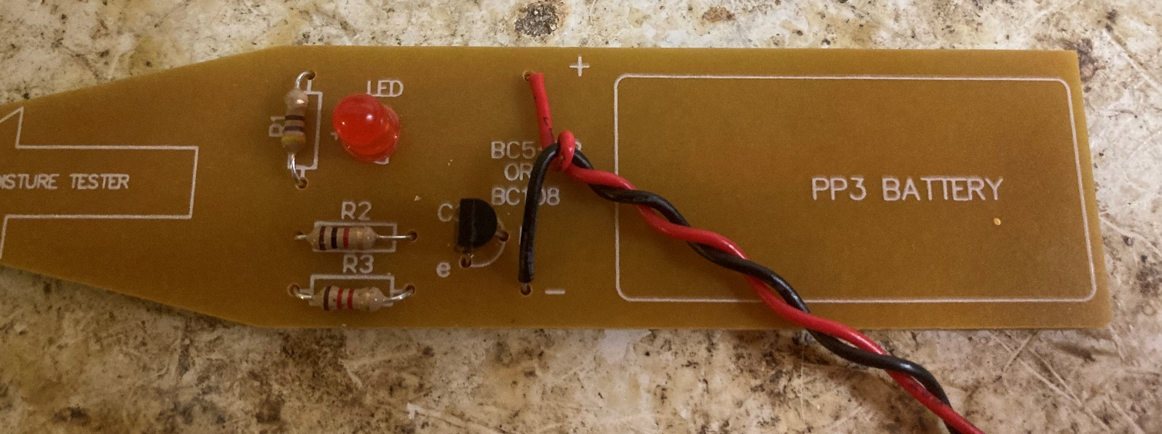
Step 3 – Battery snap
⚠
Mount and solder the battery snap wires to the PCB. The red wire goes to ‘+’ and the black wire goes to ‘-’
Snip the ends when soldered
Twist the wires together
Notes:
The battery snap wires must be connected as shown or the circuit will not work. Twisting the wires together will make the wiring neater and less likely to break.

Slide 9
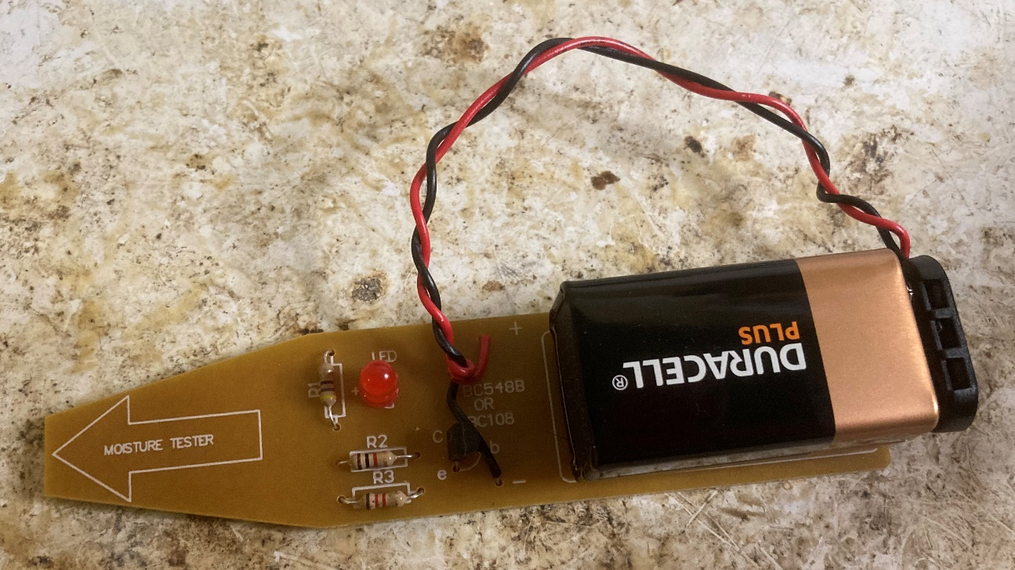
Step 4 – Battery
Connect the battery to the battery snap and stick onto the board with a double sided sticky pad
Notes:
Remember to disconnect the battery to save power when not in use.

Slide 10
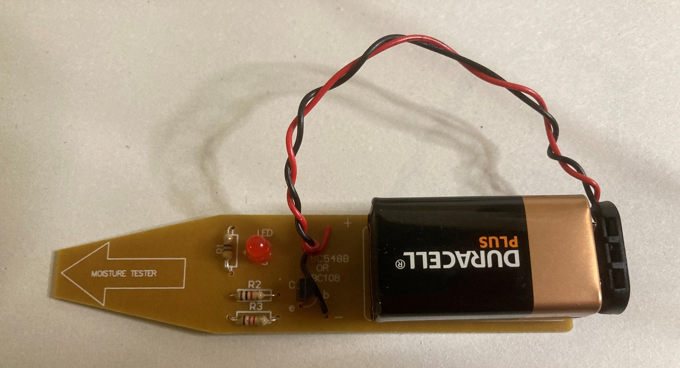
Finished example
Notes:
An example of a finished circuit with all components in place and ready to test.

Slide 11

Testing
Place the moisture sensor in wet soil or grass to see if it works!
Notes:
When the soil/grass is wet the LED should light up. When it is dry it will not. This is because the moisture causes current to flow across the sensor and therefore ‘makes’ the circuit. If the circuit does not work check for dry joints or short circuits in the soldering, or polarised components that are connected the wrong way round.

