Slide 1
Trees and Carbon Capture
Key Stage 3 Maths

Slide 2
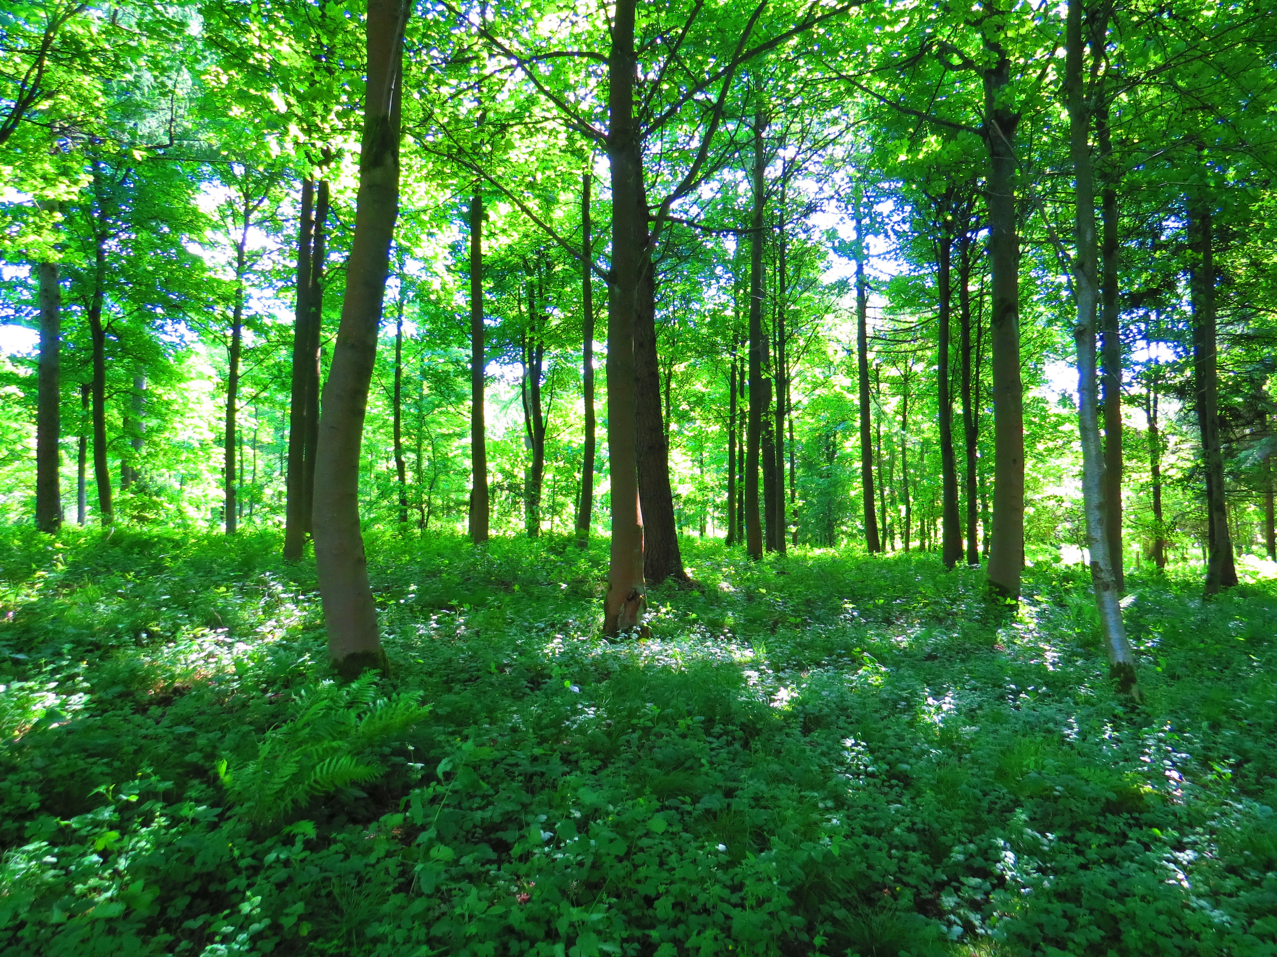
Carbon Capture and Storage
Through photosynthesis, trees convert carbon dioxide and water into sugar and oxygen using energy from light.
The sugar produced contains carbon and is used by the tree to grow.
Any sugar isn’t needed right away is stored in the tree’s trunk and roots as starch.
A tree is only increasing the carbon it stores if it is growing.
Notes:
Photo by trevor pye on Unsplash

Slide 3
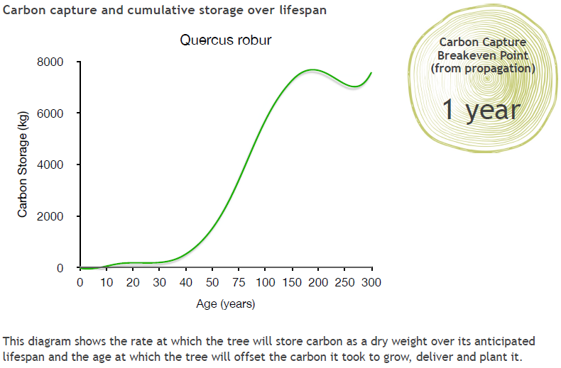
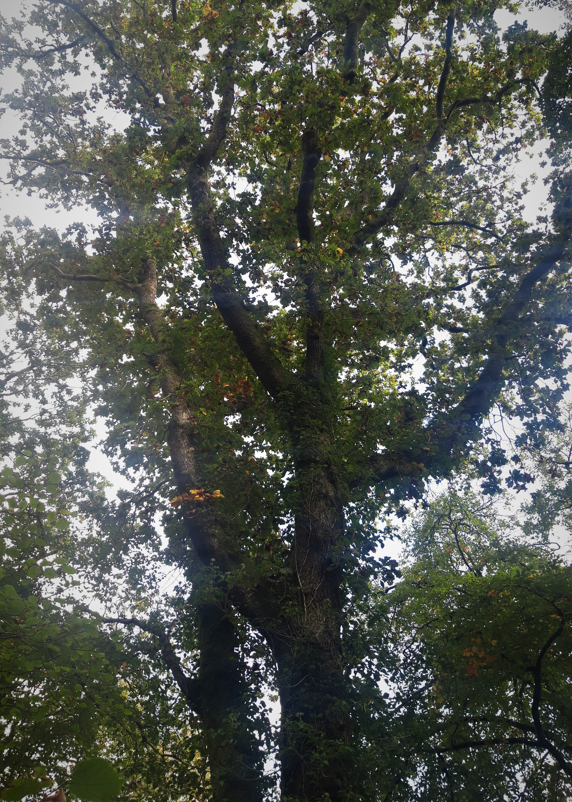
English Oak
Oak
Notes:
Slides 15-18 show how three species of tree store carbon over their lifespan. We will use this information to help us decide how many trees are needed to offset a flight from London to New York, and whether it matters what kind of tree you plant.
What do you notice about the scale on these graphs?
Information about how this data was collected is available here: https://www.treeconomics.co.uk/projects/barchamcarbonperformanceproject/ and here: https://www.barcham.co.uk/store/. Each tree in the Barcham shop has a certificate. The negative carbon storage in the first few years of each graph are explained by taking into account the carbon emissions in driving to collect the tree before planting it.

Slide 4
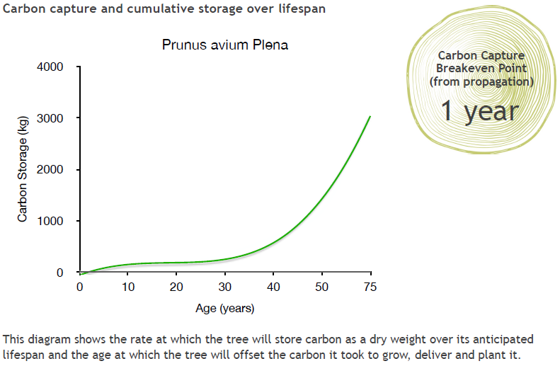
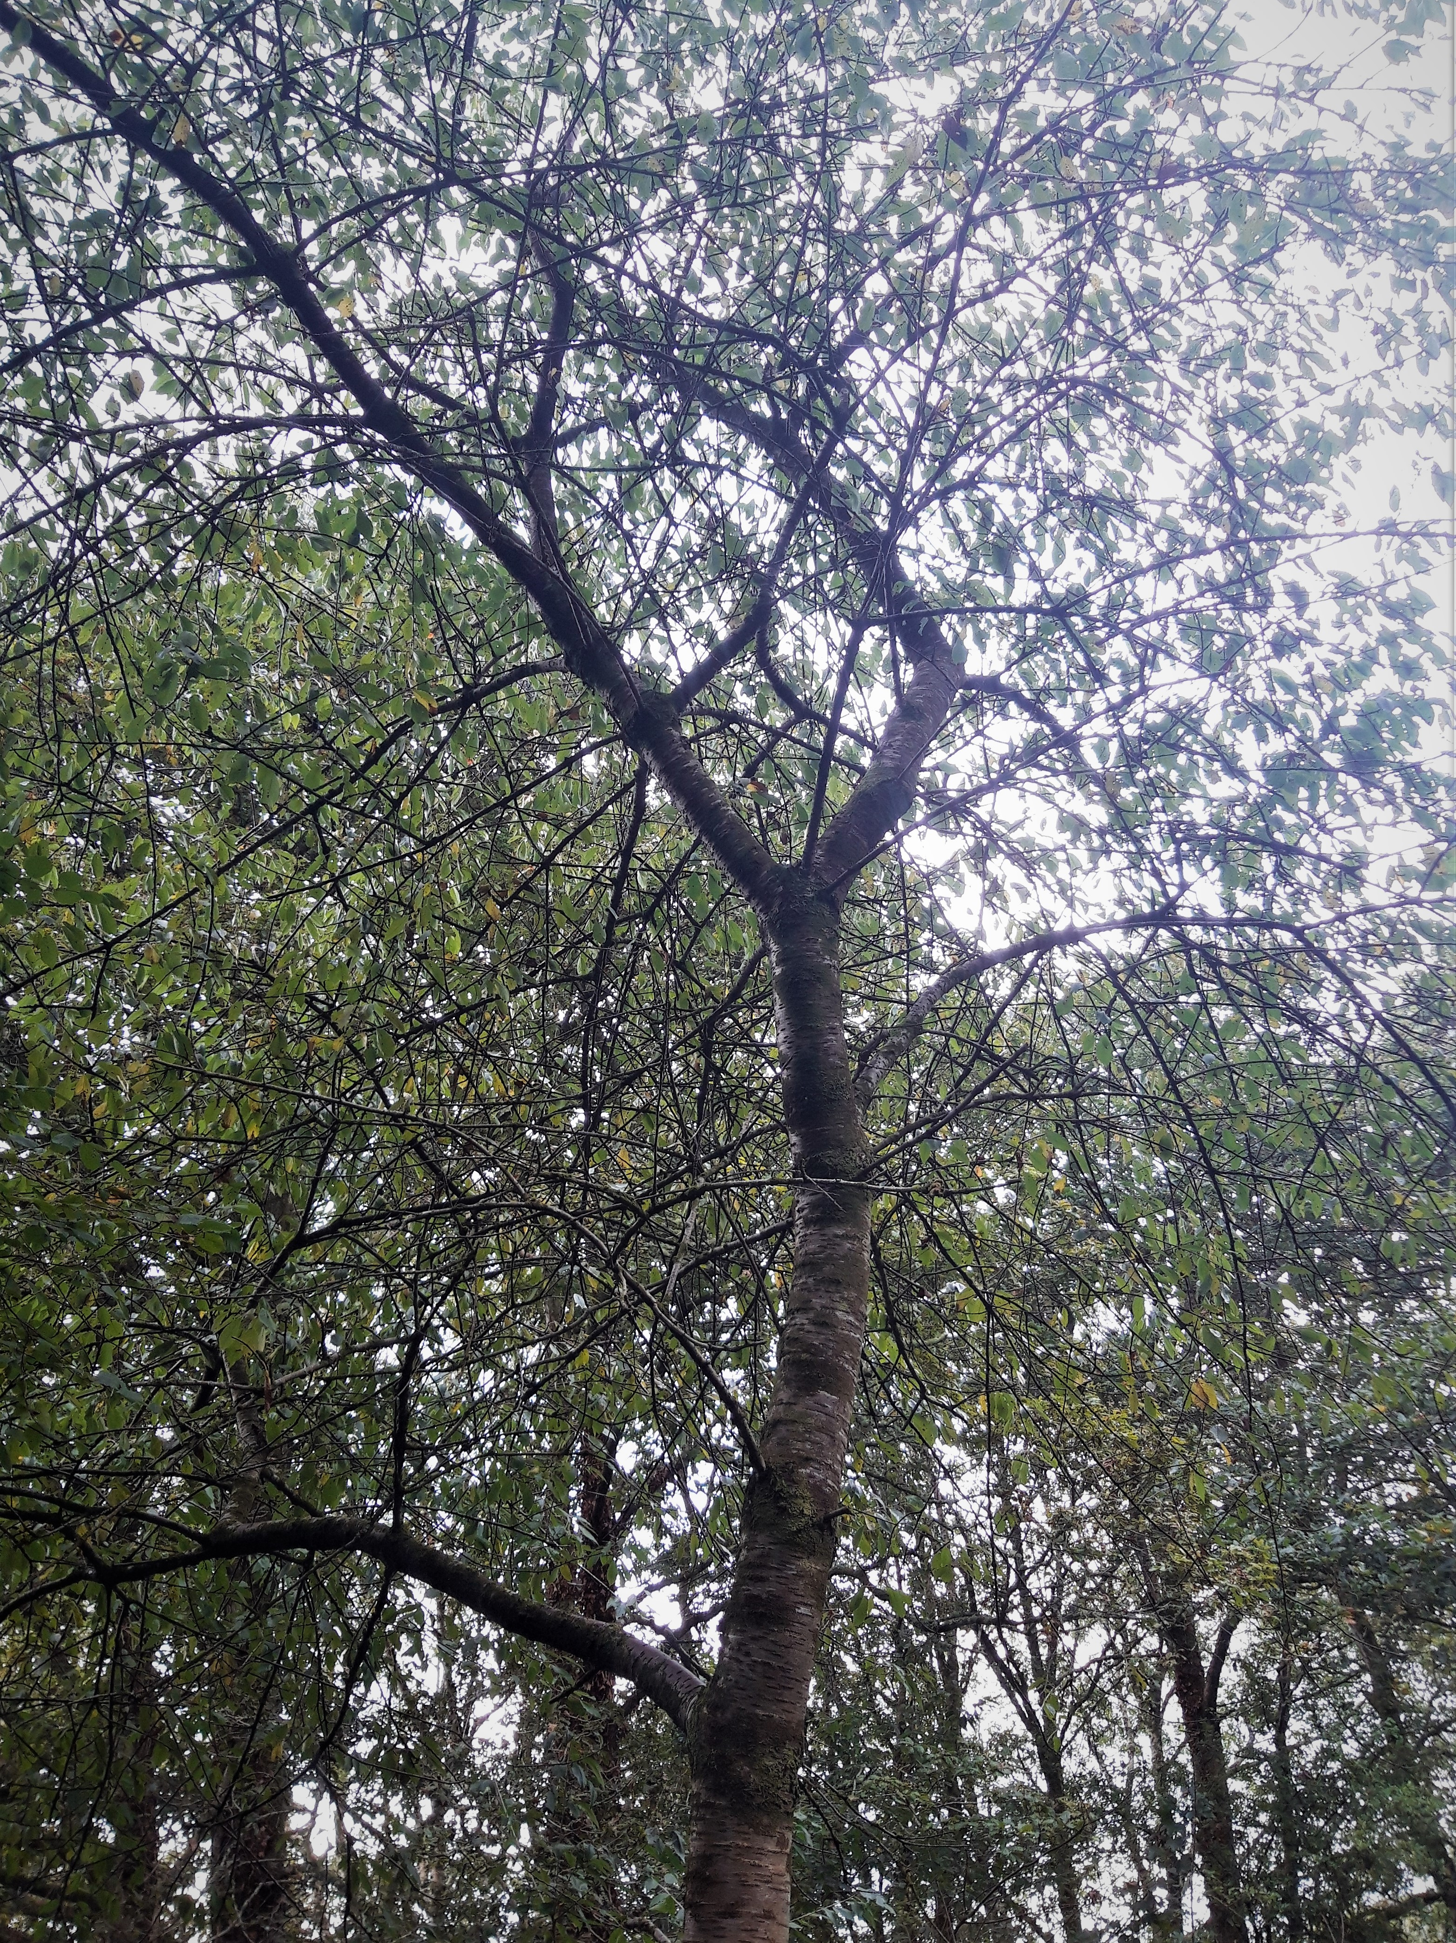
Wild Cherry
Cherry

Slide 5
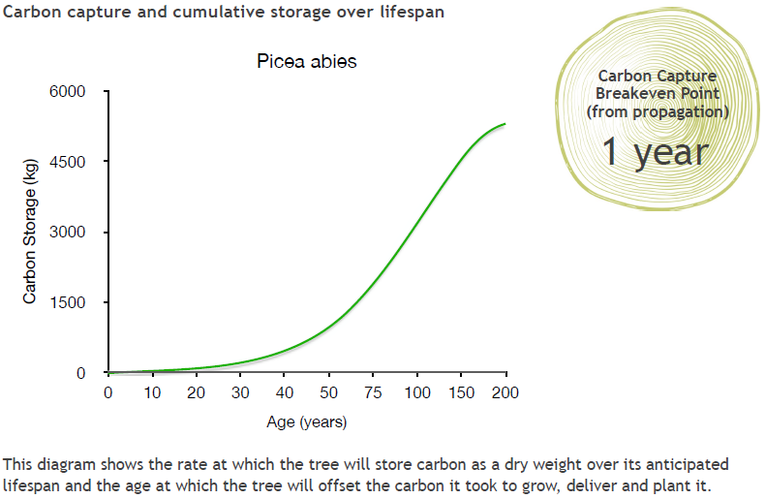
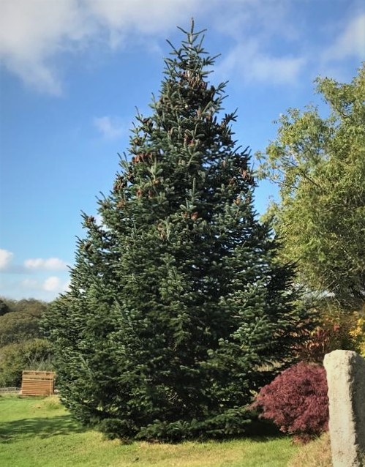
Norway Spruce
Spruce
Notes:
The Norway Spruce is a common variety of Christmas Tree.

Slide 6
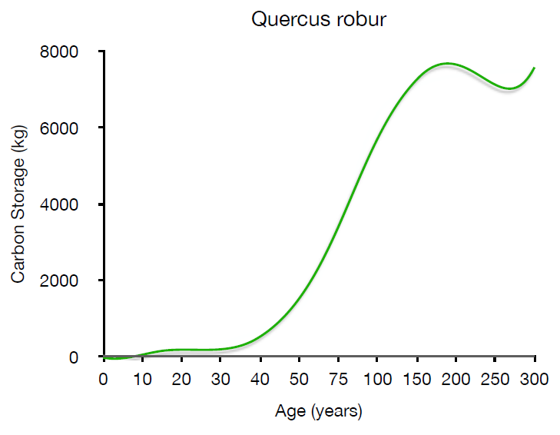
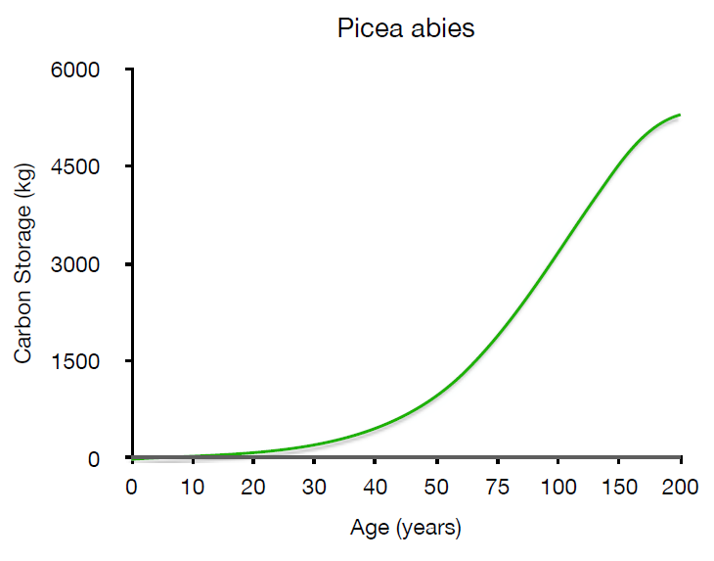
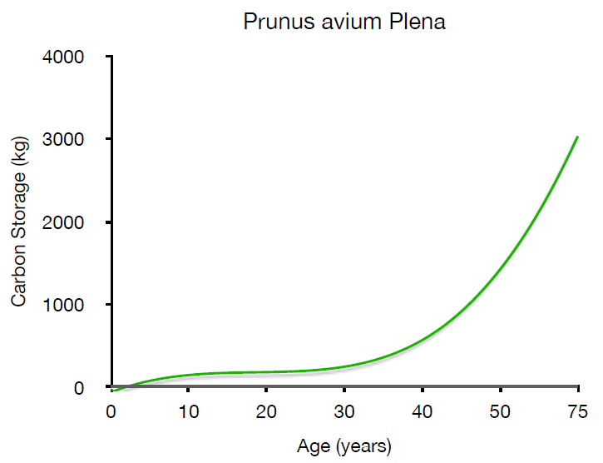
How do they compare?
Oak
Spruce
Cherry
Notes:
It is difficult to compare these graphs in this form – can your students say why? What do they notice about these graphs?
One problem is that the axes are different for each graph. Not only that, but the scales for AGE are not linear – the intervals on the x axes vary. Invite students to explain what they would need to do in order to compare these graphs effectively.

Slide 7
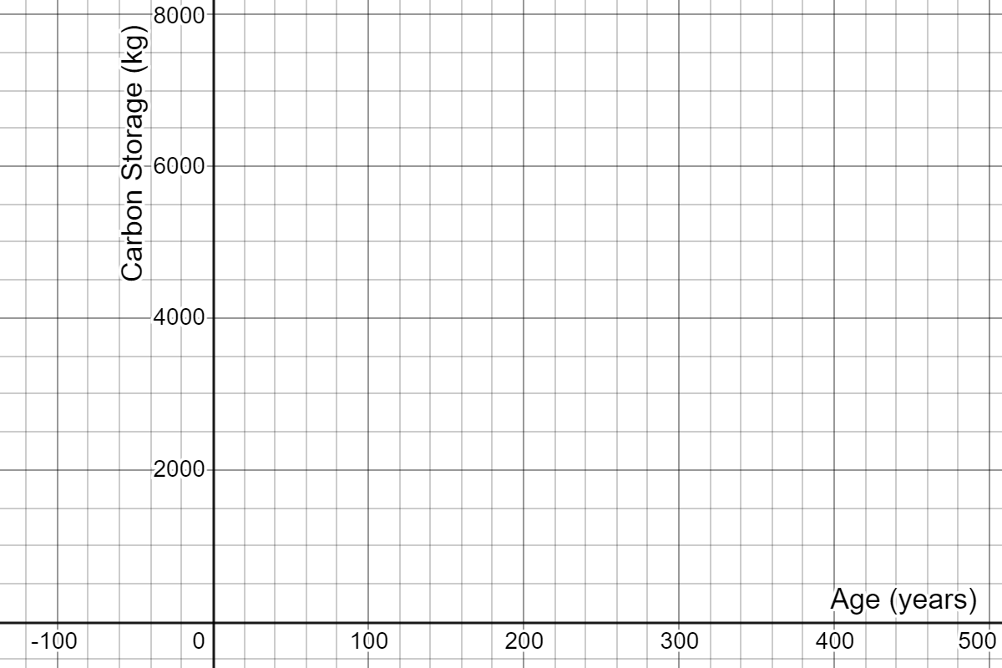
How do they compare?
Use the data from the graphs to redraw them on one set of axes so that we can compare them.
Oak
Cherry
Spruce
Notes:
Students to be handed the data sheets in groups. After 15 minutes they need to present their argument for which trees they would choose to plant and why.
Here are the three sets of data plotted on the same set of axes, in Desmos: https://www.desmos.com/calculator/rci87lp05w

Slide 8
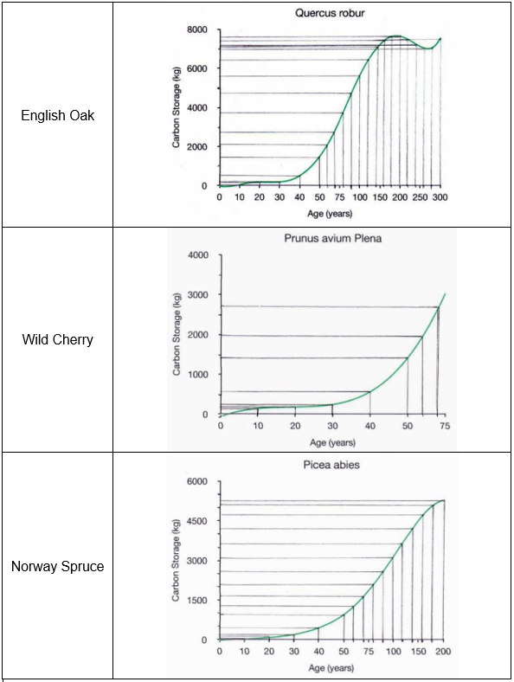
Possible approach
Age of tree |  | Carbon stored, in kg, by:
 |  | English Oak | Wild Cherry | Norway Spruce
0 |  | 0 | -100 | -50
10 |  | 0 | 200 | 50
20 |  | 200 | 250 | 150
30 |  | 250 | 300 | 250
40 |  | 550 | 600 | 450
50 |  | 1400 | 1400 | 950
60 |  | 2100 | 2000 | 1300
70 |  | 2750 | 2700 | 1700
80 |  | 3750 |  | 2100
90 |  | 4700 |  | 2600
100 |  | 5600 |  | 3150
120 |  | 6400 |  | 3650
140 |  | 7150 |  | 4200
160 |  | 7450 |  | 4750
180 |  | 7600 |  | 5150
200 |  | 7600 |  | 5300
220 |  | 7450
240 |  | 7250
260 |  | 6950
280 |  | 7000
300 |  | 7500
Oak
Cherry
Spruce
Notes:
Students to be handed the data sheets in groups. After 15 minutes they need to present their argument for which trees they would choose to plant and why.
Here are the three sets of data plotted on the same set of axes, in Desmos: https://www.desmos.com/calculator/rci87lp05w

Slide 9
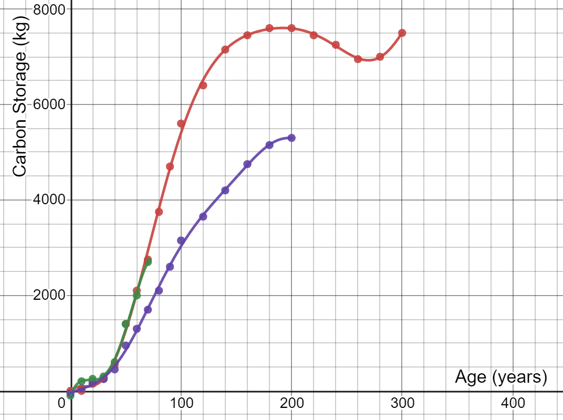
How do they compare?
Oak
Cherry
Spruce
Notes:
Students to be handed the data sheets in groups. After 15 minutes they need to present their argument for which trees they would choose to plant and why.
Here are the three sets of data plotted on the same set of axes, in Desmos: https://www.desmos.com/calculator/rci87lp05w
Some more data students might use is the Yield Class of trees, the volume (in m³) of wood produced per hectare per year. broadleaves generally grow with a YC of between 4-8, meaning they grow 4-8 cubic metres per hectare per year. Oak grows at around 6, Wild Cherry at 8 and Poplar achieving rates of up to 12. How does this relate to the data in the graphs? Note that the graphs consider mass of carbon, not volume, and they don’t take into account the density of planting. However, Yield Class doesn’t take into account the varying growth rates of trees.
For more information on Yield Class, see: https://www.carbonbrief.org/in-depth-qa-how-will-tree-planting-help-the-uk-meet-its-climate-goals

Slide 10
How do they compare?
Oak
Cherry
Spruce
Which trees would you plant?
Notes:
Students to be handed the data sheets in groups. After 15 minutes they need to present their argument for which trees they would choose to plant and why.
Here are the three sets of data plotted on the same set of axes, in Desmos: https://www.desmos.com/calculator/rci87lp05w

