Slide 1
Trees and Carbon Capture
Level 3 Core Maths

Slide 2
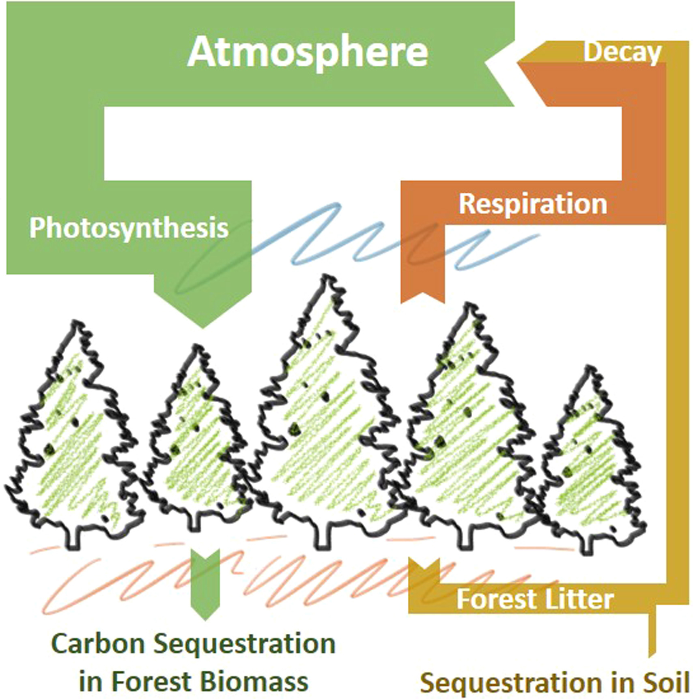
Carbon sequestration
Carbon sequestration is the process of capture and long-term storage of atmospheric carbon dioxide.
All of the CO₂ absorbed by trees is converted into sugar by a process of photosynthesis.
This sugar is used by trees either to grow leaves, or to grow wood.
If a tree is fully grown, it sheds as much carbon in Autumn as it absorbs in Spring.
A tree is only increasing the carbon it stores if it is growing.
Notes:
Image taken from: https://www.sciencedirect.com/science/article/pii/S1364032116306050
Schematic illustration of the carbon cycle within a mature unmanaged forest. The width of the arrows indicate the approximate relative scale of the carbon exchanges based on the values of Broadmeadow and Matthews [reference available in article linked above]. We note that sustainable harvesting of forestry timber (with suitable usage, e.g. in construction) would add a significant pathway to carbon sequestration in addition to those shown in the illustration.

Slide 3
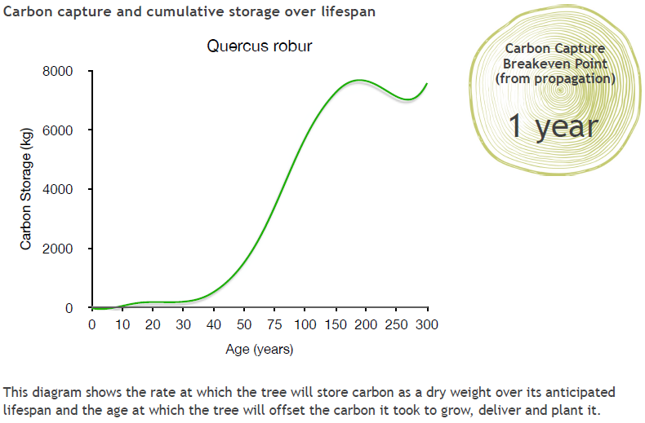
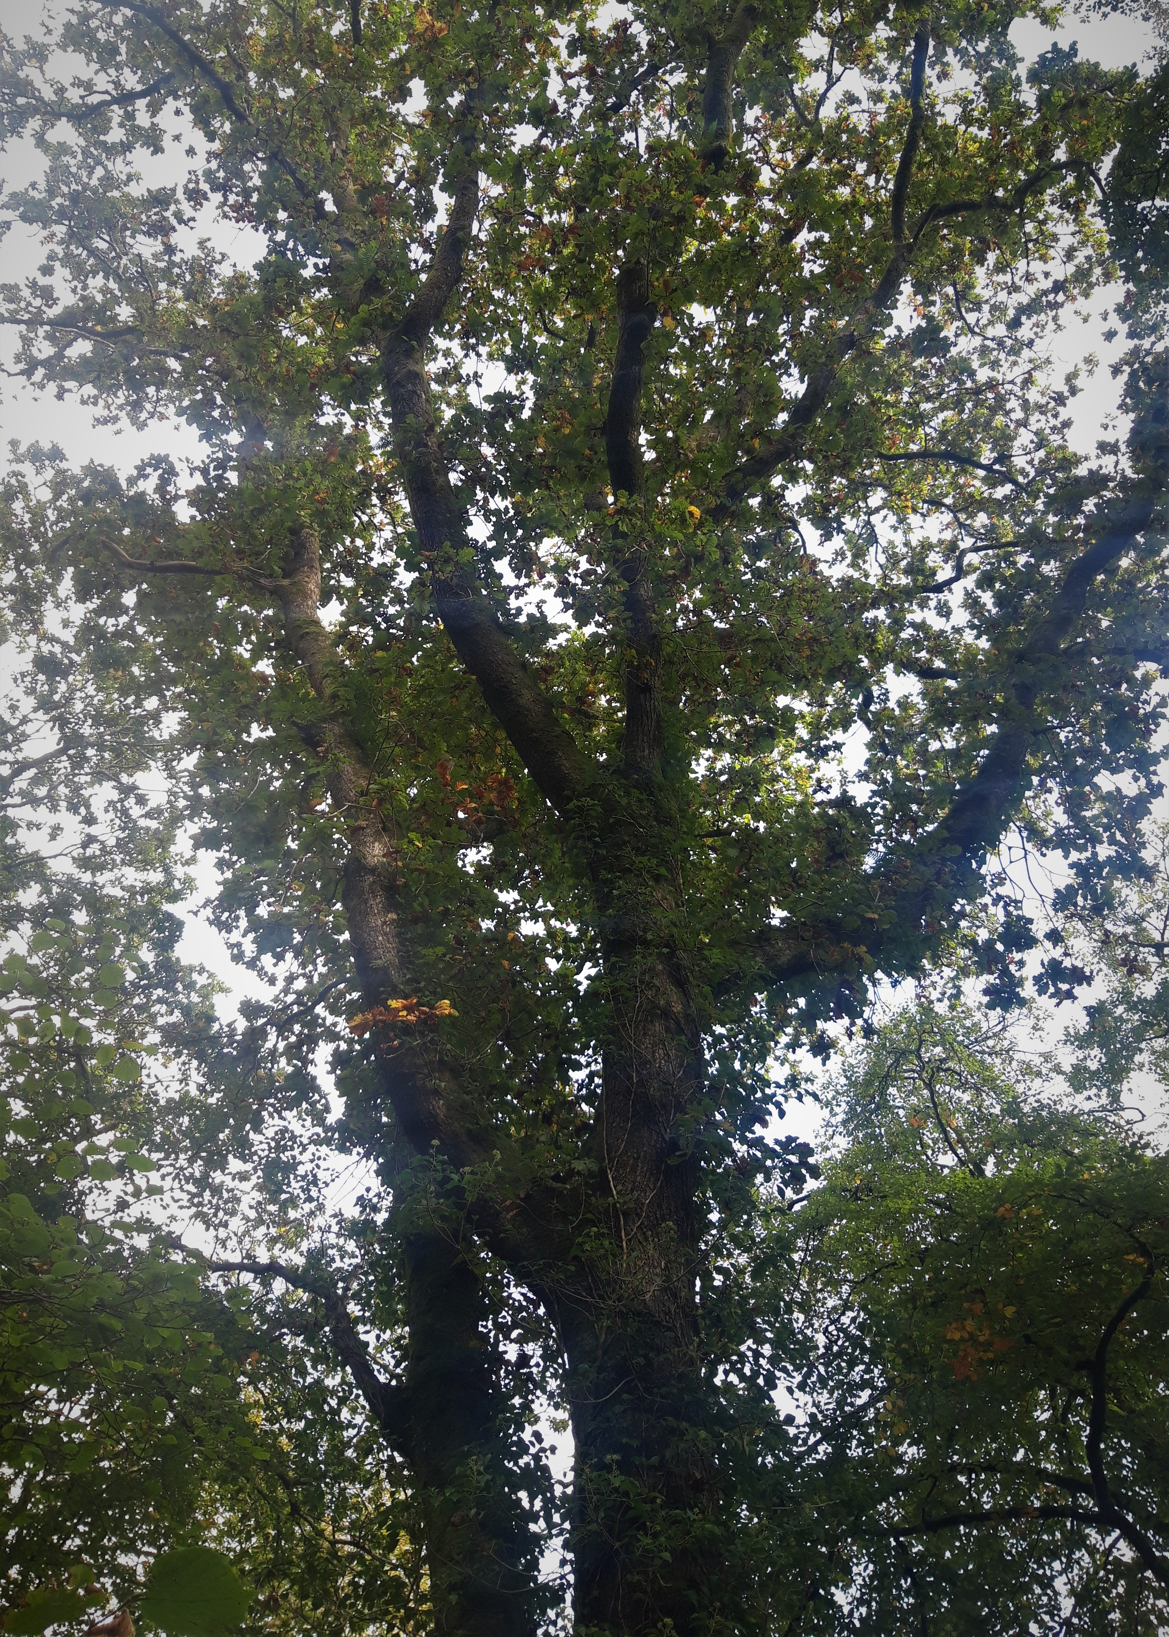
English Oak
Oak
Notes:
Slides 15-18 show how three species of tree store carbon over their lifespan. We will use this information to help us decide how many trees are needed to offset a flight from London to New York, and whether it matters what kind of tree you plant.
What do you notice about the scale on these graphs?
Information about how this data was collected is available here: https://www.treeconomics.co.uk/projects/barchamcarbonperformanceproject/ and here: https://www.barcham.co.uk/store/. Each tree in the Barcham shop has a certificate. The negative carbon storage in the first few years of each graph are explained by taking into account the carbon emissions in driving to collect the tree before planting it.

Slide 4
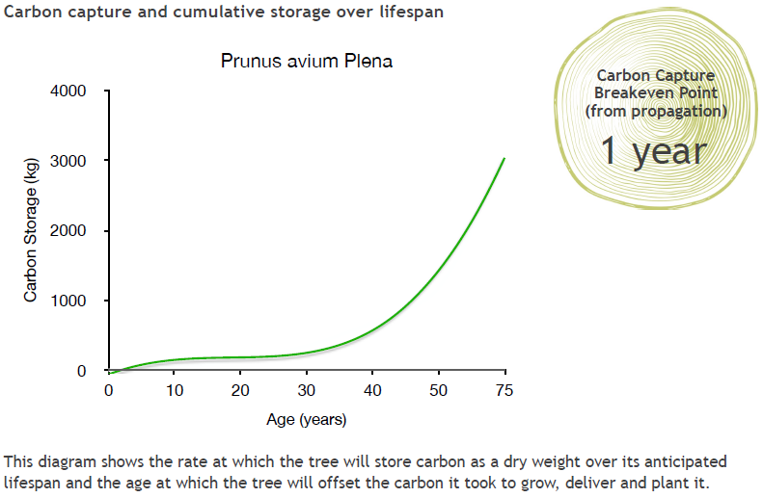
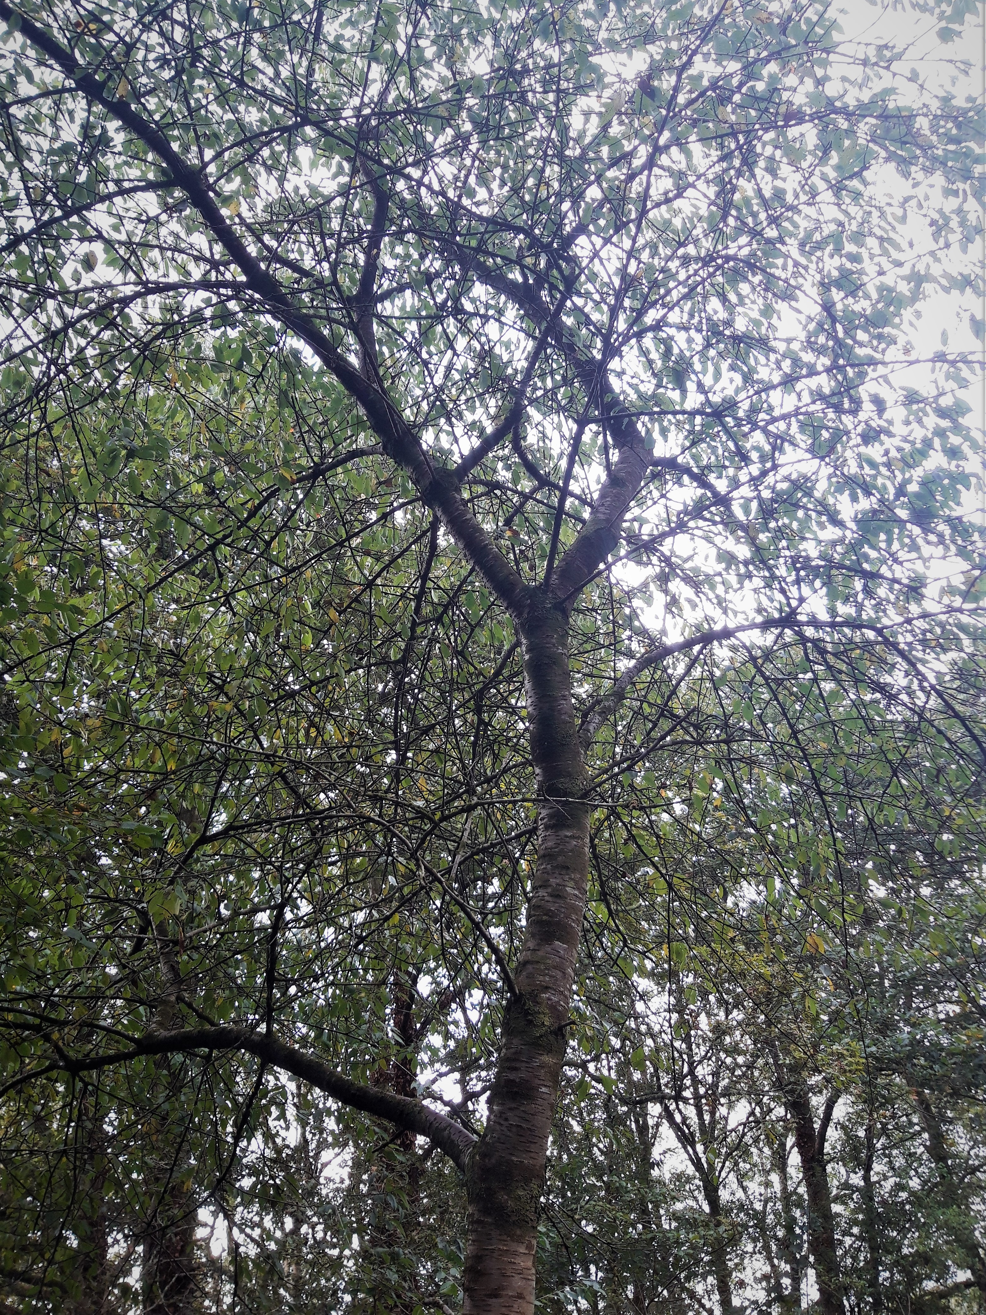
Wild Cherry
Cherry

Slide 5
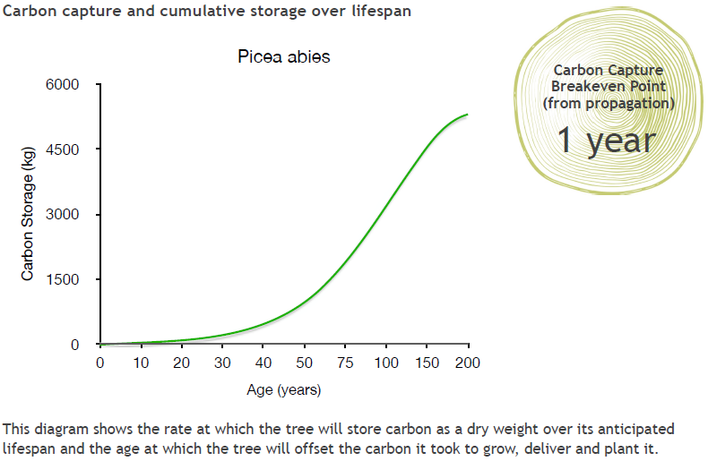
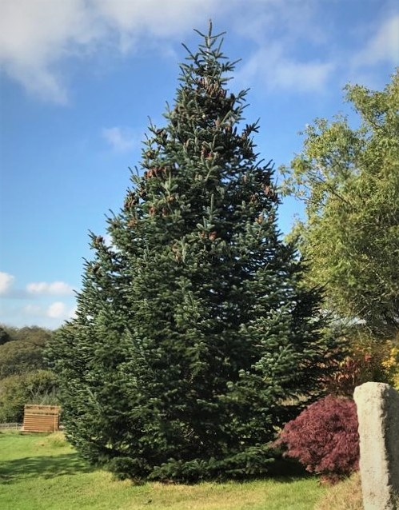
Norway Spruce
Spruce
Notes:
The Norway Spruce is a common variety of Christmas Tree.

Slide 6
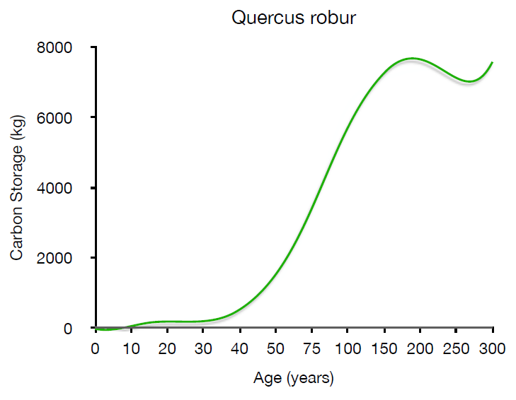
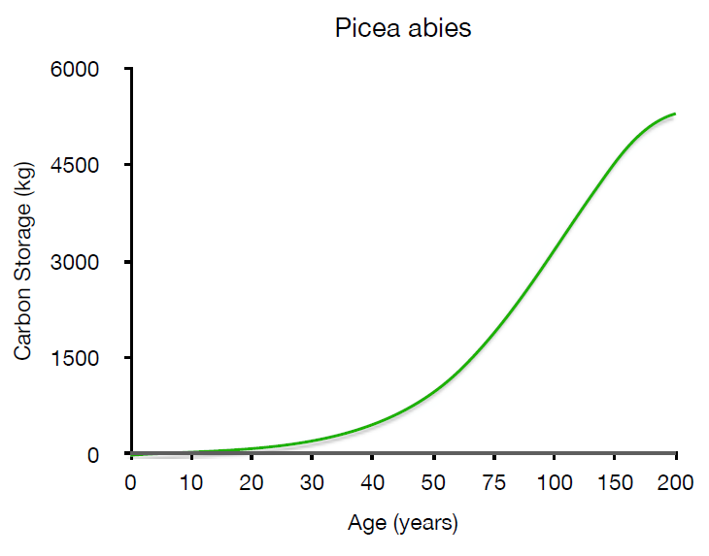
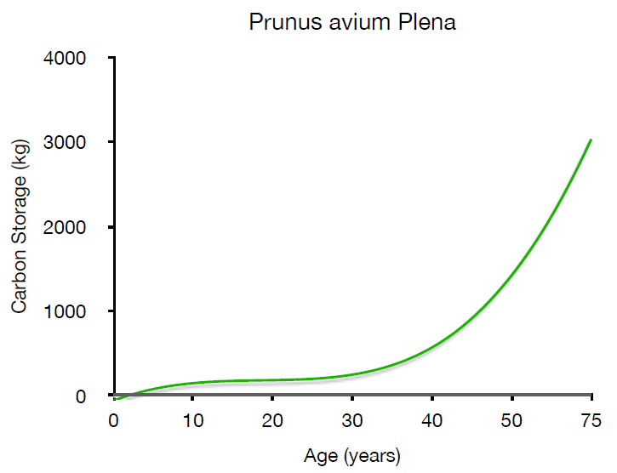
How do they compare?
Oak
Spruce
Cherry
Notes:
It is difficult to compare these graphs in this form – can your students say why? What do they notice about these graphs?
One problem is that the axes are different for each graph. Not only that, but the scales for Age are not linear – the intervals on the x axes vary. Invite students to explain what they would need to do in order to compare these graphs effectively.

Slide 7
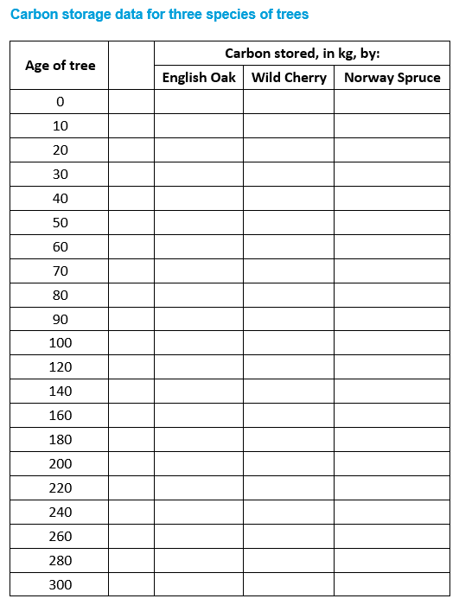
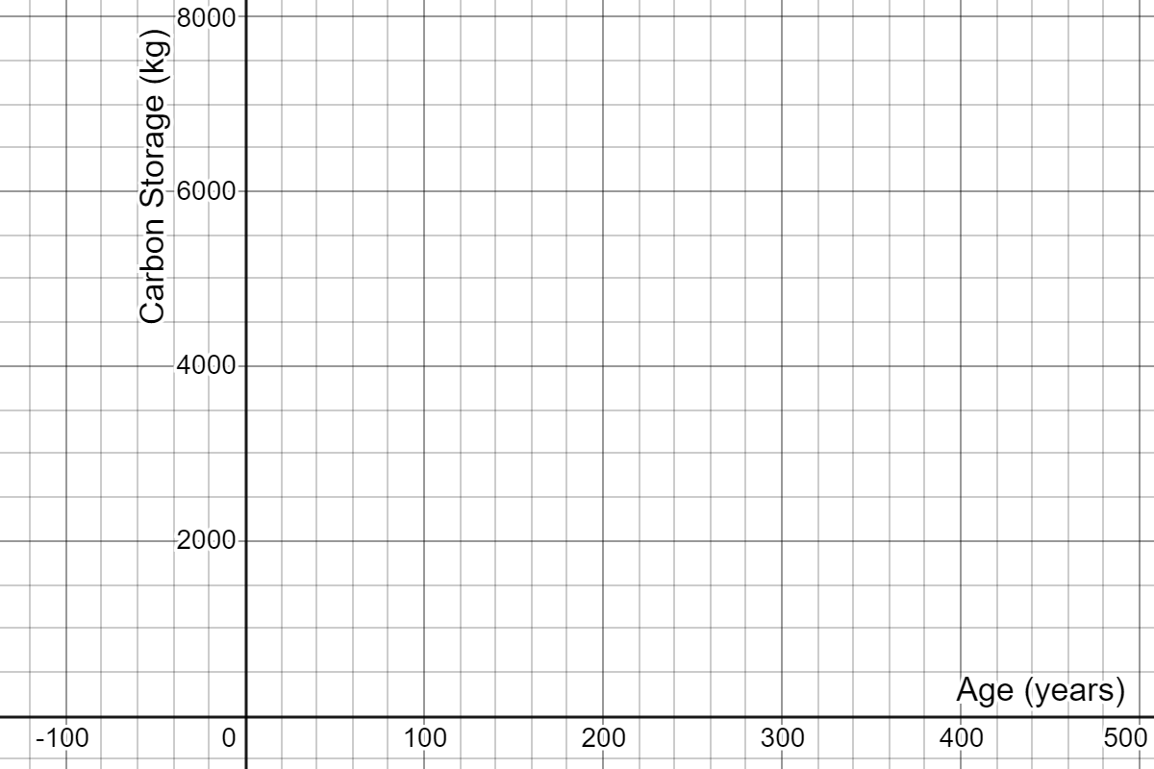
How do they compare?
Use the graphs to record the carbon stored by each of the tree species. Then re-draw these graphs on one set of axes.
Oak
Cherry
Spruce
Notes:
Students to be handed the data sheets in groups. After 15 minutes they need to present their argument for which trees they would choose to plant and why.
Here are the three sets of data plotted on the same set of axes, in Desmos: https://www.desmos.com/calculator/rci87lp05w
Some more data students might use is the Yield Class of trees, the volume (in m³) of wood produced per hectare per year. broadleaves generally grow with a YC of between 4-8, meaning they grow 4-8 cubic metres per hectare per year. Oak grows at around 6, Wild Cherry at 8 and Poplar achieving rates of up to 12. How does this relate to the data in the graphs? Note that the graphs consider mass of carbon, not volume, and they don’t take into account the density of planting. However, Yield Class doesn’t take into account the varying growth rates of trees.
For more information on Yield Class, see: https://www.carbonbrief.org/in-depth-qa-how-will-tree-planting-help-the-uk-meet-its-climate-goals

Slide 8
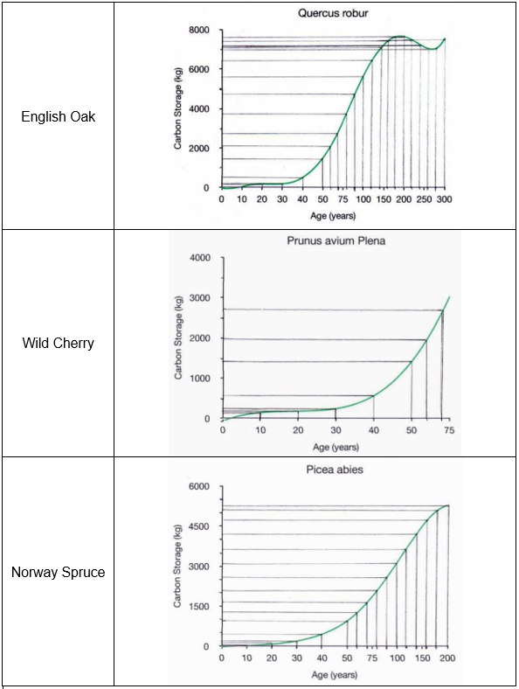
Possible approach
Age of tree |  | Carbon stored, in kg, by:
 |  | English Oak | Wild Cherry | Norway Spruce
0 |  | 0 | -100 | -50
10 |  | 0 | 200 | 50
20 |  | 200 | 250 | 150
30 |  | 250 | 300 | 250
40 |  | 550 | 600 | 450
50 |  | 1400 | 1400 | 950
60 |  | 2100 | 2000 | 1300
70 |  | 2750 | 2700 | 1700
80 |  | 3750 |  | 2100
90 |  | 4700 |  | 2600
100 |  | 5600 |  | 3150
120 |  | 6400 |  | 3650
140 |  | 7150 |  | 4200
160 |  | 7450 |  | 4750
180 |  | 7600 |  | 5150
200 |  | 7600 |  | 5300
220 |  | 7450
240 |  | 7250
260 |  | 6950
280 |  | 7000
300 |  | 7500
Oak
Cherry
Spruce
Notes:
Students to be handed the data sheets in groups. After 15 minutes they need to present their argument for which trees they would choose to plant and why.
Here are the three sets of data plotted on the same set of axes, in Desmos: https://www.desmos.com/calculator/rci87lp05w

Slide 9
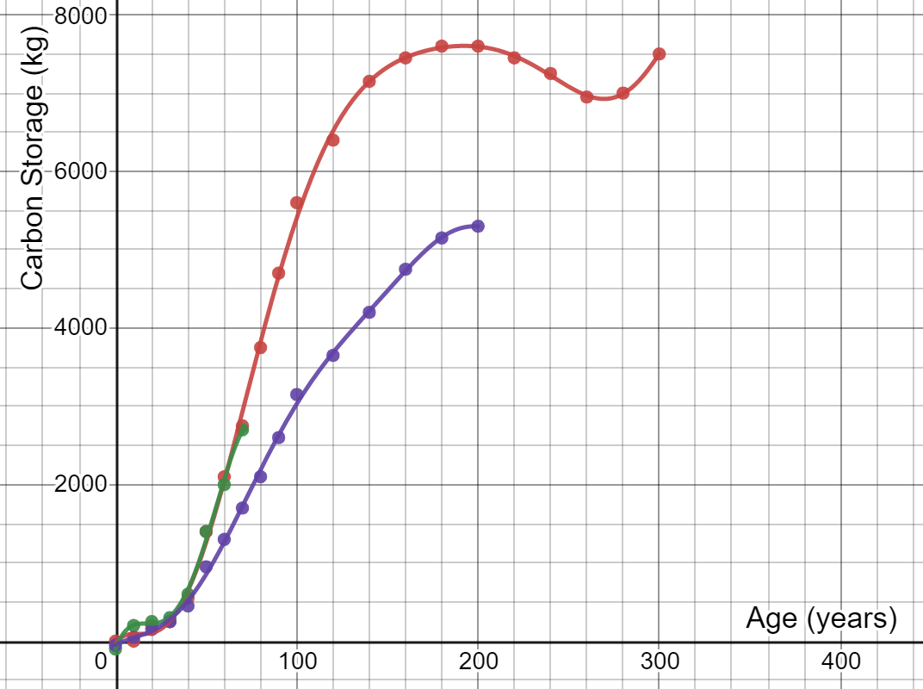
How do they compare?
Oak
Cherry
Spruce
Notes:
Students to be handed the data sheets in groups. After 15 minutes they need to present their argument for which trees they would choose to plant and why.
Here are the three sets of data plotted on the same set of axes, in Desmos: https://www.desmos.com/calculator/rci87lp05w
Some more data students might use is the Yield Class of trees, the volume (in m³) of wood produced per hectare per year. broadleaves generally grow with a YC of between 4-8, meaning they grow 4-8 cubic metres per hectare per year. Oak grows at around 6, Wild Cherry at 8 and Poplar achieving rates of up to 12. How does this relate to the data in the graphs? Note that the graphs consider mass of carbon, not volume, and they don’t take into account the density of planting. However, Yield Class doesn’t take into account the varying growth rates of trees.
For more information on Yield Class, see: https://www.carbonbrief.org/in-depth-qa-how-will-tree-planting-help-the-uk-meet-its-climate-goals

Slide 10
How do they compare?
Oak
Cherry
Spruce
Which trees would you plant?
Notes:
Students to be handed the data sheets in groups. After 15 minutes they need to present their argument for which trees they would choose to plant and why.
Here are the three sets of data plotted on the same set of axes, in Desmos: https://www.desmos.com/calculator/rci87lp05w
Some more data students might use is the Yield Class of trees, the volume (in m³) of wood produced per hectare per year. broadleaves generally grow with a YC of between 4-8, meaning they grow 4-8 cubic metres per hectare per year. Oak grows at around 6, Wild Cherry at 8 and Poplar achieving rates of up to 12. How does this relate to the data in the graphs? Note that the graphs consider mass of carbon, not volume, and they don’t take into account the density of planting. However, Yield Class doesn’t take into account the varying growth rates of trees.
For more information on Yield Class, see: https://www.carbonbrief.org/in-depth-qa-how-will-tree-planting-help-the-uk-meet-its-climate-goals

