Slide 1
Aims
Nature-based
To appreciate that research on geoengineering (sometimes known as climate intervention or climate engineering) takes place in a social, political and cultural context.
To be able to understand some of the challenges associated with communicating about geoengineering.
Scientific
Social
Political
Notes:
As the impacts of the climate emergency become more severe and the timeline for action more restricted, more radical solutions - large-scale intervention in Earth's climate - are being proposed.
In this unit, students will appreciate that scientific research takes place in a social, political and cultural context, that the interaction of science with society creates new questions that need to be answered by science and other disciplines and that applications of science prompt us to consider implications such as risks and costs, questions about their use, and make decisions on what is the best or right thing to do at individual and societal level. Science can only take us so far in exploring answers to these questions and making these decisions – it is useful and necessary to consider ideas from other disciplines.

Slide 2
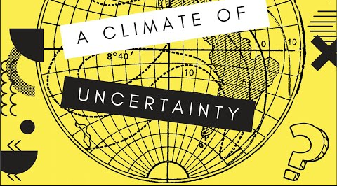
Introduction
Geoengineering: a climate of uncertainty?
Click on the image to play the video.
Notes:
Activity 1 (slide 1/4), Phase 1
This activity sets the scene for the unit.
Watch the video that describes the context for this unit.
Discuss the context on the next slide and then the questions that follow.

Slide 3
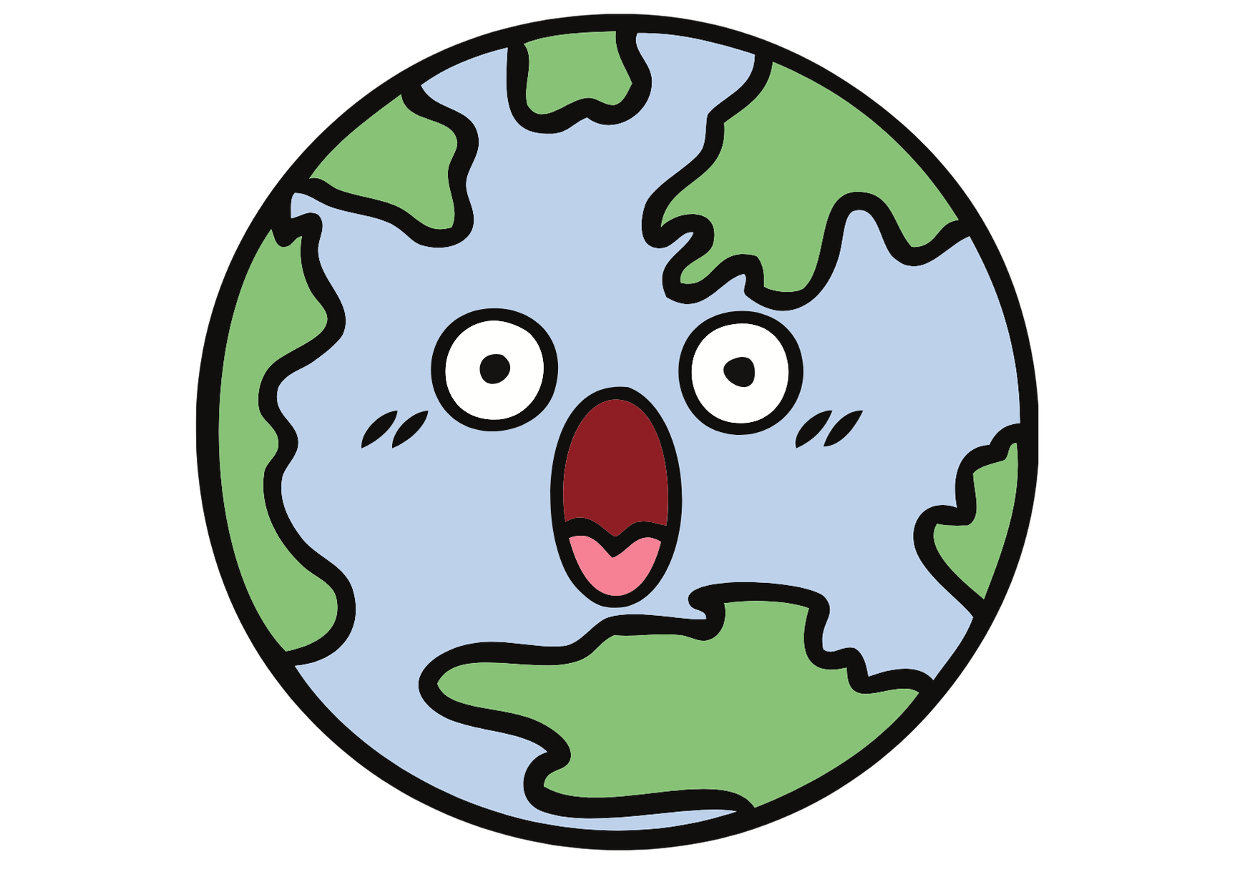
Context: responding to climate change
2030
1.5ºC
Notes:
Activity 1 (slide 2/4), Phase 1
The Earth is getting hotter due to increasing levels of carbon dioxide and other greenhouse gases in the atmosphere.
A heating planet means that the climate becomes more extreme, more unpredictable, and as a result we have food and water insecurity, migration and conflict, with 2030 is often quoted as a key date when climate change becomes irreversible. The Paris Agreement sets out a global framework to avoid dangerous climate change by limiting global warming to well below 2°C.
The big question is how? To respond climate change, there are three main proposals
Adaptation: adapting to a changing climate - e.g. changing what is grown where, and how
Mitigation: Reducing emissions of and stabilizing the levels of heat-trapping greenhouse gases in the atmosphere. Can be done by reducing the sources of these gases (stopping using fossil fuels or enhancing sinks like forests, soils and oceans).
Geoengineering - sometimes called climate intervention - is the deliberate intervention in the Earth’s climate and describes many different types of activity to control or manage temperatures on Earth.

Slide 4
All in a name?
‘Geoengineering’ and ‘climate intervention’ are terms used to refer to a range of approaches to intervening in the Earth’s climate system.
What connotations do you think these different terms have?
Why might it be difficult to talk about ‘geoengineering’?
Notes:
Activity 1 (slide 3/4), Phase 1
All in a name?
‘Geoengineering’ is an umbrella term used to refer to a range of approaches to intervening in the Earth’s climate system - from peatland reforestation and afforestation to solar radiation management using space mirrors or injecting aerosols into the stratosphere.
Some people think ‘engineering’ implies greater levels of precision and control than ‘climate intervention’
It can be difficult to talk about climate intervention because different approaches to intervening in the Earth’s climate have different mechanisms, risks, costs and impacts and are reversible to different degrees.

Slide 5
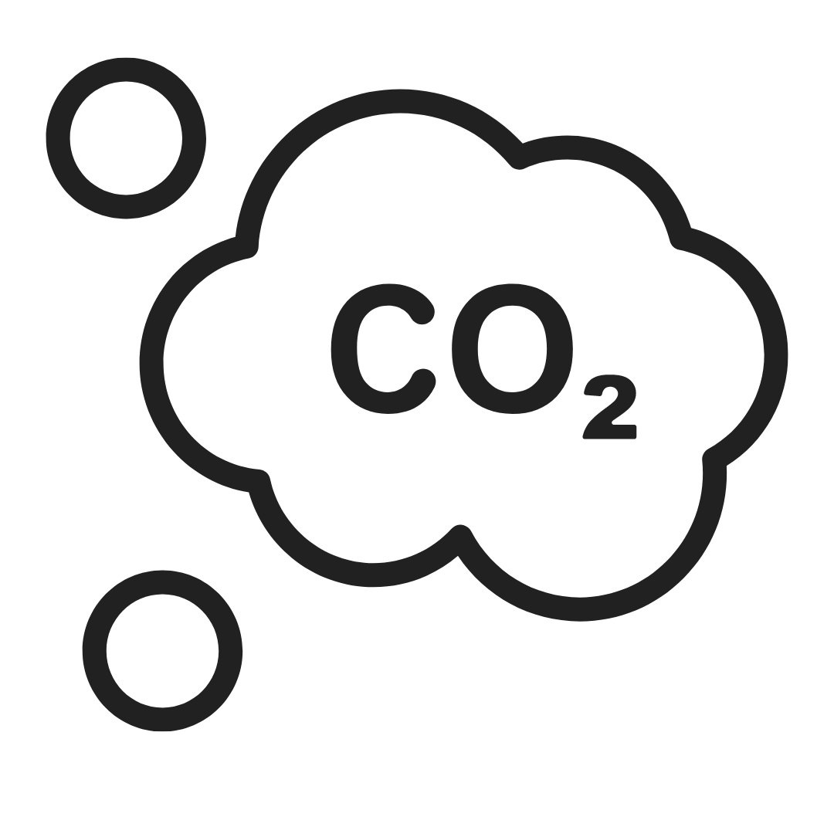
Geoengineering proposals
Carbon geoengineering
These approaches focus on the removal of carbon dioxide using biological, chemical and physical methods.
Methods include planting forests on a large scale and changing the composition of oceans.
Solar radiation management
These approaches reflect heat from the sun back into space without changing atmospheric concentrations of greenhouse gases.
Methods include installing reflectors and releasing aerosols into the atmosphere to scatter heat into space.
Notes:
Activity 1 (slide 4/4), Phase 1
Geoengineering generally takes one of two approaches:
the removal of carbon dioxide from the atmosphere (carbon geoengineering), or
reflection of solar radiation away from the Earth (solar geoengineering).
In a recent Nature communication, researchers noted that “if climate geoengineering techniques were actively pursued on global scales, they would very unlikely be implementable prior to the second half of the century…” (Lawrence et al., 2018). Therefore, decisions about geoengineering research and deployment are set against a background of climate mitigation (minimising greenhouse gas emissions) and adaptation (minimising the effects of climate change).
Research on geoengineering is inherently problematic because it is an umbrella term used to describe a range of technologies from low-risk less-controversial methods to high-risk more controversial methods of intervening in the Earth’s climate, and there is little public understanding about these different methods and how they work. Furthermore, introducing geoengineering as a potential response to climate change is risky, because there exists a risk of influencing attitudes towards climate action.

Slide 6
Engage
Fallacy spotting!
Can you spot a bad argument?
Notes:
Activity 2 (slide 1/11), Phase 1
Fallacies can often be found in discussions about science, particularly in the context of climate change.
A fallacy is an invalid argument caused by faulty reasoning. While many logical fallacies may appear to be appealing or persuasive, they are not logically valid and should therefore be rebutted.
Being able to spot fallacies in everyday life is incredibly important — it can stop you being fooled into believing something that isn’t true.
Knowing when an argument is fallacious can give you power — and words — to hold people to account for bad reasoning and attempts to distract or to deflect attention from an issue, as is often the case in arguments about environmental issues.
Being able to spot bad arguments might help you to create better arguments yourself.

Slide 7
Types of fallacy
Appeal to ignorance
Appeal to authority
Appeal to emotions
Ad hominem
Appeal to nature
False dichotomy
Notes:
Activity 2 (slide 2/11), Phase 1
Examples of common fallacies are:
Ad hominem: attacking the person, not the argument
Appeal to authority: claiming something is true because an authority said it, rather than the evidence for the claim
Appeal to emotion: when emotions (like fear, envy, pity) are manipulated to win an argument
Appeal to ignorance: claiming that something is true because it has not been shown to be false, or that something is false because it has not been demonstrated to be true
Appeal to nature: saying something is good because it is natural, or bad because it is not
False analogy: using the fact that because two things have one thing in common to claim that they therefore have another thing in common
False dichotomy: when two alternatives are presented as the only possible options when in reality a range of possibilities exist
Many other fallacies exist - these are just a few.In the following slides you will be asked to identify which fallacy is being used - you might agree or disagree with the statements. They are being used because they are all examples of bad reasoning.

Slide 8
Types of fallacy
We don’t have evidence that geoengineering is safe so it should not be considered as a response to climate change as it is harmful.
Spot the fallacy!
Notes:
Activity 2 (slide 3/11), Phase 1
What type of fallacy is this?

Slide 9
Appeal to ignorance
This makes a claim that geoengineering is harmful based on absence of evidence for safety.
Notes:
Activity 2 (slide 4/11), Phase 1
Why not? Discuss.

Slide 10
Types of fallacy
Solar geoengineering introduces aerosols into the atmosphere to cool the planet, just like a volcano, so it is a good thing to do.
Spot the fallacy!
Notes:
Activity 2 (slide 5/11), Phase 1
What type of fallacy is this?

Slide 11
Appeal to nature/false analogy
This appeals to volcanoes as ‘natural’.
It is a false analogy because volcanoes and solar engineering have some things in common, but are not the same.
Notes:
Activity 2 (slide 6/11), Phase 1
Is everything that is natural good or desirable? In what ways are volcanic eruptions similar to and different from geoengineering?

Slide 12
Types of fallacy
To prevent climate change-related catastrophe, geoengineering must be applied now.
Spot the fallacy!
Notes:
Activity 2 (slide 7/11), Phase 1
What type of fallacy is this?

Slide 13
False dichotomy
This presents an option between two alternatives.
There are other options: adaptation and mitigation, and other social and political responses related to changes in how we live.
Notes:
Activity 2 (slide 8/11), Phase 1
What other options might there be?

Slide 14
Types of fallacy
A billionaire scientist is funding geoengineering research so it must be safe and effective.
Spot the fallacy!
Notes:
Activity 2 (slide 9/11), Phase 1
What type of fallacy is this?

Slide 15
Appeal to authority
This argument claims that something is true because of who said it rather than the evidence for the claim.
Notes:
Activity 2 (slide 10/11), Phase 1
Does it matter what expertise the scientist has? Are scientists best placed to decide on how their technologies are used?

Slide 16
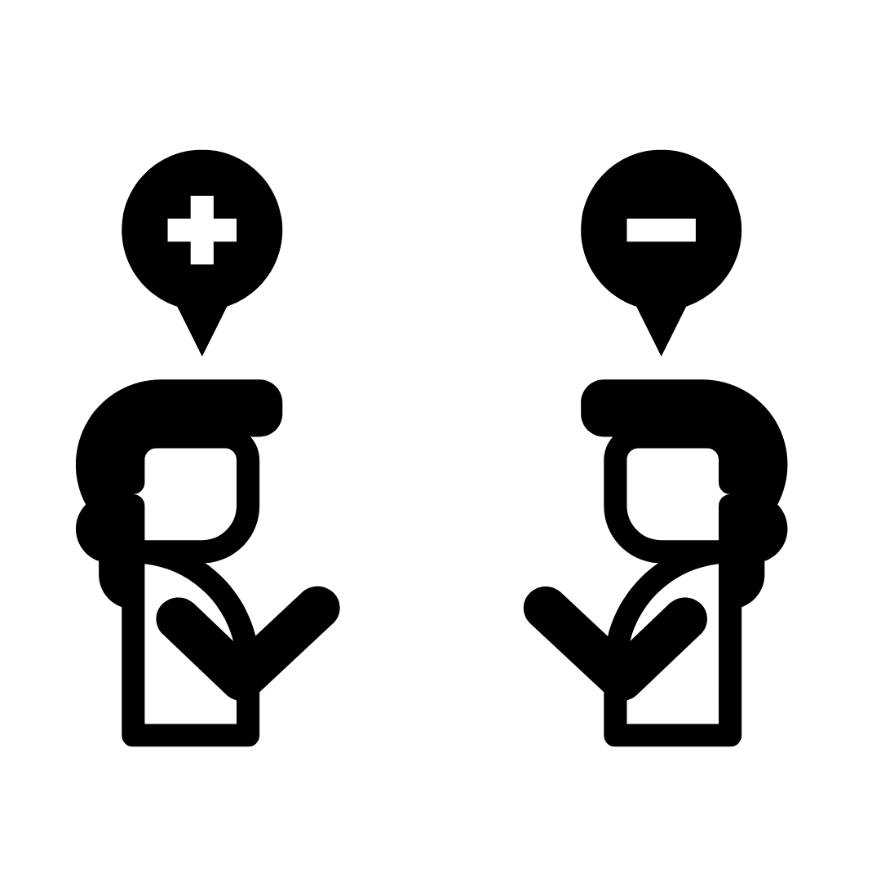
Making better arguments
Explain your grounds (evidence and facts to support your claim)
Say how your facts and evidence support your claim
Note any circumstances when your claim is not true
Explain why other perspectives are not true
Notes:
Activity 2 (slide 11/11), Phase 1
We have looked at some common fallacies - there are many others!
But what does a good argument look like?
Here are some pointers to help you look for good arguments.

Slide 17
Explore
Geoengineering
Notes:
Activity 3 (slide 1/4), Phase 2
Students explore geoengineering as a homework, keeping in mind logical fallacies as they investigate.
Ask students to read three sources. As they research they should:
Identify any logical fallacies they identify.
Identify questions they think it is important to answer or to think about in relation to climate interventions.
Before beginning the research phase, it is important to look out for how articles frame geoengineering.

Slide 18
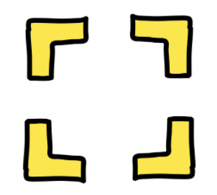
What to look out for...
Framing
‘Nature’
Geography
Alternatives
Notes:
Activity 3 (slide 2/4), Phase 2
Some things to look out for when reading about geoengineering (‘climate intervention’)
Framing - do the authors want you to take a particular stance?
Nature - are appeals to nature made, and are these valid?
Is the source written from a particular geographical position?
Is it compared to alternatives?

Slide 19
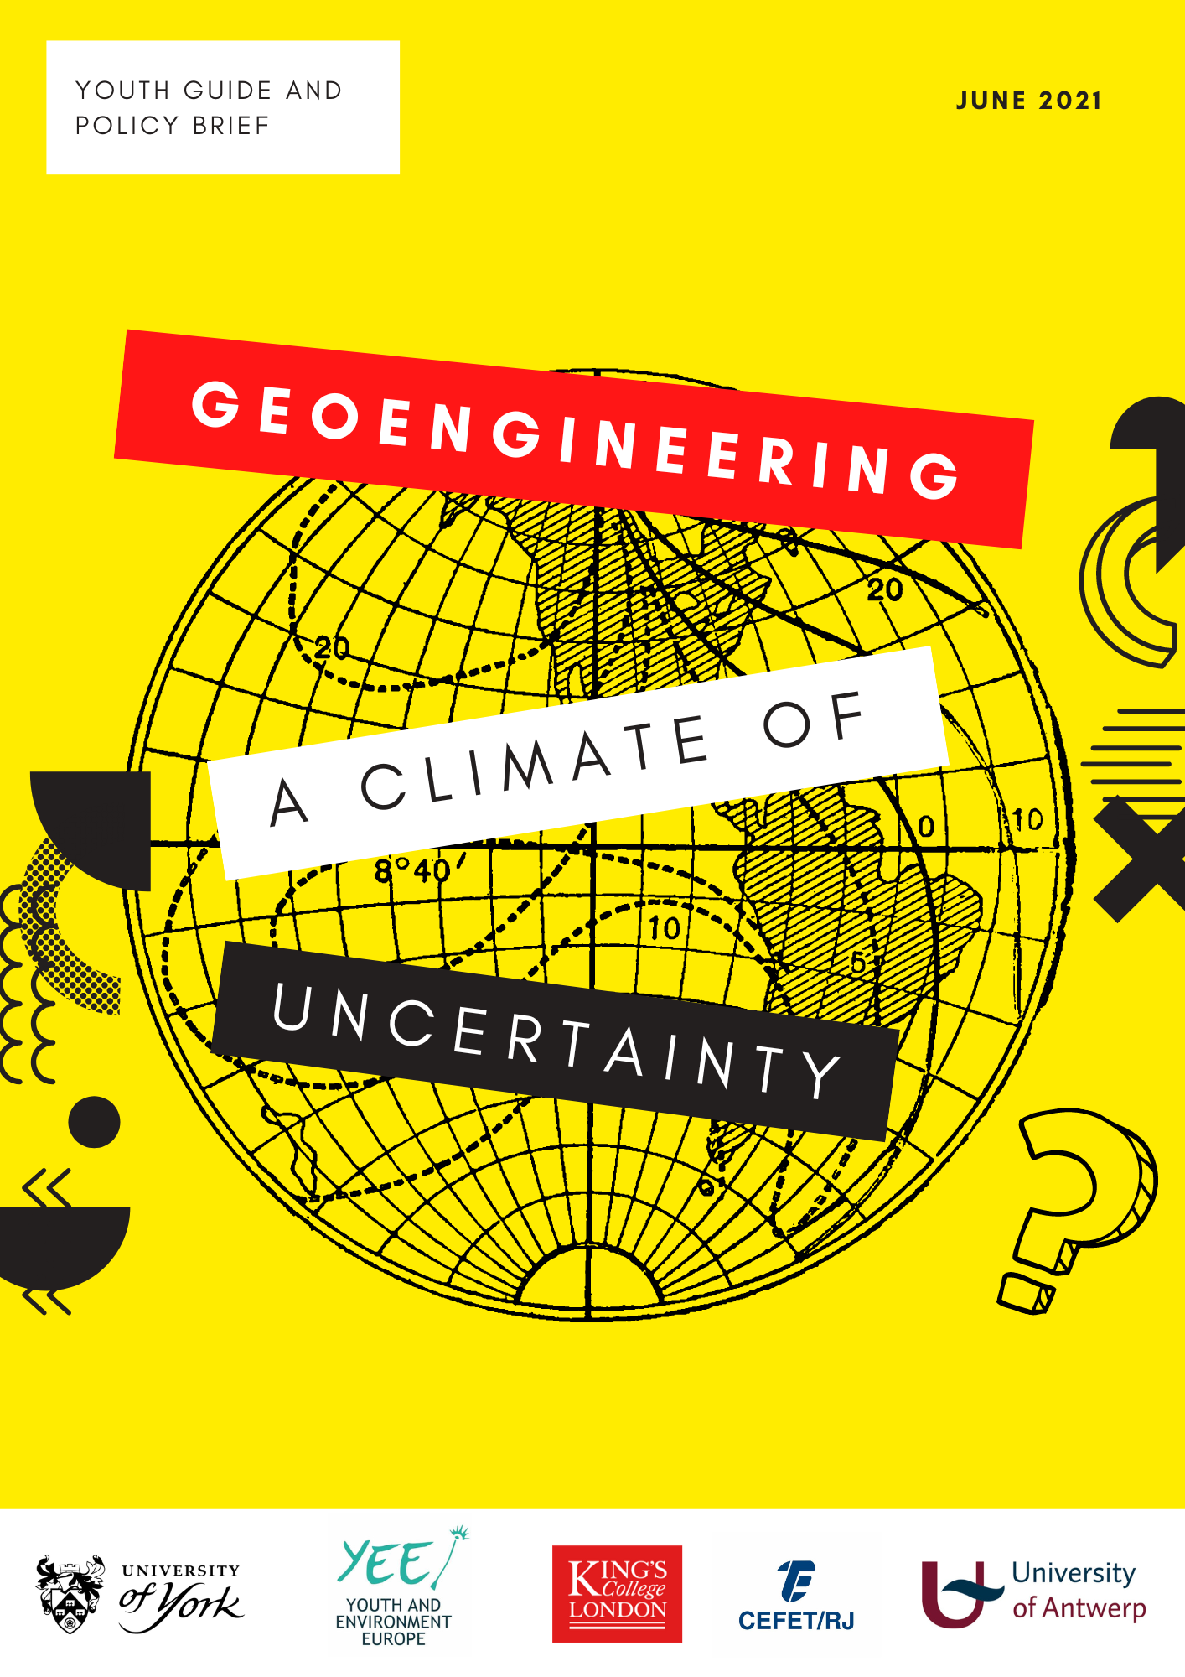
Find out more:
Article in New Scientist
Article in Ecologist
Youth Guide and Policy Brief
Carnegie Climate Governance initiative
Heinrich Böll-Stiftung
Note other sources you use.
Notes:
Activity 3 (slide 3/4), Phase 2
Some starting sources for homework research include
New Scientist article: https://institutions.newscientist.com/article/mg24732980-500-silicon-valley-billionaires-want-to-geoengineer-the-worlds-oceans/
Ecologist article: https://theecologist.org/2018/aug/30/engineering-climate-could-cost-us-earth
Youth Guide and policy brief: https://www.york.ac.uk/media/policyengine/documents/Geoengineering.pdf
Carnegie Climate Governance Initiative
Heinrich Böll Stiftung Green Political Foundation (includes videos) https://www.boell.de/en/geoengineering

Slide 20
Homework task
Research different approaches to geoengineering.
You might begin with the sources on the previous slide.
As your research:
Identify any logical fallacies you notice.
Record questions that you think are important to know the answer to, or to discuss in relation to geoengineering.
Bring these to class.
Notes:
Activity 3 (slide 4/4), Phase 2
Set the homework task.

Slide 21
Explain
Geoengineering
Notes:
Activity 4 (slide 1/5), Phase 3
In this phase, the teacher presents a question quadrant to classify the questions created during the homework task in phase 2 and uses this to create an agenda for discussion.
Initially, students are invited to share any fallacies they encountered in their research. They are then asked to share their questions. This might be on a shared slide deck, or using post-it notes.
The teacher then introduces the question quadrant on the following slide.

Slide 22
Questions created
Notes:
Activity 4 (slide 2/5), Phase 3
Students either share their questions using a shared slide deck, or write them on post it notes so that they can be rearranged in the next activity

Slide 23
Philosophical questions | Scientific questions
Psychological questions | Political questions
Question quadrant
Notes:
Activity 4 (slide 3/5), Phase 3
Introducing the question quadrant, the teacher asks:
What is the difference between these different types of questions?
The teacher might suggest some key features, e.g.
philosophical questions are those where the answers are in principle open to informed, rational, and honest disagreement, and which require reasoning to be answered
scientific questions may be those which relate to the natural world and which are testable or measurable empirically or using scientific methods
psychological questions relate to people’s thoughts and behaviours
political questions are those relating to how decisions are made and by whom.
Students then rearrange their questions, classifying them as philosophical, scientific, psychological or political.
The teacher might draw attention to the need for empirical work (e.g. through surveys or experiments) to answer the psychological and scientific questions.
The teacher uses the philosophical and political questions to form an agenda for the discussion by
informing students that they will prioritise by identifying the three most important questions to discuss. Each student has three votes which they can use as they like - all on one question, or split between two or three questions.
reading each question aloud.
re-reading each question aloud, this time collecting votes from the class.
ordering questions in order of priority.

Slide 24
Our question for discussion:
Notes:
Activity 4 (slide 4/5), Phase 3
When ordered, begin by discussing the question with the most votes.
Some starting questions before discussing the question might include the following. This is an important stage to ensure a common understanding on which the question is based.
What problem is being identified here?
What assumptions are being made in the question?
Do we have a shared understanding of key concepts or ideas in the question?
Is there a need to clarify or qualify the question?
Are there any questions we need to know the answer to before we discuss this question?
What is the scope of the question - is there a need to think about other places, or into the past or future?
When discussing the question, the teacher might ask for agreement and disagreement with reasons, and ask for examples and counterexamples. Students can be encouraged to identify fallacies during the discussion.
This ‘explain’ phase can be used to draw out different arguments, positions, attitudes and feelings towards geoengineering.

Slide 25
Reflecting on the discussion
What important new questions have you thought about?
Which emoji best reflects how you felt during the discussion? Explain why.
😮😂😀😬🤯😣🤬🤓🤔😫
Were any perspectives missing?
What would the missing person have said?
Notes:
Activity 4 (slide 5/5), Phase 3
Encourage students to reflect on their

Slide 26
Elaborate
Geoengineering:
a thought experiment
Notes:
Activity 5 (slide 1/5), Phase 4
In this phase, students elaborate on their thinking using a philosophical thought experiment to explore the consequences of different geoengineering proposals. The thought experiment is an adaptation of the ‘veil of ignorance’ (https://www.youtube.com/watch?v=A8GDEaJtbq4), used by John Rawls in his theory of justice.

Slide 27
Notes:
Activity 5 (slide 2/5), Phase 4
A thought experiment is a thinking exercise which allows us to test a hypothesis without doing a physical experiment in the real world. Thought experiments are used in science and in philosophy. Well known thought experiments include Schrödinger's cat, Mary’s Room and Twin Earth.
The thought experiment we will do in this unit uses the idea of a veil of ignorance to figure out what is fair. This video is a general introduction to the experiment. We will then apply it to geoengineering.
Watch the video and give students the opportunity to ask clarification questions.

Slide 28
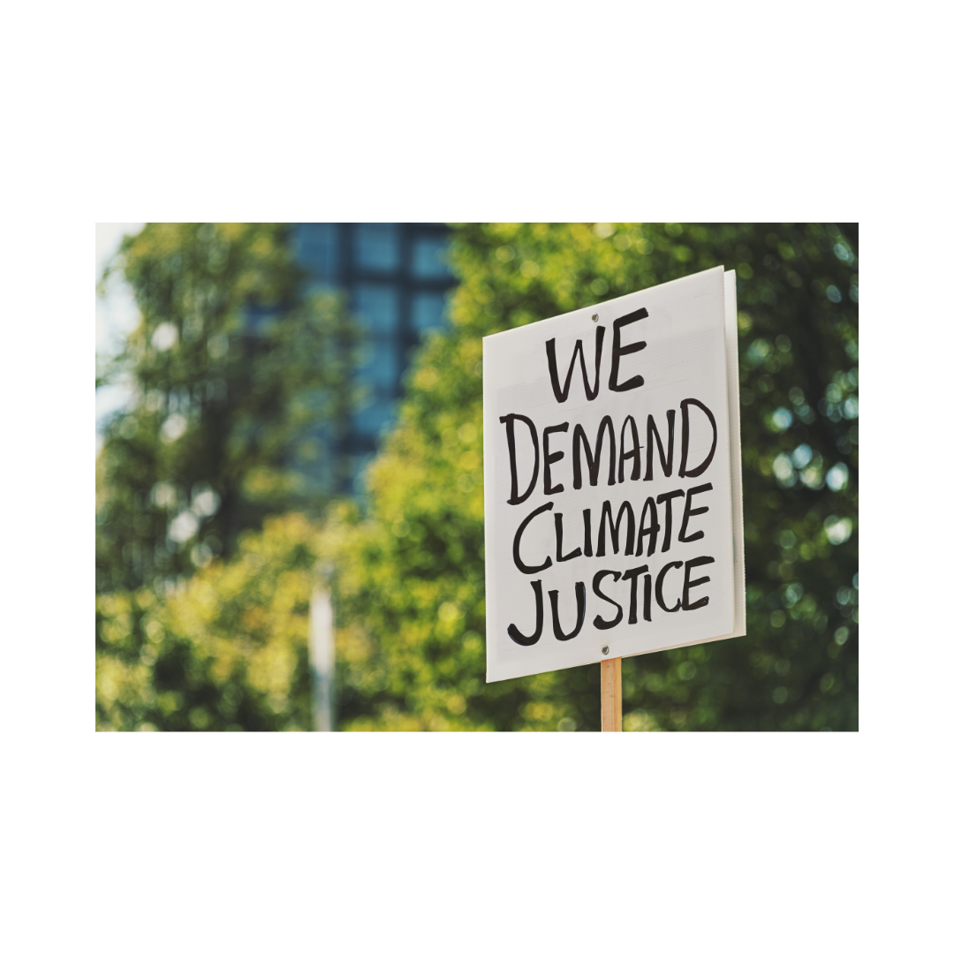
The veil of ignorance: applied
The climate crisis
Imagine you have the power to introduce three new policies for responding to the climate crisis.
You must decide not knowing what position you will be born into.
In small groups, discuss and agree your three policies.
Write your 3 policies on separate pieces of paper.
Policy (n):
a statement of intent to act proposed by or adopted by an organisation.
Notes:
Activity 5 (slide 3/5), Phase 4
Rawls sees justice as fairness and proposes that decisions are made behind a ‘veil of ignorance’. This is a condition in which the people making the decision don’t know where they are born, what they look like, their intelligence, strength, or place in society. This means that when they make a decision or agree on a policy or principle for how decisions are to be made, they don’t know how it will affect them when the veil of ignorance is lifted. It is a way of improving impartiality in decision making.
In this set up, students are asked to take the present climate crisis as the initial situation. From reading the youth guide and doing research on geoengineering, there are a range of actions which can be taken, including:
doing nothing, or very little.
changing the way we live to drastically reduce emissions of greenhouse gases (social and political change)
accelerating research and development of technology which removes carbon dioxide from the Earth’s atmosphere*
accelerating research and development of technology which reflects solar radiation away from the Earth.
Students are asked to discuss and agree on some fair policies or principles for governing different responses to climate change from behind a ‘veil of ignorance.’
*[Note that on (3) and (4), Lawrence et al (2018) have argued that even if actively pursued on global scales, it would be unlikely they could make an impact before 2050 because they are at early stages of development, involve uncertainties and risks and raise ethical and governance dilemmas.]

Slide 29
Deciding on fair policies for responding to the climate crisis
Each group shares their policies with the class.
Whole class discussion.
Students vote on the fairest policies for all.
Our fairest policies are:
1.
2.
3.
Notes:
Activity 5 (slide 4/5), Phase 4
Following the small group discussion on the previous slide, each group shares their ideas with the class.
They place their written policy or principle on a spot on the floor, and explain why they are proposing it.
The class discusses the policies in relation to fairness.
Finally, students ‘vote with their feet’ on the fairest policies. The three most popular are recorded and evaluated in the next slide.

Slide 30
Examining the consequences
A billionaire with funds to invest.
A person living on a flood plain.
Industry-based climate scientists working on carbon capture and storage.
An authoritarian leader
You
A factory owner in China
A farmer in sub-Saharan Africa
A person living overseas, away from their family
Elected representatives in a democracy
PhD student in aerosol science.
Your teacher
Who else should we consider?
Notes:
Activity 5 (slide 5/5), Phase 4
Finally, students examine the consequences of their decisions.
This can be done by cutting each of these into strips and asking students to select one strip from a bowl.
Their strip represents who they become with the veil of ignorance removed.
Lead a class discussion on whether they gain or lose from the new policies compared and whether or not this is fair.
Discuss: which perspectives were missing? Should some of these perspectives be prioritised over others?

Slide 31
Evaluate
Geoengineering
Notes:
Activity 6 (slide 1/2), Phase 5
In this activity, we
Evaluate the thought experiment
Evaluate learning on the unit

Slide 32
The Oxford Principles
Principle 1: Geoengineering to be regulated as a public good
Principle 2: Public participation in geoengineering decision-making
Principle 3: Disclosure of geoengineering research and open publication of results
Principle 4: Independent assessment of impacts
Principle 5: Governance before deployment
How do these compare with your policies?
Notes:
Activity 6 (slide 2/2), Phase 5
Researchers at the University of Oxford have developed a series of principles for governing geoengineering, available at http://www.geoengineering.ox.ac.uk/www.geoengineering.ox.ac.uk/oxford-principles/history/index.html. The principles are summarised as follows:
Principle 1: Geoengineering to be regulated as a public good
Principle 2: Public participation in geoengineering decision-making
Principle 3: Disclosure of geoengineering research and open publication of results
Principle 4: Independent assessment of impacts
Principle 5: Governance before deployment
How do your principles compare? How do these fare when analysed in the way you analysed your principles?

Slide 33
Final evaluation
What was positive about this unit?
What was negative about this unit?
What was interesting about this unit?
What questions remain about geoengineering?
Notes:
Activity 7 (slide 1/1), Phase 5

