Slide 1
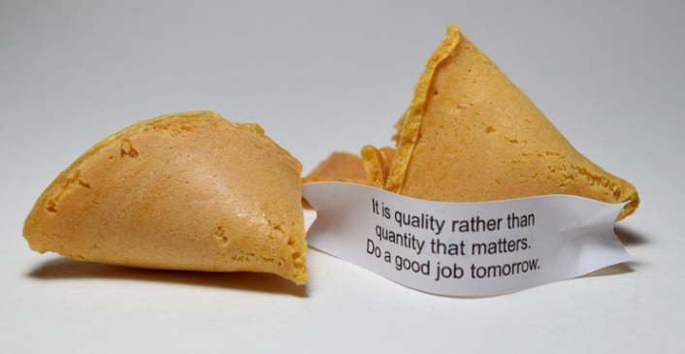
Fortune Cookie
Making a fortune cookie from card

Slide 2
Stay safe
Whether you are a scientist researching a new medicine or an engineer solving climate change, safety always comes first. An adult must always be around and supervising when doing this activity. You are responsible for:
ensuring that any equipment used for this activity is in good working condition
behaving sensibly and following any safety instructions so as not to hurt or injure yourself or others
Please note that in the absence of any negligence or other breach of duty by us, this activity is carried out at your own risk. It is important to take extra care at the stages marked with this symbol: ⚠

Slide 3
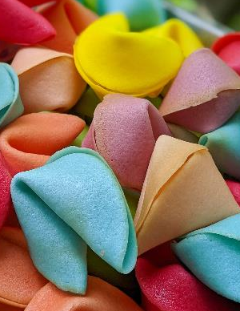
Fortune Cookies
The fortune cookie first appeared in 1890 in San Francisco, USA
They have a typical shape and contain a message on paper
It became a Chinese New Year tradition
Fortune cookies only reached China in 1989!

Slide 4
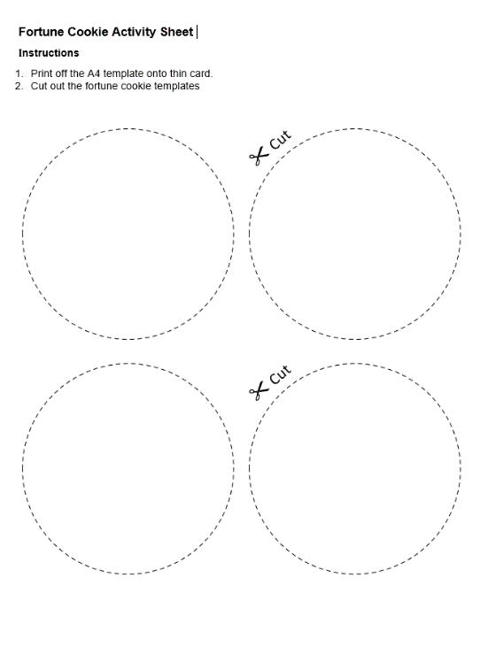
Step 1 Cutting out the Template ⚠
Print the template onto card
Safely cut out the circles and messages with scissors
⚠

Slide 5
Step 2 Make Crease
Fold the cookie template in half
Make a 10 mm crease just in the centre
Hint: you can do this by pinching the centre
Crease

Slide 6
Step 3 Bend
Bend the circle in half so that the crease is horizontal

Slide 7
Step 4 Folding
Push the crease line in
Fold together
Fortune cookie
Push in
Fold together

Slide 8
Step 5 Add a Message and Assemble
Unfold the cookie and add a message
Fold back together and glue with a glue stick
Paper clip may be needed until glue dries
Completed Fortune Cookie
Glue

Slide 9
Extension
Write your own fortune cookie messages

