Slide 1
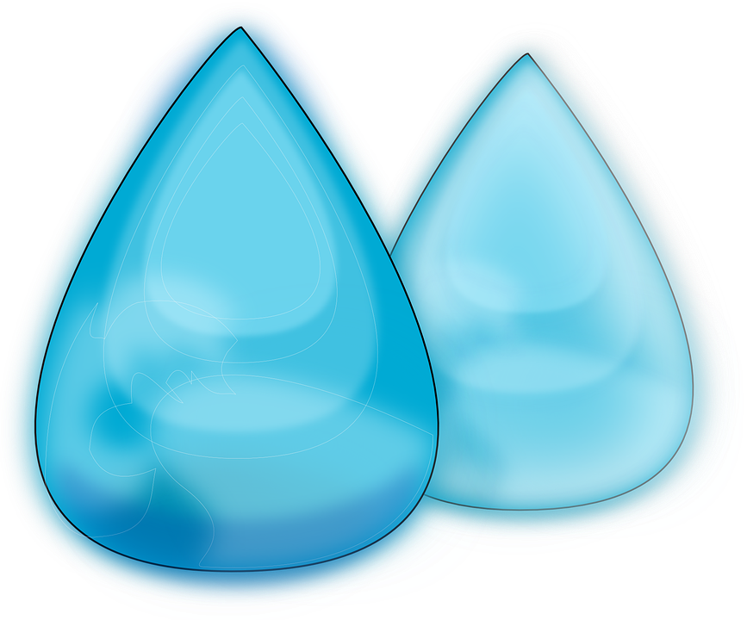
Hydrogen power
Making hydrogen from water

Slide 2
Stay safe
Whether you are a scientist researching a new medicine or an engineer solving climate change, safety always comes first. An adult must always be around and supervising when doing this activity. You are responsible for:
ensuring that any equipment used for this activity is in good working condition
behaving sensibly and following any safety instructions so as not to hurt or injure yourself or others
Please note that in the absence of any negligence or other breach of duty by us, this activity is carried out at your own risk. It is important to take extra care at the stages marked with this symbol: ⚠

Slide 3
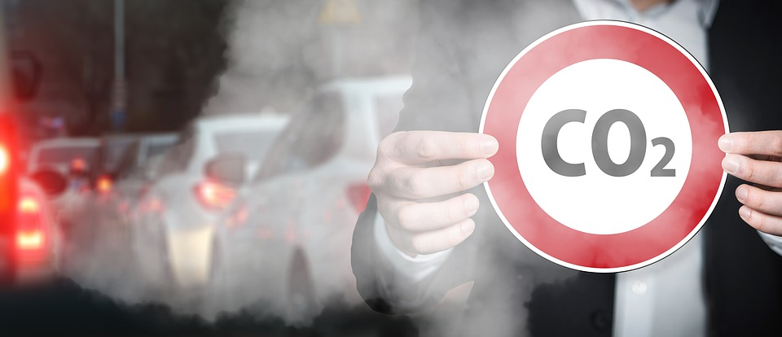
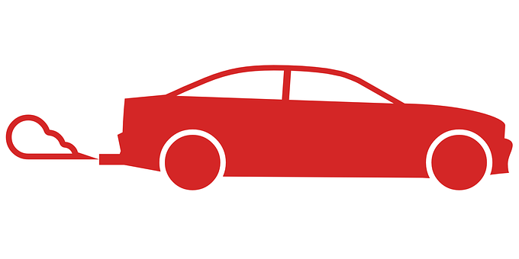
Starter – petrol and diesel fuels
Petrol and diesel fuels are used to power many forms of transport, such as cars, buses, trains and aircraft
What do you think the problems are with using these types of fuels?
Notes:
Discuss the issues with using petrol and diesel fuels. E.g. drilling for crude oil, the fact that oil is a fossil fuel/not renewable, production of carbon emissions/greenhouse gases, pollution, health concerns from breathing in fumes etc. Learners could also research these as a starter activity.

Slide 4

Brief
Petrol and diesel fuels for vehicles are made from crude oil and produce harmful emissions
Hydrogen is one possible alternative that does not harm the environment or cause pollution
The only by-product of hydrogen fuel is water
Your task is to make hydrogen from water, which could be used as an environmentally friendly and sustainable power supply for transport vehicles
Notes:
Discuss the benefits of hydrogen-based fuels in comparison to petrol and diesel fuels.

Slide 5
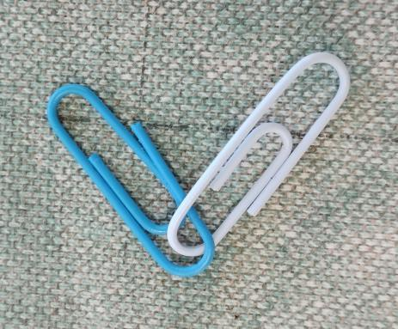
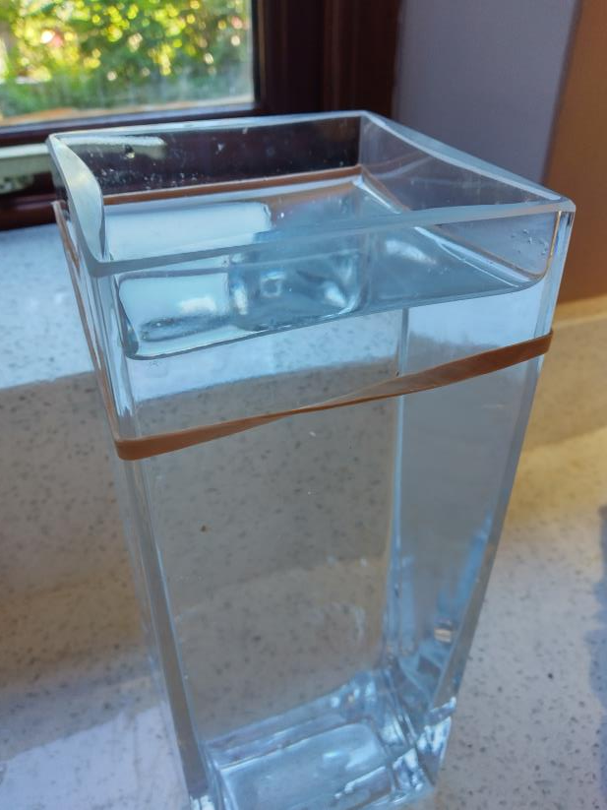
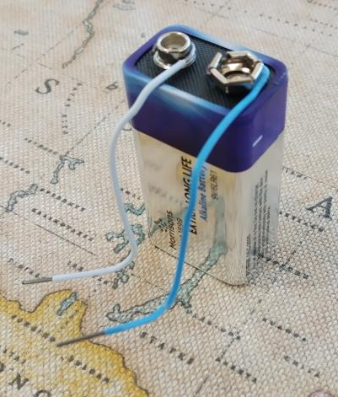
Resources
Paperclips
A glass vessel
Water from a tap
A 9V battery
A rubber band
Notes:
Paperclips with a plastic covering could be used.
A large square vase could be used for the glass vessel
Ensure the 9 V battery has some charge – this can be tested using a battery tester.

Slide 6
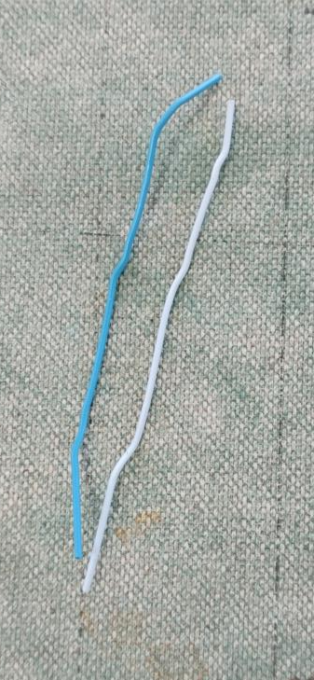
Step 1 ⚠
Straighten the paperclips
Strip the plastic off both ends, one end longer than the other
Wind the longer stripped ends round the connectors on the battery

Slide 7
Step 2
Add water to the vessel
Put the rubber band around the top of the vessel

Slide 8
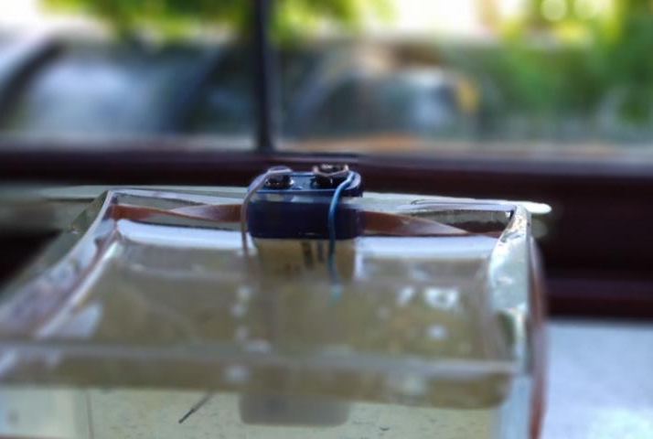
Step 3 ⚠
Push the battery through the rubber band so that the two ends of the paperclips hang in the water
You are now making hydrogen!
Notes:
Make sure the paperclip ends are as close together as you can get them without them touching.
This will make the experiment more effective as the shorter the distance between them the less energy the battery needs to push the current through the gap.
If you look really carefully at the negative electrode you should see some bubbles forming on the wire.
After some time you might see bubbles on the positive wire too.
The negative electrode (wire) the has the hydrogen. The other electrode has the oxygen.

Slide 9
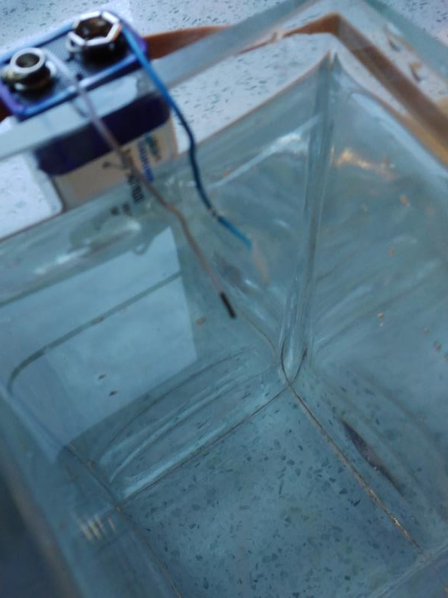
Step 4 ⚠
To increase the rate of hydrogen prooduction you need to add an electrolyte
Add a spoonful of salt (NaCl) and see what happens
How else could you improve the experiment?
Notes:
Electrolytes make the water more conductive to electricity, thus increasing current flow form the battery – salt is an effective electrolyte
Instead of making hydrogen and oxygen the positive electrode react with the chlorine from the salt and makes copper chloride.
Paperclips are often made of copper. If you use steel paper clips you should get ferric chloride.
This sticks to the electrode and that is why the electrode goes dirty looking.
If you leave the experiment running the water slowly turns a yellowy brown.
This is the copper chloride and another chemical that is made, sodium hydroxide, making the water this colour.
The water needs to be disposed of carefully as it will now be alkaline.

Slide 10
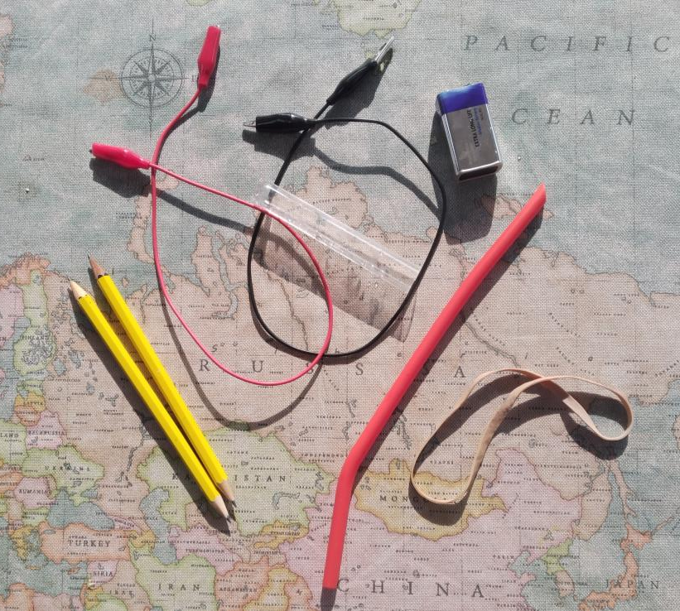
Additional resources
⚠
Pencils
Playdough or modelling clay
Crocodile clips
Bendy straw
Test tube
Notes:
The next few slides show a possible extension activity to improve the experiment and collect the hydrogen.

Slide 11
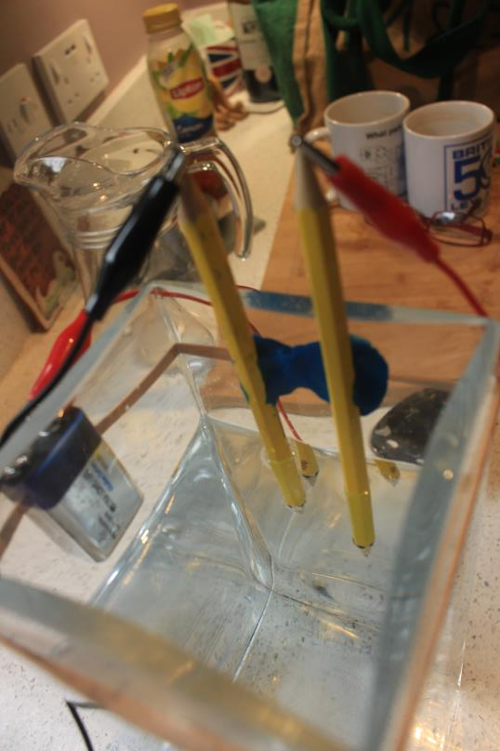
Extension step 1 ⚠
Take two pencils and sharpen them at both ends
Attach two crocodile clips to the ends of the pencils
Stick the pencils to the side of the vessel using the playdough or modelling clay
Refill the water vessel and lower the negative electrode (pencil) into the water
Notes:
The next few slides show a possible extension activity to improve the experiment and collect the hydrogen.
Pencils should have long points so be careful as they will be sharp.

Slide 12
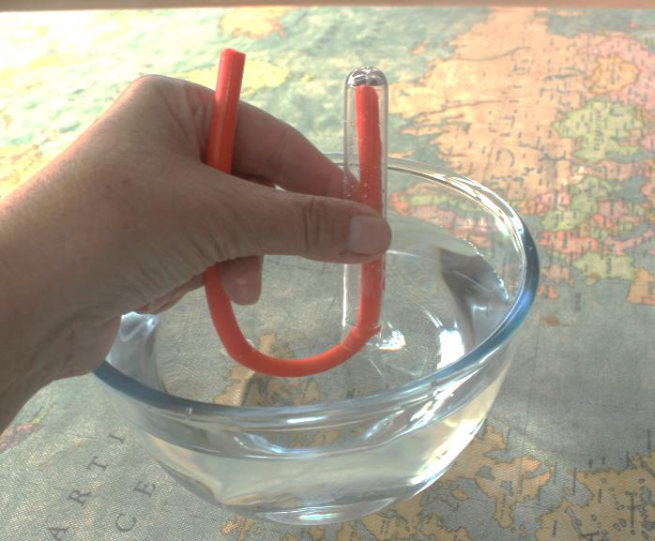
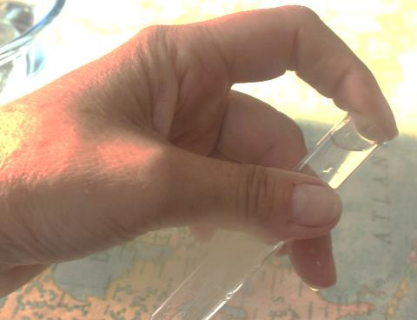
Extension step 2
Empty the test tube of air by sucking it out using the bendy straw
Put your finger over the end of the tube

Slide 13
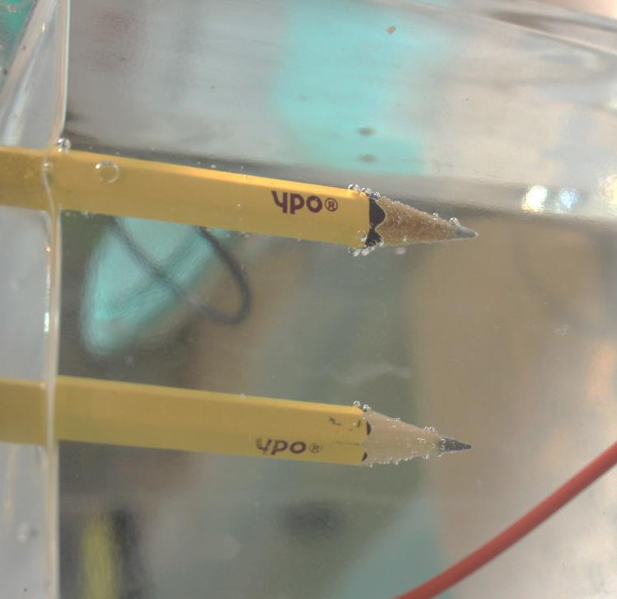
Extension step 3
Put the test tube over the negative electrode so it catches the bubbles
It will take quite along time to collect the hydrogen
See that the water stays clear as there isn’t any copper chloride anymore

Slide 14
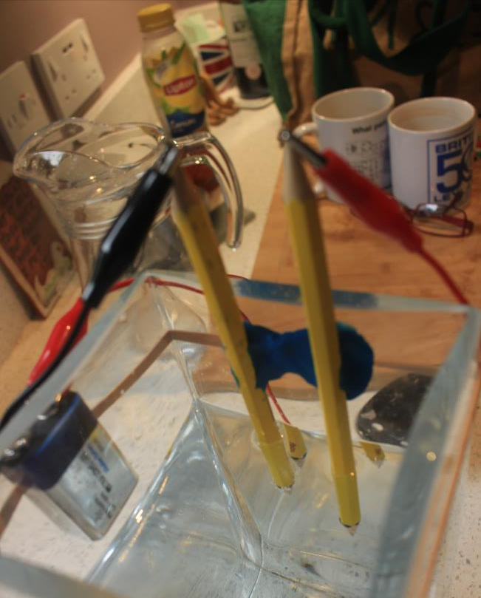
Extension step 4
Now lower the positive electrode into the water
You should see bubbles forming on both electrodes
The test tube should start slowly filling with gas and the water level in the tube should fall

Slide 15

Extension step 5
Once the test tube is full of gas, and all the water has gone out of it, you should be ready to test for hydrogen
What is the test for hydrogen gas?

Slide 16

Testing for hydrogen
Hold a lighted splint at the end of the test tube
You should hear a clear “POP” noise
This is the test for hydrogen as it combines with the oxygen in the air (making water)

Slide 17
What have we done?
We have made Hydrogen and Oxygen from water and electricity.
A Fuel cell makes electricity and water from Oxygen and Hydrogen.
H₂O + Electrical Energy
=
H₂
+
O₂
H₂
+
O₂
=
H₂O + Electrical Energy

