Slide 1
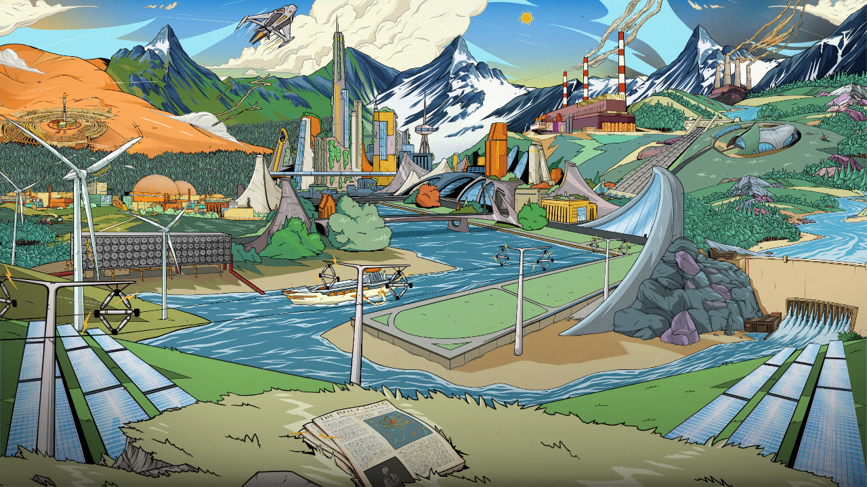
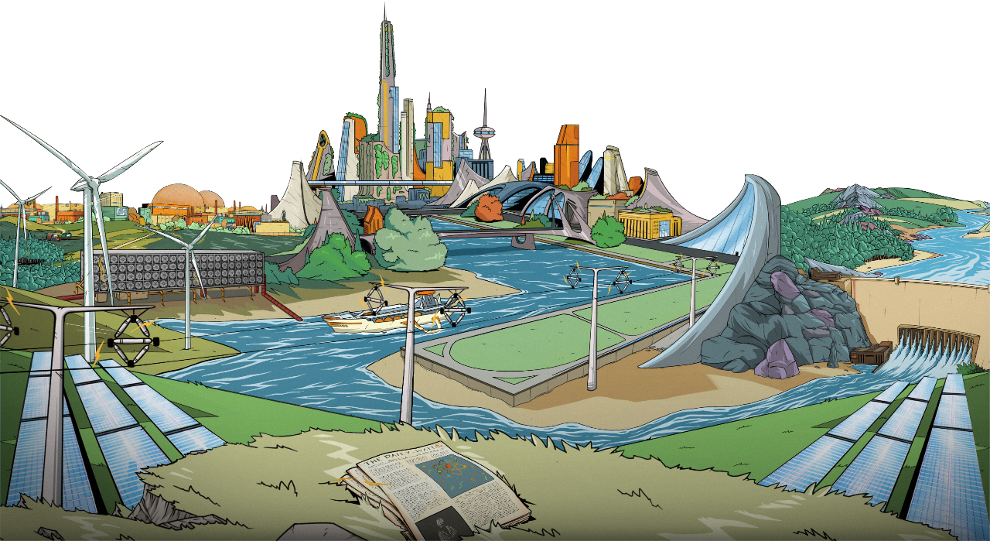

Slide 2
CONTENTS
Introduction to Megawatt
Build Phase
Event Phase
Scoring
Select a chapter, or click a card to learn more about card types

Slide 3
CONTENTS
Introduction to Megawatt
Build Phase
Event Phase
Scoring
Select a chapter, or click a card to learn more about card types

Slide 4
Megawatt
Megawatt is about building an electricity grid that can power the future!
Tech cards supply power
Upgrade cards improve your grid
Action cards boost your hand or mess with other players
Event cards put your grid to the test as the world changes

Slide 5
Setup
Shuffle each pile and place face down in the middle of the table.
Draw piles
Discard piles
Gameplay area

Slide 6
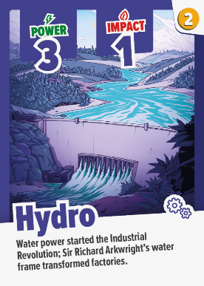
How to win
Build a grid with the highest POWER and the lowest IMPACT, using a limited amount of COIN.
PowER
IMPACT
COIN

Slide 7
How to win
Build a grid with the highest POWER and the lowest IMPACT, using a limited amount of COIN.
!
Score = Grid POWER – Grid Impact

Slide 8
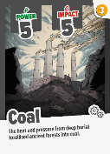
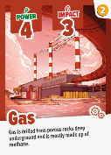
Technology Cards
There are 7 types of Tech cards. They are played to supply POWER to your grid, each card has an IMPACT and a cost in COIN .

Slide 9
Technology Cards
There are 7 types of Tech cards. They are played to supply POWER to your grid, each card has an IMPACT and a cost in COIN .

Slide 10
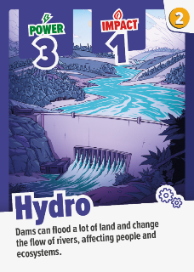
Build phase
Megawatt starts with a build phase of 2 rounds, where you draw and play Tech cards.
Draw up to 4 tech cards
Spend up to 5 coins
Keep up to 1 card for the next round; left over cards must be discarded into the middle
Gameplay area

Slide 11
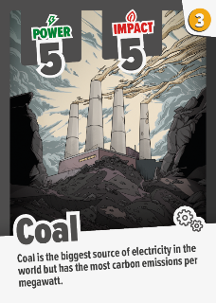
Build phase
Megawatt starts with a build phase of 2 rounds, where you draw and play Tech cards.
Draw up to 4 tech cards
Spend up to 5 coins
Keep up to 1 card for the next round; left over cards must be discarded into the middle

Slide 12
Build phase
Megawatt starts with a build phase of 2 rounds, where you draw and play Tech cards.
Draw up to 4 tech cards
Spend up to 5 coins
Keep up to 1 card for the next round; left over cards must be discarded into the middle

Slide 13
Build phase
Lets play 2 rounds now!
Build Phase Rule summary:
Draw up to 4 tech cards
Draw cards until you have a total of 4 cards in your hand.
In the build phase, you may only draw cards from the Tech pile.
Spend up to 5 coins
All cards cost coin which is shown on the top right of the card.
You have 5 coin to spend each turn. You do not have to spend all of your coin, but any unspent coin is lost at the end of your turn.
Play tech cards face up in front of you into your grid.
Keep up to 1 card for the next round; left over cards must be discarded into the middle
You may keep up to 1 card in your hand for the next round.
Any extra cards in your hand must be discarded into their matching discard pile, face up.
The round ends when everyone has had a turn.

Slide 14
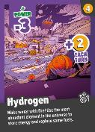
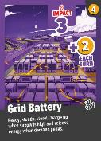
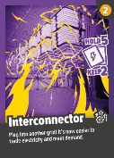
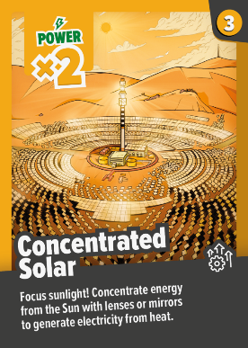
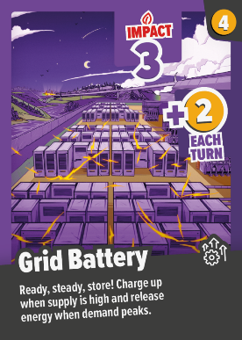
Upgrade Cards
There are 8 types of Upgrade cards. These augment the cards on your grid by affecting POWER, IMPACT, COIN and draw limits.

Slide 15
Upgrade Cards
There are 8 types of Upgrade cards. These augment the cards on your grid by affecting POWER, IMPACT, COIN and draw limits.

Slide 16
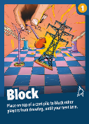
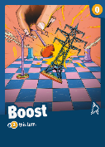
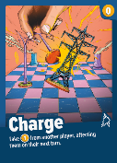
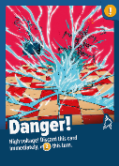
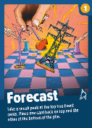
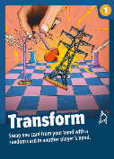
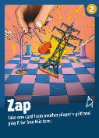
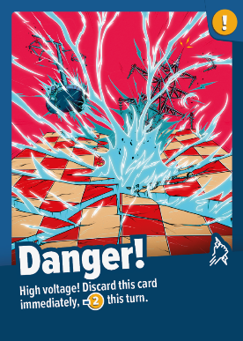
Action Cards
There are 8 types of Action card. Action cards can boost your hand or mess with other players. Be careful - if you pick up the Danger! card you lose 2 COIN.

Slide 17
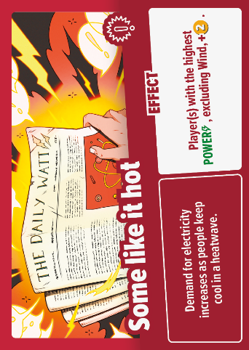
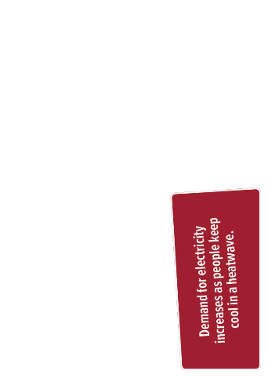
Event Cards
The event phase has 7 rounds, with 25 Event cards that put your grid to the test. Events have a headline, event and effect. Some events are caused by humans, and some by nature.

Slide 18
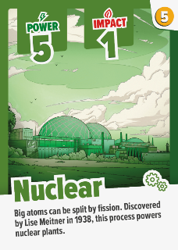
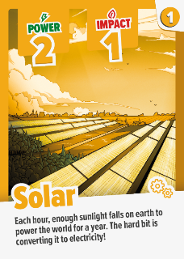
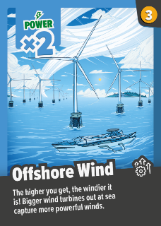
Event phase
The game continues with an event phase of 7 rounds.
At the start of each round, turn over the top Event card and read out the news
Draw up to 4 cards from Tech, Upgrade or Action piles

Slide 19
Event phase
The game continues with an event phase of 7 rounds.
At the start of each round, turn over the top Event card and read out the news
Draw up to 4 cards from Tech, Upgrade or Action piles
Spend up to 5 coins
Keep up to 1 card for the next round; left over cards must be discarded into the middle

Slide 20
Event phase
Lets play the event phase!
Event Phase Rule summary:
Make sure someone reads the Event card out loud so everyone knows what the Event card says.
At the start of each round, turn over the top Event card and read out the news
Draw one card at a time. You may look at each card before drawing the next one.
Remember, if you have a card in your hand already, only draw 3 cards!
If any card pile runs out, shuffle the matching discard pile and turn it over.
Draw up to 4 cards from Tech, Upgrade or Action piles
TECH: Play face up in front of you into your grid.
UPGRADE: Play face up in front of you into your grid. You can only have 1 of each type of Upgrade card in your grid. The effect of each Upgrade starts from the next round.
ACTION: Read out the Action card and resolve its effect. Once the effect is complete,place face up on the Action discard pile.
Spend up to 5 coins
Keep up to 1 card for the next round; left over cards must be discarded into the middle
Make sure to discard each card type in its corresponding discard pile, face up.

Slide 21
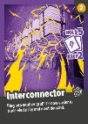
SCORING
6
15
28
24
73
POWER
4
3
21
6
34
Impact
Score = POWER - Impact
Score = 73 - 34
Score = 39

Slide 22
Gameplay
Let’s imagine a game where we build the current UK grid:
Build Phase
Round 1
Round 2
Event Phase
Round 1
Round 2
Round 3
Round 4
Round 5
Round 6
Round 7
Scoring

Slide 23
Gameplay
Let’s imagine a game where we build the current UK grid:
Build Phase
Round 1
Round 2
Event Phase
Round 1
Round 2
Round 3
Round 4
Round 5
Round 6
Round 7
Scoring
Lets skip forwards a few rounds

Slide 24
Gameplay
Let’s imagine a game where we build the current UK grid:
Build Phase
Round 1
Round 2
Event Phase
Round 1
Round 2
Round 3
Round 4
Round 5
Round 6
Round 7
Scoring

Slide 25
Gameplay
Let’s imagine a game where we build the current UK grid:
Build Phase
Round 1
Round 2
Event Phase
Round 1
Round 2
Round 3
Round 4
Round 5
Round 6
Round 7
Scoring

Slide 26
Gameplay
Let’s imagine a game where we build the current UK grid:
Build Phase
Round 1
Round 2
Event Phase
Round 1
Round 2
Round 3
Round 4
Round 5
Round 6
Round 7
Scoring

Slide 27
Gameplay
Build Phase
Round 1
Round 2
Event Phase
Round 1
Round 2
Round 3
Round 4
Round 5
Round 6
Round 7
Scoring

Slide 28
Gameplay
6
15
28
24
73
POWER
Build Phase
Round 1
Round 2
Event Phase
Round 1
Round 2
Round 3
Round 4
Round 5
Round 6
Round 7
Scoring
4
3
21
6
34
Impact
Score = POWER - Impact
Score = 73 - 34
Score = 39

