Slide 1
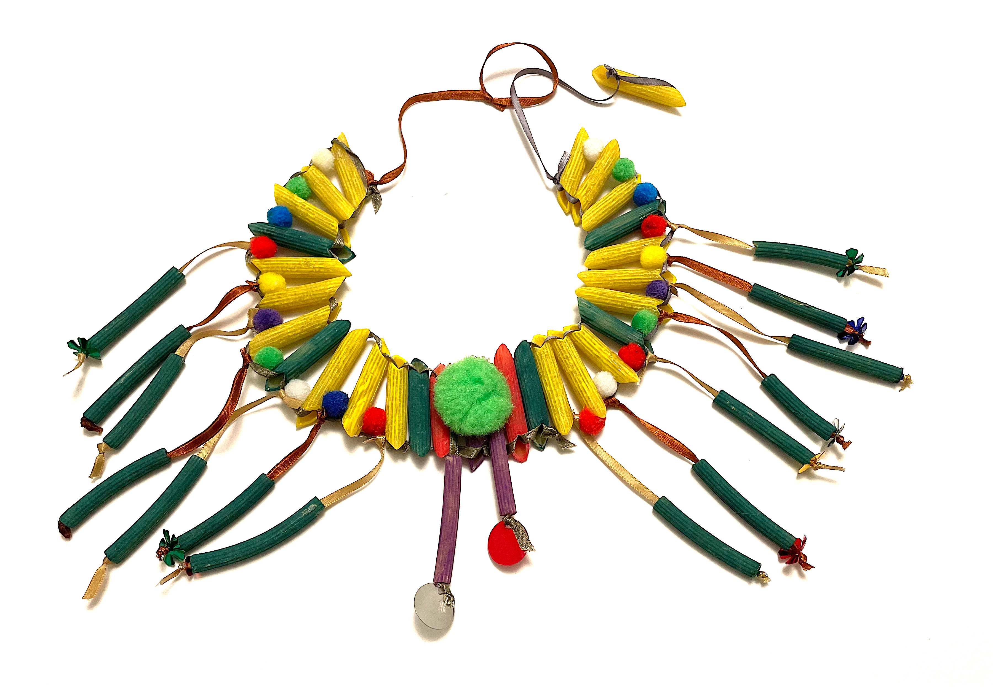
Make an Egyptian pasta necklace
Making an Egyptian Necklace using Pasta & Ribbon

Slide 2
Stay safe
Whether you are a scientist researching a new medicine or an engineer solving climate change, safety always comes first. An adult must always be around and supervising when doing this activity. You are responsible for:
ensuring that any equipment used for this activity is in good working condition
behaving sensibly and following any safety instructions so as not to hurt or injure yourself or others
Please note that in the absence of any negligence or other breach of duty by us, this activity is carried out at your own risk. It is important to take extra care at the stages marked with this symbol: ⚠

Slide 3
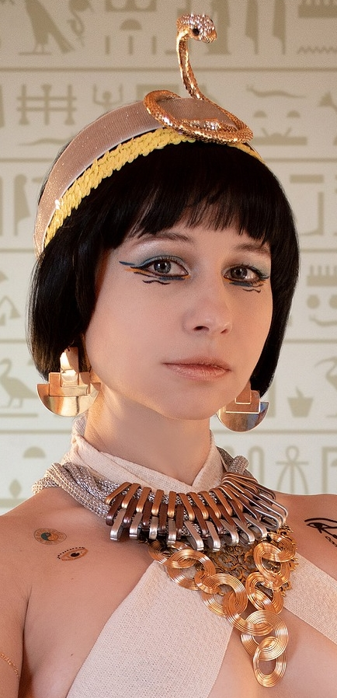
Design Brief
Your task:
Make a piece of jewellery inspired by the ancient Egyptians

Slide 4
Gold
Silver
Things to consider
Copper
Earrings
Rings
Beads
Necklace
Materials used
Types
Egyptian Jewellery
Precious Stones/Gems
Bracelet
Men
Who would wear it
Adults
Women
Children
Poor
Rich

Slide 5
Things to consider
Egyptian men and women liked to wear jewellery, especially necklaces, bracelets and earrings
Wealthy people wore jewellery made of gold and precious stones such as amethysts and turquoise
Less wealthy people wore jewellery made from bone, stone or artificial gemstones

Slide 6
Example of Ancient Egyptian necklace

Slide 7
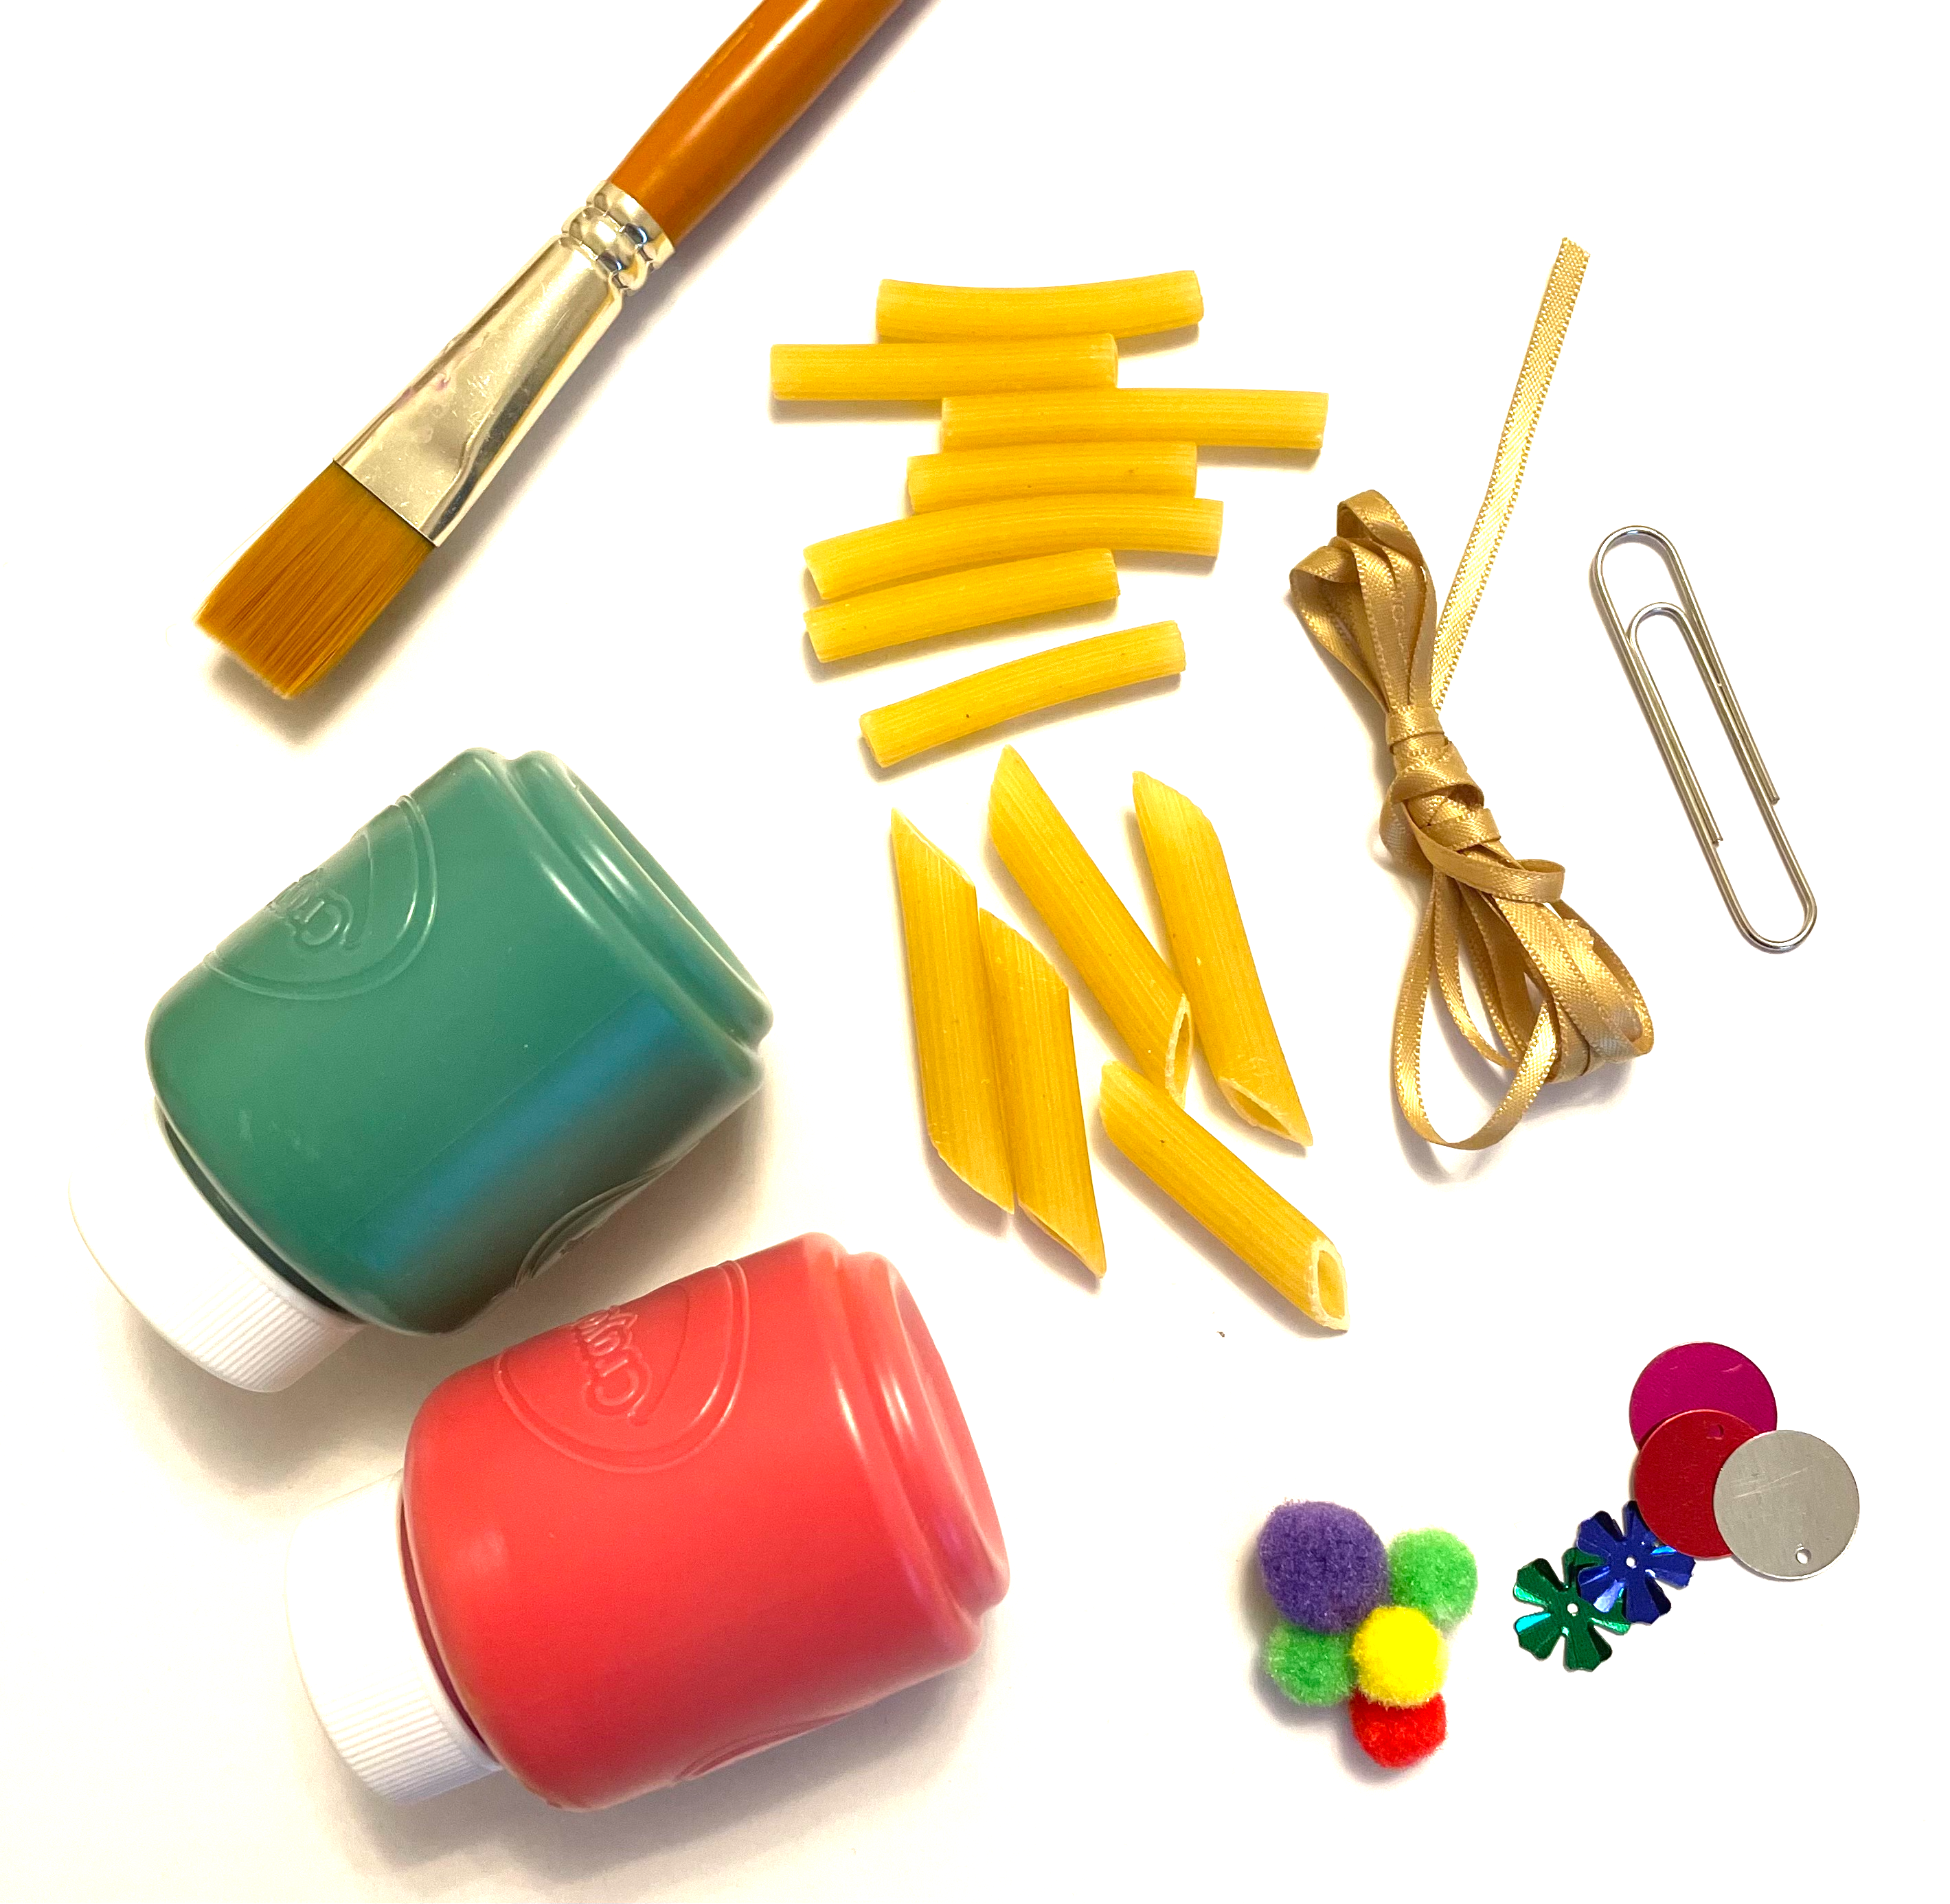
Equipment and Resources
Pasta tubes
Ribbon
Paint & brush
Pom poms & sequins
Paperclip
Scissors

Slide 8
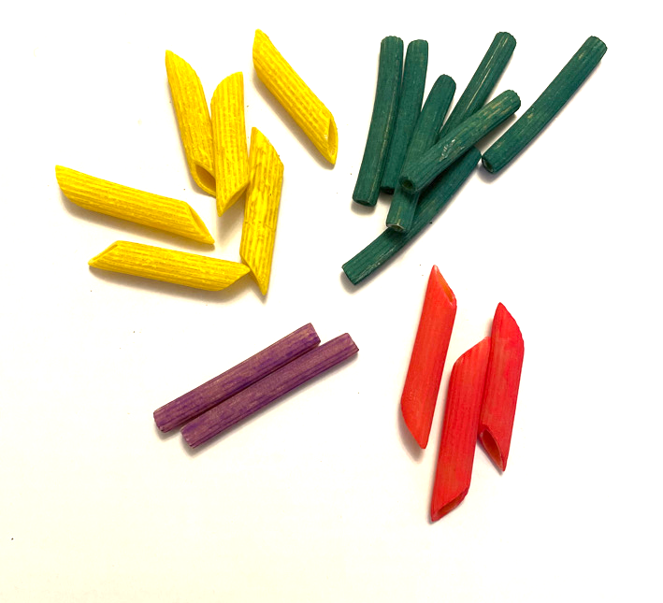
Step 1 Paint your pasta
⚠
Research typical colours used by the Egyptians
Choose your major colours
Paint your pasta

Slide 9
Step 2 Thread your pasta onto the ribbon
Unbend the paper clip and use it to thread the ribbon through one piece of pasta
Ensure the pasta is located in the middle of the ribbon - both ends should be the same length

Slide 10
Step 3 Add Another Piece
Thread your next pasta shape onto the ribbon
Then thread through the ribbon in the other direction, so that both ends of the ribbon cross inside the pasta shape

Slide 11
Step 4 Add More Pasta and Spacers
Add more pasta pieces in the same way
Add different coloured pasta to create your own design
As you add more pasta pieces to your ribbon, glue in pompoms on one side – this will give the necklace a gentle curve shape

Slide 12
Step 5 Keep threading
Keep building up your design until you have a crescent shape
Tie the ribbon together and cut ends neatly
Repeat the process to create another crescent shape - copy the same pattern of colours with pasta and pompoms

Slide 13
Step 6 Create a middle section
Be creative with the middle section - use contrasting colours and odd numbers of pasta
Create add-on shapes by threading single pieces of pasta onto short lengths of ribbon - fix these in place with knots or sequins
Tie these onto the middle section and trim ribbon ends

Slide 14
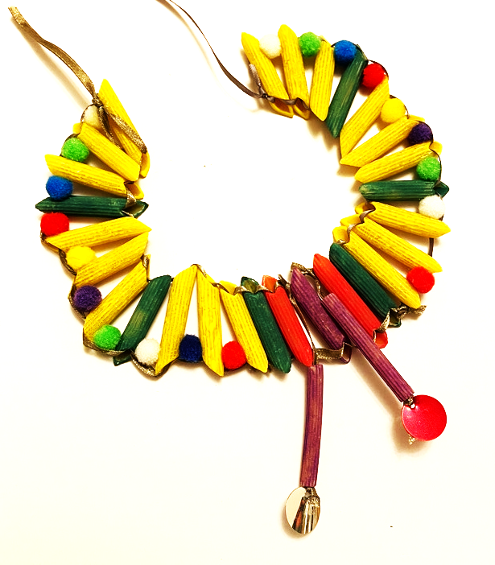
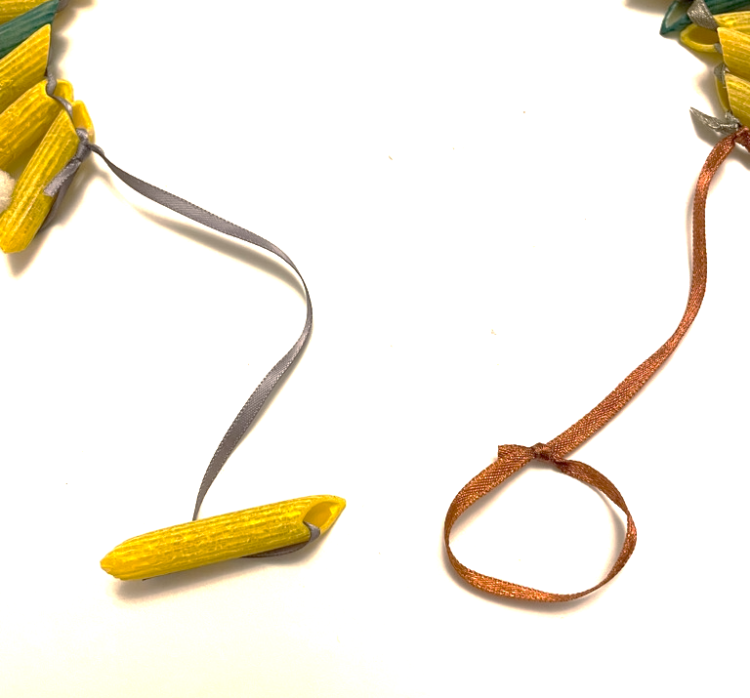
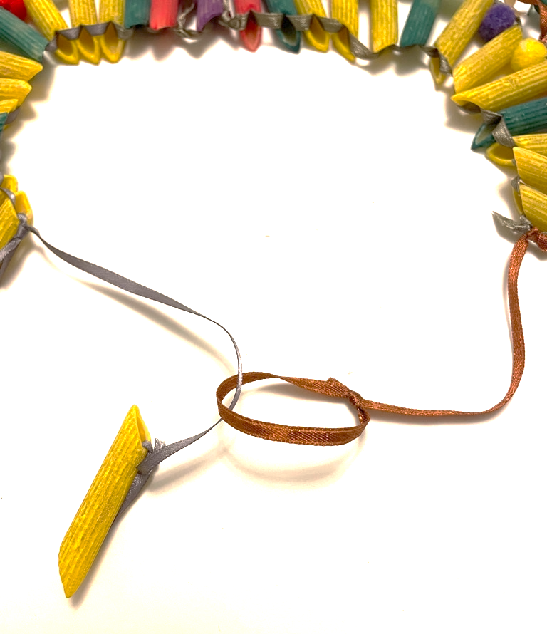
Step 7 Assembly
Tie each side section to the middle section
Create a clasp by tying on a piece of pasta and creating a ribbon loop to hook through

Slide 15
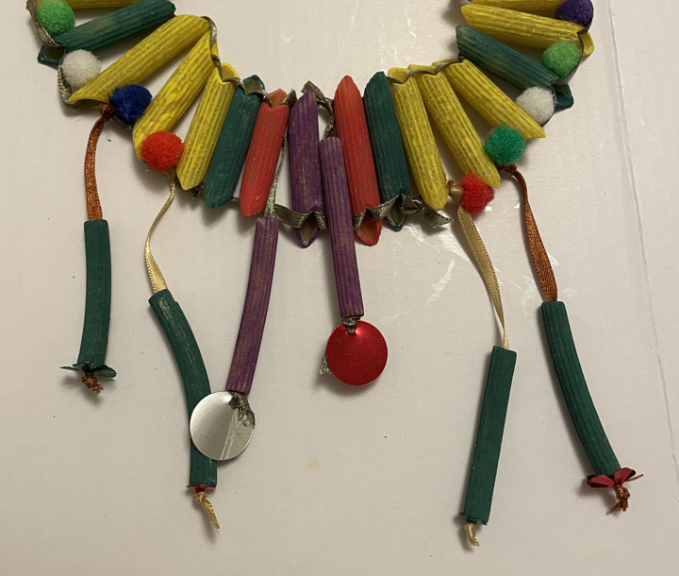
Extension
You could:
add additional pasta
use different coloured ribbon
Tie additional decorations to the bottom of the necklace using ribbon

