Slide 1
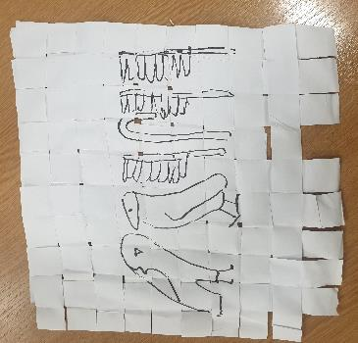
Make papyrus
Making ‘papyrus’ from paper

Slide 2
Stay safe
Whether you are a scientist researching a new medicine or an engineer solving climate change, safety always comes first. An adult must always be around and supervising when doing this activity. You are responsible for:
ensuring that any equipment used for this activity is in good working condition
behaving sensibly and following any safety instructions so as not to hurt or injure yourself or others
Please note that in the absence of any negligence or other breach of duty by us, this activity is carried out at your own risk. It is important to take extra care at the stages marked with this symbol: ⚠

Slide 3
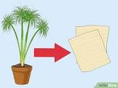
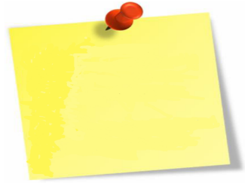
What is Papyrus?
The Egyptians invented papyrus.
It is a sort of paper made from reeds.
It was much quicker to draw symbols on papyrus than to carve them into rock.
Papyrus was also much easier to carry around than clay tablets!
The stem of the Papyrus plant is squashed and laid flat and in layers to create a paper like material

Slide 4
Equipment and Resources
You will need:
A sheet of A3 white paper (or 2xA4)
2 cups of water
1 cup of sugar
2 large sheets of wax paper or aluminium foil
A rolling pin, large bowl, scissors

Slide 5
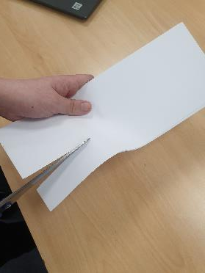
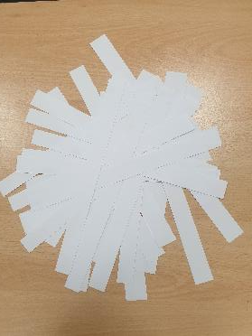
Step 1 Cutting the paper ⚠
Cut the white paper into 20 strips, each about 1½ cm wide

Slide 6
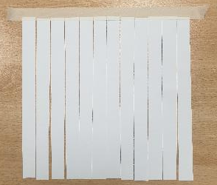
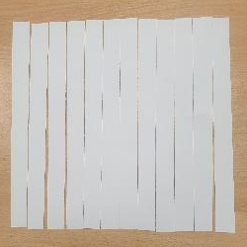
Step 2 Layout
Lay 10 strips next to each other as close to each other as possible
Secure the top of the strips to the work surface with a piece of tape

Slide 7
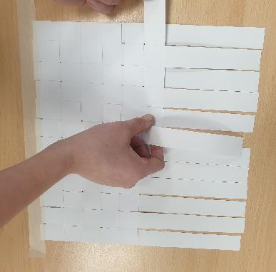
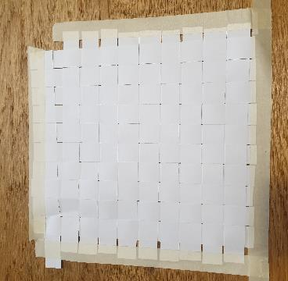
Step 3 Weaving
Weave the remaining 10 pieces through the original 10
Once complete tape the other edges (to hold it together when removing from the work surface)

Slide 8
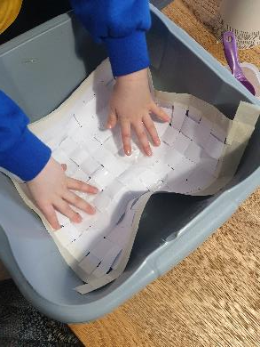
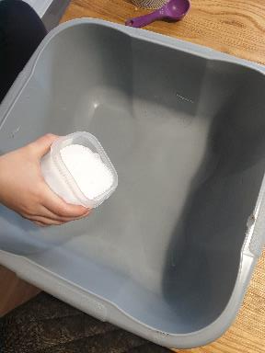
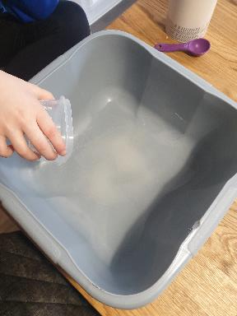
Step 4 Bonding
Mix the sugar and water until the sugar has dissolved
Place the weaving into the water/sugar mix
Leave for 2 hours so that the paper absorbs some of the sugar water

Slide 9
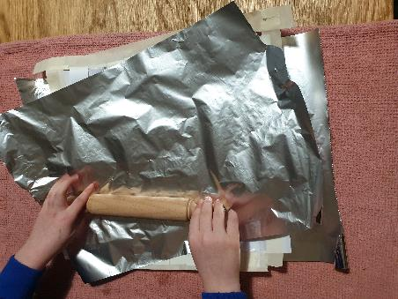
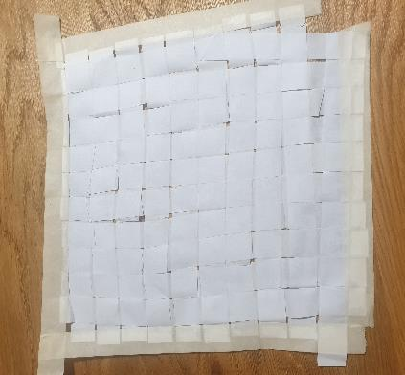
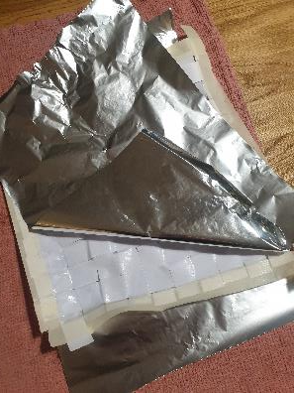
Step 5 Removing water
Remove the weaving and put on the wax paper/foil
Sandwich the weaving between two sheets of wax paper/foil.
Using a rolling pin, press out excess water and flatten the weaving
Allow to dry overnight

Slide 10
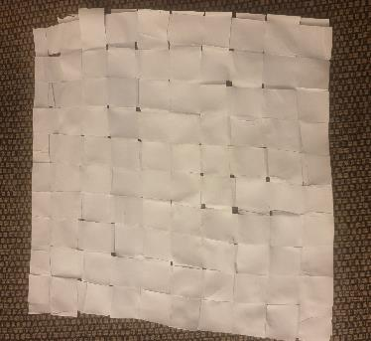
Step 6 Finished ‘Papyrus’ ⚠
Remove weaving from wax paper/foil and cut off any excess from the sides

Slide 11
Finished example
(with writing)
This reads ‘Maisie’

