Slide 1
Creating media: Audio editing
Record and edit your own interview

Slide 2
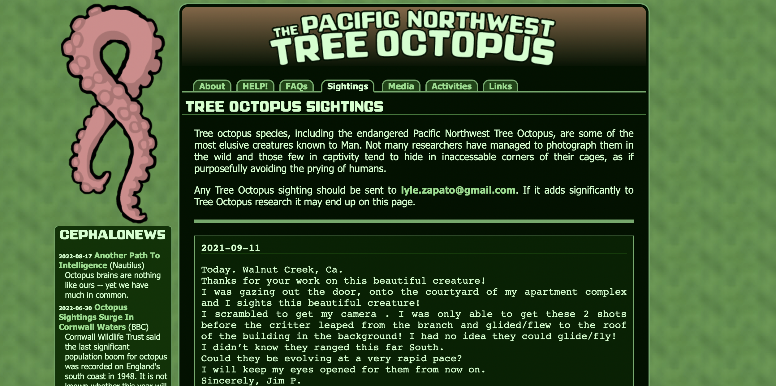
Fake news!
There is something a little odd with this website, what signs tell us that this is not real.
Notes:
Have a look through the website, signs like inaccurate photos and people providing false information.

Slide 3
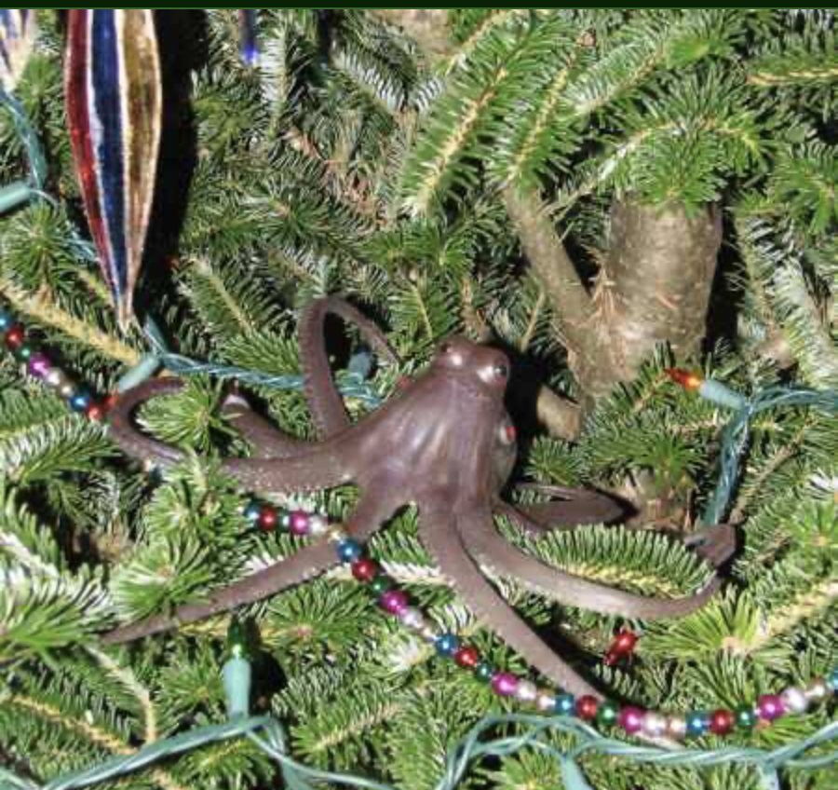
Fake news!
Anyone can write a webpage or even edit Wikipedia! How can we tell what information to believe?
Notes:
Discuss the use of using multiple sources to fact check

Slide 4
Historical Sources
What do you think is the most useful source?
Think about…
Accuracy
Bias
Authenticity

Slide 5
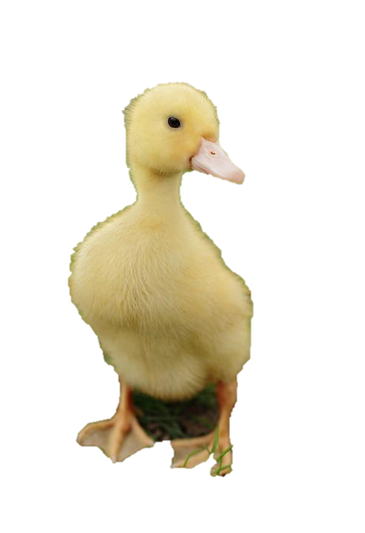
Historical Sources
Accuracy
Is the source correct or does it have mistakes or errors? A picture might have been staged but might not actually show the real thing.
Authenticity
Is it the real thing? Some items might be replicas and therefore not authentic to the time period.
Bias
Is someone writing something in favour of someone or something? An account of a war may be biased towards one side depending on who has written it.

Slide 6
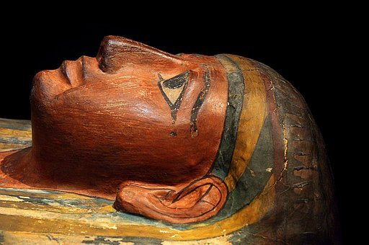
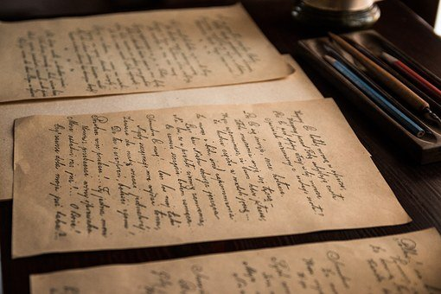
Historical Sources
What do you think is the most useful source?
Think about…accuracy, authenticity, bias?
News articles
Interviews
Pictures
Letters
Artifacts
Diaries
Notes:
Hold a mini debate, which do they think is better and why, remind them to come back to AAB on previous slide.

Slide 7
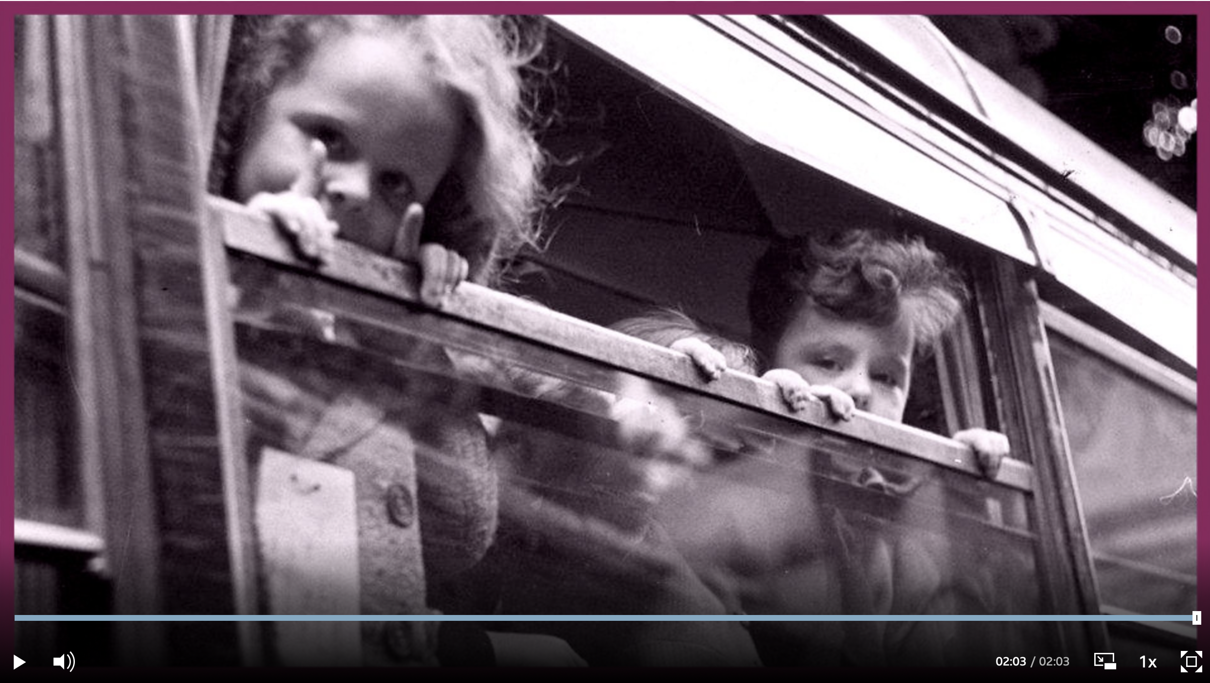
Giving an interview
We call this oral history.
Why are interviews important in history? Let’s watch this interview from some evacuee learners - what did you learn?
Notes:
Watch this interview, talk about what the learners learnt.

Slide 8
Why is it important for us to interview people?
And why is it important to interview people about technology?
Notes:
Fill in, some potential answers on the next slide

Slide 9
Why is it important for us to interview people?
It helps us preserve history.
It gives us an opinion we might not have learnt about otherwise.
It can help us understand and provide detail explaining how people lived.
It gives us a sense of the individuals.
And why is it important to interview people about technology?
It is always changing.
It is important to know how we have evolved.
It is interesting to know what our parents and grandparents used.

Slide 10
What would you like to know about your families experience with technology?
Notes:
Explain that they will be interviewing their families about technology, talk about what they want to know. Listen to interview on next slide and come back to this slide again to see if there is anything else they want to add.

Slide 11
Giving an interview
What A Good One Looks Like
Let’s have a look at some example interviews.
What kind of questions did they ask?
What did you learn?
Interview 1:
Interview 2:
Remember, do not record or film someone without their consent.
Notes:
Either play as a slide show or hover over the speaker and press the play button.

Slide 12
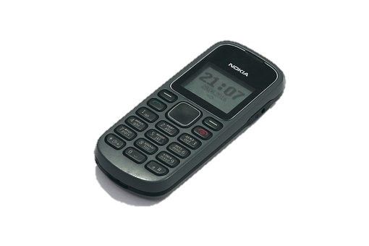
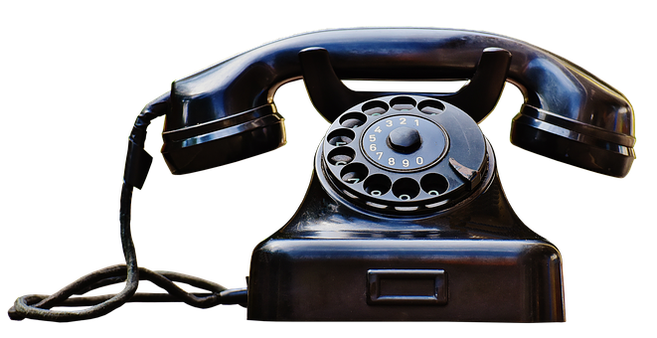
Your task
Create your interview script so that it’s all ready for your homework task! We will then test it out on our friends and learn how to create audio recordings.
Audience?
Purpose?
Key questions: (What would you like to know?)
Checklist: (What makes a good interview?)
Click here to watch a video to help you write your checklist!
Notes:
Example checklist on next slide
https://www.bbc.co.uk/teach/class-clips-video/history-ks2-how-to-interview-people/zrhgwty

Slide 13
Example questions
What was technology like when you were young?
What technology did you have growing up?
How did you do your shopping?
How did you communicate with people?
When did you get your first phone? What was it like?
When did you get your first computer? What was it like?
Did you use any technology we don’t see anymore? How did it work? What did you use it for?
What’s your favourite piece of modern technology? What do you use it for?
If you could invent some new technology to help you, what would it be?

Slide 14
Checklist
Checklist: (What makes a good interview?)
Speak clearly
Try to avoid background noise
Remove unwanted sounds
Use open questions
Intro section included
Credits section included
Remember, you don’t need your interview to be too long, we want to keep our audience engaged!
Notes:
Example checklist on next slide

Slide 15
Homework task
Conduct some interviews! Using the script you have made today, interview some of the members of your family and friends.
Use a device to record your interview - the next few slides will show you how to do this.
Don’t worry if you don’t have a device to record your interview - you can always write out the answers and then record it at school.
Remember to note the age of the person you interview and get their consent before recording them.
Notes:
We advise you to share these next few slides on your website with parents, so they know how to record the interviews. Make it clear to the learners that it is okay if they do not have a device at home, as they can always write down their answers and then record the interview at school with a friend standing in to say the answers.

Slide 16
How to give your interview
See separate video files in the download area for this resource.

Slide 17
Recording your interview
Recording on a PC:
Record your voice. Test it out by saying hello. Make sure you are sat close enough to the microphone and there is not too much background noise.
Stop
Record
Click play to listen to the recording.
Delete this test so you can begin your interview.
Play
Delete
Notes:
In this presentation we recommend and show how to use audacity. However, you may wish to use another programme. Some others you may wish to use are https://twistedwave.com/online or Office 365 online https://support.microsoft.com/en-us/office/record-audio-or-video-notes-b90fa4a2-253b-47ec-99bd-c9b368268465
Download https://www.audacityteam.org/download/mac/ on PC or download audio editor app. The learners can then use this to interview their families.

Slide 18
Recording your interview
Using a mobile and editing with Audacity - Part 1
Download the app Audio editor, this app is free to use.
Record your interview.
Skip the advert by clicking the cross in the top corner.
Select your interview.
Export file to MP3.
Select your new interview file and click share.
Email the link to your teacher.
See separate video files in the download area for this resource.
Notes:
This cannot be recorded on voice memo etc. as the files cannot be uploaded to audacity. The file must be an MP3. Make this clear to parents.
Download https://www.audacityteam.org/download/mac/ on PC or download audio editor app. The learners can then use this to interview their families.

Slide 19
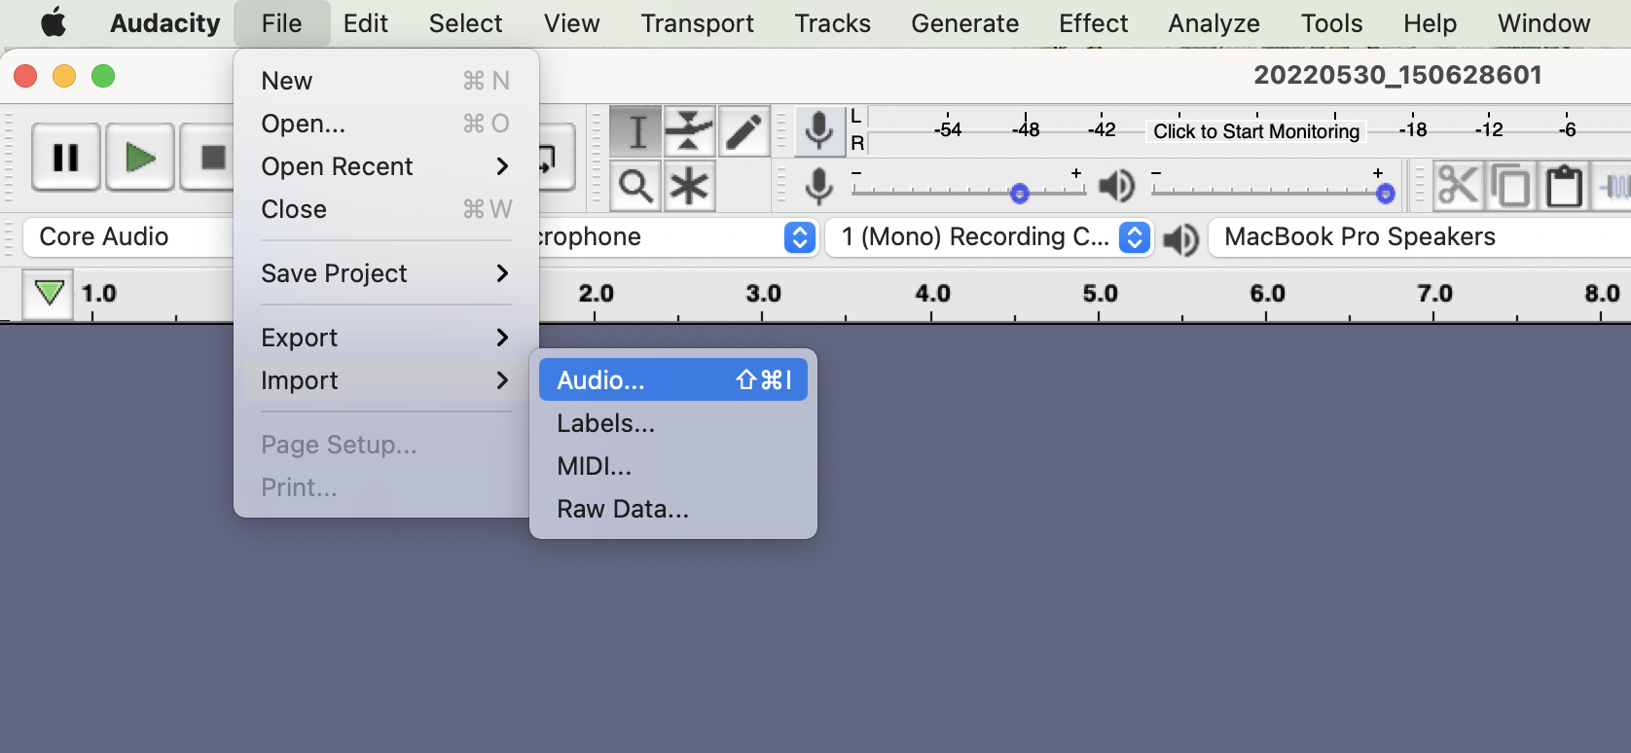
Recording your interview
Using a mobile and editing with Audacity - Part 2
Input your audio by clicking- file, import, audio, then choosing your file.
Click play to listen to the recording.
Notes:
Download https://www.audacityteam.org/download/mac/ or get the app. The learners can then use this to interview their families. If the parents do not wish to download the app they can just record it on voice memos on phone or ipads and then edit on audacity in school.

Slide 20
Editing audio
Have you said something wrong in your recording? Maybe a dog barked and you had to ask your question again. Trimming your audio will allow you to cut this out!
Notes:
Download https://www.audacityteam.org/download/mac/ or get the app. The learners can then use this to interview their families. If the parents do not wish to download the app they can just record it on voice memos on phone or ipads and then edit on audacity in school.

Slide 21
Trimming audio
Click and drag over the spot you want to trim.
Right-click and click cut.
Remember to listen back to the recording to make sure you have cut the correct part.
See separate video files in the download area for this resource.
Notes:
Download https://www.audacityteam.org/download/mac/ or get the app. The learners can then use this to interview their families. If the parents do not wish to download the app they can just record it on voice memos on phone or ipads and then edit on audacity in school.

Slide 22
Did you enjoy conducting interviews?
What jobs could you do?
Journalism
Historian
Audio Engineer
Editor
Audio Designer

Slide 23
Did you enjoy audio editing/recording?
On the Archives of IT website you can watch short interviews with a real audio editor and learn all about their job and how they got there.
Step 1: Follow the link https://archivesit.org.uk
Step 2: Click on Gallery in the education section of the homepage
Step 3: Click on interviews
Notes:
Careers- Talk through the various jobs learners can do if they enjoy digital art, all on our video which can be accessed via the link provided.

