Slide 1
The Evidence for the Big Bang

Slide 2
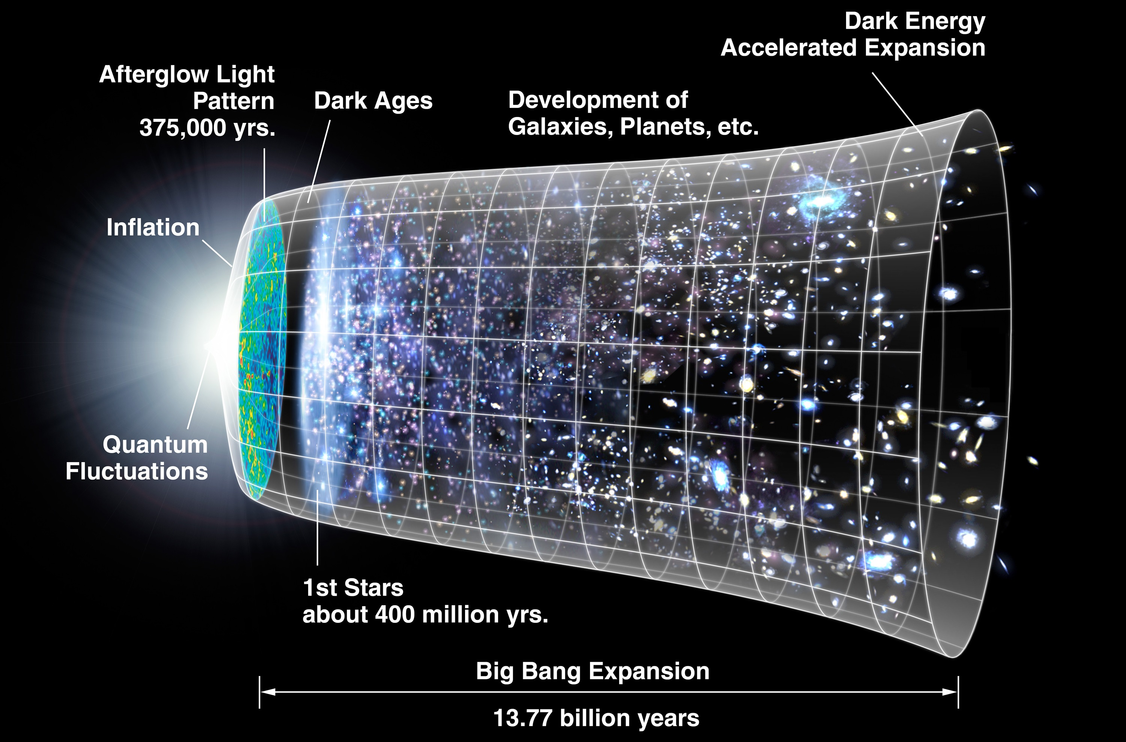
How do we know?
The Big Bang model is a concisely explains three independent observations:
The light from distant galaxies is longer wavelength than expected
Helium is a large fraction of the matter in the universe
The universe appears to be filled with microwave radiation
Each observation can be explained in other ways, but the Big Bang model draws all of them together into one convincing story
{image credit: NASA/WMAP Science Team/ Art by Dana Berry}
Notes:
Historically, Cosmology was not really something that a well brought up young physicist got into until the 1970s. S Weinberg’s book “The first three minutes” popularised and legitimised the subject.
The discovery of the red shift was made in 1929
Helium abundance calculations from Big Bang theory were first done in about the 1940s
The CMB was detected for the first time in 1965

Slide 3
The red shift
absorption lines
Spectrum of light from the sun
Δλ = λ₂ − λ₁
λ₂
λ₁
Light from a cluster of galaxies 10⁹ light years away
The light in this spectrum seems to be shifted to the right

Slide 4
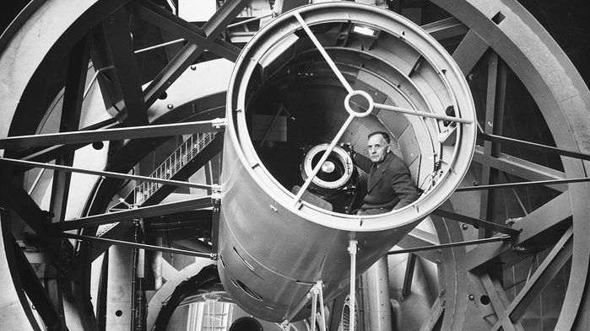
Hubble’s Law
Hubble related the amount of redshift to the speed of a galaxy redshift
Then he plotted speed against distance to a galaxy
Edwin Hubble and telescope (1953)
{image credit: NED/STEER/HUCHRA/RIESS; NASA/ESA}

Slide 5
Hubble’s original data
Red shift due to expansion
The further away the galaxy, the longer the light has been traveling
Universe has expanded more in that time
The wavelength of the light gets stretched out by a larger amount
The velocity plotted is the rate at which the distance to the galaxy has changed in the age of the universe
Notes:
This is Hubble’s original data. He was doing the best he can, but even so you can see what a fortunate guess it was on his part to say the red shift was proportional to distance.
The distance scale is calibrated in Mpc or mega parsecs - a parsec is a technical distance unit used by astronomers, it works out to being about 3.25 light years.
The red shift is often explained in terms of a Doppler shift (like what you hear when a police car blaring its siren goes past). It is NOT a Doppler shift. This would imply that the red shift was due to galaxies moving through space away from us. It may be convenient to talk in such a manner for ease of explanation, but the cosmological red shift is actually due to the expansion of space. As the universe expand space stretches. Light passing through space is stretched as well, so the wavelength gets bigger. The further away the galaxy, the further the light has to travel to get to us. In that time, the space is stretched more so the wavelength is stretched out further.
Galaxies do move through space, but that motion gives a red (or blue) shift that is much smaller than the cosmological red shift if you concentrate on the more distant galaxies.

Slide 6
Much improved data
Distance scale 250 x bigger
Much more convincing!
Implication - the universe had a start
Gradient of line = Hubble Constant
Notes:
This date from the 1990s is much more convincing. Note that the distance scale is much bigger now.
The key issue here is that the relationship is linear, which implies that there was a definite start to the universe.
If different parts of the universe started stretching at different times, then there wouldn’t be one line that you could draw through all the data.
A set of galaxies in part of the universe that started stretching sooner than another could now be at the same place, but the amount of stretch in the light coming from them would be different as they had taken different times to get to the same place.

Slide 7
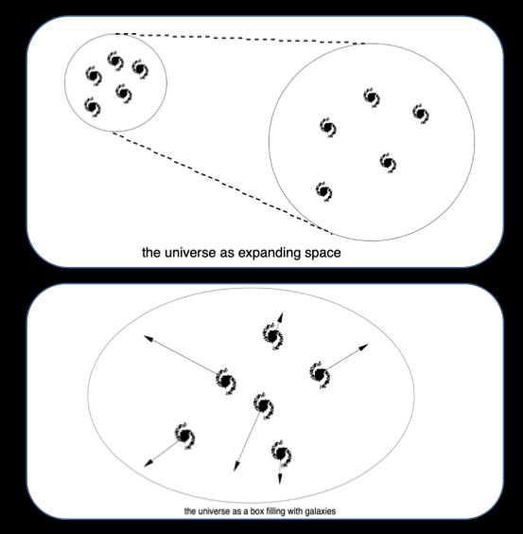
Expansion of the universe
Expansion of the universe is NOT a rushing to fill
empty space
The WHOLE universe is expanding - there is no empty space
Notes:
The top diagram is trying to illustrate a universe that started as mostly empty space with all the galaxies clustered in one part. The expansion is then filling that empty space as the galaxies rush apart. THIS IS NOT WHAT IS HAPPENING IN OUR UNIVERSE.
The second diagram shows a universe full of galaxies, but one that is getting bigger.

Slide 8
Cosmic Microwave Background
Arno Penzias Robert W Wilson (Nobel Prize, 1978)
Persistent microwave ‘hiss’ independent of time and direction
Notes:
In the background of the picture is the microwave antenna they used to detect the CMB.
They were not actually looking for this radiation at the time.
They had been using an ultra-sensitive microwave receiving system to study radio emissions from the Milky Way when they found an unexpected background of radio noise with no obvious explanation.
At first they thought the signal was interference within the equipment and went to great trouble to sort this out. This even included crawling down the antenna horn and clearing out the pigeons nesting there along with their less than savoury ‘deposits’. After trying all sources of interference, they were on the verge of giving up.
Penzias and Wilson consulted with Princeton physicist Robert H. Dicke, who had theorized that if the universe was created according to the Big Bang theory, a background radiation at 3-degree Kelvin would exist throughout the universe. Dicke visited Bell Labs and confirmed that the mysterious radio signal Penzias and Wilson detected was, indeed, the cosmic radiation that had survived from the very early days of the universe.

Slide 9
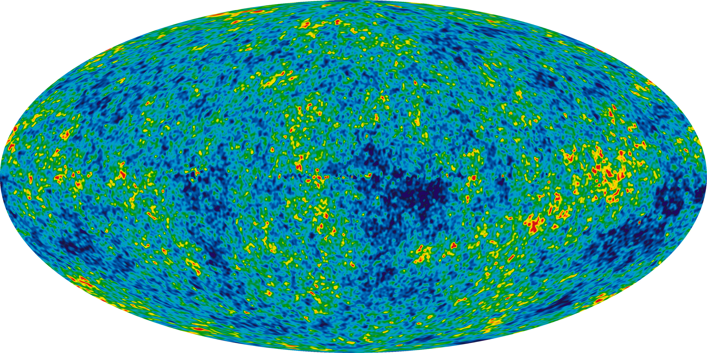
Cosmic Microwave Background
The early universe was hot and dense
Full of electrically charged particles
High-energy gamma rays were constantly emitted and absorbed by these charges
As the universe expanded and cooled, about 380 000 years into creation, the charges joined together to form atoms
The radiation could now escape, but has nowhere to go
Still fills the universe, but now reduced to microwaves due to expansion
Provides evidence of the hot dense early universe
Thermal map of the microwaves in the sky
{image credit: NASA / WMAP Science Team}
{image credit: NASA / WMAP Science Team}
Notes:
The CMB thermal map is from the WMAP satellite data. It corresponds to a density map of the universe when the radiation broke free.

Slide 10
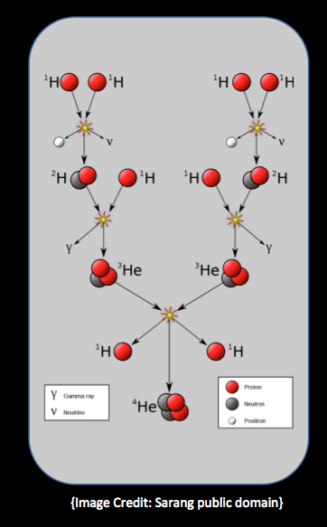
Helium
Universe is 24% He (by mass)
That’s far more than can be explained by Helium being made in stars!
Stars fuse hydrogen into helium
The oldest stars (11 billion years) also have 24% He
Big Bang - in early history, whole universe same temperature as the inside of a star
Fusion in the first three minutes of history happened everywhere in the universe
This is how the helium was made…
Shows the universe was hot in earliest times
{Image Credit: Sarang public domain}
Notes:
Helium abundance is quite a technical piece of evidence. Effectively the fact that there is so much helium in the universe is something that needs to be explained. A convenient way of seeing this come about is to assume that the universe went through a very hot early phase. If this is the case, then the same nuclear reactions that are currently powering stars and turning hydrogen into helium would be taking place in the whole universe. You put the numbers into the theory and it comes our with exactly the right amount of helium that would be made.

Slide 11
Summary
The Universe has evolved
In early history there were no galaxies or stars
The universe was a ‘soup’ of charged particles with very high energy (hot) and very dense
So hot, that fusion took place in the whole universe – making helium
The universe was full of gamma rays bouncing around the charges
As the universe got older it cooled down
Atoms formed and the radiation stopped bouncing around, but still fills the universe
Eventually, galaxies and stars started to form
{image credit: TheAstronomyBum, CC1.0}

