Slide 1
The Martians are Coming

Slide 2
Mars was always conspicuous in the night sky due to its red colour
Jupiter with some of its moons (right)
Mars (left) – note the distinctly red shade as viewed from Earth
Image credit: R Raybell via CC 2.0

Slide 3
Early Observations of Mars
1610 Galileo Galilei - first telescope observations of Mars: could not see surface features (telescope not good enough)
1644 Daniello Bartoli - reported seeing two darker patches on surface
1651, 1653 & 1655 oppositions - Giovanni Riccioli & Francesco Grimaldi noted patches of differing reflectivity on surface
1659 - Christiaan Huygens first drawing of Mars
showed dark region now known as Syrtis Major Planum, and possibly one of the polar ice caps.
1704 - Jacques Maraldi South Pole cap varied as the planet rotated
the cap was not centered on the pole…
1781 Sir William Herschel - South cap appeared "extremely large"
Syrtis Major Planum

Slide 4
The crucial century….
1809 Honore Flaugergues, French amateur astronomer,
notices "yellow clouds" on the surface of Mars,
Now know to be dust clouds
1813 Flaugergues
polar ice cap melts significantly in the Martian spring
Image credit: NASA / HST

Slide 5
The crucial century
1854 William Whewell
concludes that Mars has green seas and red land, wonders if there is extra-terrestrial life
1858 Fr Angelo Secchi (Vatican Observatory)
First person to use the word canale (plural canali) in connection with Mars,
did not see any straight lines
applied the term to large features —e.g. "Canale Atlantico" for what later came to be called Syrtis Major Planum.
Syrtis Major Planum

Slide 6
Giovanni Virgino Schiaparelli
Leading expert on Mars for 20 years
1877 opposition
8.6 inch refractor (lens) telescope
322 X magnification
Naked eye observations
Produced new map of Mars
Systematic naming convention for surface features
Giovanni Virginio Schiaparelli (1835 -1910)
Notes:
Schiaparelli was a respected astronomer who worked on binary stars, discovered an asteroid, demonstrated that meteor showers were associated with comets (suggested that the meteors came from cometary tails) and determined the rotational periods of Mercury and Venus (although like may others of the time, the Mercury period was incorrect).

Slide 7
1877 map
Named bright and dark areas after seas and lands on Earth
Linear features seen from time to time he named “canali” or channels
Repeated observations in 1879 (another opposition) identified 80 canali

Slide 8
Comparison of Schiaparelli's 1888 map of Mars with a modern satellite map
The location of Gale Crater (landing site of the Curiosity rover), is noted with the green arrow
Image credit NASA

Slide 9
Giovanni Schiaparelli's map of Mars, compiled over the period 1877-1886, used names based on classical geography or were simply descriptive terms; for example, Mare Australe (Southern Sea). Most of these place names are still in use today.
Image source NASA publication SP-4212, On Mars: Exploration of the Red Planet. 1958-1978. ch1-2

Slide 10
What did Schiaparelli think?
“Rather than true channels in a form familiar to us, we must imagine depressions in the soil that are not very deep, extended in a straight direction for thousands of miles, over a width of 100, 200 kilometers and maybe more. I have already pointed out that, in the absence of rain on Mars, these channels are probably the main mechanism by which the water (and with it organic life) can spread on the dry surface of the planet.”
1893 – La vita sul pianeta Marte (Life on Mars)
Notes:
Note that Schiaperelli stops short of saying that they are artificial

Slide 11
Percival Lowell
Interpreted Schiaparelli’s canali as canals
i.e. Artificial water carrying routes
May 22nd 1894 Boston Scientific Society: “The most self evident explanation from the markings themselves is probably the true one; namely, that in them we are looking upon the results of the work of some sort of intelligent beings”
He had not looked at Mars through a telescope by this stage
Set up an observatory in Flagstaff Arizona 1894
Percival Lowell (1855 - 1916)
Notes:
Lowell used his wealth and influence to dedicate himself to the study of astronomy and especially Mars.
Founded the Lowell observatory in Flagstaff Arizona. The altitude of 2 100 m, the few cloudy nights and being far from city lights made this an ideal location for astronomical ‘seeing’. This was the first time that an observatory had been set up in a remote and elevated location deliberately chosen for the impact on visibility.

Slide 12
Lowell using the 61 cm refracting telescope, installed in the summer of 1896 at the Lowell Observatory

Slide 13
A civilization in crisis
Lowell studied the canals and the seasonal variations of the ice caps
Martians using the ice to irrigate desert areas of the planet
Published successful popular books:
Mars (1895)
Mars and Its Canals (1906)
Mars As the Abode of Life (1908)
Notes:
The late 19th century was a time of construction of giant infrastructure projects of all kinds, and particularly canal building. For instance, the Suez Canal was completed in 1869, and the abortive French attempt to build the Panama Canal began in 1880. It is understandable that 19th century people who accepted the idea of a Mars inhabited by a civilization might interpret the canal features as giant engineering works.

Slide 14
Life on Mars…
We may, perhaps, in conclusion, consider for a moment how different in its details existence on Mars must be from existence on the Earth. If we were transported to Mars, we should be pleasingly surprised to find all our manual labor suddenly lightened threefold.
Quite possibly, such Martian folk are possessed of inventions of which we have not dreamed, and with them electrophones and kinetoscopes are things of a bygone past, preserved with veneration in museums as relics of the clumsy contrivances of the simple childhood of the race. Certainly what we see hints at the existence of beings who are in advance of, not behind us, in the journey of life.
Even on this Earth man is of the nature of an accident. He is the survival of by no means the highest physical organism. He is not even a high form of mammal. Mind has been his making. For aught we can see, some lizard or batrachian might just as well have popped into his place early in the race, and been now the dominant creature of this Earth. Under different physical conditions, he would have been certain to do so. Amid the surroundings that exist on Mars, surroundings so different from our own, we may be practically sure other organisms have been evolved of which we have no cognizance. What manner of beings they may be we lack the data even to conceive.
From Mars by P Lowell, 1895

Slide 15
H G Wells
Martians invade Earth
Influenced by the idea of a Martian civilization fighting surface conditions on their dying planet…
Novel: The War of the Worlds
1897 magazine serial
1898 hardback book
Written 1895 - 1897
Yet across the gulf of space, minds that are to our minds as ours are to those of the beasts that perish, intellects vast and cool and unsympathetic, regarded this earth with envious eyes, and slowly and surely drew their plans against us.
— H. G. Wells (1898), The War of the Worlds
Martian war machines destroy an English town
Artwork for the book "The War of the Worlds" from a 1906 Belgian edition by the Brazilian artist Henrique Alvim Corréa.

Slide 16
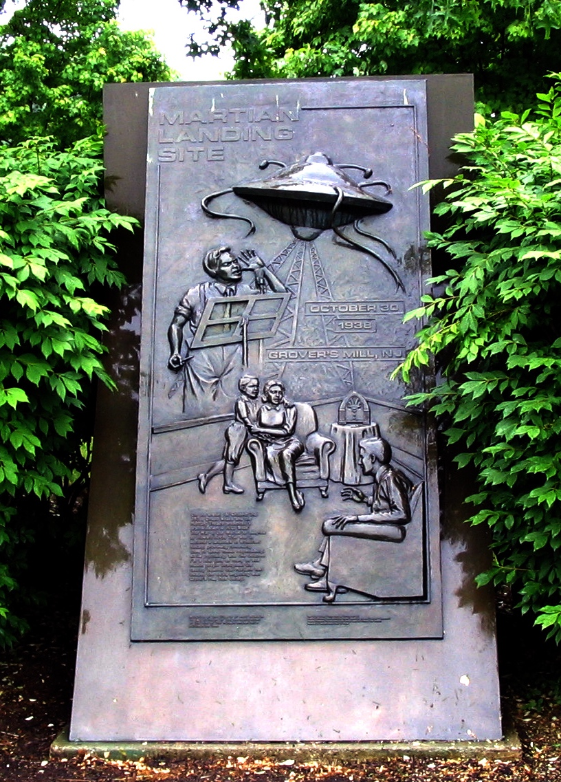
Radio play…
October 1938 radio broadcast
Dramatization of H G Wells’ book
Format: simulated live broadcasts interrupting programs of dance music
listeners believed it to be real…
Most did not understand it to be aliens, thought it was a German invasion or natural disaster
Caused a degree of panic
Later research suggested not as much panic as reported at the time
Commemorating the 1938 broadcast: Van Nest Park in West Windsor Township, New Jersey Image credit: ZeWrestler
Notes:
"The War of the Worlds" was the 17th episode of the CBS Radio series The Mercury Theatre on the Air, which was broadcast at 8 pm ET on Sunday, October 30, 1938
The program's format was a simulated live newscast of developing events. The first two-thirds of the hour-long play is a contemporary retelling of events of the novel, presented as news bulletins interrupting programs of dance music. "I had conceived the idea of doing a radio broadcast in such a manner that a crisis would actually seem to be happening," Welles later said, "and would be broadcast in such a dramatized form as to appear to be a real event taking place at that time, rather than a mere radio play."

Slide 17
Modern fiction
The Martian (Andy Weir) 2011 book
2015 film with Matt Damon
Astronaut Mark Watney stranded on Mars
Has to survive until a mission can collect him
Grows his own crops
Ventures across the surface
Scientifically very accurate
Uses information about the surface conditions
Uses plausible mission profiles for Mars exploration
Author Andy Weir visits the Johnson Space Center
Image credit: NASA/James Blair and Lauren Harnett

Slide 18
Life on Mars
1854 William Whewell
concludes that Mars has green seas and red land, wonders if there is extra-terrestrial life
1858 Fr Angelo Secchi (Vatican Observatory)
First person to use the word canale (plural canali) in connection with Mars,
did not see any straight lines
applied the term to large features —e.g. "Canale Atlantico" for what later came to be called Syrtis Major Planum.
Ares 3 Landing Site
Ares 4 Landing Site
Schiaparelli crater
Image credit: Wolf Gang via CC 2.0
Notes:
At the climax of the book, Watney has to journey across the Martian surface from the site of his own landing (the Ares 3 mission) to where the Mars lander for Ares 4 is parked at the Schiaparelli crater.

