Slide 1
Key concept PSL7.2: Electromagnetic spectrum
Learning focus
Electromagnetic radiation transfers energy and interacts with matter in different ways, depending on the frequency and matter. Each radiation type can be both helpful and harmful.
As students’ conceptual understanding progresses they can:
C o n c e p t u a l p r o g r e s s I o n
Identify types of electromagnetic radiation that can be naturally occurring.
Describe a range of sources of harmful electromagnetic radiation.
Describe some ways in which electromagnetic radiation can interact with matter.
Explain why some types of electromagnetic radiation are more ionising than others.
Apply understanding of ionising radiation to explain how radiotherapy works.
Diagnostic questions
Natural radiation
Bad radiation
EM interactions
Most ionising
Response activities
Pulling electrons
Radiotherapy
Ready, steady, poster
P
Prior understanding from earlier stages of learning.
Run the slide show to activate the clickable boxes.
Useful information can be found in the slide notes.
B
Bridge to later stages of learning.
Notes:
The boxes containing the titles of the diagnostic questions and response activities are clickable links that will take you to the starting slide for each activity in this presentation.
In edit mode, hold down the Ctrl key and left-click the box.
In slide show mode, simply left-click the box.
Click the ‘Home’ button at the top right of the final slide of each activity to return here.

Slide 2
Section 1: Diagnostic questions
Use diagnostic questions to identify quickly where your students are in their conceptual progression, and what preconceptions and misunderstandings they may have.
Then decide how to best focus and sequence your teaching.
Use further diagnostic questions and response activities to move students’ understanding forwards.
A zip file containing all the resources for this key concept can be downloaded from
www.BestEvidenceScienceTeaching.org
The zip file provides:
Teacher guidance for this key concept, including a summary of the research evidence on relevant preconceptions and misunderstandings.
A full set of editable and printable student sheets and teacher notes for each diagnostic question. The teacher notes include a summary of research evidence, guidance for using the activity, expected answers and suggestions of how to respond to students’ misunderstandings.

Slide 3
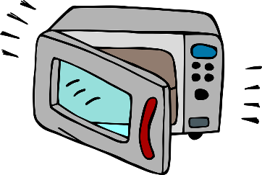
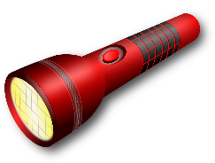
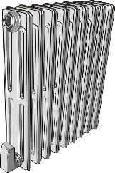
Natural radiation
There are seven broad types of electromagnetic radiation.
Radio
waves
Microwaves
Infrared
Light
Ultraviolet
X-rays
Gamma radiation
Notes:
From key concept PSL7.2: students should be able to identify types of electromagnetic radiation that can be naturally occurring.
Common misunderstandings: all radiation is artificial; living away from urban or industrial areas reduces and even eliminates exposure to radiation.
N.B. The electromagnetic spectrum can be divided up in different ways. These are the broad groups it is most often divided into.
Student sheets and teacher notes for this activity contain printable and editable worksheets, together with teacher support materials.
Images: radio by alefonte, microwave oven by ArtRose, radiator by Painter06, torch by OpenClipard-Vectors, suncream by Clker-Free-Vector-Images, X-ray by marcmanhart and radiation warning symbol by Clker-Free-Vector-Images – all from Pixabay.

Slide 4
Natural radiation
Home
How is each type of EM radiation made?
To do: Put each type of electromagnetic radiation into one column.
Made artificially | Made naturally | Made artificially and naturally
Radio
waves
Microwaves
Infrared
Light
Ultraviolet
X-rays
Gamma radiation
Notes:
Expected answer: All types of radiation are made artificially and naturally.
A breakdown of what each choice tells you about students’ understanding or misunderstanding can be found in the teacher notes for this activity.

Slide 5
Bad radiation
Electromagnetic radiation is all around us.
Sometimes it can be harmful.
Notes:
From key concept PSL7.2: students should be able to describe a range of sources of harmful electromagnetic radiation.
Common misunderstandings: all radiation is harmful; radiation is either useful or harmful and not both; electronic devices are sources of harmful radiation; living far from industrial areas greatly reduces or even eliminates exposure to radiation.
Student sheets and teacher notes for this activity contain printable and editable worksheets, together with teacher support materials.
Images: London by Iiushuquan, oil refinery by dbchandler, office by StockSnap and Lake District by 2895780 – all from Pixabay.

Slide 6
Bad radiation
Home
Where does harmful radiation comes from?
I am sure this is right
I think this is right
I think this is wrong
I am sure this is wrong
What do you think about each statement?
A
There is no harmful radiation in the countryside.
B
All electronic devices emit harmful radiation.
C
The Sun emits some harmful radiation.
Notes:
Expected answers: Statements C is correct, and statements A and B are wrong.
A breakdown of what each choice tells you about students’ understanding or misunderstanding can be found in the teacher notes for this activity.

Slide 7
Electromagnetic interactions
Electromagnetic radiation transfers energy.
It is made of oscillating electric and magnetic fields.
In the photon model, radiation consists of small packets called photons.
3V 0.2W
Notes:
From key concept PSL7.2: students should be able to describe some ways in which electromagnetic radiation can interact with matter.
Common misunderstandings: EM radiation is confused with alpha or beta particles; EM radiation causes ionisation by colliding with outer electrons of atoms.
Avoid saying: photons knock electrons off atoms
Do Say: photons force electrons off atoms
Student sheets and teacher notes for this activity contain printable and editable worksheets, together with teacher support materials.

Slide 8
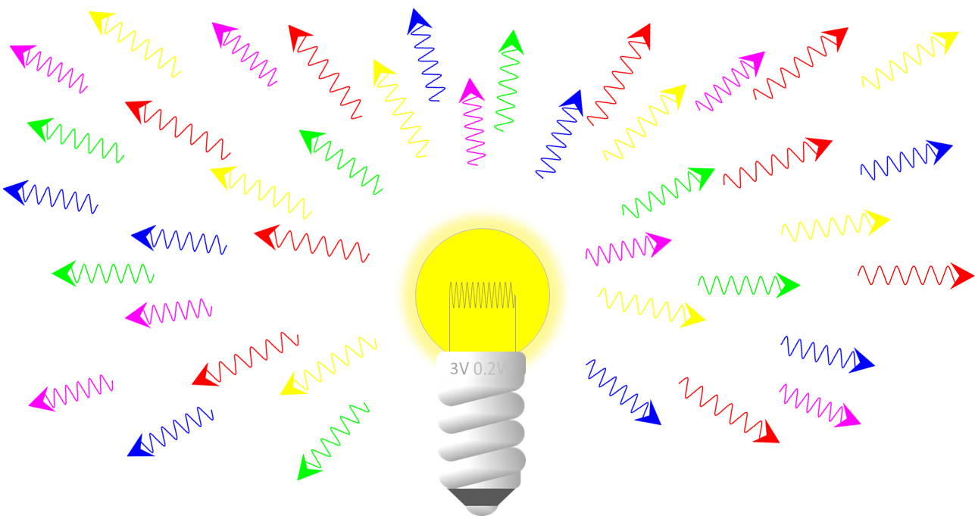
Electromagnetic interactions
Home
Electromagnetic radiation interacts with matter in different ways.
What does EM radiation not do to matter?
A
Pass straight through some solids.
B
Move electrons through a conductor.
C
Pull electrons off atoms.
D
Knock atoms off solids.
Notes:
Expected answer: D
A breakdown of what each choice tells you about students’ understanding or misunderstanding can be found in the teacher notes for this activity.

Slide 9
Most ionising
Gamma photons (for example) are different to ultraviolet photons.
Some types of photons are more ionising than others.
a. Which statement about ionising radiation is correct?
A
Infrared is more ionising than ultraviolet.
B
Ultraviolet is more ionising than X-rays.
C
Gamma radiation is more ionising than ultraviolet.
D
Microwave radiation is more ionising than ultraviolet.
Notes:
From key concept PSL7.2: students should be able to explain why some types of electromagnetic radiation are more ionising than others.
Common misunderstandings: an object exposed to radiation becomes radioactive; radiation ionises atoms when photons collide with electrons; and students find it hard to distinguish between ionising and non-ionising radiation.
Avoid saying: photons knock electrons off atoms
Do Say: photons force electrons off atoms
Expected answer: C
Student sheets and teacher notes for this activity contain printable and editable worksheets, together with teacher support materials.
Image by PIRO4D from Pixabay

Slide 10
Most ionising
Home
b. What is the best reason for your answer to part a?
A
It has a longer wavelength.
B
It has a higher frequency.
C
It causes more heating.
D
It is more radioactive.
Notes:
Expected answer: B
Student sheets and teacher notes for this activity contain printable and editable worksheets, together with teacher support materials.

Slide 11
Section 2: Response activities
Response activities encourage students to talk and think about what they’re thinking (metacognition).
This challenges students’ misunderstandings, facilitates meaning-making, and develops and consolidates their scientific understanding.
A zip file containing all the resources for this key concept can be downloaded from
www.BestEvidenceScienceTeaching.org
The zip file provides:
Teacher guidance for this key concept, including a summary of the research evidence on relevant preconceptions and misunderstandings.
A full set of editable and printable student sheets and teacher notes for each response activity. The teacher notes include a summary of research evidence, guidance for using the activity and expected answers.

Slide 12
Pulling electrons
Some types of electromagnetic radiation can ionise atoms.
An atom is ionised when it loses or gains electrons.
Ionising radiation forces atoms to lose electrons.
Notes:
From key concept PSL7.2: students should be able to describe some ways in which electromagnetic radiation can interact with matter.
Common misunderstandings: EM radiation is confused with alpha or beta particles; EM radiation causes ionisation by colliding with outer electrons of atoms.
Avoid saying: photons knock electrons off atoms
Do Say: photons force electrons off atoms
Student sheets and teacher notes for this activity contain printable and editable worksheets, together with teacher support materials.

Slide 13
Pulling electrons
Some students are discussing how electromagnetic radiation can ionise an atom.
Will: EM radiation is made of oscillating electric and magnetic fields.
Violet: EM radiation is made of photons.
Xavier: gamma radiation is more ionising than ultraviolet.
Zain: EM radiation bashes into electrons to knock them off an atom.
Yasmine: Some photons have more mass than others.

Slide 14
Pulling electrons
Home
Some students are discussing how electromagnetic radiation can ionise an atom.
Will: EM radiation is made of oscillating electric and magnetic fields.
Violet: EM radiation is made of photons.
Xavier: gamma radiation is more ionising than ultraviolet.
Zain: EM radiation bashes into electrons to knock them off an atom.
Yasmine: Some photons have more mass than others.
To answer:
Who is right about how EM radiation causes ionisation?
Explain your answer
Who is wrong about how EM radiation causes ionisation?
What would you say to help them understand?
Notes:
Expected answers: Violet, Will and Xavier are right, and Yasmine and Zain are wrong.
A more detailed answer, with a discussion of what the statements reveal about students’ understanding can be found in the teacher notes for this activity.

Slide 15
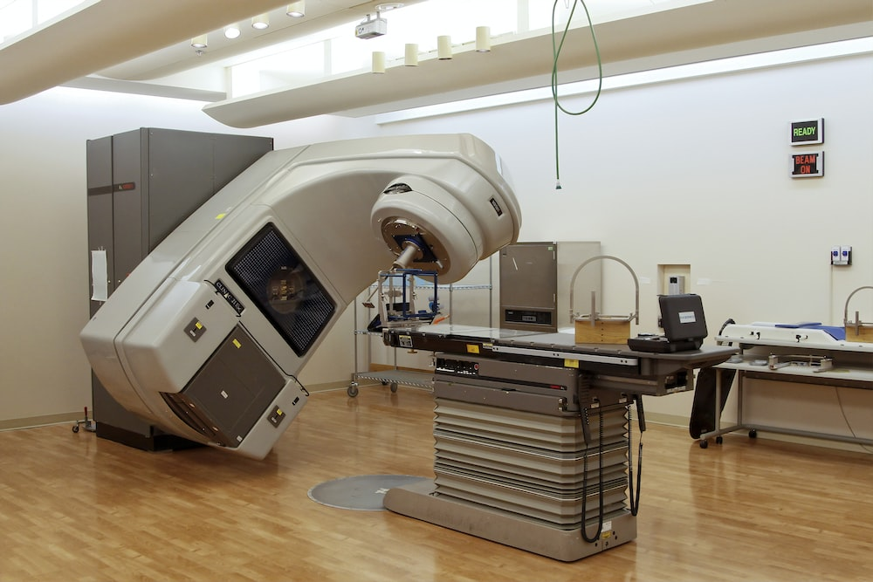
Radiotherapy
Radiotherapy is a type of cancer treatment.
A linear accelerator (LINAC) used for radiotherapy.
Notes:
From key concept PSL7.2: students should be able to apply understanding of ionising radiation to explain how radiotherapy works.
Common misunderstandings: each type of radiation is either good or bad.
Student sheets and teacher notes for this activity contain printable and editable worksheets, together with teacher support materials.
Image by National Cancer Institute from Unsplash

Slide 16
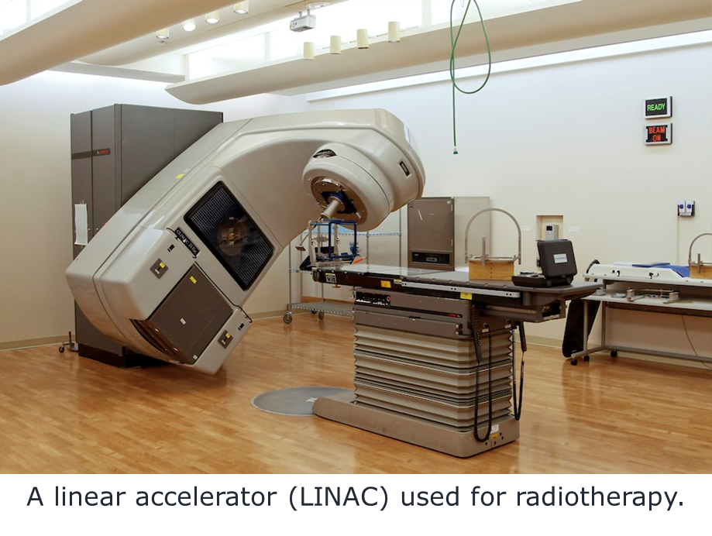
Radiotherapy
To do: rearrange these sentences to describe radiotherapy.
Radiotherapy is a type of cancer treatment.
A. It uses gamma radiation to destroy cancer cells.
B. Side effects are usually temporary and can be managed with medication or other treatments.
C. Some side effects are tiredness, skin irritation, and nausea.
D. Surrounding healthy cells are exposed to much less radiation.
E. The radiation damages the DNA inside the cancer cells, making it difficult for them to grow and divide.
F. The radiation is carefully targeted on the cancer cells.
G. The radiation is targeted from several different directions.
Notes:
Answers: revealed by mouse clicks
Student sheets and teacher notes for this activity contain printable and editable worksheets, together with teacher support materials.

Slide 17
Radiotherapy
Home
Answers:
Radiotherapy is a type of cancer treatment.
A. It uses gamma radiation to destroy cancer cells.
E. The radiation damages the DNA inside the cancer cells, making it difficult for them to grow and divide.
F. The radiation is carefully targeted on the cancer cells.
G. The radiation is targeted from several different directions.
D. Surrounding healthy cells are exposed to much less radiation.
C. Some side effects are tiredness, skin irritation, and nausea.
B. Side effects are usually temporary and can be managed with medication or other treatments.
Notes:
Answers: revealed by mouse clicks
Student sheets and teacher notes for this activity contain printable and editable worksheets, together with teacher support materials.

Slide 18
Ready, steady, poster
All electromagnetic waves are part of the EM spectrum.
The EM spectrum is often split into seven types of radiation.
Each type of radiation has a distinct set of properties.
light
radio
X-rays
Gamma
infrared
ultraviolet
microwave
Notes:
From key concept PSL7.2: students should be able to identify types of electromagnetic radiation that can be naturally occurring; describe a range of sources of harmful electromagnetic radiation; describe some ways in which electromagnetic radiation can interact with matter; explain why some types of electromagnetic radiation are more ionising than others; and apply understanding of ionising radiation to explain how radiotherapy works.
Common misunderstandings: all radiation is artificial; radiation is either useful or harmful and not both; electronic devices are sources of harmful radiation; an object exposed to radiation becomes radioactive; radiation ionises atoms when photons collide with electrons; and students find it hard to distinguish between ionising and non-ionising radiation.
Student sheets and teacher notes for this activity contain printable and editable worksheets, together with teacher support materials.

Slide 19
Ready, steady, poster
To do: research one type of electromagnetic wave.
Next lesson you will have 20 minutes to work in a group to make a very big, informative poster about one type of EM radiation.
First you need to prepare the ‘ingredients’ for your poster:
Information – the facts to write onto your poster
Clips of text – quotes from the internet printed out in large text (to stick onto a big poster) N.B. you need to add a source to the bottom of any quote to state where you got it from (e.g. the website name)
Pictures – printed out as large as you can to stick onto a big poster
Drawings – your own illustrations drawn out ready to stick on
Decoration – themed decoration to beautify your poster. E.g. a border made up of lumps of coal would set off a poster about a coal fired power station
Title – a very large title, drawn or printed off ready to stick on.
Specific details are on the worksheet for your type of EM radiation.
Notes:
Student sheets and teacher notes for this activity contain printable and editable worksheets (one for each type of EM radiation that needs to be researched), together with teacher support materials.

Slide 20
Your 20 minutes are up
Click to start timer (20 min)
Ready, steady, poster
To do: working in your group, make your poster.
Title
Facts
Danger
Use 1
Image
Image
Image
Use 2
Safety
Notes:
This slide includes a 20 minute timer – one of 20 green rectangles will appear after each minute.
Student sheets and teacher notes for this activity contain printable and editable worksheets (one for each type of EM radiation that needs to be researched), together with teacher support materials.

Slide 21
Ready, steady, poster
Home
Use the class posters to complete this summary of the EM spectrum.
Type of EM radiation | What can it be used for? | What are its properties that make it useful? | What are its dangers (if any)? | How can we keep safe from this radiation? | Why do these precautions work?
Radio
Microwave
Infra-red
Visible light
Ultra-violet
X-ray
Gamma radiation
Notes:
Student sheets and teacher notes for this activity contain printable and editable worksheets, together with teacher support materials.

