Slide 1
Should we rewild parts of Britain?
Notes:
Before the pupils come into the room display the poster ‘Agree - We should rewild parts of Britain’ on one side and on the other side of the classroom put up the poster ‘Disagree – We should NOT rewild parts of Britain.’ (Make sure it is easy for pupils to move toward these posters. See slide 12 for ore details.)
Introductory slide. Tell the pupils that in this session they are going to look at the pros and cons of rewilding parts of Britain. They are going to take on different characters in a role play debate which looks at many sides of the argument. They will then have to form their own opinion on the question and be able to justify it.
Image: Outcrop on Diebidale Ridge Scottish Highlands CC-BY-SA 2.0 Andrew Tyron

Slide 2
Should we rewild parts of Britain?
Date, name, job role
Notes:
This slide is optional and is for an Environment Agency Stem Ambassador to introduce themselves if one is present. Get them to add their name, job role and if possible a photo of them at work in their work clothes.
If no Environment agency Ambassador is available skip this slide.

Slide 3
What is rewilding?
1 minute to think 1 minute to pair
1 minute to share
Think pair share
Notes:
Before entering into the debate section of this activity it is important that pupils understand what is meant by the term rewilding. Ask pupils this question and get them to think about the answer for 1 minute in silence, then get them to talk for one minute with their partner about the question. Finally choose some partnerships to tell you their answers. The pupils may come up with many ideas that are in the right area. Gather the ideas together and then give the full definition on the next slide.

Slide 4
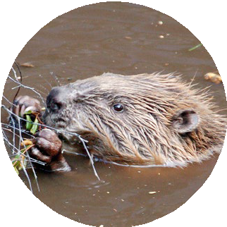
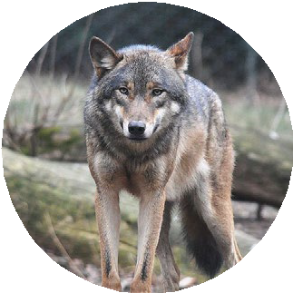
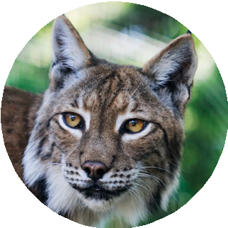
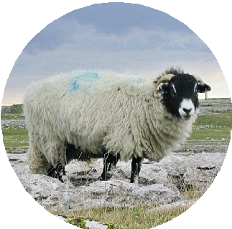
What is rewilding?
Rewilding converts large areas of countryside to its natural state. Rewilding lets plants and animals take over an area with minimal human interference, and may involve the reintroduction of species that had disappeared from an ecosystem like beavers and wolves which were hunted to extinction by humans in the UK.
Rewilding helps to increase biodiversity, which can reduce the effect of climate change on ecosystems.
Notes:
This is a simple explanation of rewilding. It is important to emphasise it means humans do not interfere with nature and that species once extinct in the UK are reintroduced. Reintroduction can also mean plant species and smaller animals being reintroduced as well as the top predators and beavers. Emphasise the point that rewilding isn’t just about reintroducing species back into an environment or not cutting grass in your garden. Rewilding is where very large areas of land are ‘given back to nature’ and farm animals are removed. This means all species can flourish. The term biodiversity is introduced here and it is important that pupils understand this term. There is a definition on the next to remind pupils what it means.
Beaver image
"Beaver Shot" by Paul Stevenson is licensed under CC BY 2.0
Eurasian Lynx Image
"Eurasian lynx, posing" by dogrando is licensed under CC BY-SA 2.0
Grey Wolf Image:
"File:European grey wolf in Prague zoo.jpg" by [1] is licensed under CC BY 2.0
Sheep image
https://commons.wikimedia.org/w/index.php?search=sheep&title=Special:MediaSearch&go=Go&type=image
Yorkshire Dales sheep https://en.wikipedia.org/wiki/User:Lupin CC BY SA 3.0

Slide 5
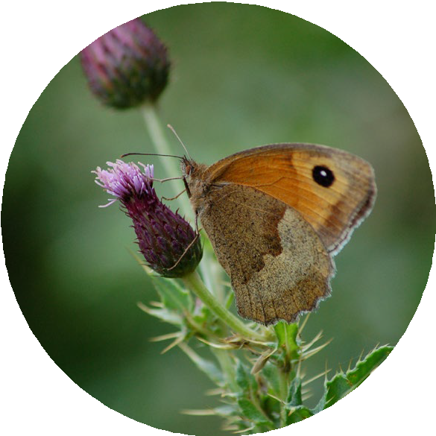
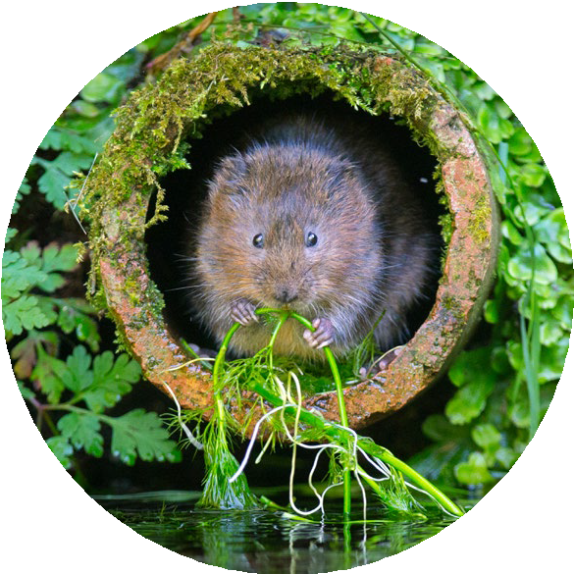
What is biodiversity?
Biodiversity is the number and variety of different species of
organisms on Earth or within an ecosystem.
Notes:
If needed you can give pupils this definition, but it may be that they know this, so just skip this slide.

Slide 6
Why is biodiversity important?
1 minute to think 1 minute to pair
1 minute to share
Think pair share
Notes:
It may be that you can skip this slide if you are confident that pupils understand the importance of biodiversity, but this task is a good way to found out how much pupils do know. Ask pupils this question and get them to think about the answer for 1 minute in silence, then get them to talk for one minute with their partner about the question. Finally choose some partnerships to tell you their answers. The pupils may come up with many ideas that are in the right area. Gather the ideas together and then give the full definition on the next slide.

Slide 7
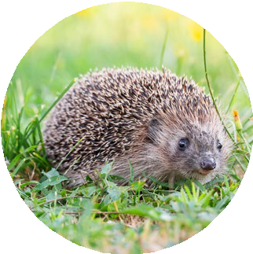
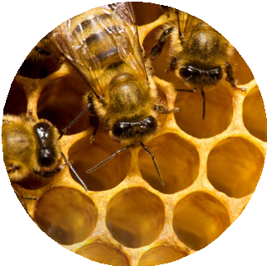
Why is biodiversity important?
High biodiversity benefits all living creatures and helps to tackle climate change and its effect. It improves the air we breathe and the variety of food we can eat.
Different species in an ecosystem are interdependent. This means they depend on each other for things like food and shelter.
In an area of high biodiversity one species is less likely to depend on only one species as a source of food or shelter. Therefore, if one species dies out, the rest are more likely to survive as they have a variety of options. This makes an ecosystem stable so it is better for us and our environment.
Notes:
Use this slide to discuss with pupils the importance of biodiversity.
Focus on the fact that humans need high biodiversity. This is a difficult concept to explain. A good example is almond trees and bees. In the USA there are large areas of land dedicated to almond farming which are low in biodiversity. Almond trees produce blossom in spring that need to be pollinated by bees in order for almond nuts to grow. In spring the bees visit almond flowers to collect nectar as food for themselves and pollinate the almond flowers. However, the bees started to die out because once the almond trees had finished flowering there were no other flowers for the bees to feed on as the whole area was just almond trees. No bees equals no almonds. No almonds means no money for the farmer.
Almond farmers in the USA have identified this problem and have planted different native wildflowers among the almond trees that flower all year long so the bees have nectar to feed on through the whole year. Bee and other insect numbers have increased as a result which has led to improved nut harvests for the farmers.

Slide 8
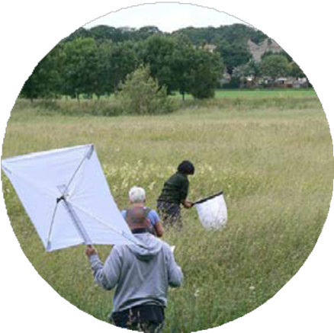
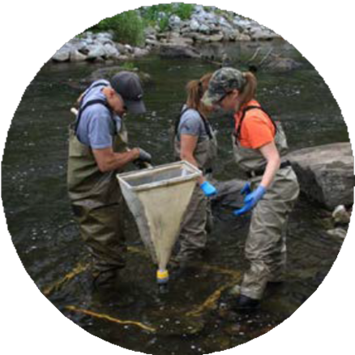
Who can help improve biodiversity?
Please watch the video:
How the Environment Agency can tackle climate change
Notes:
This video introduces an Environment Agency employee who looks at where the Environment Agency can spend money to improve the environment and how this helps plants and animals become more resilient to climate change.
If an Environment Agency STEM Ambassador is present they could explain how the Environment Agency improve biodiversity and insert some of their own slides at this point rather than show the video.

Slide 9
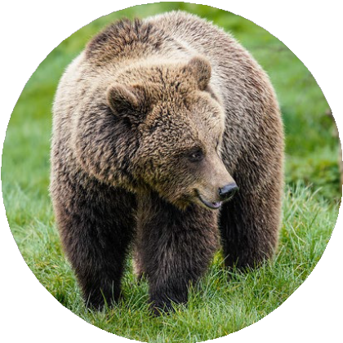
Why is rewilding controversial?
Many people have different opinions about rewilding particularly reintroducing certain species to an area where they live.
Can you think of some of the arguments for and against rewilding?
Write your thoughts on your sheet.
Notes:
Get pupils to think about the pros and cons of rewilding for a few minutes and write their thoughts in section 1 of their student worksheet.
Brown Bear Image Credit:
"European Brown Bear" by Adrian Snood is licensed under CC BY 2.0

Slide 10
Should we rewild parts of Britain?
You are going to take on the role of a character affected by rewilding and share their opinion with your group.
In the debate:
introduce your character
give your character’s opinion
give the reasons for your character’s opinion
Remember you must listen to the opinions and arguments of the other characters and complete section 2 on your worksheet.
Remember in this debate you are gathering the points of view of lots of different people to see the argument from both sides.
Notes:
Introduce students to the role play task. For the role play you will need to split the class up into groups of 5 pupils. Each pupil will take on the role of a character involved in the debate and read it to the rest of the group. Others in the group will take notes on arguments for and against rewilding in section 2 on the ‘gathering information’ worksheet. There are 10 role play cards, so the number of characters played by pupils could be adapted depending on the time available and the ability of the pupils. If the time is available and the ability of the students permits each pupil could take on 2 characters so all the characters are used.

Slide 11
Let’s hear your opinion!
Time to vote (be prepared to justify it)
Agree - We should rewild parts of Britain
Disagree -
We should NOT rewild parts of Britain
Notes:
In the classroom put the sign up ‘Agree - We should rewild parts of Britain’ on one side and on the other side of the classroom put up the sign ‘Disagree – We should NOT rewild parts of Britain.’ Get pupils to stand up with their worksheet and go to the opinion that they support. You might find some pupils don’t go to a side which is fine. Once the pupils have decided where they are going to go ask some pupils why they have chosen to support that opinion. If there are some pupils that are undecided, they should be asked why. It may be that they think rewilding is a good thing, but that the introduction of some species likes wolves is too controversial because wolves are large predators so may hunt livestock like sheep and pets. Therefore, making an ‘agree/disagree’ decision is not easy.

Slide 12
What do you think?
Now that you have finished your debate look at all the arguments for and against rewilding parts of Britain.
Do you think that we should rewild parts of Britain?
Explain your thoughts as much as possible using arguments from the debate to support your own opinion.
Do you think there are some compromises that could be made to achieve some of the rewilding objectives, that would satisfy people who are against it.
Notes:
This slide is optional and this written task may not be appropriate for a particular group of students or they may not be time to complete this step.
Pupils will need their worksheet to write their responses to this question and give their justifications in section 3.

Slide 13
© Environment Agency 2022. This content is available under Open Government Licence v3.0.

