Slide 2
Hello, we’re the Office for National Statistics, or the ONS.
We’re an independent producer of official statistics and the recognised national statistical institute of the UK.
At the ONS, we collect, analyse and disseminate statistics about the UK's economy, society and population.
The government, charities, community groups, businesses and individuals use these statistics to make informed decisions on important issues that affect us all - everything from healthcare and school places to environmental issues.
We have created five toolkits based on real world themes.
Each toolkit introduces a different tool or dataset to help you explore some of the data we use in our statistics.
You will also find three activity or project ideas in each toolkit to get you started.

Slide 3
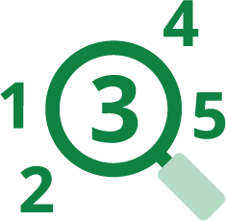
Main principles in data and statistics
The following slides will help you get familiar with some common terms and statistical concepts, including:
1. collecting data and making statistics
2. sample design and estimation
3. time series
4. index numbers
5. measuring uncertainty
6. communicating data and statistics

Slide 5
Collecting data and making statistics
To create statistics, we collect data from a variety of sources, including:
our own surveys
the census that happens every 10 years
data that other organisations collect, which is known as admin data

Slide 7
Sample design refers to how the samples in surveys are specified and selected.
For some statistics, we collect the data using surveys based on a sample of people, households, businesses, or whatever we want to find out about. The samples we use can be complicated, so we need to design them carefully for high quality statistics about the economy and society.
Larger samples produce statistics that are more precise, or more likely to be close to the true value.

Slide 8
Stratified sampling
Stratification is dividing the list we are sampling from into groups, or strata, and drawing independent samples from each of these strata.
This is more efficient than using a simple random sampling approach, which could by chance result in a sample that does not look like the population. For example, a health survey sampling more people in older age groups would show more ill health than the true health of the population. Or it could work
the other way with more younger people.
If we know information about the people on the list, or sampling frame, we can divide it into strata, such as age group. Then we can decide how much of the sample to take from each stratum.
For many surveys, we would sample in proportion to the size of the stratum. For example, if 10% of addresses were in a region, we would draw 10% of the sample from that region.

Slide 9
Cluster or multi-stage sampling
If we need to visit people to collect data, it’s more efficient if the addresses we need to visit are close together. We can achieve this by dividing the sampling frame into groups, or clusters, of addresses. We can then draw a random sample of those clusters. We can take all the addresses within those sampled clusters, or a random sample within the cluster.
Estimates from a clustered sample are less precise than from a non-clustered sample of the same size, but the cost of collecting the data is less. So, this comes down to a balance of cost and precision.

Slide 10
Estimation is the process of creating estimates from data.
At the ONS, we use estimates when calculating the characteristics of the population as a whole from the responses given by those people and businesses responding to a sample survey.
Estimation is usually achieved through ‘weighting’.
Responses from a sample are weighted to ensure they represent the entire population without bias, producing good quality outputs.

Slide 12
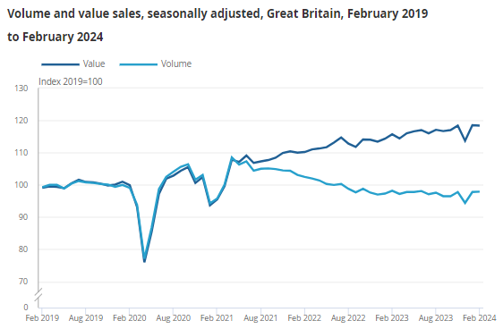
A time series is a series of data points indexed in time order.
A time series is typically plotted on a line chart and is often used to show the history of a subject. For example, looking at changes in spending on a certain item over time.

Slide 14
What are index numbers?
Index numbers are used to measure changes and simplify comparisons.

Slide 15
What are index numbers?
Sometimes, we’re most interested in how things have changed, rather than the actual values over time. For example, instead of saying that the average cost of a pint of milk has gone from 80p to 84p, we’d say the price has risen by 5%. An index is a statistical measure designed to help understand change and is a statistical measure of average change.
The Consumer Price Index (CPI)
Tracks the variation in prices for different consumer goods and services over time for the country. It’s used to help calculate inflation, which is the change in prices.

Slide 16
What are index numbers?
INTERESTING FACT!
Index numbers are most often used in economics as they allow economists to turn complex data into easily understood terms.
Index numbers typically measure average change over time, such as inflation, cost of living, house prices and employment. They can also be used to make other comparisons, such as between regions of the UK.
Mathematically, an index number is a figure reflecting price or quantity compared with a standard or base value. Usually, the base equals 100, with the index number expressed as 100 times the ratio to the base value. Here’s an example.
The original average price for a pint of milk was 80p and we can set this as 100. If it rises to 84p, the index becomes (84/80 x 100) = 105. This clearly shows the 5% increase.

Slide 18
Using a sample means that statistics are uncertain, an estimate might differ from the ‘true value’.
At the ONS, the methods we use to report uncertainty in our statistics include:
standard error
confidence interval
coefficient of variation
statistical significance
Further explanations of the individual methodologies are available.
Understanding sampling and the effect it has on statistics is also important for interpreting these measures of uncertainty. As well as random sampling, we also report on other factors that impact the quality of our estimates. This helps to make sure that people use our statistics correctly.

Slide 20
Communicating data and statistics is more than just presenting the numbers.
At the ONS, we deal with a lot of complex data and concepts. Good communication can help ensure data is interpreted accurately and used appropriately. It also allows us to be completely open about the methods we use to collect data and calculate statistics.
Some common challenges include:
working out which statistical terms and classifications can be simplified, and which cannot
finding out which facts are most important and deciding whether to make those more prominent
making it clear what conclusions the statistics do, and do not, support

Slide 21
Data visualisation is the graphical representation of information and data.
Tables of estimates presented as rows and columns of numbers can be difficult to read. Using visual elements, such as charts, graphs and maps, we can provide an accessible way to see and understand trends, outliers and patterns in data.
A graph should look good, but it should also present information in a way that can be easily understood and analysed.

Slide 22
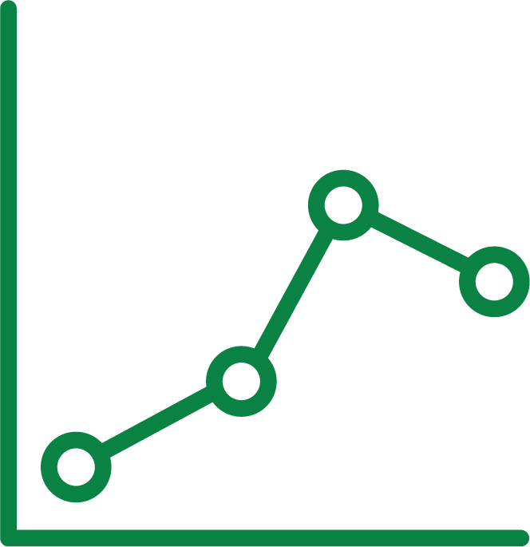
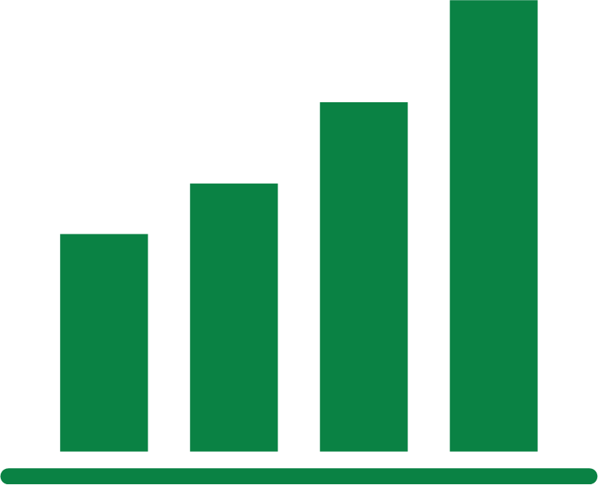
Charts for change over time
These charts usually have time on the horizontal axis, moving from left to right, with the variable of interest’s values on the vertical axis.
Line charts
Allows more flexibility with the y-axis or when there would be too many bars to plot.
Box plot
When there’s a distribution of values for each time period, a box plot is helpful to visualise the most common data values.
Bar charts
Show value through the heights of bars from a baseline.

Slide 23
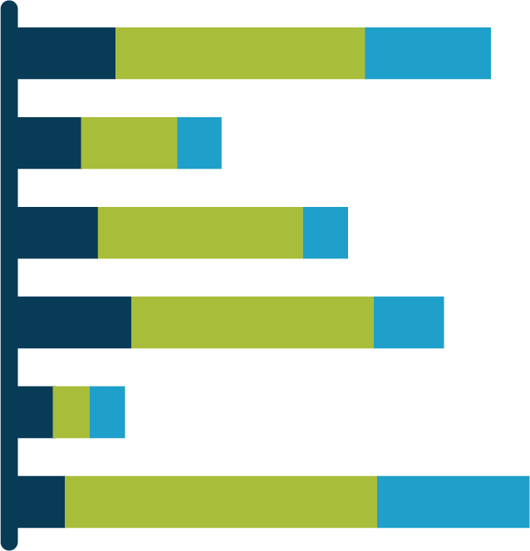
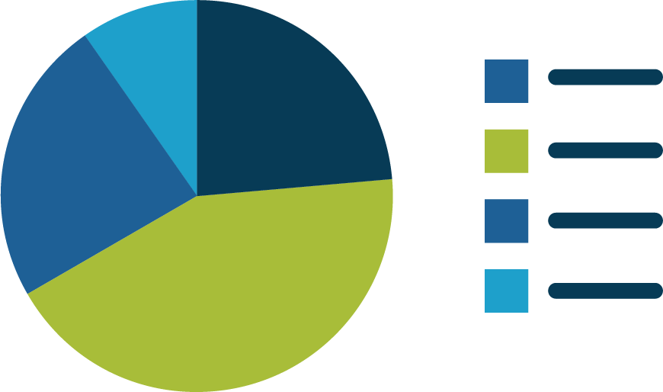
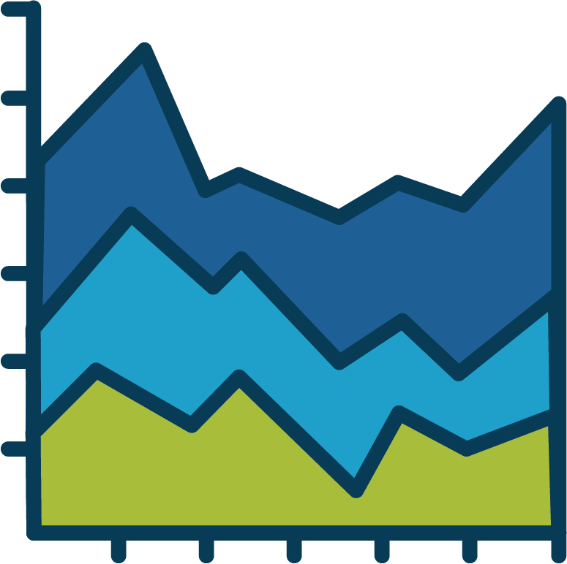
Charts for composition
Used to show the different components of a total.
Stacked bar chart
Each bar is divided into multiple sub-bars, for demonstrating composition of multiple values.
Pie chart
Represent the whole with a circle, divided into parts.
Stacked area chart
Show composition of cumulated totals over time.

Slide 24
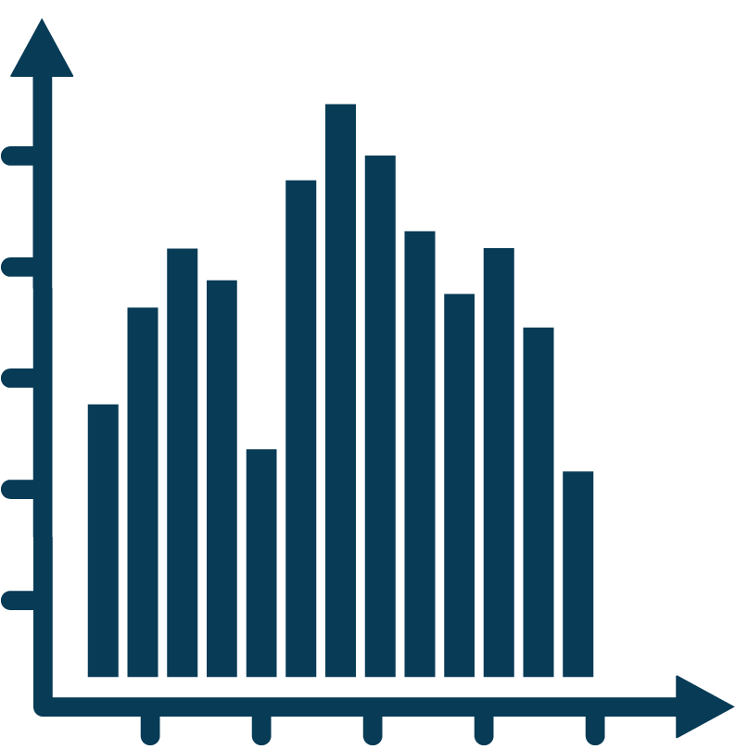
Charts for data distribution
Used to show the different components of a total.
Histogram
Ideal for analysing data of an ordered categorical variable.
If ordered, focus on the shape of the distribution by bringing the bars together.
If you move the bars apart, it becomes a bar chart.
Bar charts
Ideal for when a variable is qualitative and has discrete values.

Slide 25
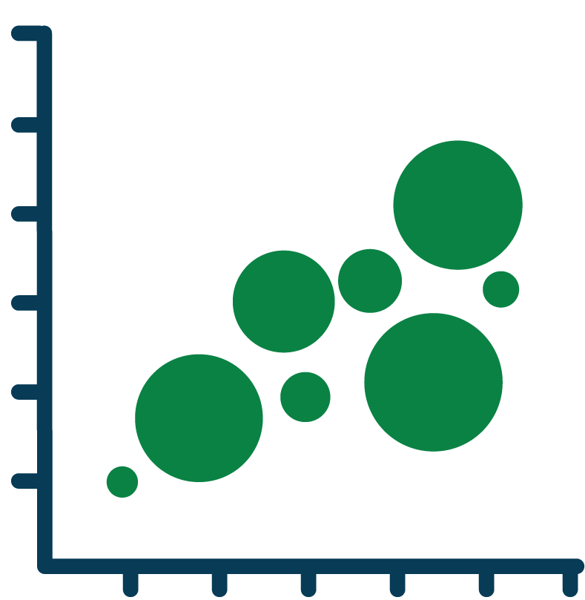
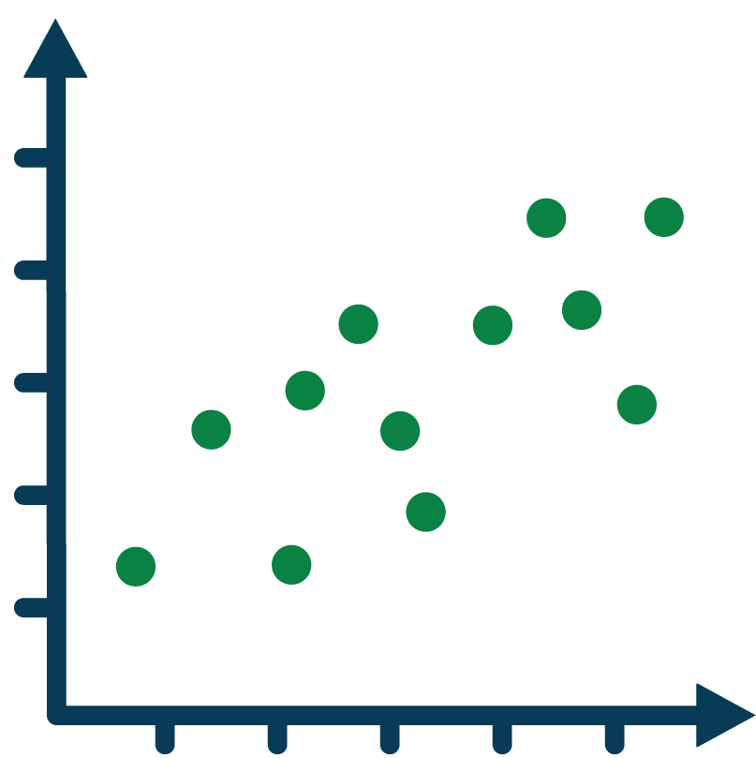
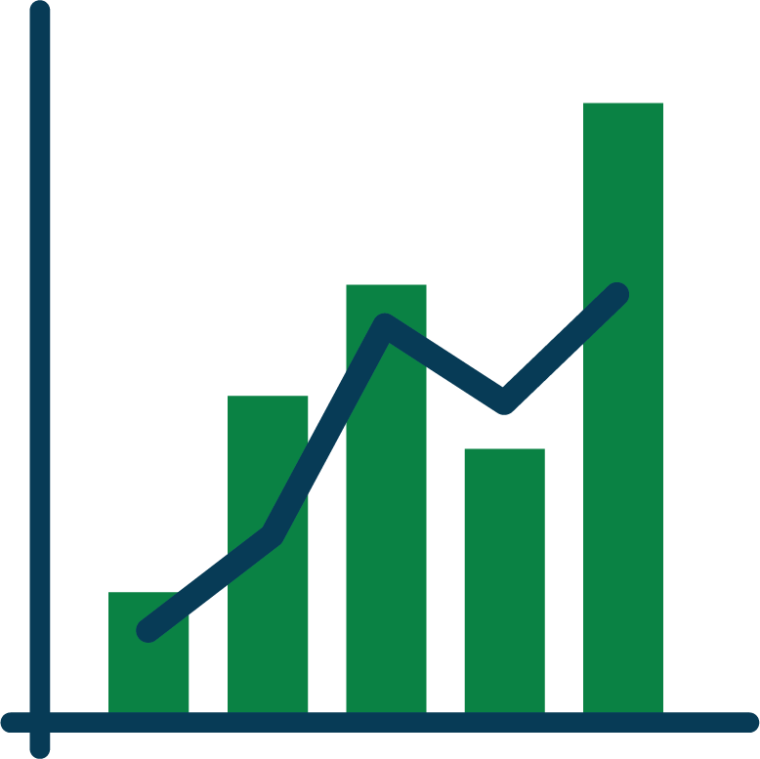
Charts for relationships between variables
Bubble chart
Like the scatter plot but can be used to include more than two variables by adding colour, shape or size to each point as indicators.
For analysing two or more variables against one another, and to observe trends and patterns between them.
Combination chart
Dual axis charts combine two different types of charts that share an X axis but have separate Y axes. Used to illustrate relationships or correlations between variables with different scales.
Scatter plot
Shows the relationship between two variables.

