Slide 2
Contents
Calculating health and well-being
The ONS’s findings
Challenges
The ONS’s tools and datasets

Slide 4
Many countries aim to measure health as a broad topic. They typically include health outcomes, health-related behaviors and wider drivers of health.
There is no universal calculation for health and well-being. It is a broad category that might include many variables, such as:
mental health
mortality
personal well-being
physical health conditions
behavioral risk factors
access to green space
access to services
So, how do we calculate health and well-being?

Slide 5
The ONS calculates the Health Index to measure health outcomes and risk factors over time, for different geographic areas.
The Health Index aims to measure health and its drivers rather than direct measures of health services. It is based on a broad definition that aligns with the World Health Organization's (WHO's) definition of health:
“Health is a state of complete physical, mental and social well-being, and not merely the absence of disease or infirmity”.

Slide 6
The Health Index consists of 56 different indicators across three categories, which are:
healthy people
healthy lives
healthy places
These measures include:
diabetes
anxiety
local unemployment
road safety
behaviors like healthy eating

Slide 7
Healthy people
This covers health outcomes, including mortality, and the impact of physical and mental health conditions.
Within each subcategory there are a number of indicators.
Difficulties in daily life
Mental health
Mortality
Personal well-being
Physical health conditions

Slide 8
Healthy lives
This covers risk factors that individuals can control themselves and wider social factors they can't change directly.
Within each subcategory there are a number of indicators.
Behavioural risk factors
Children and young people
Physical risk factors
Protective measures

Slide 9
Healthy places
This includes social and environmental risk factors for health that affect the population at a collective level.
Within each subcategory there are a number of indicators.
Access to green space
Access to services
Crime
Economic and working conditions
Living conditions

Slide 11
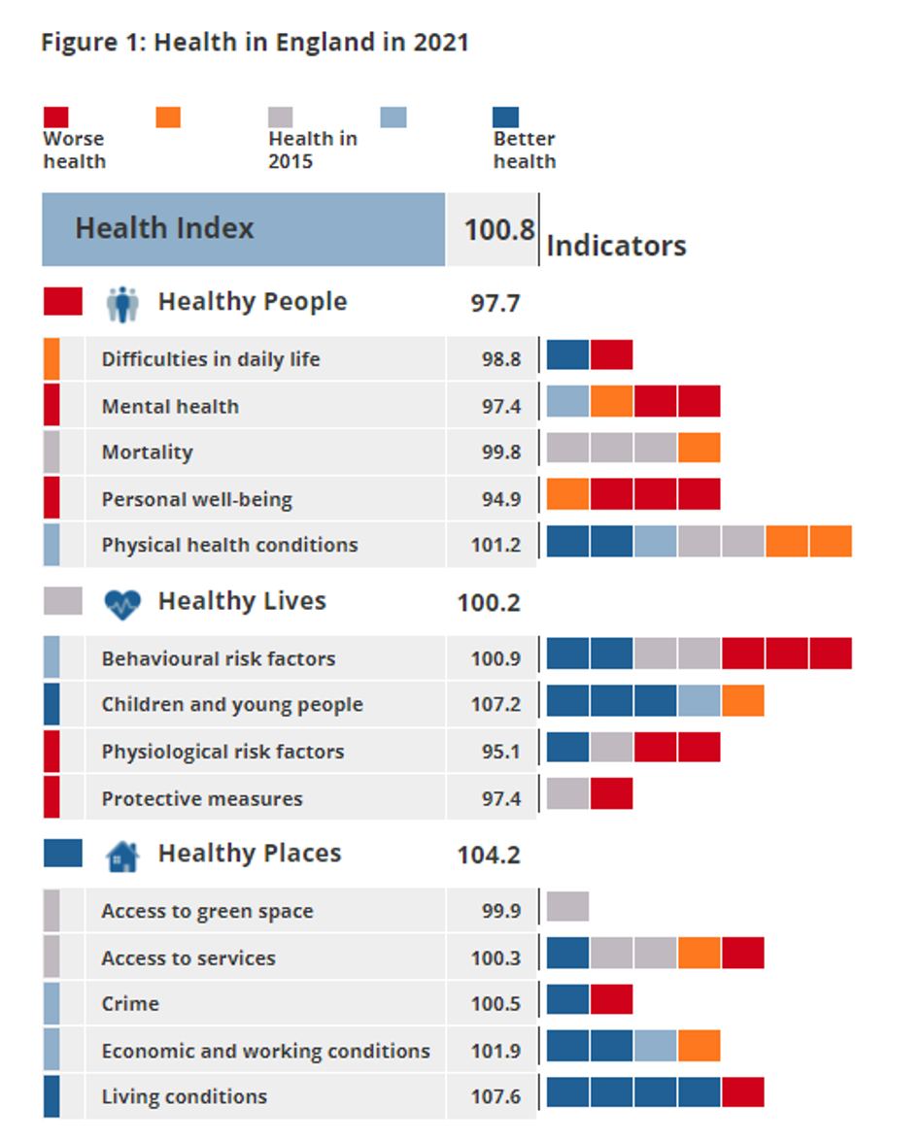
Important statistics for England
The graph shows the latest scores of health in England in 2021. The score is a number relative to the 2015 baseline of 100. A score higher than 100 signifies an improvement since 2015 and a score lower signifies a decline.
Health in England: 2015 to 2021

Slide 12
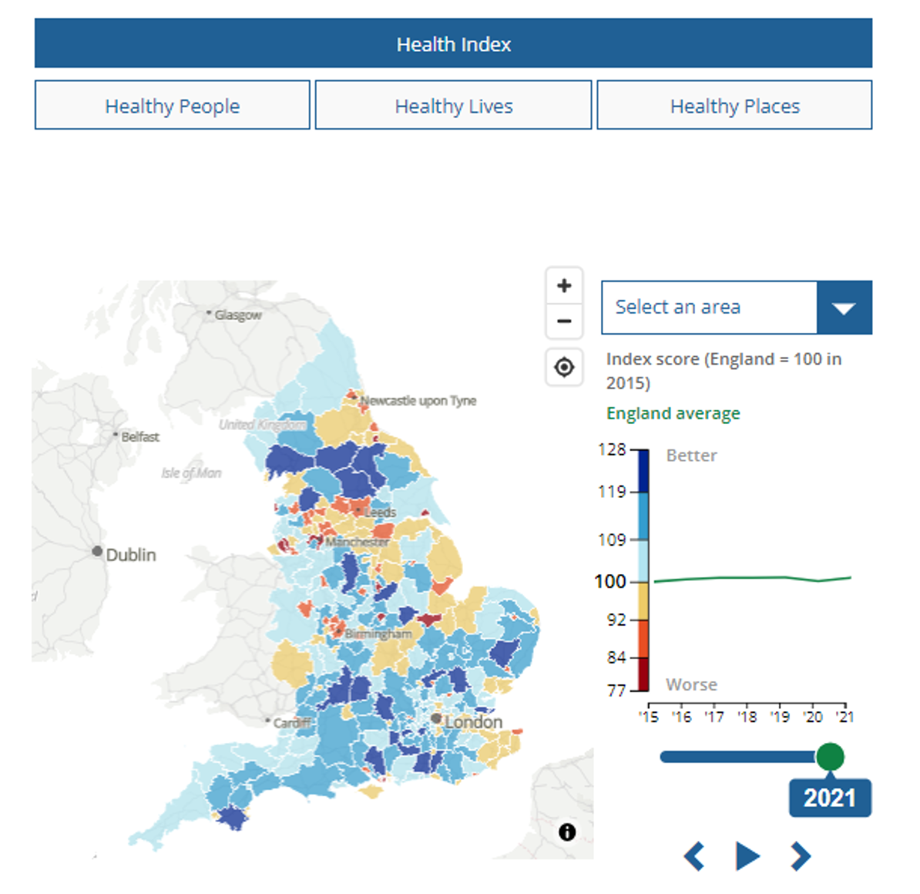
Important statistics for England
Health in England - Office for National Statistics (ons.gov.uk)
Used to explore the Health Index results across the three different areas:
healthy people
healthy lives
healthy places

Slide 14
There are lots of challenges when it comes to calculating health and well-being. Some common ones include:
Data sources and methodology
A lot of indicators use repurposed data. For this reason, the indicators do not always measure health concepts in the best way.
For example, the indicator for alcohol misuse consists of alcohol-related hospital admissions. This does not measure all alcohol misuse, but it still indicates the patterns and trends expected to be present in alcohol misuse as a whole.

Slide 15
There are lots of challenges when it comes to calculating health and well-being. Some common ones include:
Availability bias
Some aspects of health cannot currently be included in the Health Index because no suitable data are available. These other topics could be represented more fully if there was more comprehensive data about them​.

Slide 16
There are lots of challenges when it comes to calculating health and well-being. Some common ones include:
Value judgements
The Health Index uses a hierarchical structure, which means there are multiple levels that will need to be weighted. Weighting in an index often comes down to value judgements. The ONS Health Index for England has all weights determined through statistical factor analysis.

Slide 18
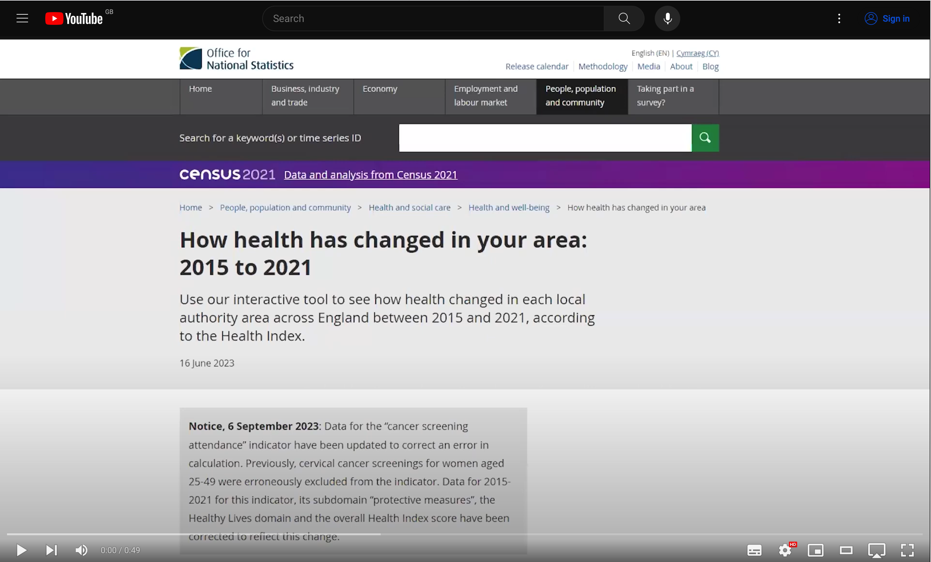
Health index calculator
Use the ONS’s interactive tool to see how health changed in each local authority area across England between 2015 and 2021, according to the Health Index.

Slide 19
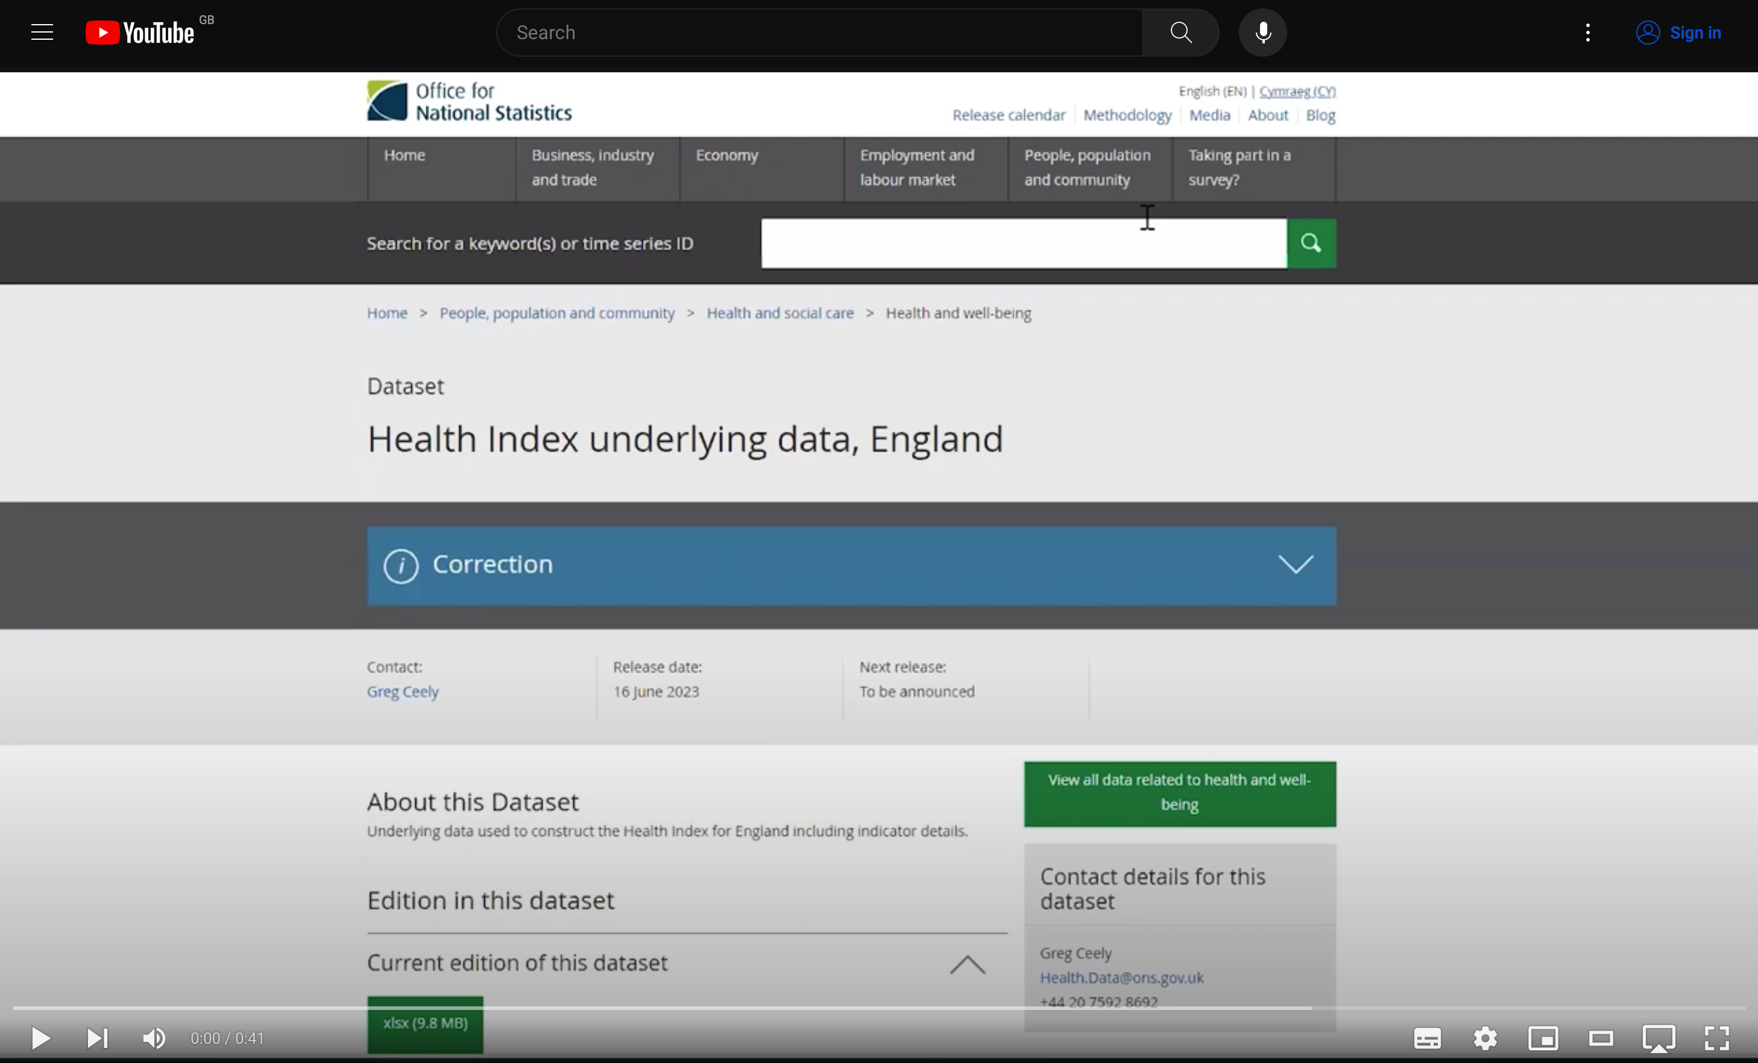
Health index data

